Slide 1


Slide 2
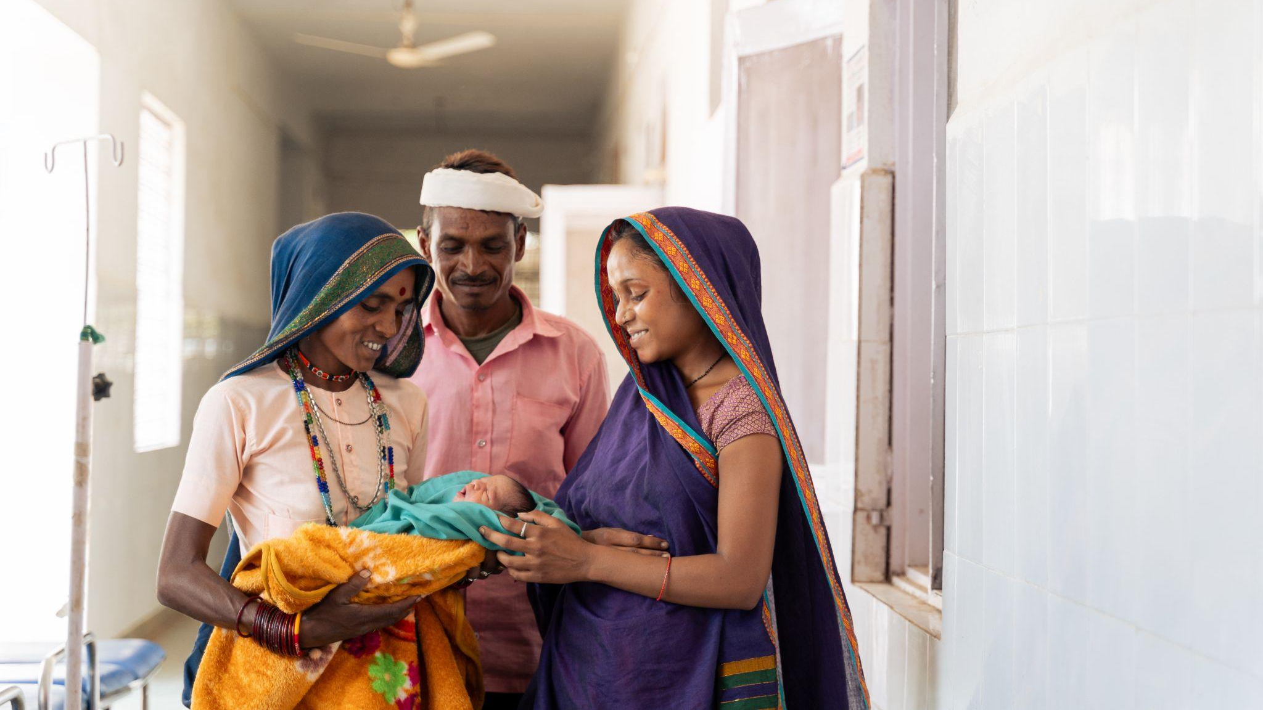
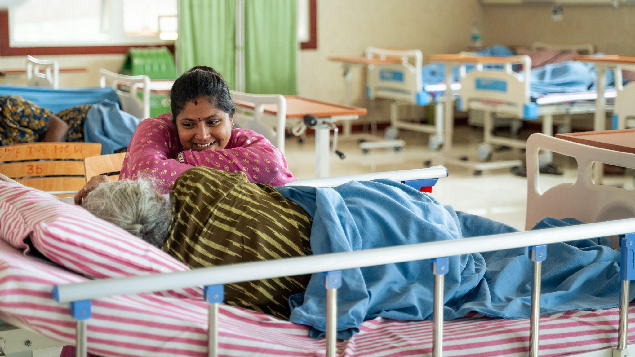
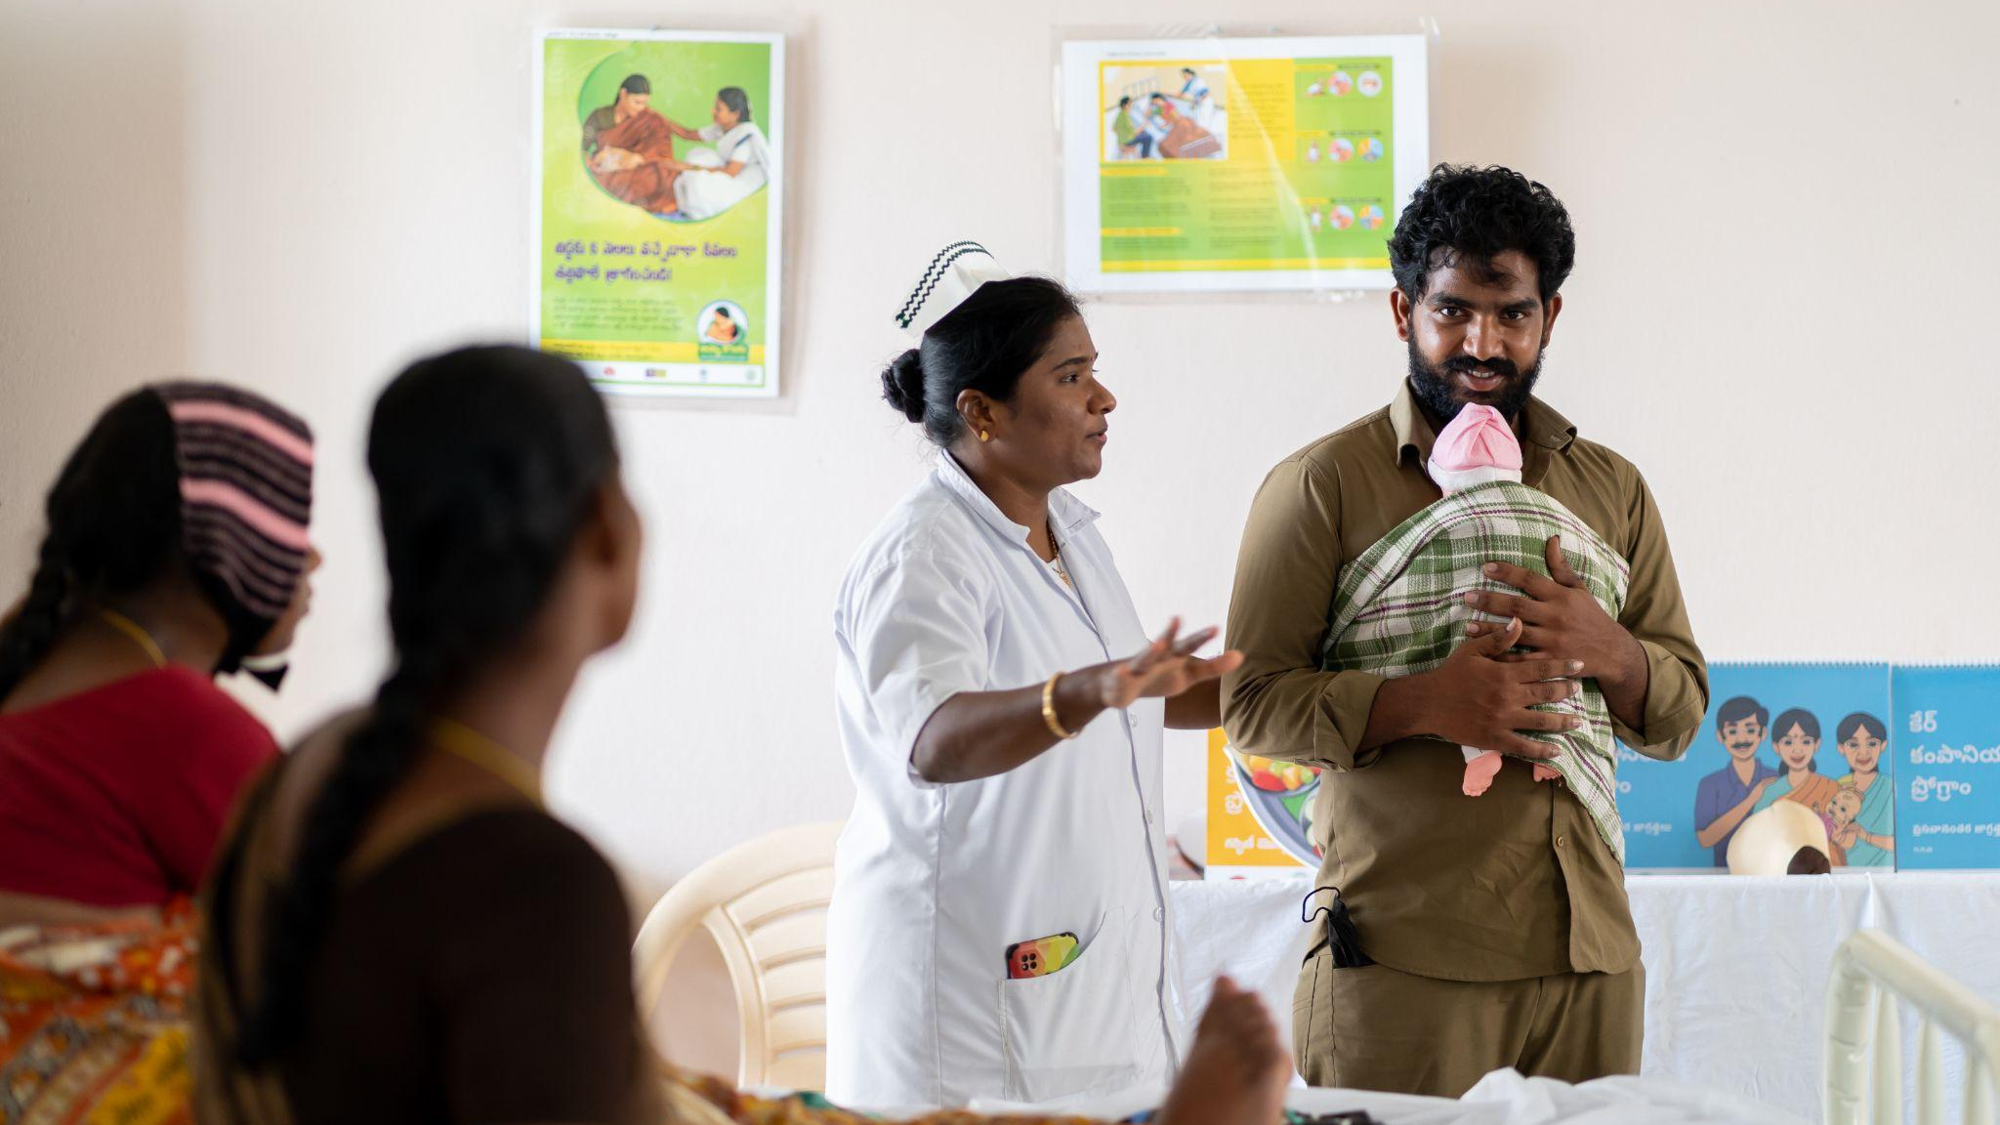
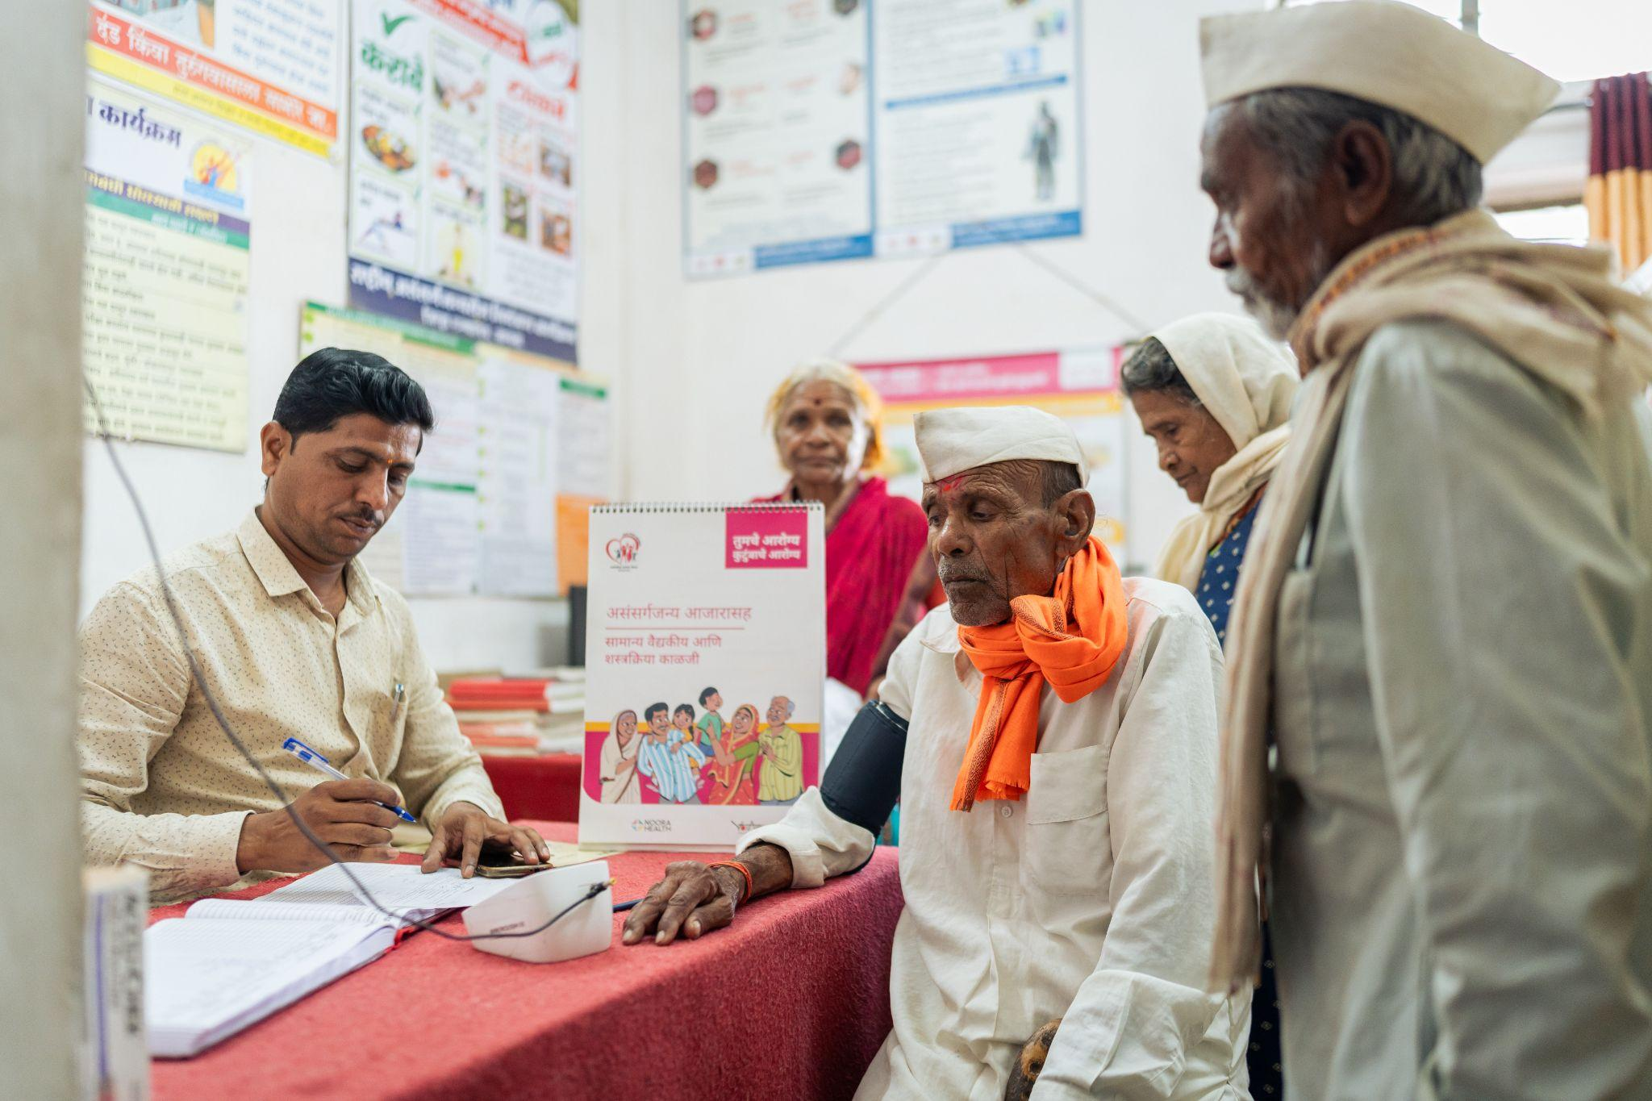
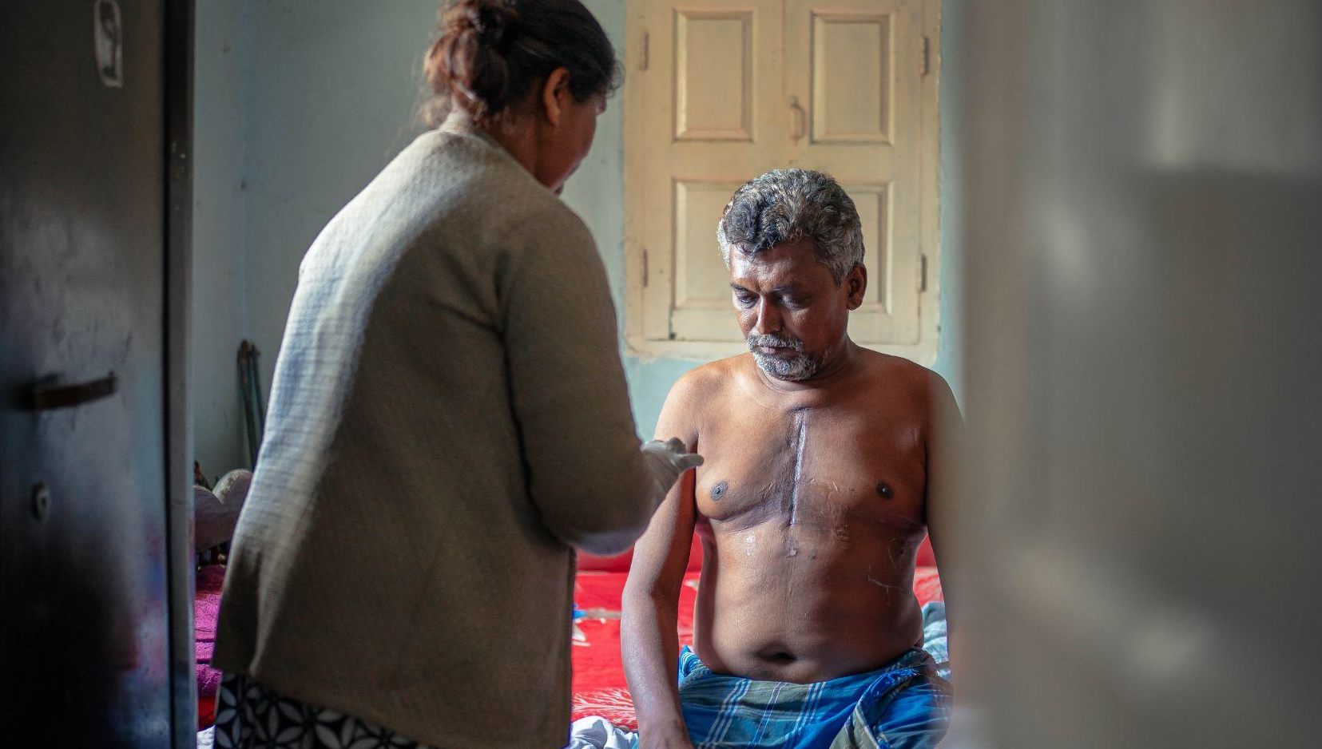
Notes:
At Noora Health, we train families to become effective caregivers through in-person programs embedded within public health systems, followed by long-term, mobile-based support.
Our mission is to make family caregiving the standard of care globally.
To date, We’ve trained 51.4 million patients and caregivers. 32000 and more healthcare workers. We work with 14000 partner facilities across India, Bangladesh, Indonesia and Nepal.

Slide 3
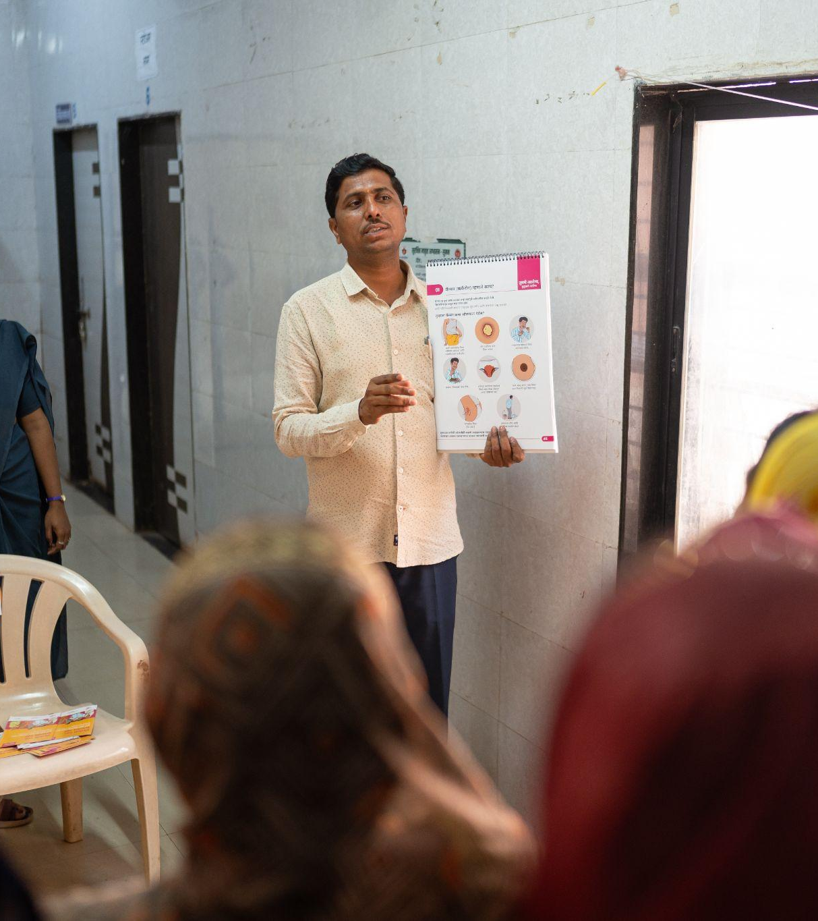
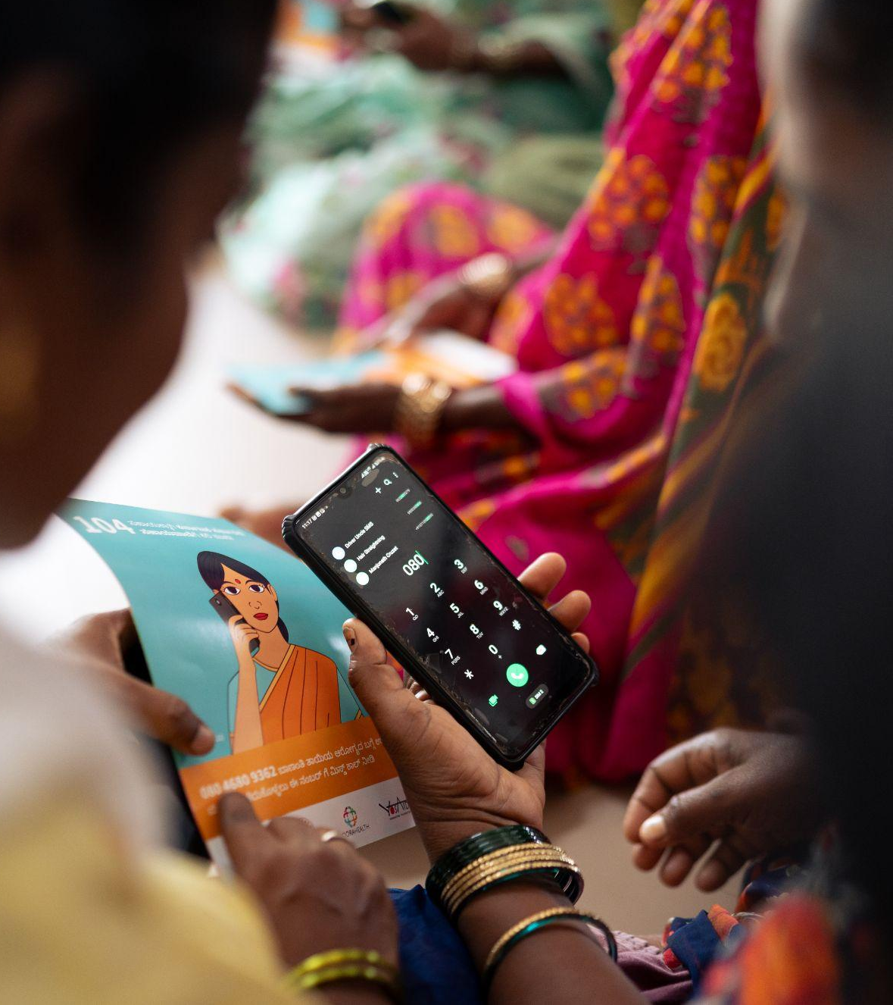
Notes:
The Care Companion Program (CCP) provides patients and caregivers with practical health education and in-person training tailored to different health conditions and local contexts.
Following a healthcare visit, family caregivers and patients access the Mobile Care Companion (MCC) which is our WhatsApp and IVR-based support system, for ongoing guidance, reminders, and on-demand support from trained medical executives as they recover at home.

Slide 4
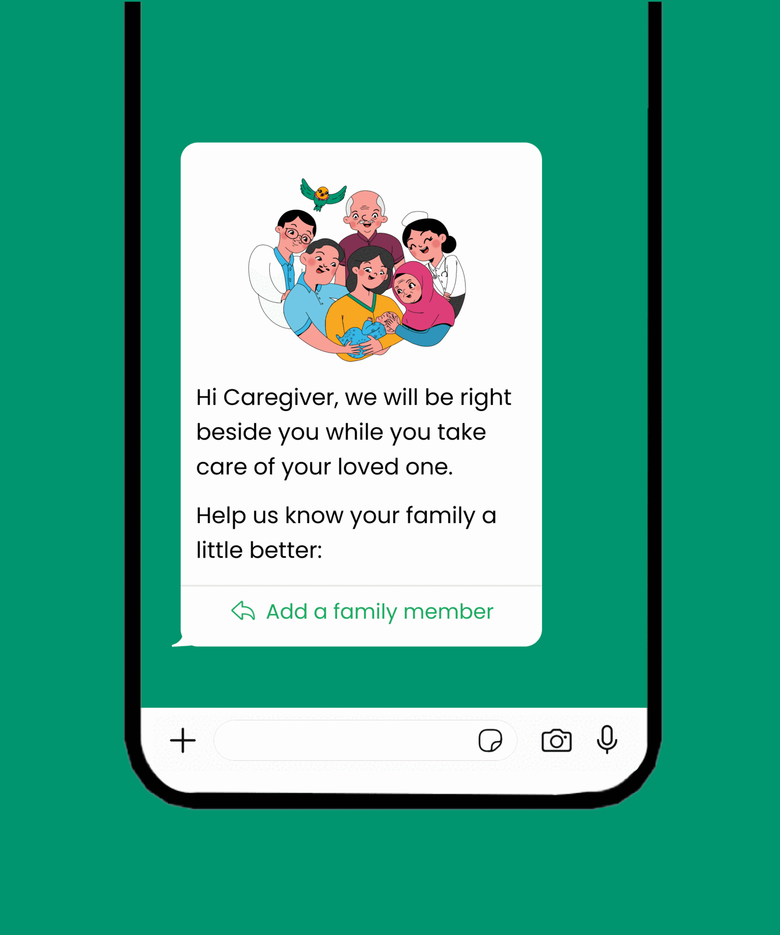
mobile Care Companion (mCC)
Tailored messaging: Customized stage-based information for users in easy-to-understand style.
Rich media: Messages include helpful visual aids and short-form videos to improve information retention.
Language: Users can select preferred language.
Live support: Caregivers can engage and ask questions on WhatsApp from 7am-9pm, all days a week in their preferred language.
2 M
~70,000
~10,000
Total users
Health nudges delivered per day
User messages received per day

Slide 5
mCC Evidence to date
What: Cluster-randomized trial across 15 intervention and 9 control facilities
When: March 2021-January 2022
Who: Women who recently delivered, with smartphones
Findings: 7 of 11 neonatal and maternal care practices increased
E.g. Skin-to-skin care doubled
(9.2 percentage points) p<0.05
9.7% (control) → 17.7% (intervention)

Slide 6
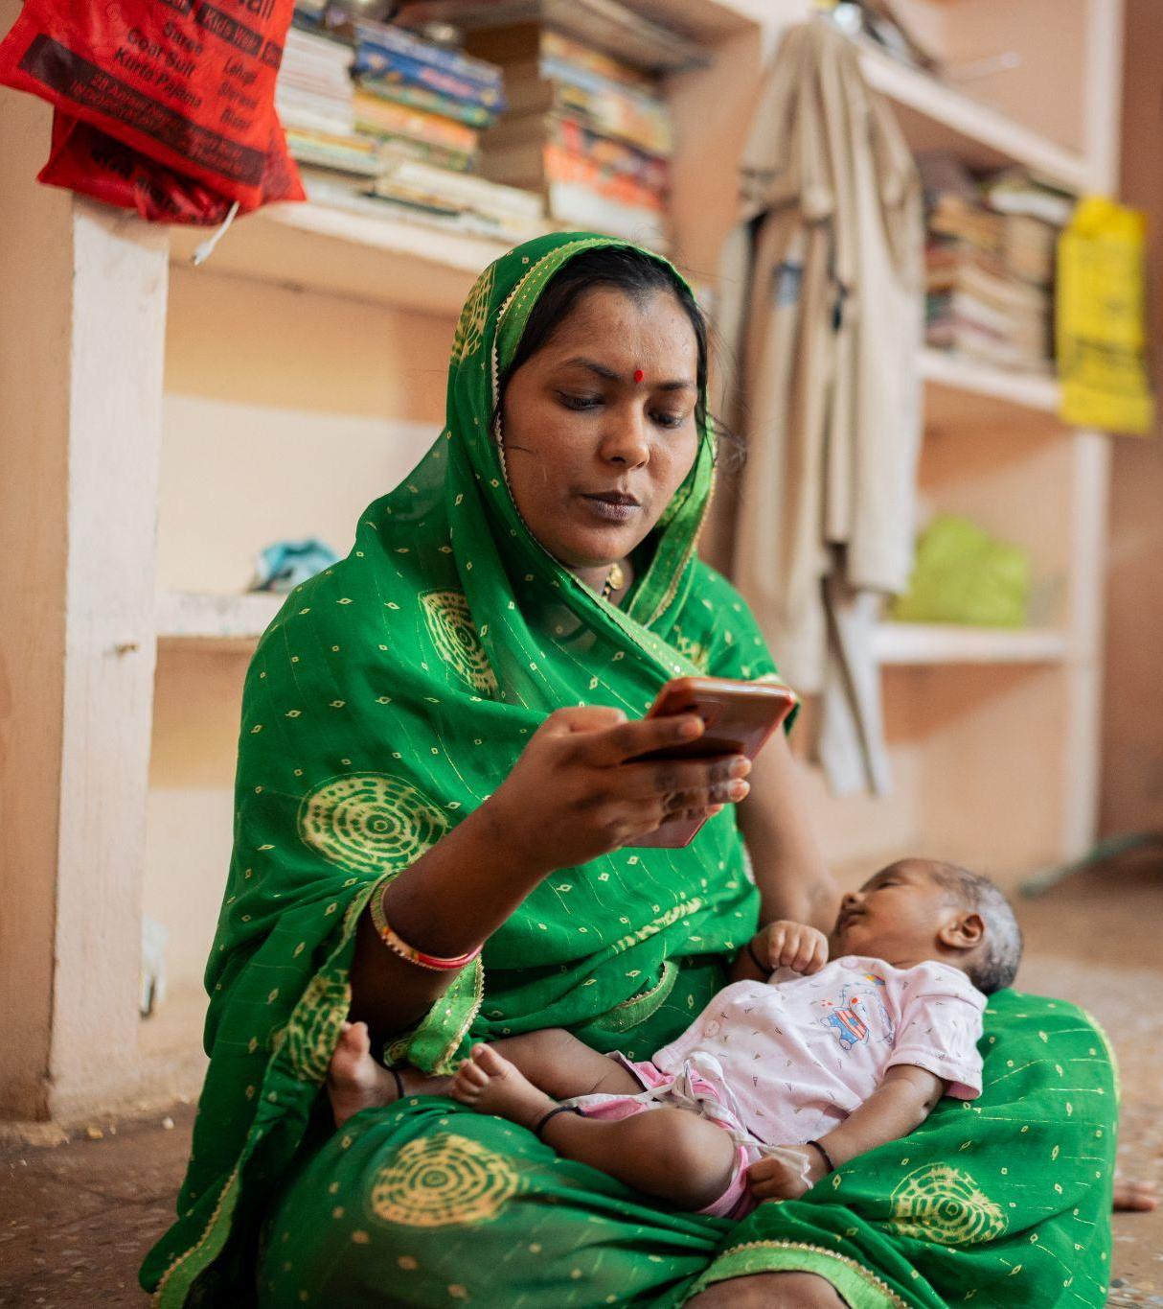
11
Languages supported
2M
Total users
~10,000
Daily incoming messages
Notes:
Last year, our Mobile Care Companion, our WhatsApp and IVR-based support system, grew to 2 million users. We were receiving 10,000 inbound messages daily.
That's caregivers reaching out with questions like 'My baby's skin is turning yellow, is this normal?' or 'My mother had heart surgery last week and she's breathing heavily, what should I do?'
As the program scaled, our nurses and medical support teams found themselves responding to thousands of questions every day across multiple languages, countries, and health conditions.
Response times began increasing, workloads grew, and we faced an important challenge:
How do we scale support without compromising quality, safety, or trust?

Slide 7
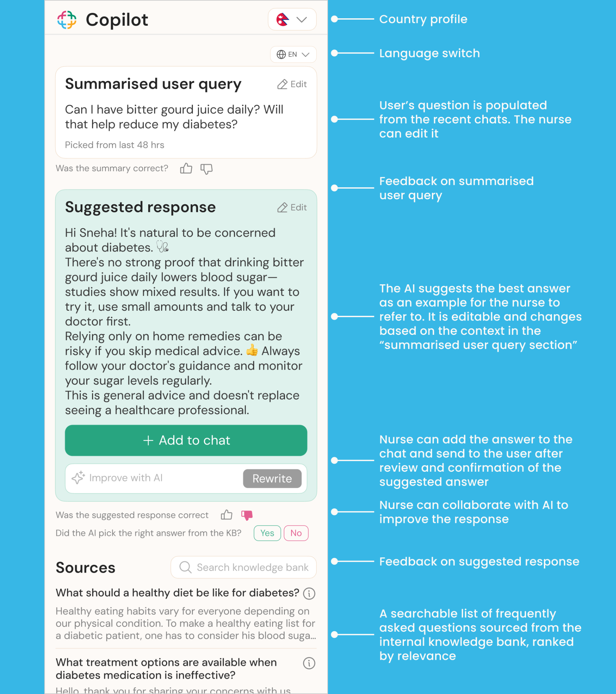
AI copilot extension
An AI‑powered assistant that suggests medical responses to our Medical Support Executives
Designed for workflow enhancements within one interface/ browser.
A singular, easily accessible knowledge base with smarter search functionality.
Made to help focus on delivering quality responses, and removes manual data entry tasks.
Faster development cycle and easier for the team to collaboratively build smarter solutions.
Notes:
So we built what we call the MSE Copilot, an AI assistant for our Medical Service Executives, our frontline nurses. And the core principle is right here: 'The nurse stays fully in control. AI drafts, humans decide.'
The Copilot helps identify message intent, flag emergencies, summarize conversations, and generate draft responses using clinically approved knowledge. But every response is still reviewed and approved by a human before it reaches a caregiver.
As we built and deployed this system, we realized something important.
The question wasn't simply whether the AI worked.
The question was:
What does "working" actually mean?

Slide 8
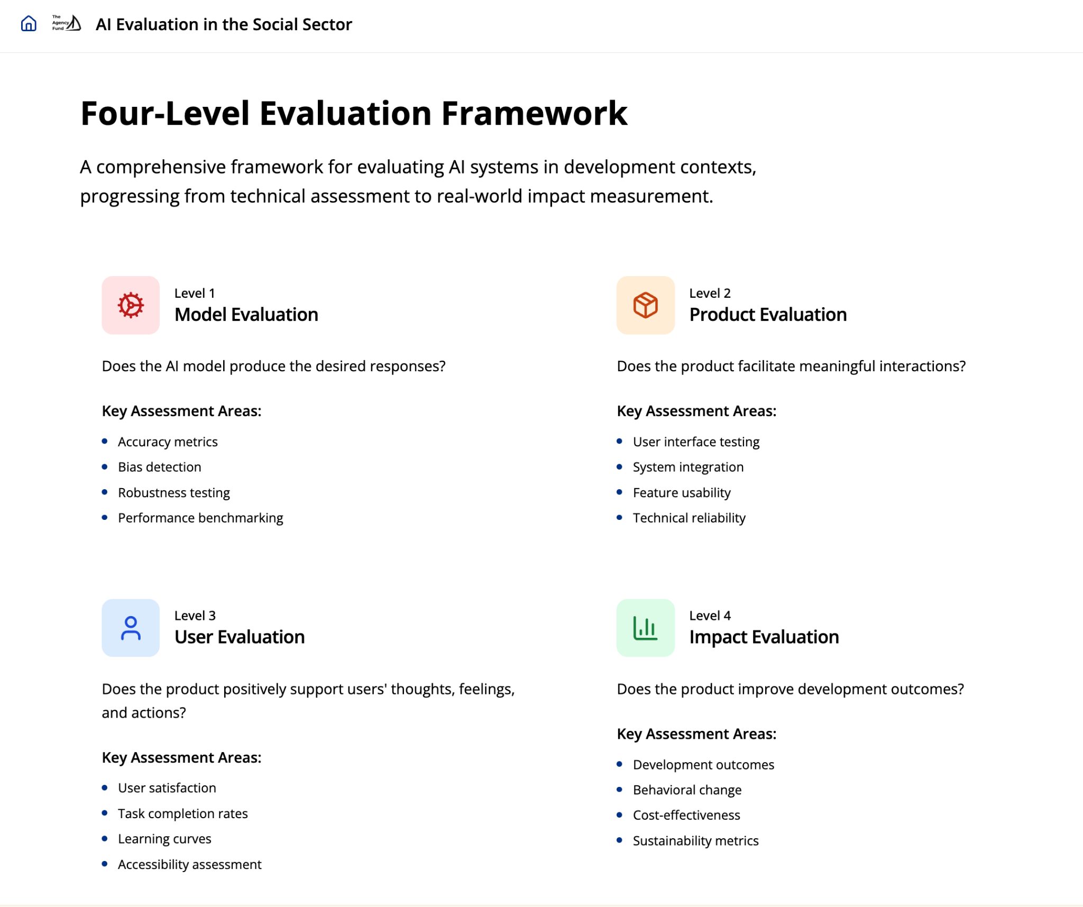
Copilot
Copilot + MSEs
MSEs + Patients/
Caregivers
Patients/
Caregivers
Notes:
To tackle this in a more systematic way, we have began using the AI Evaluation Playbook developed by The Agency Fund, IDinsight, and Center for Global Development.
One of the challenges in evaluating GenAI products is that "evaluation" often means different things to different stakeholders. Technical teams tend to focus on model performance metrics such as accuracy, latency, and reliability, sometimes without fully considering real-world impact. Conversely, impact evaluators often prioritize user and system outcomes but may pay less attention to the underlying technology and its limitations.
The framework helps bridge these perspectives by encouraging a more holistic approach—one that connects model performance, user experience, and real-world outcomes within a single evaluation strategy.

Slide 9
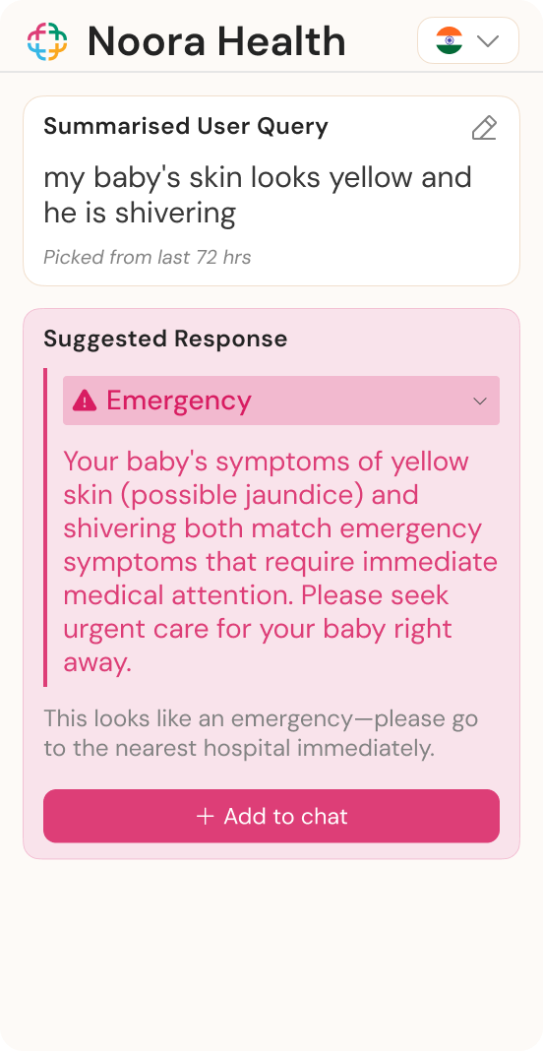
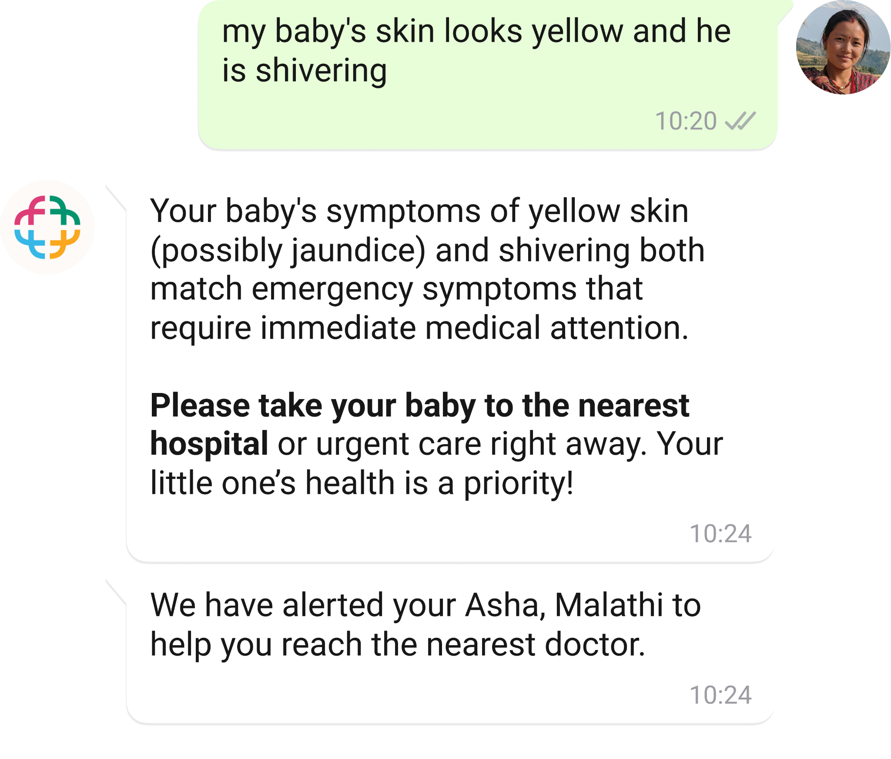
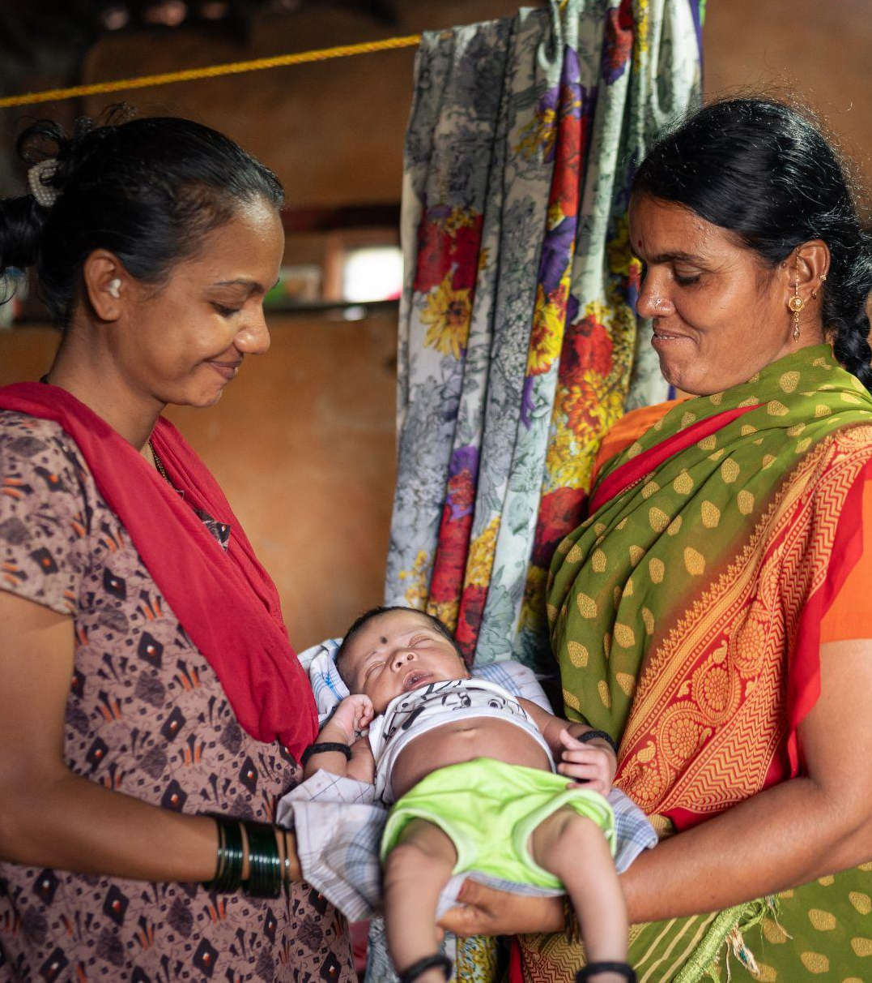
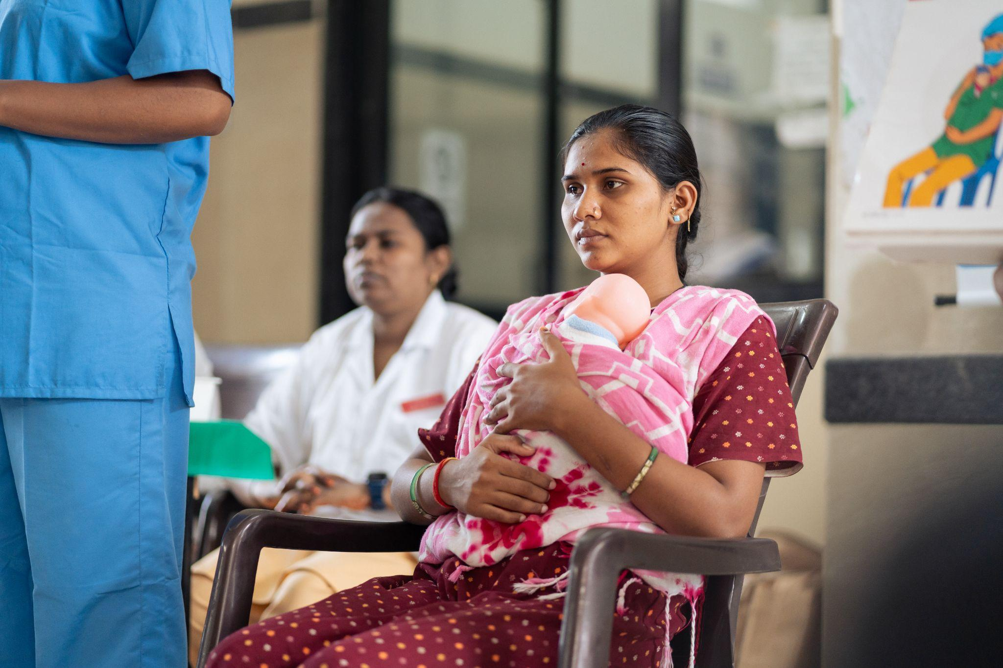
L1- Is the Copilot producing medically safe and relevant content? Is it accurately identifying high risk infants?
L2- Does the Copilot support MSE workflow and decision-making? Is it improving overall efficiency and response quality?
L3-Are users engaging with mCC, gaining clarity for their care? Do users understand and trust the messages? Is there any improvement in health behaviour uptake? MSE’s agency?
L4- Is there improved health outcomes for families?
Notes:
Translating it to our context, it meant understanding,

