Slide 1

03-06-2026
AI in Qualitative Evaluation
Efficiency, Bias & Human Responsibility
Andrea Adler
Independent Evaluation Consultant
www.glocalevalweek.org
Notes:
Thank you for the invitation. It’s a pleasure to join this gLOCAL session here at the University of Georgia. My contribution focuses on how AI is already reshaping qualitative evaluation — not as a future scenario, but as a present methodological reality. I’ll highlight where AI creates efficiency, where it introduces new forms of bias, and why human responsibility becomes even more important.

Slide 2
AI can listen fast. But not always well.
www.glocalevalweek.org
Notes:
In evaluation, we often celebrate efficiency. AI gives us speed, transcription, translation — but it also introduces a new kind of silence. It listens fast, but not always well. And sometimes, the voices that matter most are the ones it mishears.”

Slide 3
Where and why do evaluators Use AI?
Transcription
Translation
Coding support
Summaries
www.glocalevalweek.org
Notes:
Across evaluation practice — including in Georgia and globally — AI is already used for repetitive tasks. Transcription and translation save hours of work. Coding support and summarisation help teams handle large volumes of qualitative data. These tools expand what evaluators can do, especially in resource‑constrained settings. But they also shift how we perceive and interpret data, which is why we need to look deeper.

Slide 4
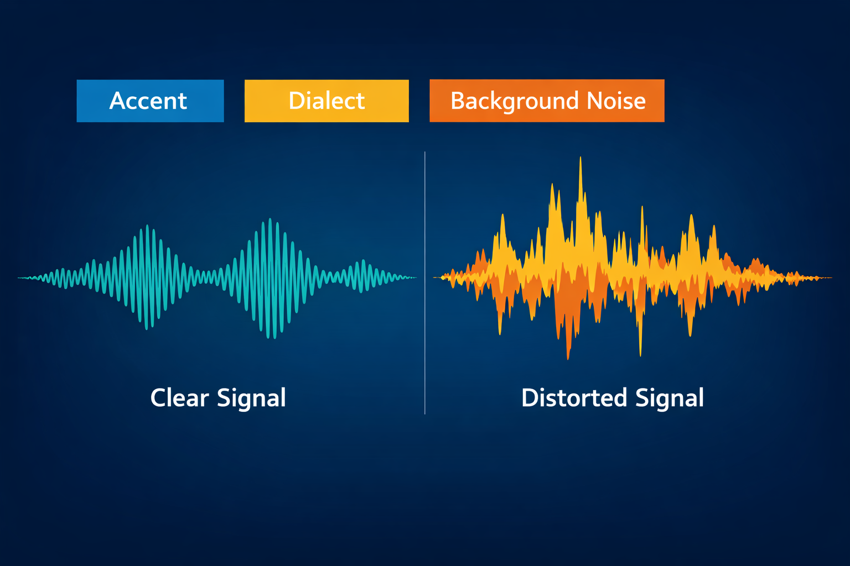
Whose Voice Is Heard?
Speech recognition bias & representation
www.glocalevalweek.org
Notes:
Speech recognition systems perform unevenly across accents, dialects and languages — including Georgian, Armenian, Azerbaijani, and regional variations. This means some voices are transcribed more accurately than others. In qualitative evaluation, this is not a small issue: it affects whose experiences become visible in the evidence base. AI can unintentionally amplify existing inequities if we don’t actively check for these distortions.

Slide 5
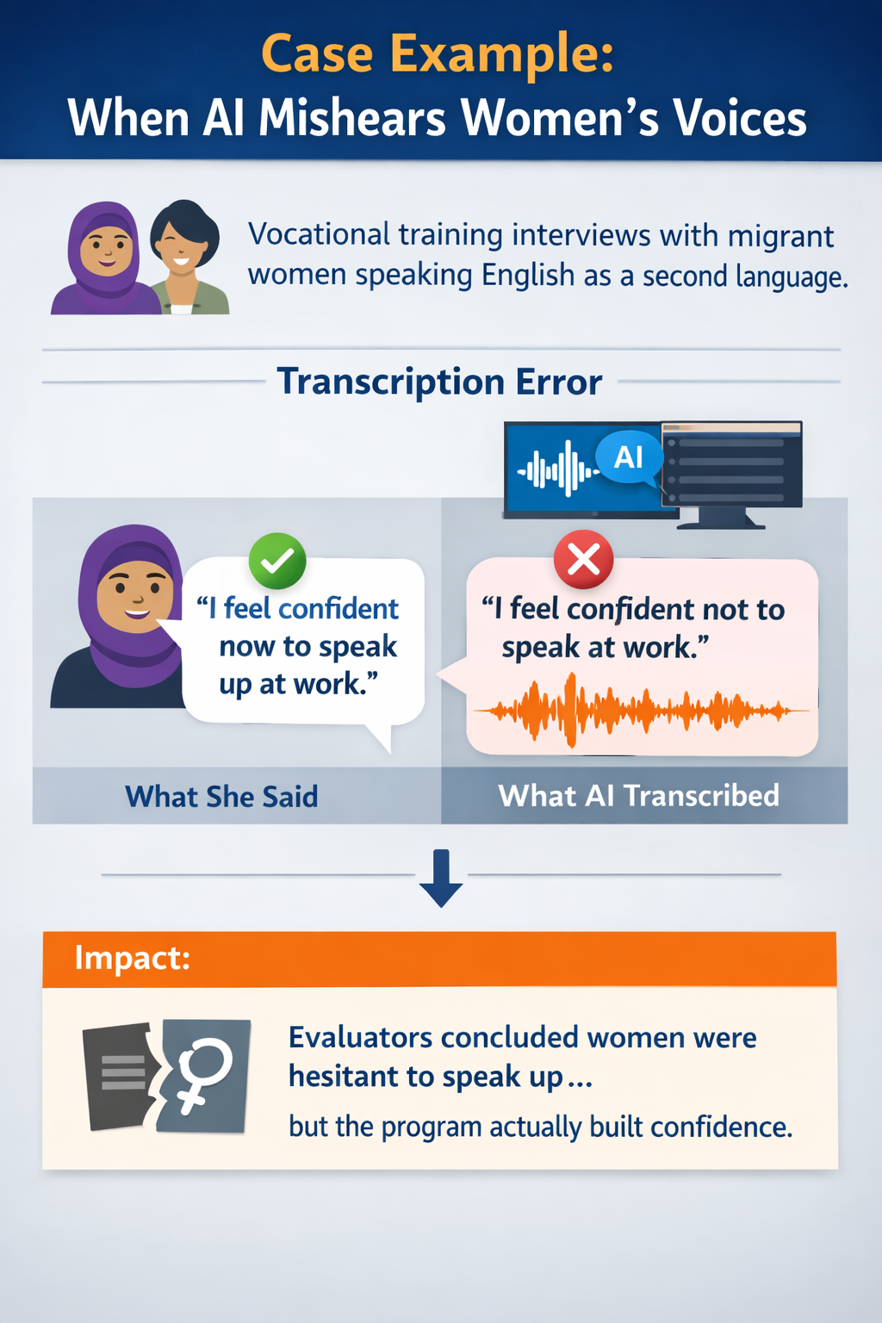
Whose Voice Is Heard?
Case example
www.glocalevalweek.org
Notes:
. Scenario: In a qualitative evaluation of a vocational training program for migrant women, interviews were conducted in English — though most participants spoke it as a second or third language. The transcription software was trained mainly on native English speakers.What happened: The AI system frequently misheard words spoken with non‑native accents.For example, when a participant said “I feel confident now to speak up at work,” the transcript read “I feel confident not to speak at work.” This subtle error completely reversed the meaning.
Impact: When the transcripts were coded, evaluators concluded that participants were still hesitant to express themselves — reinforcing a stereotype of passivity among migrant women.In reality, the program had successfully built confidence; the bias came from the transcription layer.Lesson: AI didn’t invent the bias — it amplified linguistic and gendered assumptions already present in the data pipeline.Without human review, the evaluation would have misrepresented empowerment as silence.

Slide 6
AI does not remove bias. It changes where bias enters the process.
www.glocalevalweek.org
Notes:
The key message for today’s discussion: AI shifts where bias enters the evaluation process. Our task as evaluators is not to avoid AI, but to understand its filters, limitations and implications. I look forward to hearing how these issues resonate with your experiences here in Georgia — across academia, associations, public administration and practice.

Slide 7
Three Principles for Responsible AI
Transparency
Critical
review
Human-in-the-loop
www.glocalevalweek.org
Notes:
To use AI responsibly in evaluation — whether in Georgia, Europe or globally — three principles matter:Human‑in‑the‑loop: Evaluators must validate, contextualize and challenge AI outputs.Transparency: Document tools, prompts, model versions and limitations.Critical review: Treat AI outputs as hypotheses, not findings.These principles help ensure that AI strengthens evaluation rather than distorting it.

Slide 8
Reflection & Discussion
Whose voices might be at risk of being misrepresented or lost when AI tools are used in your context?
Where in your own evaluation practice do you already see AI influencing how evidence is collected or interpreted?
Which parts of the evaluation process should remain irreducibly human, no matter how advanced AI becomes?
www.glocalevalweek.org

Slide 9

global
evaluation
initiative
Thank you!
www.glocalevalweek.org

