Slide 1
GEI 2.0: Initial reflections on the way forward June 10, 2025

Slide 2
1. Recap of GEI 2.0

Slide 3
Recap of GEI 2.0
PURPOSE
Revisit and refresh the GEI vision, mission, model and approach for the second 5-year MDTF period to enhance impact and sustainability
INPUTS
Four key analytic inputs:
External evaluation
Internal stock-taking
Rapid evidence review
Actor landscape analysis
PARTNER CONSULTATIONS
Individual partner interviews (Feb 13-Mar 31)
Partner “thinking sessions” (Mar 24-26)
PC meetings (Dec 4 Rome; Jun 10 Brussels)
Written comment period (June 10-24)
Partner mtg to confirm strategy (Aug)

Slide 4
2. What have we learned…?

Slide 5
…from the evidence (Internal Stocktake)
Operational Coherence & Strategic Focus
Theory of Change too visually complex
Misses Global Network contributions
Work in ‘business lines’ can be siloed
New projects can dilute focus
Opportunities to Standardize Training Quality
Decentralized content development
Lack of consistency in core content, delivery across network
Effort duplication
Impact Demonstration & Opportunities to Strengthen Evidence
Platform Development & Resource Realities
Valuable but disorganized content
Declining usage signals gaps
Need evaluator-user/commissioner bridge
Scaling requires more resources
More systematic evidence needed
Moving beyond stories
Showcasing outcomes remains weak
Output focus persists
Notes:
This line of evidence used the archive of PC meeting minutes, decision notes and was consulted and refined alongside the GEI Global team over the course of August to December 2024

Slide 6
…from the evidence (Rapid Evidence Reviews)
Dynamic Nature of M&E Systems
Pathways for Evidence Use
Evidence Impact Pathways
Direct policy use
Mindset shifts
Engagement
Symbolic value
Advocacy leverage
Trust Builders
Co-production
Knowledge brokering
Constantly evolving systems
Snapshots miss long-term change
Requires longitudinal metrics
Needs adaptive measures
Barriers to Evidence Uptake
Critical Enablers for Effective Systems
Limited capacity & resources
Misuse & resistance
Complex policy environment
Institutional inertia
Electoral cycles affect uptake
Trust & hierarchy challenges
Organizational culture
Political will decisive
Trust networks
Use > transparency
Notes:
This line of evidence was built from a need to gain a lot of information across many resources and analysed quickly. We used innovation to achieve a workable solution
This line of evidence is the equivalent of 20 literature reviews of hundreds of pieces of academic research and used Generative AI to support analysis and compilation.
This literature review took place between November 2024 and March 2025

Slide 7
…from the evidence (Landscape Analysis)
Dominance of “Beginner” Eval 101 Training
Relationship -Driven Engagement
Senior leaders drive change and influence
Over-reliance on individuals
Weak institutionalization
Engagement with GEI partners
Training is often the ‘go-to’ starting activity
Training is simplest activity to measure
Training alone doesn’t strengthen systems
Fragmented Technical Assistance
Stakeholder Motivations for Evaluation Use
Users Seek:
Political credibility
Effective decisions
Reputation
Producers Focus:
Policy coverage
Quality standards
Compliance
Sustainability
Multiple development actors but hard to find individual expertise
Limited coordination across levels
Isolated from systems and global efforts – sum of parts
Ad hoc engagement

Slide 8
…from the evidence (External Evaluation)
Achievements/Strengths
Challenges/Needs
Mission aligns with partners’ priorities
Global leader in ECD/M&E system strengthening
CLEARs: Focused, increasingly visible and seen as legitimate, increased impact
Valued platforms: IPDET/gLOCAL
Need a sustainable business model to keep operations steady during financing ebbs and flows
Need realistic expectations related to targeted outcomes
Work to prioritize efforts to support and enhance GEI’s niche
Update IPDET model that includes local tailoring and workplace relevance
Increase emphasis on country level outcomes
Improve multilingual content

Slide 9
# | Implications for GEI | Internal stocktake | Rapid evidence review | Actor landscape analysis | External evaluation
1 | Develop sustainable business model, improve funding stability for implementing partners
2 | Focus on GEI niche in country-level M&E systems strengthening
3 | Improve program coherence through coordinated packages of support for focal countries; consider strategic alignment of new activities to avoid splintering efforts
4 | Approach M&E systems strengthening as institutional reform (e.g., consider readiness, political economy, non-linear process, link to national priorities, agendas, etc.)
5 | Pivot away from ‘defragmentation’ objective through pooled funding approach
6 | Update/refine the IPDET training model (new content, updated pedagogy, more access, greater tailoring, etc.)
7 | Enhance GEI’s own MEL framework for accountability, adaptive management and learning
8 | Increase opportunities for technical engagement with Partnership Council
9 | Clarify the specific role(s)/function of the GEI network in achieving outcomes; tailor approaches by region
10 | Make CLEARs available to work with other ECD actors
11 | Make network building more of an explicit aim of events, training; deliberately leverage these relationships
12 | Enhance knowledge platform (BE), improve multi-lingual content and interface, broaden the user base, leverage it more deliberately to support GEI objectives

Slide 10
3. Where to from here?
Notes:
In the interest of time, we will focus on strategic pivots and *not* discuss the parts that will remain from GEI 1.0

Slide 11
The GEI Niche and Comparative Advantage
GEI’s niche and value proposition
Unique bridge between country engagement + network approach at regional and global levels
Global comparative advantage
Regional Comparative Advantage
Global coalition of leaders in evaluation – reputation and credibility
Convening power and reach of the partners
Knowledge sharing platforms
Trust Fund supports delivery that others can’t
Visibility, established credibility of existing relationships
Collaboration with regional partners that fit contexts
Provide direct entry points with governments for triangular / South‑South learning & coaching

Slide 12
GEI’s Vision, Mission and Five-Year Goal
Vision
Mission Statement
GEI envisions a world in which public institutions consistently turn to credible evidence about what works, for whom, and under what conditions to inform decisions about policy and program planning and implementation.
To advance the supply, demand and use of evidence, particularly from evaluation, to inform public sector policy and planning. This is done through partnering with governments to build and strengthen their national M&E systems, and by convening a global network that offers trusted analytic and advisory support, high-quality training, and champions practical knowledge and insight about how to strengthen M&E systems and practice.
5 Year Goal
Evaluation is integrated and positioned as an accountability and learning mechanism within government systems in focus countries.

Slide 13
What’s different?
Why does it matter?
Pivot from ECD to “evidence economy”
Re-envision GEI theory of change
Actualize “network of excellence” model
Move to hybrid funding for sustainability
Enhance GEI’s own M&E approach
Brings emphasis on demand in line with supply
Positions GEI as a “market builder” and broker
Reflects reality of M&E strengthening as institutional reform
Elevates country work, clarifies value add of the network
Enhances training quality, accessibility, relevance, tailoring
Leverages content and expertise from across the network
Supports IP funding stability in challenging financial landscape
Equips CLEARs to do non-MDTF work aligned with GEI mission
Guides country-specific adaptive management
Establishes GEI contribution, produces learning for the field

Slide 14
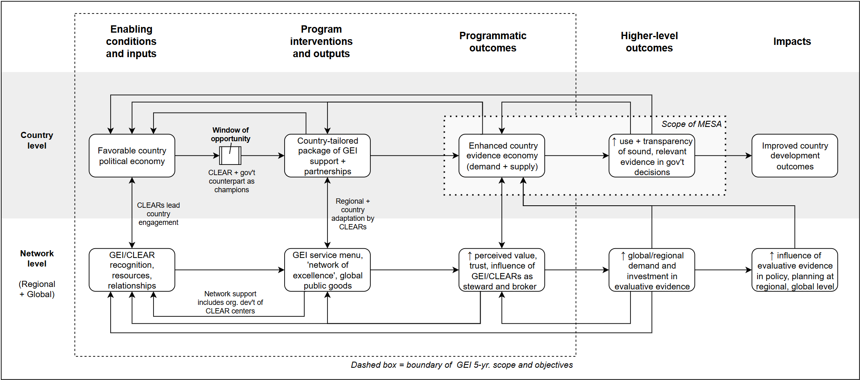
How does all of this fit together?

Slide 15
Short, Medium and Long-Term Priorities
Standards/Network of Excellence
c
Define ‘network of excellence’ across implementing partners - the “GEI model”
Connections established with partners and others working in evaluation-adjacent spaces
Connections strengthened across the GEI Network
Promote positioning of evaluation as a source for credibility and trust
Sustained Financing
c
Sustainable funding model that is diversified and allows for both income generation and Trust Fund commitments
Global Team is positioned to support diversification of funding for implementing partners sustainability
Develop and implements Trust Fund replenishment strategy based on Network’s outcome, niche and values
Holistic and long-term relationship-building with governments
c
Long-term relationships with governments and change to culture of evaluation use
Knowledge transfer across peers in government and outside of government

Slide 16
4. Key choices, feedback and direction

Slide 17
The Strategic Direction
Reflection and discussion on the following issues:
The Vision and the Outcome
To what extent is the vision and objective the correct positioning for the network?
To what extent is the Outcome in line with the Partnership Council’s interests as a network?
Where and With Whom
How do we determine a more focused approach to country engagement?
How does the Network engage with partners outside of the network? What role should it take in these partnerships?
How the network delivers on its desired outcome
To what extent does the two-level ToC address the problem the Network is attempting to solve?
In which ways does the Partnership Council become involved – what strengths and competencies of the PC can be used and in which ways, to support the achievement of the outcomes?
Does the evidence economy capture the approach to national evaluation capacity development?

Slide 18
The Strategic Direction
Reflection and discussion on the following issues:
Competencies Needed to Achieve the Goals
What resources are needed to support the Theory of Change?
How best does the Network achieve and cultivate these competencies?
What resources can be better captured by the Network? How can the Network do this?
Governance
What does governance look like for the network? Who and how are partners involved in making decisions related to the strategic direction?
How are discussions held across the Network? How often and how are decisions made and followed?

