Slide 1



Quality by Design: Creating Evaluations that Matter
Ketevan Murusidze
www.glocalevalweek.org

Slide 2
Navigating Complexity - Five Challenges to Overcome
Ketevan Murusidze
www.glocalevalweek.org

Slide 3


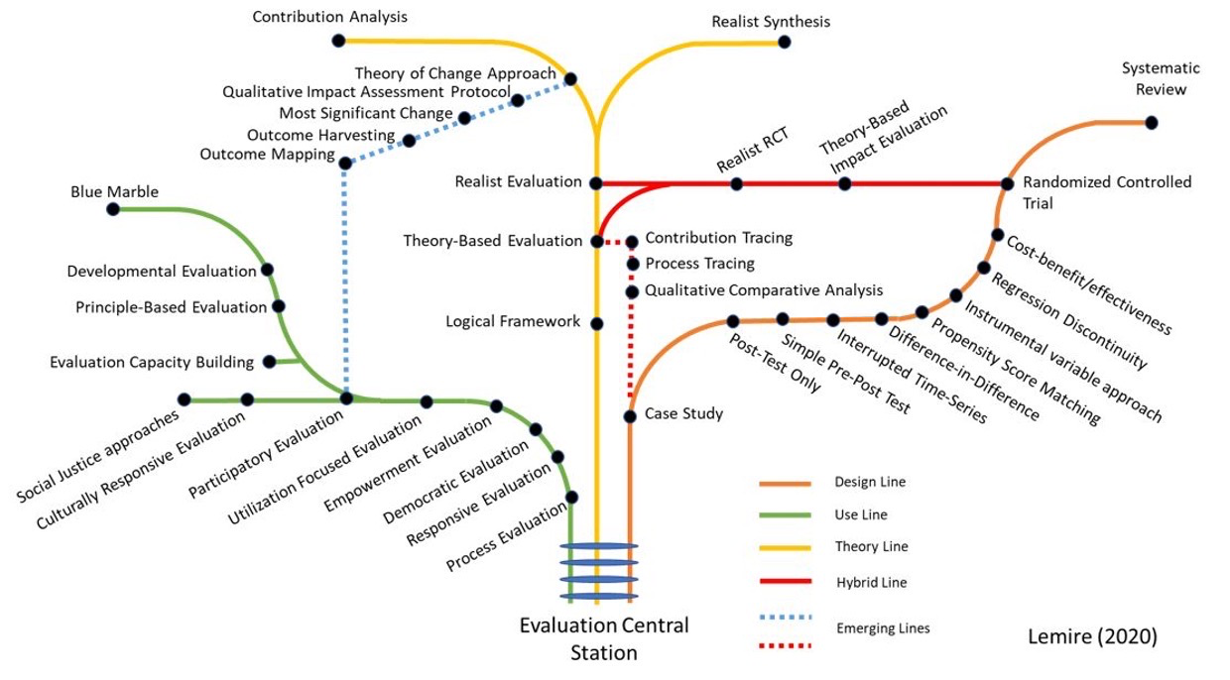
Challenge 1: Selecting the Right Line on the Evaluation Tube - Evaluation Design
www.glocalevalweek.org

Slide 4
Our Destination, aka Evaluation Objectives
I want to know IF my intervention really made a difference and IF so, to what extent.
I want to know in which configuration my intervention worked the best.
I want to know why and how my intervention made the expected difference.
I want to know all the desirable and undesirable consequences of my intervention.
www.glocalevalweek.org

Slide 5
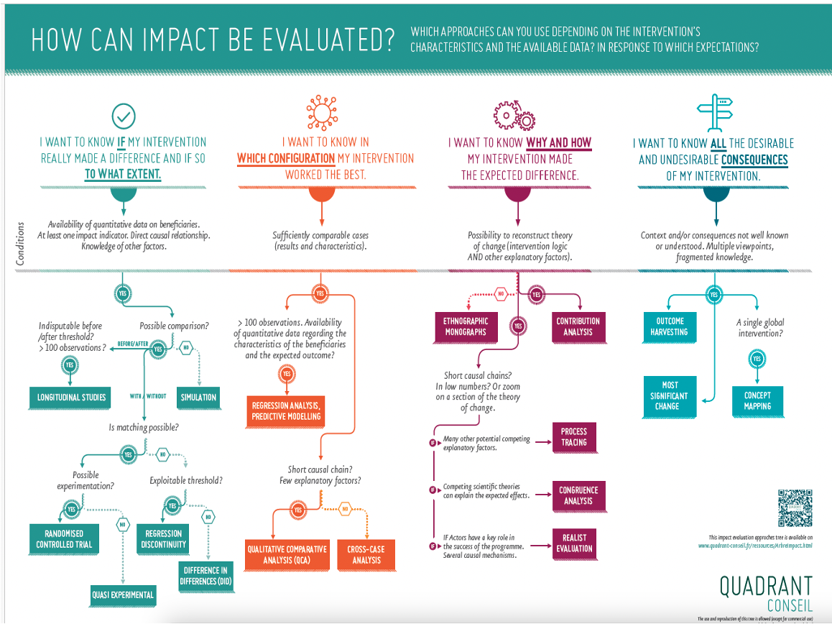
Selecting the Evaluation Line
www.glocalevalweek.org

Slide 6
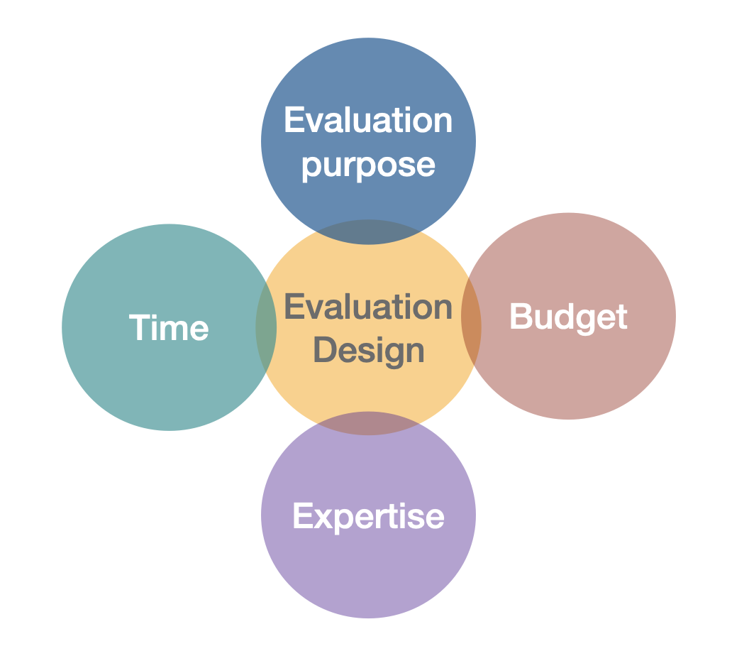
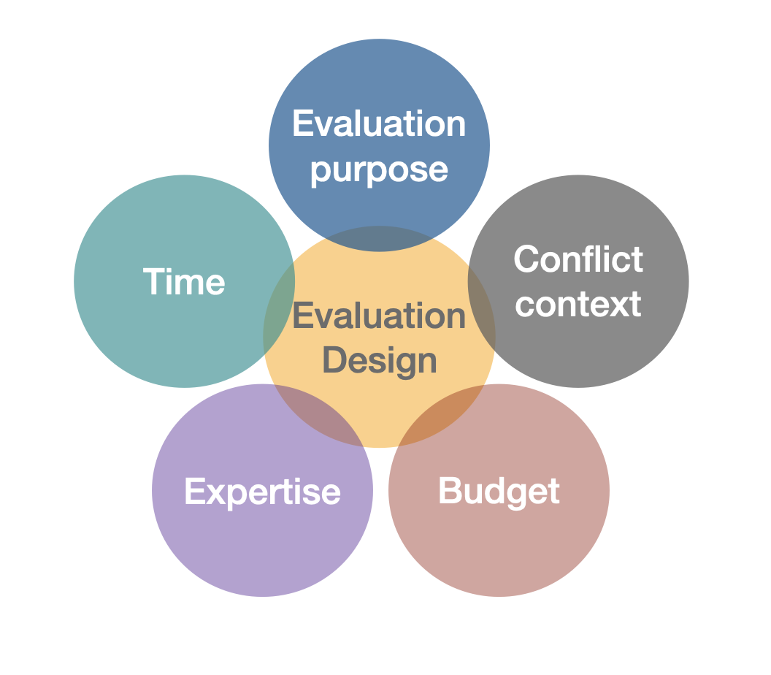
Designing Evaluation in Conflict Settings
www.glocalevalweek.org

Slide 7
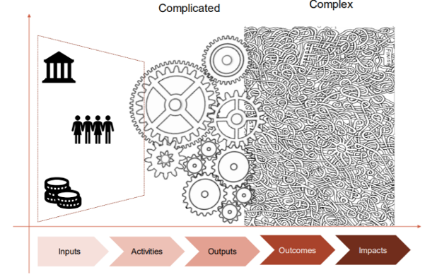

Challenge 2: Methodological Rigour
From complex systems to eco-chambers - at the expense of quality evidence
©ECPC
‘There is no way around this. ‘Good’, ‘Quick’, or ‘Cheap’ – pick two!’
www.glocalevalweek.org

Slide 8
Challenge 3: Conflict Sensitive Evaluation
Conflict sensitivity entails
Understanding the context in which a programme is operating;
Understanding the interaction between the intervention and that context; and
Acting upon that understanding, in order to avoid negative impacts and maximise positive impacts on the conflict [the object of the intervention]
(Lemon and Pinet 2018).
www.glocalevalweek.org

Slide 9
Conflict Sensitive Evaluation
Analyse the conflict (requires expert engagement).
Assess the interaction between the programme and the context in which it operates.
Assess the (unintended) negative impacts of the programme on the conflict.
Assess the (un)intended positive impacts of the programme on the conflict.
Provide recommendations to minimise negative impact and maximise positive impact on the conflict.
Requires genuine engagement and a willingness to discuss what may have gone wrong!
www.glocalevalweek.org

Slide 10
Challenge 4: Who defines what Peace is? Evaluating Peacebuilding
Reality check:
Would your neighbour understand what we are trying to measure here? (Critical assumption: your neighbour is not a MEL expert!)
Indicator 1: % of targeted local and national institutions with improved mechanisms for dispute resolution and conflict management.
Indicator 2: Number and types of interventions targeted to address both women and men considering the differences in the nature of conflict impact and priorities.
www.glocalevalweek.org

Slide 11
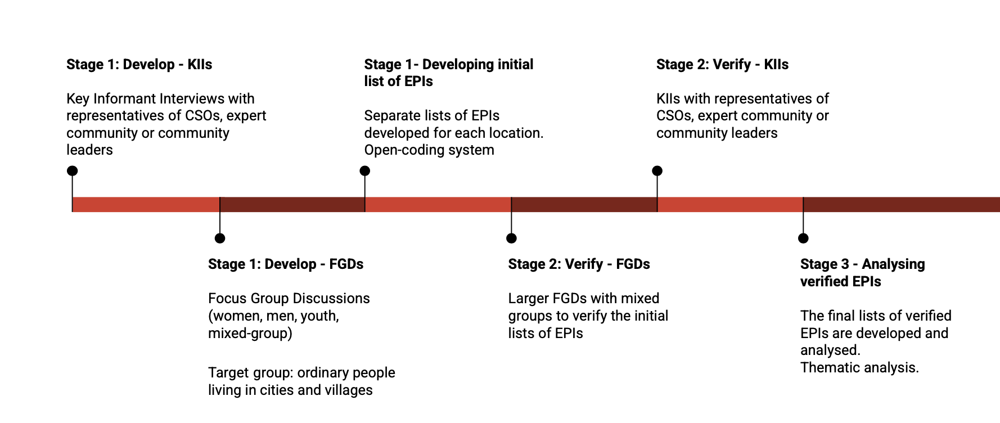
Way forward:
Participation and Inclusion
Any Participatory Evaluation methods can work.
We piloted the Everyday Peace Indicator (EPI) methodology in the conflict-divided communities in Georgia
www.glocalevalweek.org
Report: Everyday Peace Indicators in Conflict-Affected Communities

Slide 12
Challenge 5: Bridging the gap –
How do we use our evaluation findings?
Report back to the community
Report to key stakeholders
Report to implementing/downstream partners
Report to the donor
www.glocalevalweek.org

Slide 13

global
evaluation
initiative
Thank you!
www.glocalevalweek.org

