Slide 1



The Anatomy of Quality Evaluation Design:
What I have learnt?
From Both Sides of the Evaluation Table
Dea Tsartsidze
Partner, SAI
www.glocalevalweek.org
Notes:
I've sat on both sides of the evaluation table - commissioning evaluations as a client, conducting them as an evaluator, and reviewing hundreds as a quality assessor. Today I want to share what separates evaluations that matter from those that gather dust."
My Unique Perspective
Independent evaluator: Designing and conducting evaluations across 80+ countries
Commissioning client: Reviewing and approving evaluation designs for major donors incorporating as Quality reviewer: Assessing hundreds of completed evaluation reports
The brutal truth: Most evaluation design failures are predictable and preventable

Slide 2





Flaw #1: Evaluation Questions That Don't Evaluate
"What activities were implemented?" (That's monitoring, not evaluation)
"How satisfied were participants after completing training?" (That's feedback, not evaluation)
"How many people were trained?" (That's counting, not evaluating)
"What were the project achievements?" (That's reporting, not evaluation)
QUALITY DESIGN REQUIRES:
Questions that judge merit, worth, or significance
"To what extent did capacity building lead to behavioral change?"
How and why did the intervention contribute to observed outcomes?
EQ1: TO WHAT EXTENT ARE JOURNALISTS NOW USING VERIFICATION TECHNIQUES IN THEIR DAILY REPORTING, AND WHAT INFLUENCES THEIR ADOPTION OF THESE PRACTICES?"
www.glocalevalweek.org
Notes:
I know this sounds basic, but this is THE most fundamental flaw I see - even in expensive-evaluations from major donors. If you get the questions wrong, everything else fails.
[Speaking note: I bet everyone here has seen these exact questions in ToRs. The problem? None of these help us judge whether something worked or was worthwhile.]
Real example: Media program evaluation - client originally wanted "How many journalists completed our fact-checking workshop?" I pushed for "To what extent are journalists now using verification techniques in their daily reporting, and what influences their adoption of these practices?"
[Speaking note: The first question tells you nothing about whether the workshop was worthwhile. The second question actually evaluates effectiveness and opens up learning about what really drives behavior change.]

Slide 3
Flaw #2: Treating Theory of Change as Truth, Not Hypothesis
Evaluations that only check if ToC outcomes were achieved
Key assumptions never explicitly tested orchallenged
No evaluation questions testing whether the assumed logic actually holds
Evaluation design assumes the program pathway is the only pathway
QUALITY EVALUATION DESIGN TESTS THE THEORY:
"Were the program's assumptions about change pathways valid?"
"What alternative explanations exist for observed changes?"
"Which ToC assumptions proved wrong and why?"
"What unintended pathways emerged?"
CAPACITY BUILDING PROGRAM ASSUMED: TRAINING → KNOWLEDGE → BEHAVIOR CHANGE → INSTITUTIONAL CHANGE.
VS
PEER NETWORKS → SOCIAL PRESSURE → BEHAVIOR CHANGE.
Notes:
[Speaking note: This is where I see evaluators become program cheerleaders instead of independent assessors]
[Speaking note: I constantly see evaluations that ask "Did we achieve outcome X?" but never ask "Was our theory about HOW to achieve X actually correct?"]
Real example: Capacity building program assumed: Training → Knowledge → Behavior Change → Institutional Change. Evaluation found the real pathway was: Peer Networks → Social Pressure → Behavior Change. Training was almost irrelevant.
[Speaking note: The program kept focusing on better training content when they should have been investing in peer network building. That's what happens when you don't evaluate your theory.]

Slide 4
Flaw #3: Wrong Evaluation Approach for the Purpose
"We need impact evaluation" for everything (even when you need process understanding)
Outcome evaluation when you actually need developmental evaluation
RCT obsession when contribution analysis would be more appropriate
Summative approaches when formative learning is the priority
QUALITY EVALUATION DESIGN MATCHES APPROACH TO PURPOSE:
Impact evaluation: When you need to prove causation for scaling decisions
Outcome evaluation: When you need to understand what changed and why
Process evaluation: When you need to understand how to improve implementation
RANDOMIZED CONTROL TRIAL FOR A PEACEBUILDING PROGRAM.
VS
OUTCOME HARVESTING+ FOUNDATIONAL OECD DAC CRITERIA EVALUATION
Notes:
[Speaking note: This is where I see the most expensive mistakes - using a Ferrari approach when you need a pickup truck]
"We need impact evaluation" for everything (even when you need process understanding)
[Speaking note: I see this constantly - every ToR says "impact evaluation" because it sounds rigorous, even when they really need to understand HOW something works, not IF it works]
RCT obsession when contribution analysis would be more appropriate
[Speaking note: RCTs are great for simple interventions with clear causal pathways, but terrible for complex programs with multiple contributing factors]
Outcome evaluation when you actually need developmental evaluation
[Speaking note: Classic mistake - trying to measure fixed outcomes when the program is still evolving and learning what works]
Summative approaches when formative learning is the priority
[Speaking note: Using end-of-program evaluation design when managers need real-time feedback to improve implementation]
[Speaking note: I constantly get calls asking "Can you do an RCT?" My first question is always "What decisions are you trying to make with this evaluation?"]
Real example: Donor wanted RCT for a peacebuilding program. I asked: "Are you planning to randomly assign communities to conflict?" We ended up with outcome harvesting + contribution analysis that actually helped improve programming.
[Speaking note: The RCT would have cost three times more and told them nothing useful about how to build peace in their specific context.]
What we did is developed the Evaluation Policy Guideline- where we have explained the different evaluation approaches, evaluation types, evaluation method to increase the understanding and advocate.

Slide 5
Flaw #4: Data Strategy Disasters
"We'll interview stakeholders" (which ones? what sampling method? "Oh, it's qualitative, so who cares about sampling?")
Data analysis method? : "We'll do qualitative analysis" with no analysis plan
Data collection questions not linked to evaluation questions
Proper use of data collection methods
Reports with no limitations section
QUALITY EVALUATION DESIGN MATCHES APPROACH TO PURPOSE:
Specific stakeholder sampling strategy with clear rationale
Evaluation matrix linking evaluation questions to data collection questions to analysis methods
Clear qualitative analysis plan (not just "we'll find themes")
Honest limitations assessment built into design
TEMPLATES
EVALUATION MATRIX
EVALUATION POLICY
Notes:
[Speaking note: This is where evaluations fail at the operational level - beautiful designs that collapse when you try to implement them]
"We'll interview stakeholders" (which ones? what sampling method? "Oh, it's qualitative, so who cares about sampling?")
[Speaking note: I constantly see this attitude that qualitative means anything goes - no sampling strategy, no purposeful selection]
Data collection questions not linked to evaluation questions
[Speaking note: Teams design interview guides in isolation from evaluation questions, then wonder why they can't answer what they were hired to evaluate]
"We'll do qualitative analysis" with no analysis plan
[Speaking note: Especially with qualitative evaluations - "we'll just find themes" - but how? Using what framework? Who decides what's significant?]
Proper use of data collection methods: From Evaluation Conclave, - one very solid representative was saying - we don't need focus group discussion, because there are usually one person who speaks more and other are shy
Reports with no limitations section (or fake limitations like "more time would have been helpful")
[Speaking note: I had to introduce mandatory templates with limitations chapters. You should have heard the evaluator complaints - everyone prefers to complete easy evaluations without acknowledging constraints]
Real example: I introduced evaluation matrices that connect evaluation questions to specific interview questions to analysis methods. Evaluators initially resisted - "too much work" - but data quality improved dramatically.
[Speaking note: The matrix forces you to think through the entire data pathway before you start collecting anything]

Slide 6
Flaw #5: Utilization as an Afterthought
No understanding of actual decision-making processes and timing
No plan for managing negative or uncomfortable findings
Different users need different information, but we produce one-size-fits-all reports
Recommendations one-size-fits-for all the reports disconnected from the findings or organizational capacity and context
QUALITY EVALUATION DESIGN MATCHES APPROACH TO PURPOSE:
Different products for different users with different information needs
Pre-agreed protocols for handling sensitive findings
Utilization checkpoints throughout the evaluation process
Link the the findings with the recommendations and co-developed with implementers, not imposed by evaluators
TEMPLATES
EVALUATION MATRIX
EVALUATION POLICY
Notes:
[Speaking note: This is the flaw that keeps me awake at night - we spend months producing beautiful evaluations that literally no one uses for actual decisions]
No understanding of actual decision-making processes and timing
[Speaking note: We deliver reports when decisions were already made last month, or right before budget season when no one has time to read]
Different users need different information, but we produce one-size-fits-all reports
[Speaking note: Board members need 2-page summaries, program managers need detailed implementation insights, donors need accountability data - but we give everyone the same 80-page report]
No plan for managing negative or uncomfortable findings
[Speaking note: What happens when the evaluation finds the program isn't working? Most designs don't even consider this possibility]
Recommendations disconnected from organizational capacity and context
[Speaking note: "Hire more staff" when there's no budget, "improve coordination" when organizations are rivals]
Cultural and political barriers to utilization ignored in design
[Speaking note: Some cultures don't challenge authority publicly, some contexts punish honest feedback - but evaluation designs pretend these don't exist]

Slide 7










The Elements of Quality Evaluation Design
Clear Evaluative Thinking
Making explicit judgments about merit, worth, and significance rather than just describing what happened.
Stakeholder Engagement Strategy
Moving beyond consultation to strategic relationship management where different stakeholders contribute different knowledge for different purposes.
Contextual Intelligence
Deep understanding of local political, cultural, and systemic factors that influence how change happens in specific settings.
Learning-Oriented Design
Designing evaluations that generate actionable insights and build organizational capacity, not just deliver final judgments.
Methodological Rigor with Pragmatic Flexibility
Balancing scientific credibility with real-world constraints and adaptation needs.
Notes:
This section moves from problems to solutions, outlining the five essential elements that distinguish quality evaluation designs. Drawing from successful evaluations across different contexts, it provides practical frameworks while positioning outcome harvesting as one valuable tool within a broader quality approach.
[Speaking notes: This is what separates evaluation from research, monitoring, or assessment - we're making judgments. From my experience reviewing hundreds of evaluations, the best ones start with clear evaluative criteria. Not just "what happened" but "was what happened good enough, appropriate, significant?" They distinguish between monitoring and evaluation from day one - monitoring asks "are we doing what we planned?" while evaluation asks "is what we're doing worthwhile and effective?" They're explicit about what constitutes "success" or "effectiveness" - if you can't articulate your success criteria, you can't evaluate. Sounds obvious, but most evaluations skip this step. Practical test: Can you explain in 30 seconds what you're evaluating and against what standards? If you can't pass this test, you're not ready to design the evaluation yet.]
[Speaking notes: This is where academic evaluation knowledge meets street-smart local understanding. What separates good from great evaluations is deep understanding of political economy - who really makes decisions? What incentives drive behavior? Evaluation designs that ignore power dynamics fail. Recognition of cultural factors affecting change - change happens differently in hierarchical vs. egalitarian cultures, individual vs. collective societies. Adaptation capacity built into design - not just "if this doesn't work, we'll try that" but systematic sensing and adapting mechanisms. This is where my outcome harvesting work really shines - it captures context-specific changes that standard frameworks miss. While other approaches impose external categories, outcome harvesting lets context define what matters.]
[Speaking notes: This is the art of evaluation design - being scientifically credible while actually doable. Quality design balances scientific rigor with practical constraints - perfect randomization vs. ethical constraints, large samples vs. budget reality. Standardization with adaptation needs - consistent methods that still flex with local context. Comprehensive coverage with resource limitations - answering the most important questions well rather than everything poorly. Real example from my work: Madagascar economic integration evaluation had to adapt entirely when political crisis changed context mid-evaluation. Original design became impossible overnight, but we'd built in adaptation mechanisms that let us still generate useful insights.]
[Speaking notes: This goes far beyond "consulting stakeholders" - it's strategic relationship management. Different stakeholders need different evaluation information - donors need accountability data, implementers need learning insights, beneficiaries need respect for their time and input. Participation versus extraction approaches - are stakeholders co-creators of knowledge or just sources of data? This fundamentally changes evaluation design. Managing conflicting stakeholder interests - when stakeholders want different answers to the same question, how do you design neutrally? Outcome harvesting insight: it turns stakeholders into knowledge generators, not just respondents. People describe and analyze their own changes rather than answering our predetermined questions.]
[Speaking notes: This is the difference between evaluation for compliance and evaluation for improvement. Quality evaluations generate insights, not just judgments - "this worked" vs. "this worked because of these factors in this context with these people." They build evaluation capacity while conducting evaluation - leave behind stronger evaluation thinking, not just a report. Create feedback loops for adaptive management - evaluation as ongoing conversation, not final verdict. Integration point: these elements work together - you can't have contextual intelligence without stakeholder engagement, can't have learning without clear evaluative thinking. Poor designs usually get one element right but miss the integration between elements.]

Slide 8

Outcome
Harvesting
www.glocalevalweek.org
Notes:
I've sat on both sides of the evaluation table - commissioning evaluations as a client, conducting them as an evaluator, and reviewing hundreds as a quality assessor. Today I want to share what separates evaluations that matter from those that gather dust."
My Unique Perspective
Independent evaluator: Designing and conducting evaluations across 80+ countries
Commissioning client: Reviewing and approving evaluation designs for major donors incorporating as Quality reviewer: Assessing hundreds of completed evaluation reports
The brutal truth: Most evaluation design failures are predictable and preventable

Slide 9

What is Outcome Harvesting?
Outcome Harvesting is an evaluation approach that allows us to retrospectively identify emergent change (outcome/impact) by collecting examples of what has changed in “behaviour writ large” (actions, relationships, policies, practices) and then work backwards to determine whether, and how an intervention has contributed to these changes.
www.glocalevalweek.org
Notes:
I've implemented Outcome Harvesting across more than 80 countries - from post-conflict settings in DRC to politically volatile contexts in Belarus.
Today, I want to share not just what Outcome Harvesting is, but what I've learned from both its spectacular successes and its notable failures.
Let me start with a fundamental question that shapes everything we do: What is Outcome Harvesting really about? [Point to slide]
The definition you see here captures the methodology, but misses the mindset shift. OH isn't just about working backwards from outcomes - it's about acknowledging that change is messy, unpredictable, and often happens in ways we never anticipated.
When I say 'behavior writ large,' I mean the full spectrum of change - not just individual behavior, but shifts in policies, relationships, practices, even how institutions operate. In our work in Lebanon's media sector, for example, we discovered changes in cross-community reporting that weren't just about journalist behavior, but about editorial policies, advertiser relationships, and audience expectations.
The key word here is 'contributed.' Not 'caused.' And that distinction will become crucial as we dive deeper."

Slide 10




When OH Works...
Complex change with multiple actors
1
4
Unintended changes matter
Contribution over attribution matters
Policy and policy influence work
2
5
Context adaptation is critical
3
www.glocalevalweek.org
Notes:
"Let me be very direct about when Outcome Harvesting actually works - because I've seen too many failed implementations to sugarcoat this.
Complex change with multiple actors - This isn't just complicated programs. I mean contexts where your carefully designed theory of change gets completely upended by external events. In DRC, we were tracking media literacy outcomes when political violence disrupted everything. Traditional indicators would have shown 'failure.' OH revealed how communities adapted information-sharing networks in ways we never anticipated.
[Point to #2] Contribution over attribution - This matters when multiple actors are influencing the same changes. In our GSMA advocacy work, policy shifts happened through multiple channels simultaneously. RCTs couldn't capture this complexity. OH could trace our specific contributions within that complex ecosystem.
[Point to #3] Context adaptation is critical - Here's where OH truly shines. When COVID hit our programs in three countries, everything changed overnight. OH helped us understand how program adaptations contributed to different outcomes than originally planned. It acknowledged reality rather than forcing programs into predetermined boxes.
[Point to #4] Unintended changes matter - In Zimbabwe's governance program, our biggest learning came from unexpected outcomes we hadn't planned for. These often revealed the most important insights about how change actually happens.
[Point to #5] Policy and advocacy work - The pathways to policy change are never linear. OH can trace influence through informal networks, timing factors, and multiple touchpoints that traditional methods miss entirely. And more importantly, when speak about policy influence, it could not only measure by adopting the policy, in many places around the world adoption of the policy is not managable but advocacy efforts and infleunce still counts
The key insight here: OH works when you need to understand how change actually happened, not just whether you met your indicators."

Slide 11
When OH is misused...
Cherry-picking positive stories for donor reports
1
4
Quantitative impact needed
Avoiding rigorous M&E because "context is too complex"
For simple interventions with clear, linear logic models that are working as expected
2
5
Resource constraints but expecting same rigor
3
www.glocalevalweek.org
Notes:
"Now let me be brutally honest about when OH gets misused - because recognizing these patterns has saved my projects from disaster.
[Point to #1] Cherry-picking positive stories - I see this constantly. Organizations collect beautiful outcome stories for donor reports, then file them away. That's not evaluation - that's marketing. Real OH demands intellectual honesty about all significant changes.
[Point to #2] Avoiding rigorous M&E - I hear 'our context is too complex for traditional methods' as code for 'we don't want to do the hard work of proper evaluation.' OH isn't easier than other methods - it's different. It still requires rigor, just applied differently.
[Point to #3] Resource constraints but expecting same rigor - Here's the hard truth: a proper OH takes 3-9 months and substantial resources. When organizations have neither time nor budget but still want OH-level insights, that's setting up for failure. Be honest about what you can actually do with available resources.
[Point to #4] When quantitative impact data is needed - OH complements quantitative methods, it doesn't replace them. If your donors need statistical measures of impact or return on investment, OH alone won't meet that need.
[Point to #5] Simple interventions with clear pathways - If your program is working exactly as planned with predictable outcomes, you probably don't need OH. Use simpler methods that match your intervention's complexity.
The critical question: Are you choosing OH for the right methodological reasons, or because you think it's easier? That choice determines success or failure."

Slide 12
Key Takeaways from OH?
Resource Reality
A thorough OH can require 3-4 months and 30+ interviews for proper verification
Verification in Impossible Contexts
Creative triangulation methods needed when direct access to stakeholders isn't possible
Potential Bias
Stakeholders bring different perspectives - what seems significant to implementers may be viewed differently by beneficiaries
Disregard other key elements
Clear framework needed for: What is the outcome? What are other factors? What is the program contribution?
The Negative Outcome Problem
In dozens of implementations, negative outcomes are rarely documented due to institutional pressures
Notes:
Let me share what decades of implementation have taught me about OH's real challenges - the ones nobody talks about in methodology guides.
[Point to Resource Reality] First, the resource reality. When we started our State Employment Agency evaluation, we planned 20 interviews. Proper substantiation required 50+. Each outcome needed verification from service recipients, agency staff, and external stakeholders. Budget implications? Substantial. Timeline implications? Even more substantial.
[Point to Potential Bias] Second, managing bias isn't just about data collection techniques. In Lebanon, media professionals saw certain coverage changes as revolutionary. Community members saw the same changes as minimal. Both were right from their perspectives. OH requires structured approaches to surface and reconcile these differences.
[Point to Negative Outcome Problem] Here's the uncomfortable truth: in dozens of OH implementations, I rarely see negative outcomes documented. Why? Career implications. Reporting pressures. Institutional resistance. In Zimbabwe, stakeholders initially pushed to focus only on positive changes. By insisting on all significant changes, we uncovered critical learning about failed approaches that ultimately strengthened the program.
[Point to Verification in Impossible Contexts] When CSOs are in exile, stakeholders are afraid to talk, or you can't access beneficiaries - what then? In Belarus, we adapted through diaspora networks, online platforms, and public records. In DRC, we relied on triangulation between local partners. Not ideal, but necessary. The key is being transparent about evidence limitations.
[Point to Disregard other key elements] Finally, the framework question that matters: For each outcome, can you clearly articulate what changed, what other factors influenced that change, and how your program specifically contributed? If you can't answer all three, you're not ready for OH."- for example, ... Outcomes are about CHANGES that have occurred, not activities that were performed- Producing materials (e.g., "published a manual")
Knowledge gain without behavior change (e.g., "participants learned new skills" without showing how they used them)
Future intentions (e.g., "planning to implement new methods")

Slide 13




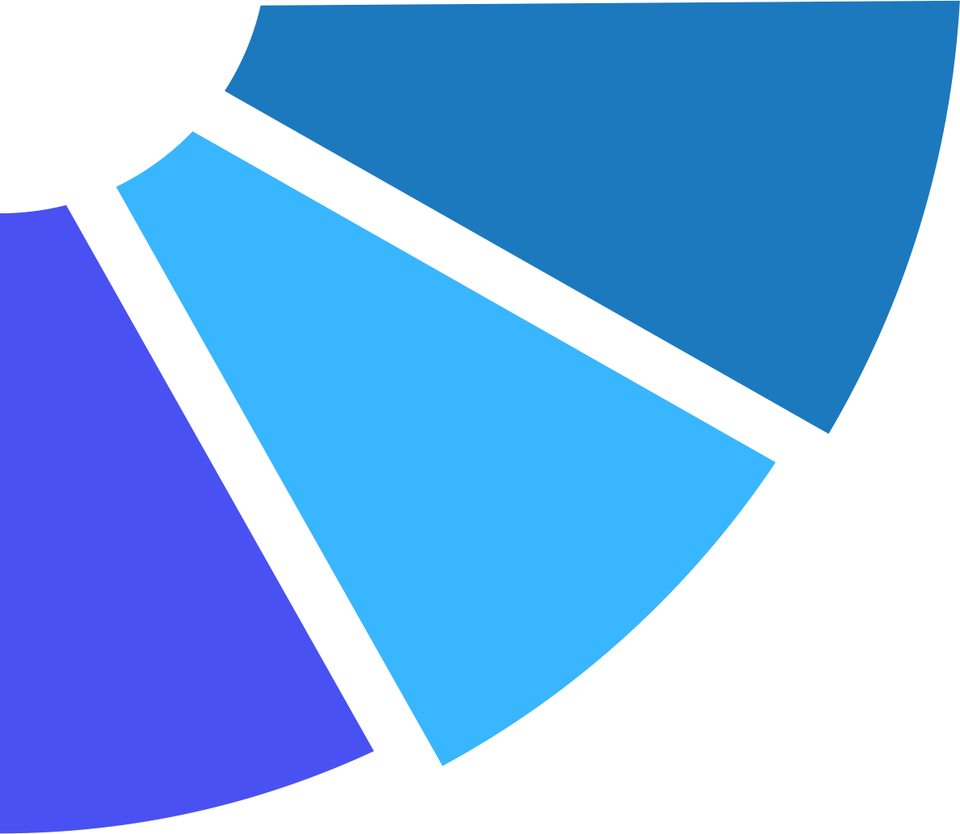







What is real OH value?
UNDERSTANDING CONTRIBUTION MECHANISMS
CAPTURING STAKEHOLDER PERSPECTIVE COMPLEXITY
Revealing HOW change happened, not just WHAT changed - the change pathways that help replicate succes
Surfacing how different actors view the same outcomes differently - implementers vs. beneficiaries vs. external observers
Making OH Actually Matter
Creating structured processes to integrate findings into program adaptation beyond donor reporting
RETROSPECTIVE LEARNING FROM IMPERFECT PROGRAMS
Extracting learning from interventions that lacked proper M&E frameworks from the start
The Learning Integration Challenge
Moving from 'interesting findings' to actual program strategy changes
www.glocalevalweek.org
Notes:
"Let me close with what I consider the biggest missed opportunity in Outcome Harvesting - and how to fix it.
[Point to Learning Integration Challenge] Most programs collect beautiful outcome stories, write compelling donor reports, then never revisit those findings for actual learning. In our DRC humanitarian program, we documented 15 rich outcomes. They made excellent reports. But six months later, program teams couldn't tell me how those findings influenced their work. Why? No structured process to move from documentation to adaptation.
[Point to Making OH Actually Matter] Real OH value isn't in proving impact - it's in learning for adaptation. But this requires intentional design. You need reflection protocols built into the harvesting process, not added afterward as an afterthought.
[Point to Understanding Contribution Mechanisms] Here's where OH truly excels: revealing the HOW of change. In our media work in Lebanon, we didn't just document that reporting practices changed - we traced how journalist networks, editorial pressures, and audience feedback created specific influence pathways. Understanding these mechanisms helps replicate success in new contexts.
[Point to Stakeholder Perspective Complexity] Different stakeholders see the same outcomes completely differently. In Zimbabwe's governance program, implementers viewed policy meetings as successful outcomes. Community members saw the same meetings as tokenistic consultation. Both perspectives were valid and crucial for understanding real impact.
[Point to Retrospective Learning] OH's unique strength: extracting learning from programs that never had proper M&E frameworks. I've worked with initiatives that ran for years with no baseline data, no indicators, but still created significant change. OH can capture and verify those outcomes retrospectively, providing learning that would otherwise be lost forever.
[Powerful closing] After 15 years and 80+ countries, here's my fundamental insight: OH's real value lies in five specific capabilities no other method provides as effectively. First, moving from interesting stories to actual program changes. Second, understanding not just what happened, but how your intervention influenced it. Third, capturing the complexity of different stakeholder perspectives. Fourth, learning from programs that lacked proper evaluation design from the start. And fifth, creating structured processes for ongoing learning beyond one-time reporting.
The question isn't whether you can do perfect OH - it's whether you can harness these five values to generate learning that actually influences how you work. That distinction determines whether OH becomes a transformation tool or just another compliance exercise."

Slide 14

global
evaluation
initiative
Thank you!
www.glocalevalweek.org

