Slide 1



Components of Quality Evaluation Design in complex contexts
Ana Kvintradze-Hardy
MELPA – Monitoring, Evaluation & Learning Professionals Association of Georgia
ana.Kvintradze@gmail.com
www.glocalevalweek.org

Slide 2


Ana Kvintradze-Hardy
Monitoring, Evaluation & Learning Professionals Association Co-Founder
15 years of evaluation research specialists;
10 years of international monitoring, evaluation & learning experience in the South Caucasus, Middle East, North Africa and Eastern Europe
Author of various publications on innovative evaluation methods
Member of IOCE, EES, IDEAS
Participatory evaluation enthusiast
Proud author of first Georgian language training on the Basics of Evaluation (carried out within the framework of MELPA)
Invited Lecturer at Caucasus University
MSc in Sociology from the University of Oxford, current PhD Student at GIPA
www.glocalevalweek.org

Slide 3
Monitoring, Evaluation & Learning Professionals Association
Main forum for Monitoring, Evaluation & Learning professionals in Georgia;
Support professionalization, quality and resources on MEL in Georgia;
70+ members;
Member of IOCE;
Regular meetings, webinars, networking events;
First Georgian language tailored training on Basics of Monitoring & Evaluation
www.glocalevalweek.org

Slide 4
Why evaluation quality matters & what to do about it?
Scientific Credibility
Humanitarian imperative
Meeting the needs
Decision making power
Adjusted to needs
Serving the community
Participatory & inclusive
CHS
UNEG Ethics Standards
www.glocalevalweek.org

Slide 5
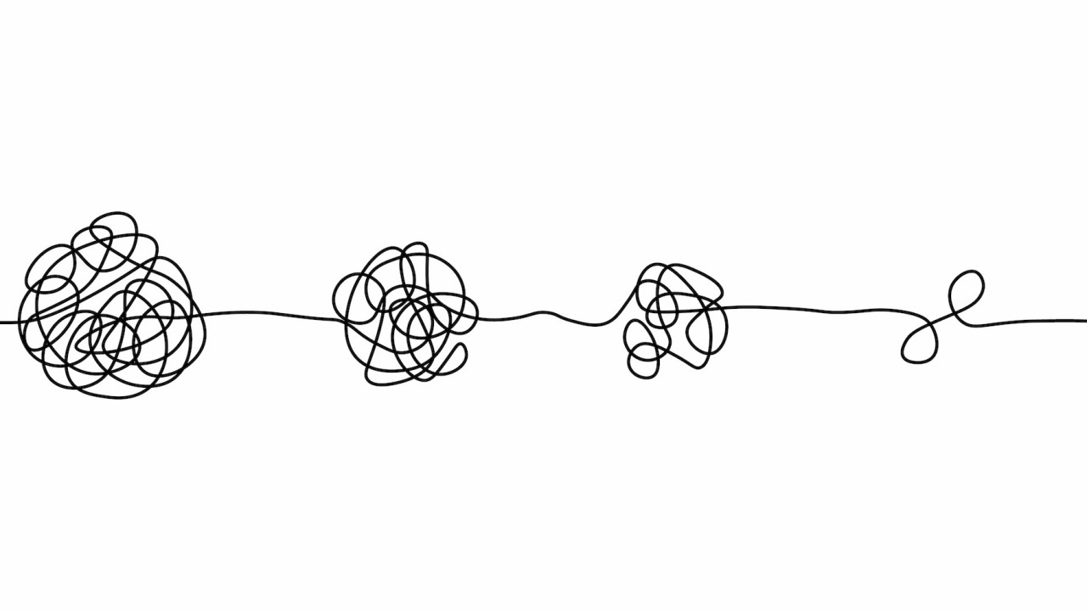
No such thing as ideal world….
Change is messy, what evaluation is trying to measure is messy, the context is messy and everything is changing all the time.
www.glocalevalweek.org

Slide 6
No such thing as ideal world….
Change is messy, what evaluation is trying to measure is messy, the context is messy and everything is changing all the time.
So, how do we balance external complexities with evaluation design?
Do we choose complexity? or do we choose simplicity?
The answer is…..messy!
www.glocalevalweek.org

Slide 7
Case study - Complex context not-so complex design for evaluation …. (for an evaluator)
Syria Adolescents Programme, implemented by Save the Children, 3 years, funded by SIDA
Syria, Lebanon, Jordan
In a nutshell: use of developmental practices in humanitarian setting
www.glocalevalweek.org

Slide 8
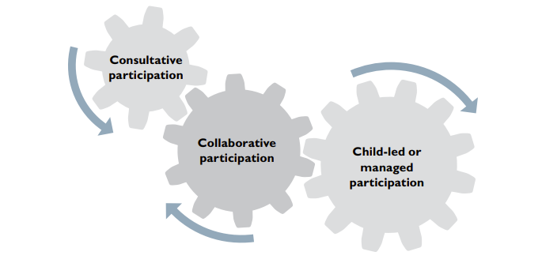
Quality Evaluation starts with the quality programme design stage
www.glocalevalweek.org

Slide 9
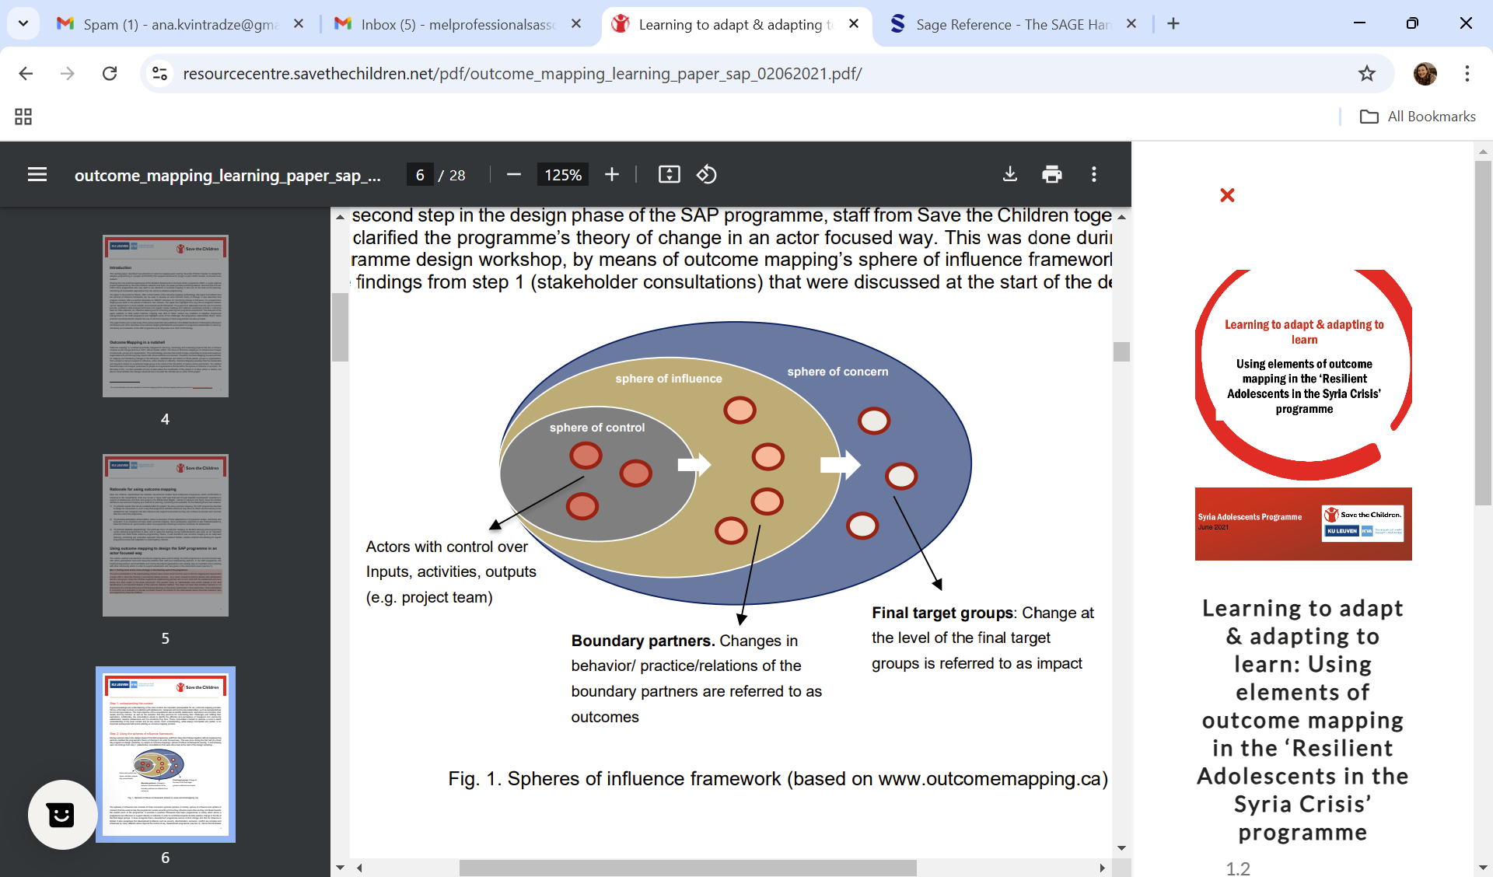
Integrating components of Conflict Sensitivity and Outcome Mapping in Spheres of Influence Model
www.glocalevalweek.org

Slide 10
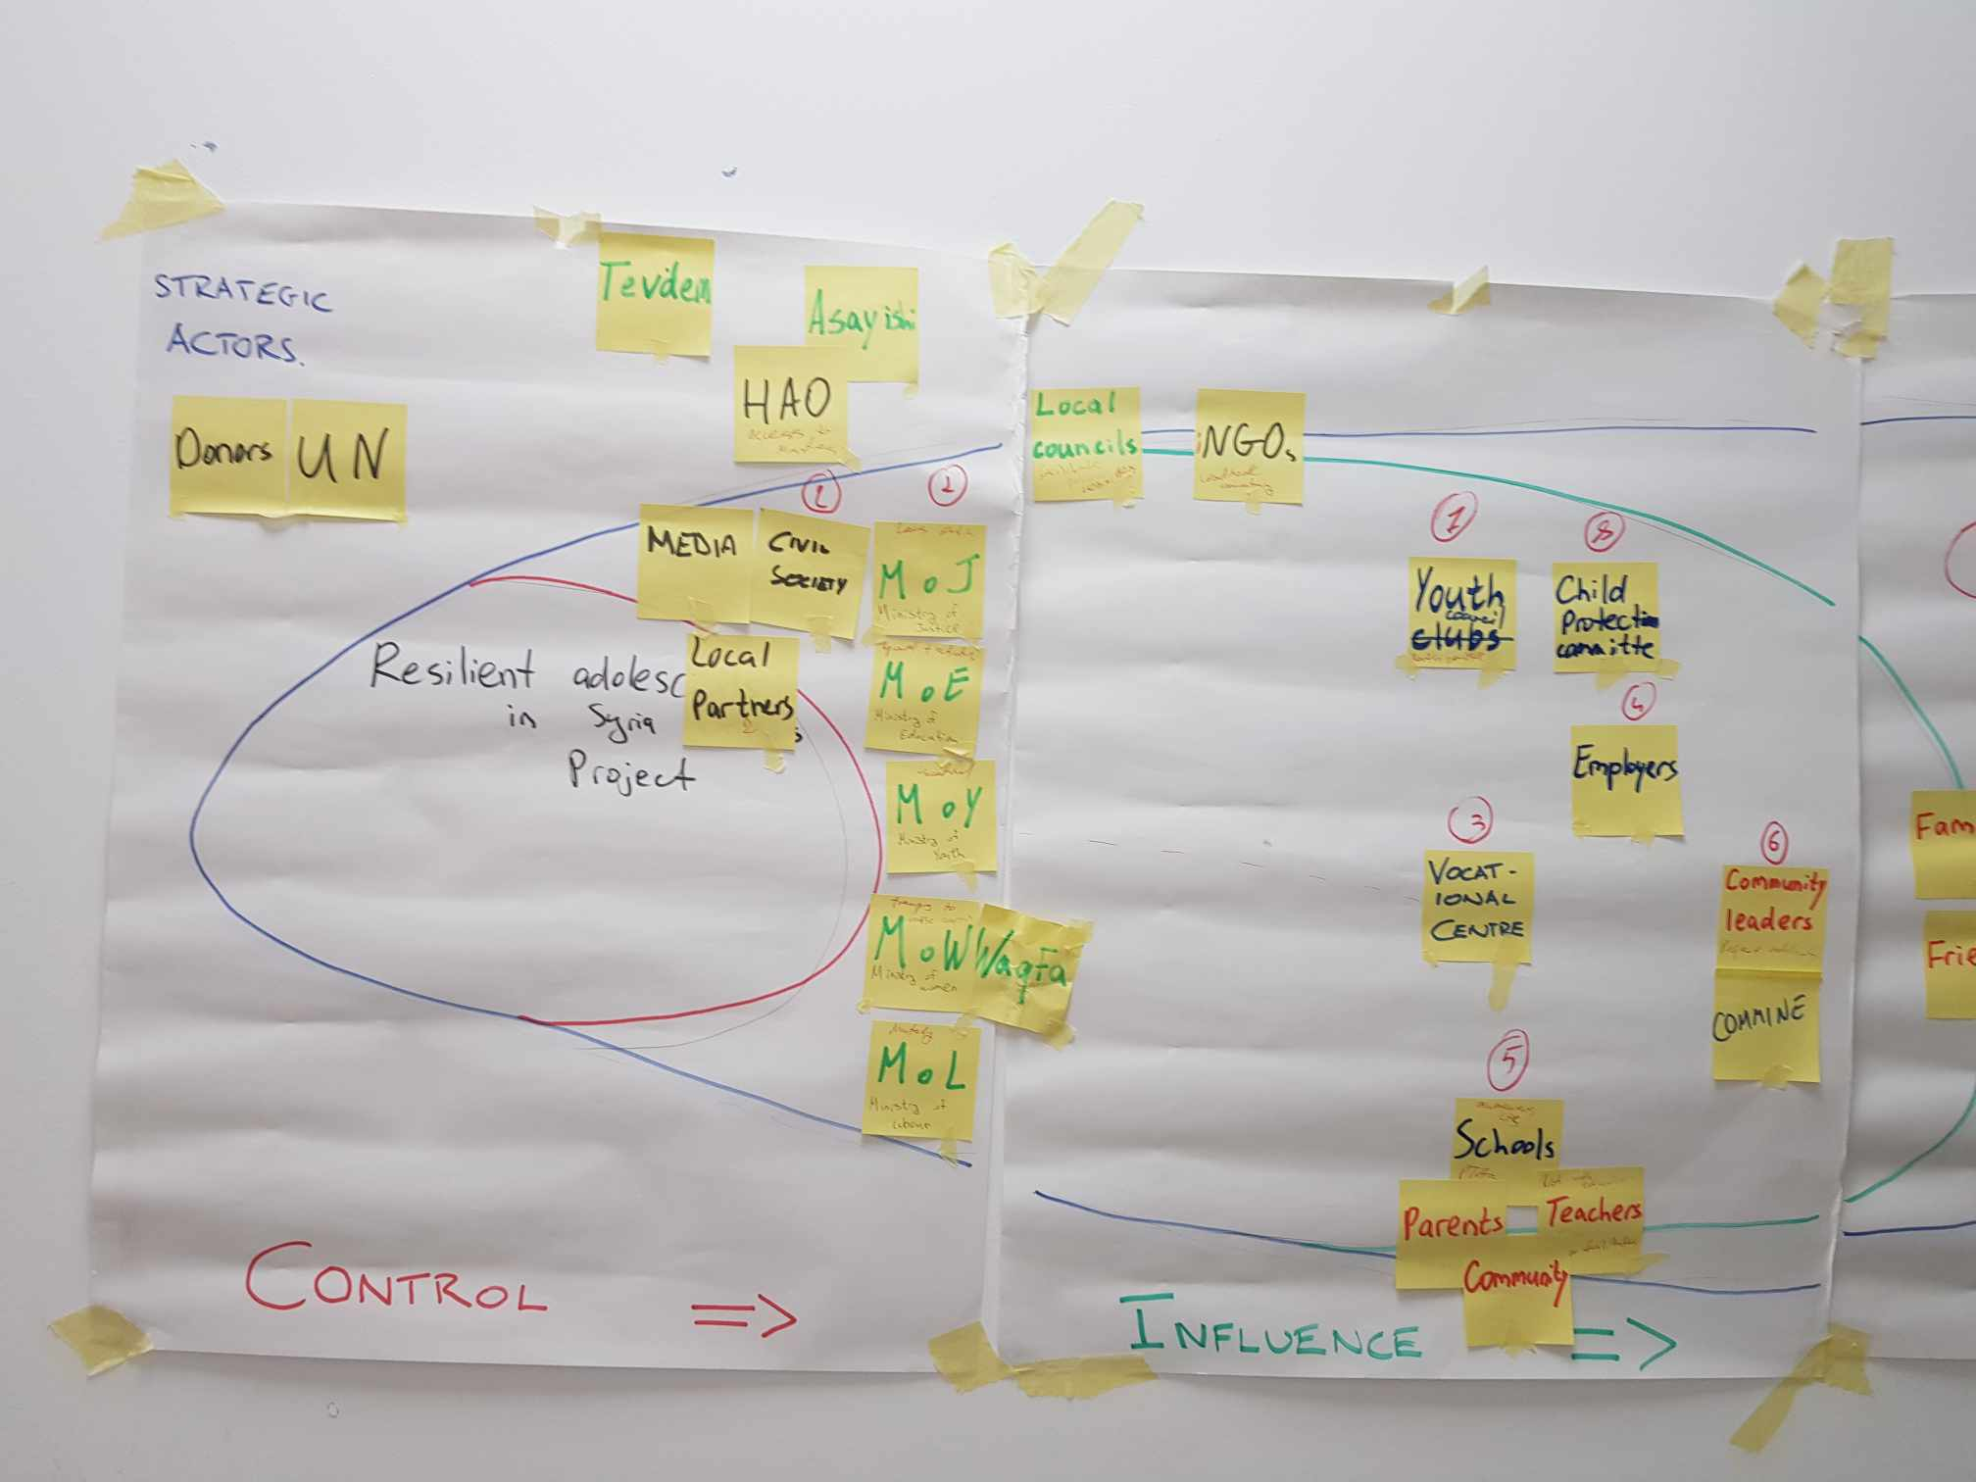
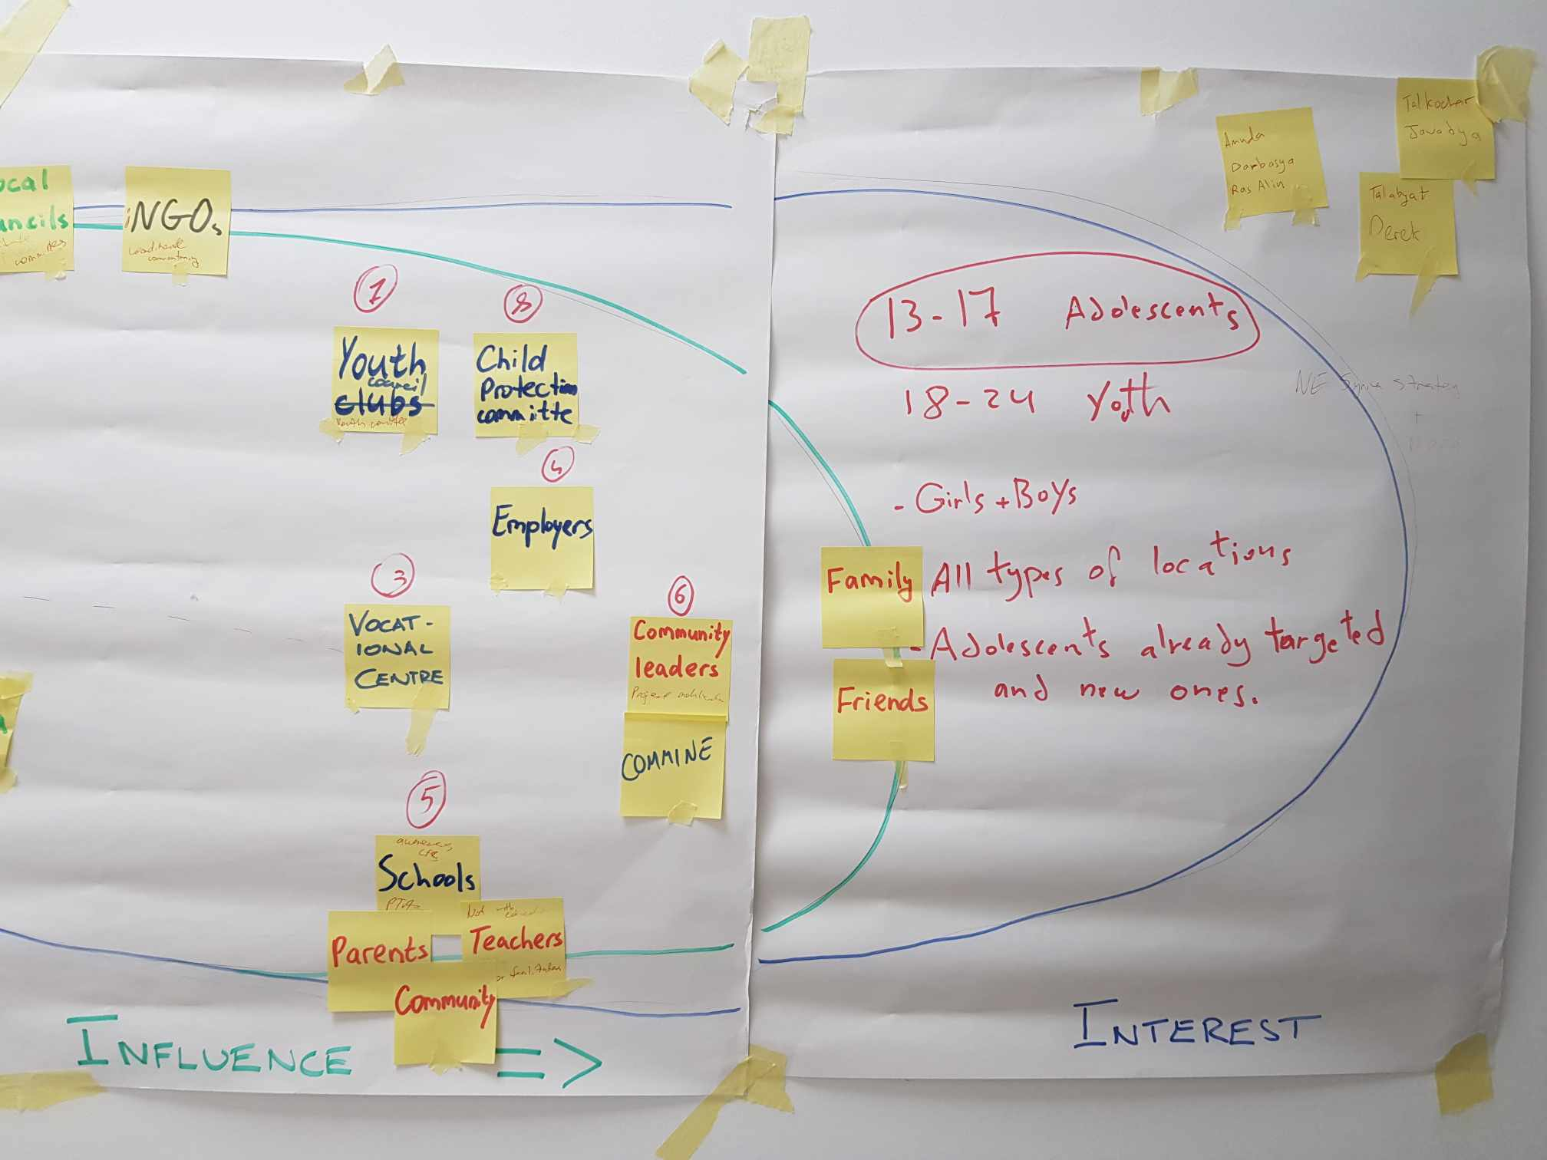
A messy workshop….
www.glocalevalweek.org

Slide 11
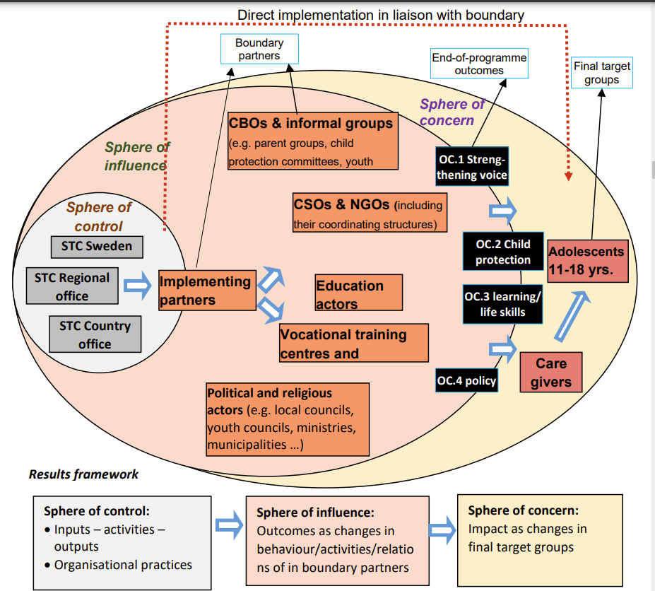
Beautiful Programme Design…
www.glocalevalweek.org

Slide 12
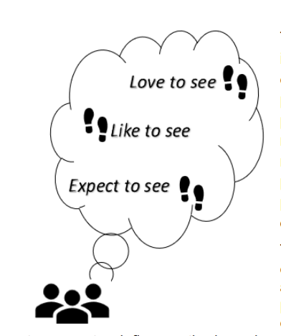
Progress markers vs SMART indicators
Expect to see
• Participate in capacity strengthening and awareness raising activities organised by the project regarding adolescent engagement approaches.
• Engage with and listen to the views of adolescent girls and boys from different parts of the community (e.g. come up with new approaches to effectively reach youth) Like to see
• Prioritise programmes for/with adolescents
• Coordinate with other actors
Love to see
• Act Implement activities to influence policy and decision making within local governance structures
www.glocalevalweek.org

Slide 13
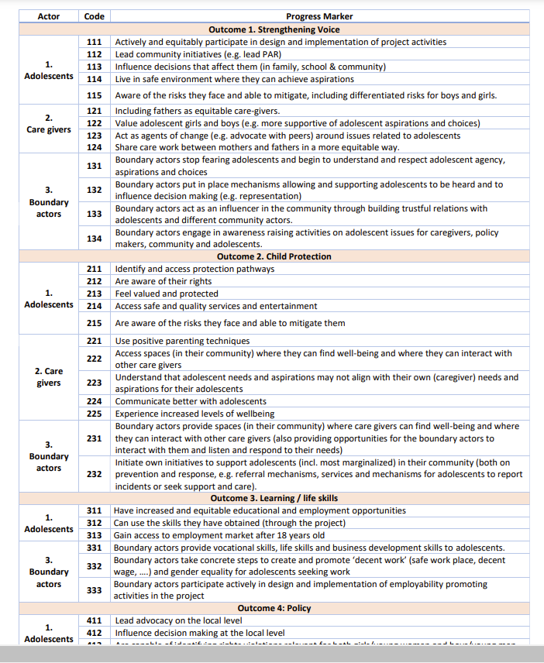
…the mix of both
www.glocalevalweek.org

Slide 14
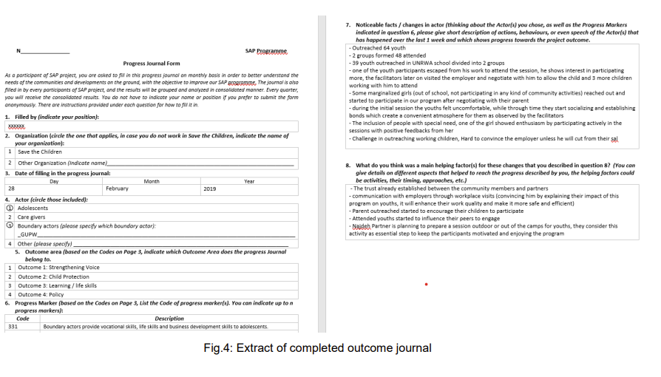
Outcome Journals
www.glocalevalweek.org

Slide 15
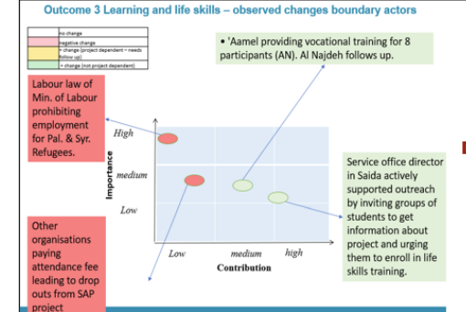
Monitoring & Evaluation process steps
Monthly field reflection workshops
6-monthly outcome harvesting cycle with conflict sensitivity component
Final evaluation with child-led research methodology
www.glocalevalweek.org

Slide 16
Challenges & Lessons Learnt on evaluation design quality
Organizational culture
  Early engagement
  Management buy in
  Field Innovators
Complexity vs fit for context
  Finding the balance
  Finding the middle ground
Sea of qualitative data – with no resources to properly analyze
www.glocalevalweek.org

Slide 17
Publications
https://resourcecentre.savethechildren.net/pdf/outcome_mapping_learning_paper_sap_02062021.pdf/
https://sk.sagepub.com/hnbk/edvol/the-sage-handbook-of-participatory-rm/chpt/59-promoting-adaptive-programming-through-outcome
www.glocalevalweek.org

Slide 18

global
evaluation
initiative
Thank you!
www.glocalevalweek.org

