Slide 1

06-06-2025
From Data to Decision: Scaling iGIS for Evidence-Based Development in Vietnam
Quang Ngoc Le, Ph.D.
MERL Manager, iDE
www.glocalevalweek.org

Slide 2

Agenda
04 - 07
08 - 13
14 - 21
22 - 24
25 - 26
27
Introduction to GIS
iGIS – What is it?
iGIS: Case study
iGIS knowledge dissemination and products
Q&A and Discussion
Team & Contact
www.glocalevalweek.org

Slide 3
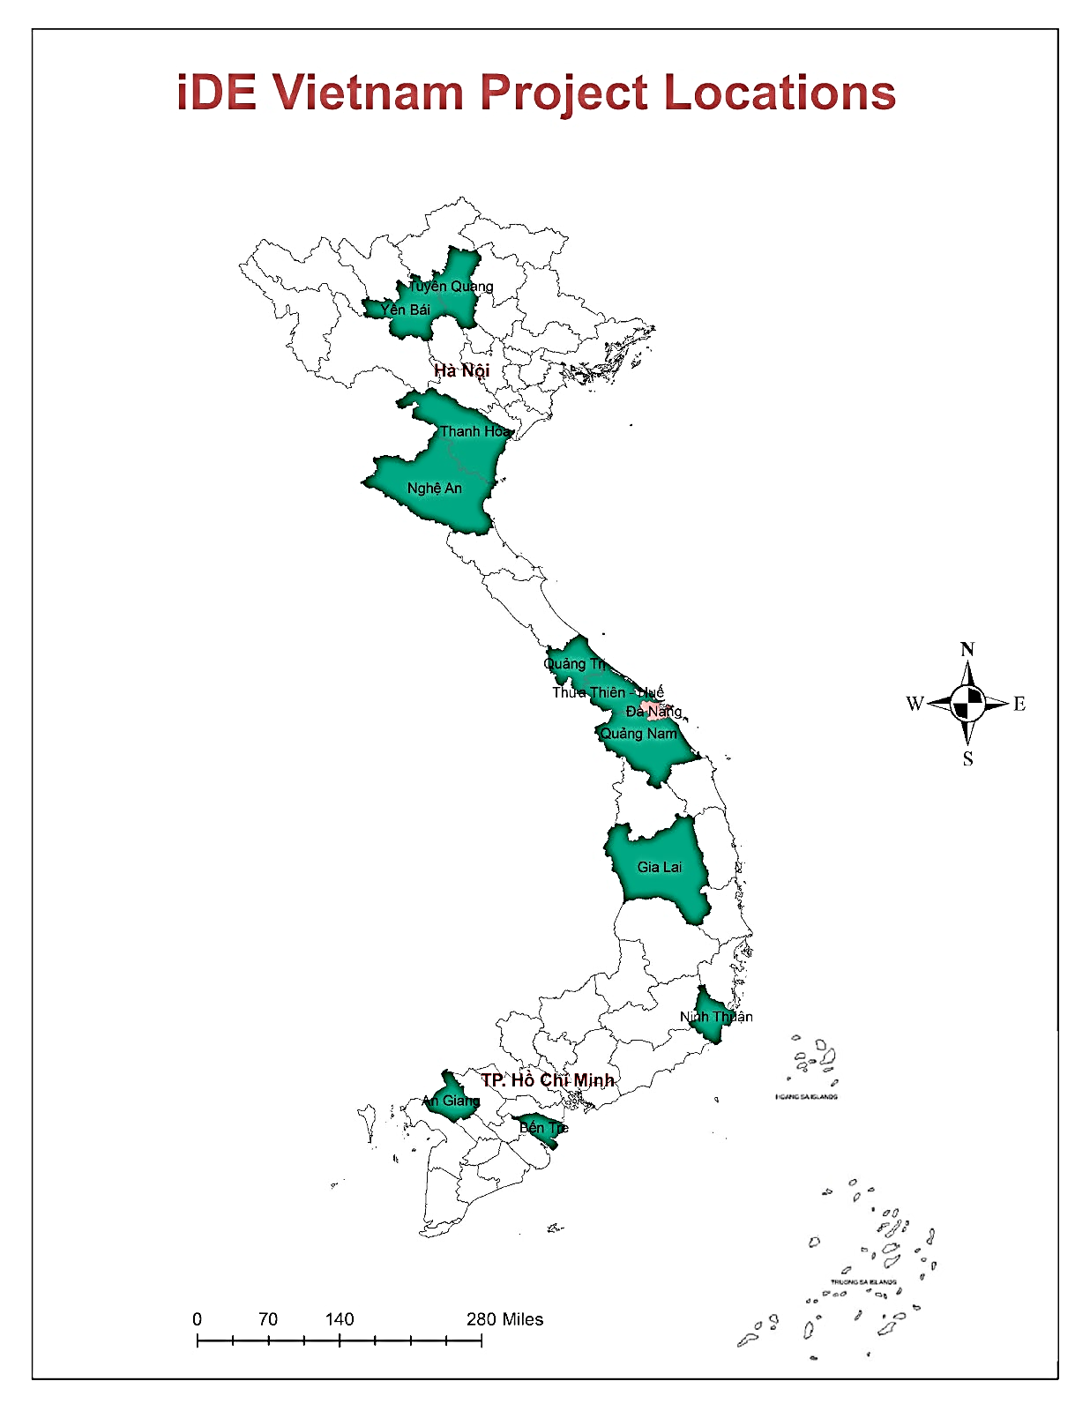












iDE Vietnam at a Glance
Our Past and Current Donors
In Brief
Started Operations: 1991
Head Office: 1, Field Office: 1
Programs: AG, WASH, Circular Economy
Long-term Partnership:
Circular Economy
Agriculture & WASH Innovation
Head Office
Field Office
Notes:
Build

Slide 4
Introduction to GIS

Slide 5
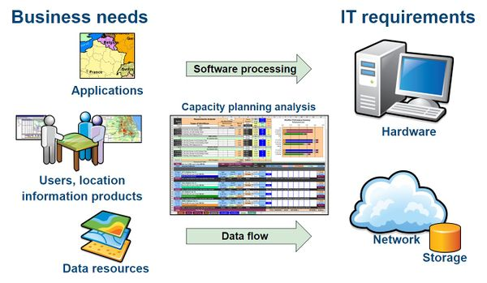
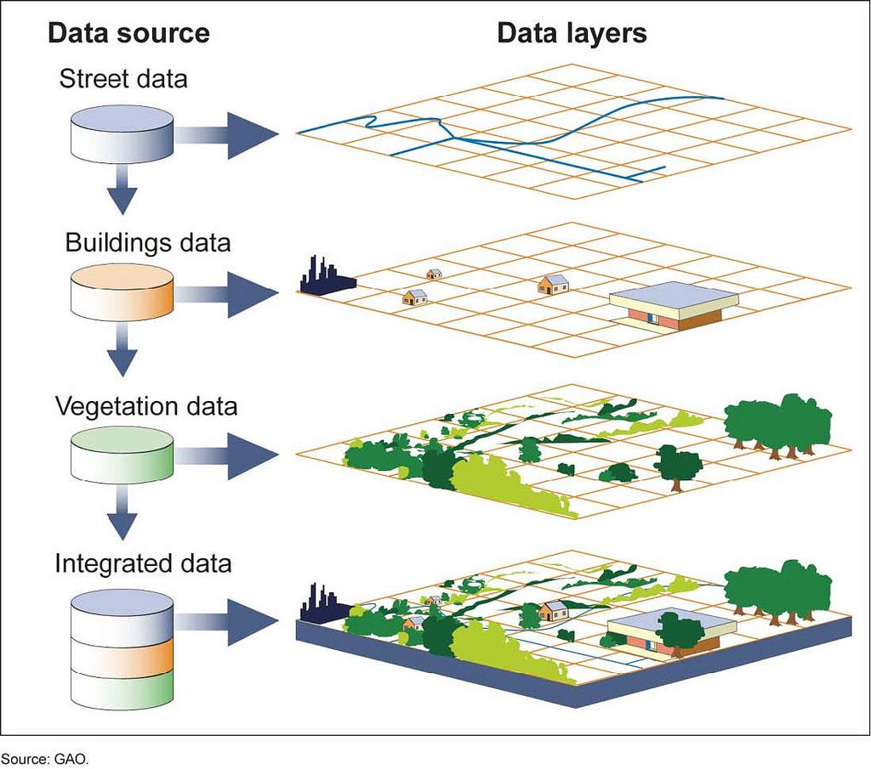
Introduction to GIS
A geographic information system (GIS) integrates five key components:
Hardware: The computer systems, technical equipment and networks where GIS operates.
Software: Provides the functions needed to store, analyze and display geographic information.
Data: Vector data & Raster data, image data attribute data (non-spatial).
Methods: Guidelines, specs, procedure and standards for analyzing and applying GIS.
People: Ask questions, choose, collect, analyze the data and interpret results.
GIS creates, manages, analyzes, and maps all types of data to help:
Connect data to a map, integrating location data (where things are) with all types of descriptive information (what things are like there).
Provide a foundation for mapping and analysis that make geographic information, patterns and relationships easy to understand.
Improve communication and efficiency as well as better management and decision making.

Slide 6
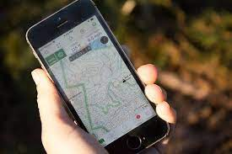
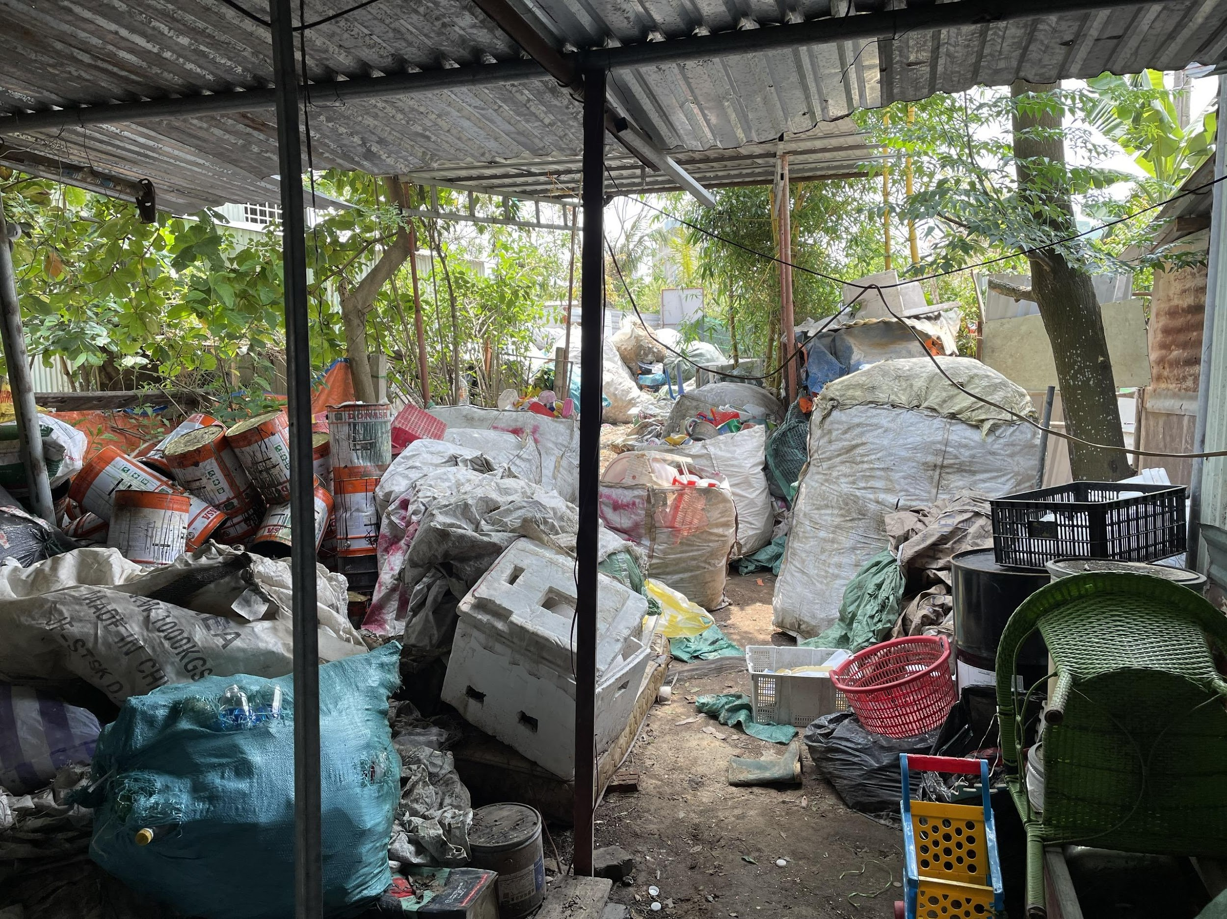
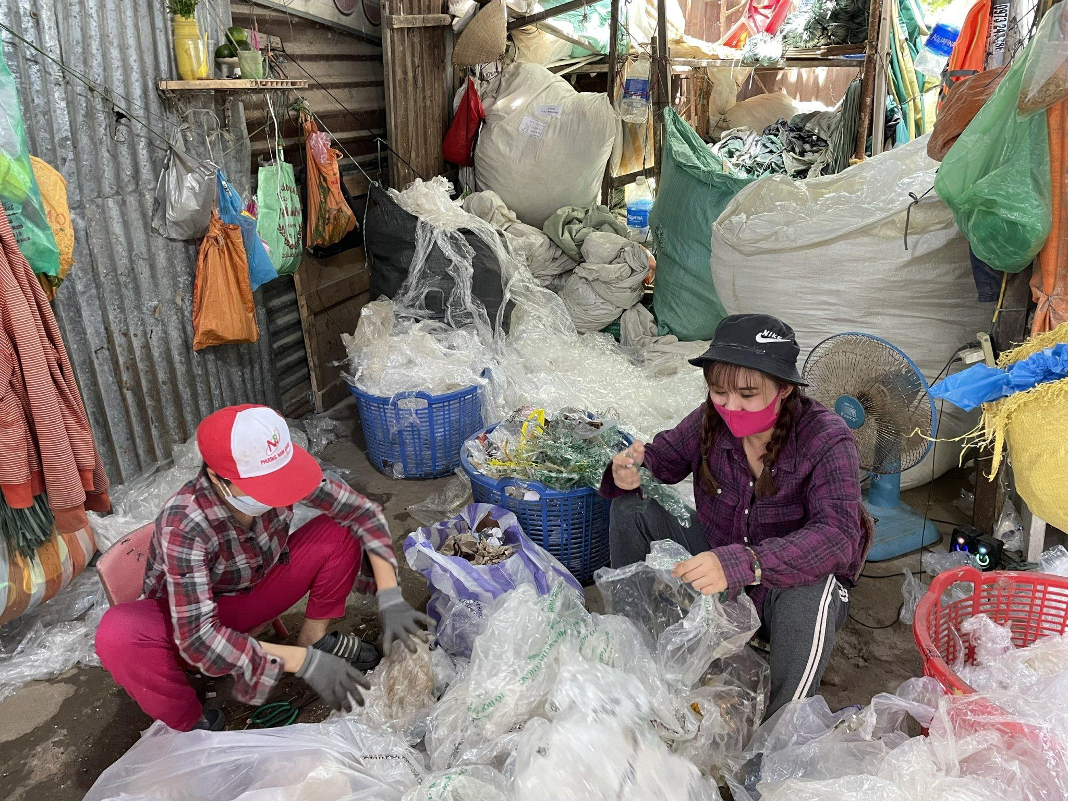

Introduction to GIS
How GIS works
Request
Acquire
Examined
Analyze
Act
What is the problem you are trying to solve or analyze, and where is it located?
Then you need to find the data needed to complete your project.
You will surely not know that your data is appropriate for your study after having thoroughly examined it.
Employ analytical tools within GIS to study spatial relationships, patterns, and trends in the data.
The results of your analysis can be shared through reports, maps, tables delivered in print or digitally over a network or on the Web.

Slide 7
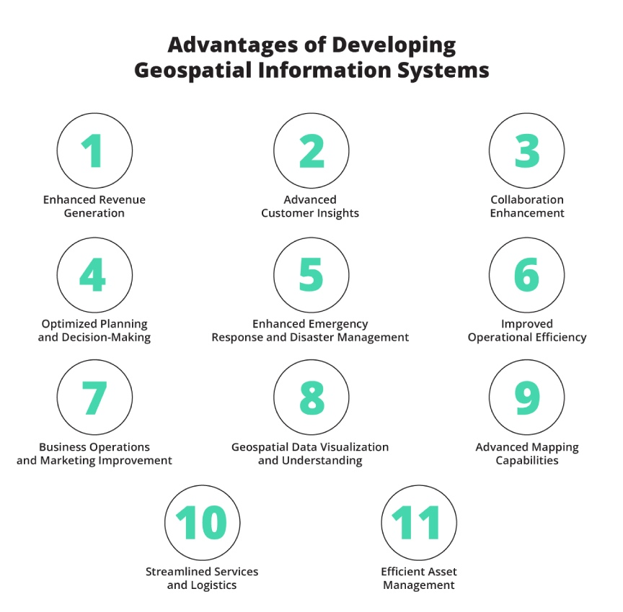
GIS in Development Works
Planning & Decision-Making: Supports infrastructure planning, resource allocation, and urban management.
Disaster Risk Reduction: Identifies vulnerable areas and enhances early warning systems.
Environmental Monitoring: Tracks deforestation, land use change, and natural resource degradation.
Public Health & Education: Maps disease outbreaks, health service access, and school coverage.
Agricultural & Rural Development: Assists in land suitability analysis, crop monitoring, and irrigation planning.
Community Participation: Empowers local communities through participatory mapping and inclusive data use
GIS, or Geographic Information Systems, plays a crucial role in various development-related fields. It helps with spatial analysis, data visualization, and decision-making in areas like urban planning, infrastructure development, environmental management, and social development.

Slide 8
iGIS – What is it?

Slide 9

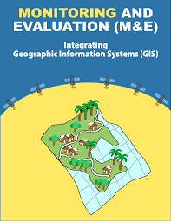
What is iGIS?
GIS is a technical system used for collecting, storing, analyzing, and visualizing spatial data. It provides a platform for processing geographic information and supports decision-making in various fields.
iGIS (Integrated GIS) emphasizes the integration of GIS into specific processes, such as Monitoring and Evaluation (M&E). Instead of using GIS as a standalone technical tool, iGIS incorporates it into M&E systems to enhance data analysis, planning, and decision-making.
GIS is a system, while iGIS refers to an integrated approach, where GIS is embedded into specific activities to optimize processes and increase practical application value. The core idea behind iGIS is not just the use of GIS as a tool but its strategic integration into M&E to enhance data-driven decision-making. By emphasizing the 'i’ in iGIS, we highlight its role in embedding GIS functionalities directly into project workflows, ensuring that spatial data actively contributes to planning, analysis, and evaluation.

Slide 10
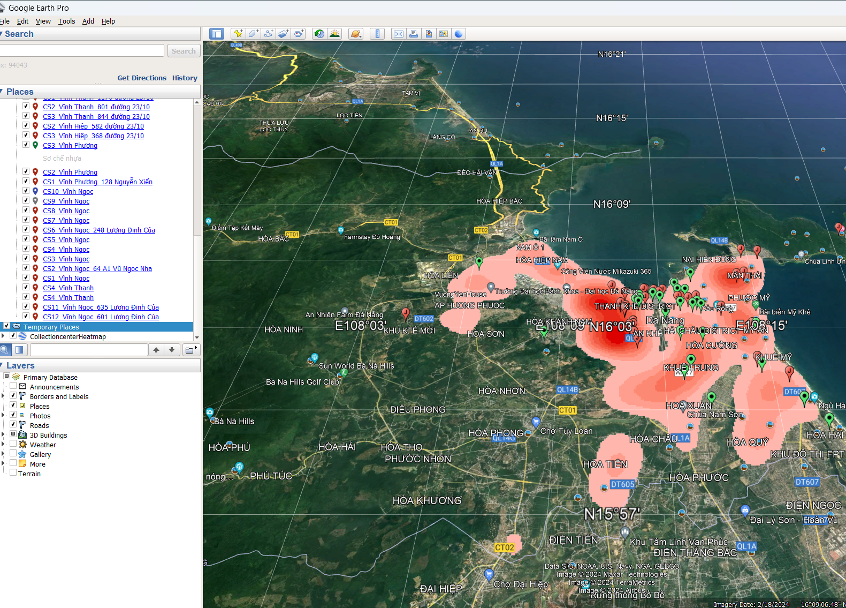
How can iGIS be used in M&E?
Here we focus on GIS applications used in monitoring and evaluation. These applications are useful both for a project implementation team, as well as MERL staff providing technical support and advice to a project.
Improving monitoring and reporting
Measuring indicators accurately
Tracking activities
Planning field visits
Revising targets and results
Updating project area maps
01
Enhancing project effectiveness
Targeting
Planning activities
Understanding the logic of interventions
Innovation.
Mitigating risks
02
Assessing impacts
Impact assessments
Environmental and climate assessments
Thematic assessments
Change detection
03
Communication
04
Maps help to visualize plans and results. The extent of activities within a project area can be showcased to relevant government ministries, donors and project beneficiaries.
Notes:
Discuss the role of GIS in Monitoring, Evaluation, Research, and Learning (MERL).
Highlight how GIS can help in making better informed decisions.

Slide 11
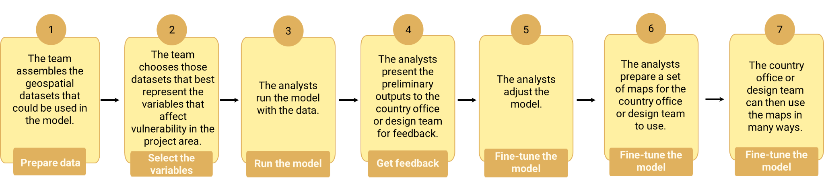
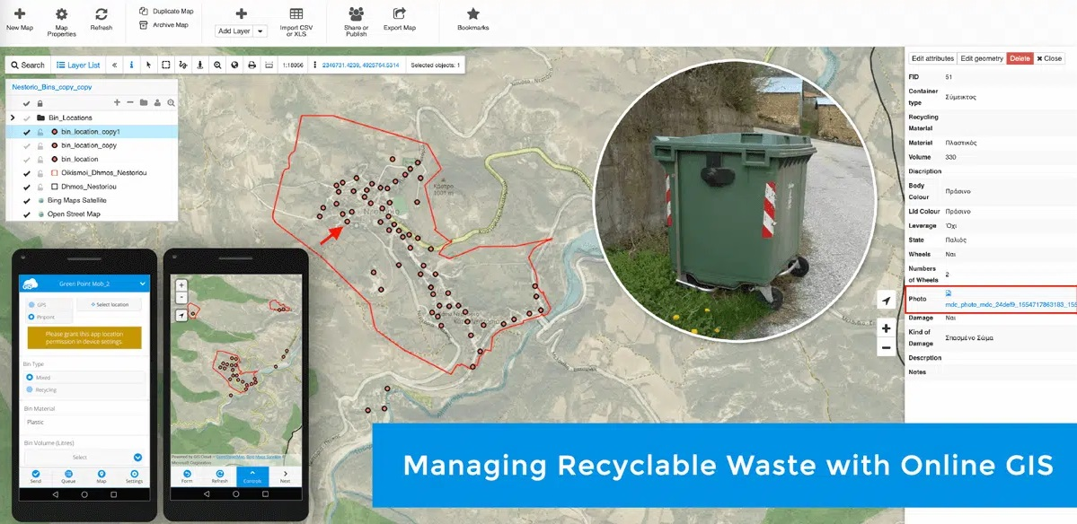
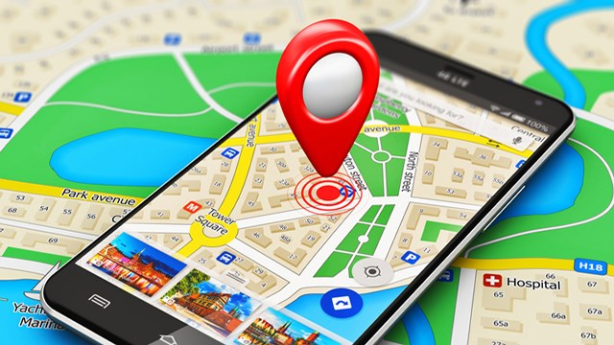
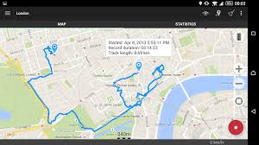
How it work? 7 steps
Here we focus on iGIS applications used in monitoring and evaluation. These applications are useful both for a project implementation team, as well as MERL staff providing technical support and advice to a project.
Notes:
1. Prepare data. The team assembles the geospatial datasets that could be used in the model.
2. Select the variables. The team chooses those datasets that best represent the variables that affect vulnerability in the project area.
3. Run the model. The analysts run the model with the data.
4. Get feedback. The analysts present the preliminary outputs to the country office or design team for feedback.
5. Fine-tune the model. The analysts adjust the model.
6. Visualize the results. The analysts prepare a set of maps for the country office or design team to use.
7. Use the maps. The country office or design team can then use the maps in many ways.

Slide 12
How can iGIS be used in M&E?
Minimum requirements for a development project to map investment sites
Area | Requirements
Expertise | One GIS expert to support the monitoring and evaluation team Field staff trained to collect GIS data
Procedures | Operational guidelines explaining what data is collected, how it is collected, reviewed, stored and used
Standards | Metadata (rules that describe data) Format: shapefile vector format Attribute table: standard fields for each indicator to record type of activity, status of activity or date of completion
Indicators | Indicators of the logical framework measured with GIS, e.g.: Rural roads constructed or rehabilitated Irrigated farmland Land area under improved management Infrastructure such as markets, processing and storage facilities Rural institutions and businesses
Data collection | Georeferenced surveys of households, businesses/producer organizations, and communities As part of regular monitoring and evaluation activities Standalone mapping missions e.g. of farmland and roads Service providers
Software | In most cases a combination of different programmes to: Collect data (such as KoBo Toolbox or Survey Solutions) Data-handling software (such as QGIS or ArcGIS) GIS platform to store and visualize data
Hardware | Smartphones GPS devices (e.g. a medium-sized project might require 20 to 30 GPS devices) Drones (if necessary)
Reporting | Reporting to the donor or related to stakeholders
Notes:
Discuss the role of GIS in Monitoring, Evaluation, Research, and Learning (MERL).
Highlight how GIS can help in making better informed decisions.

Slide 13
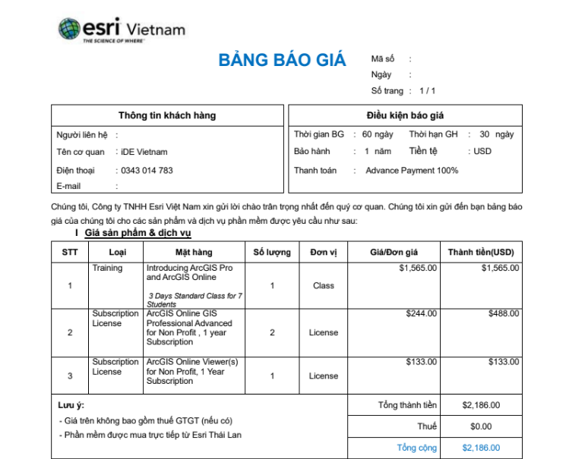
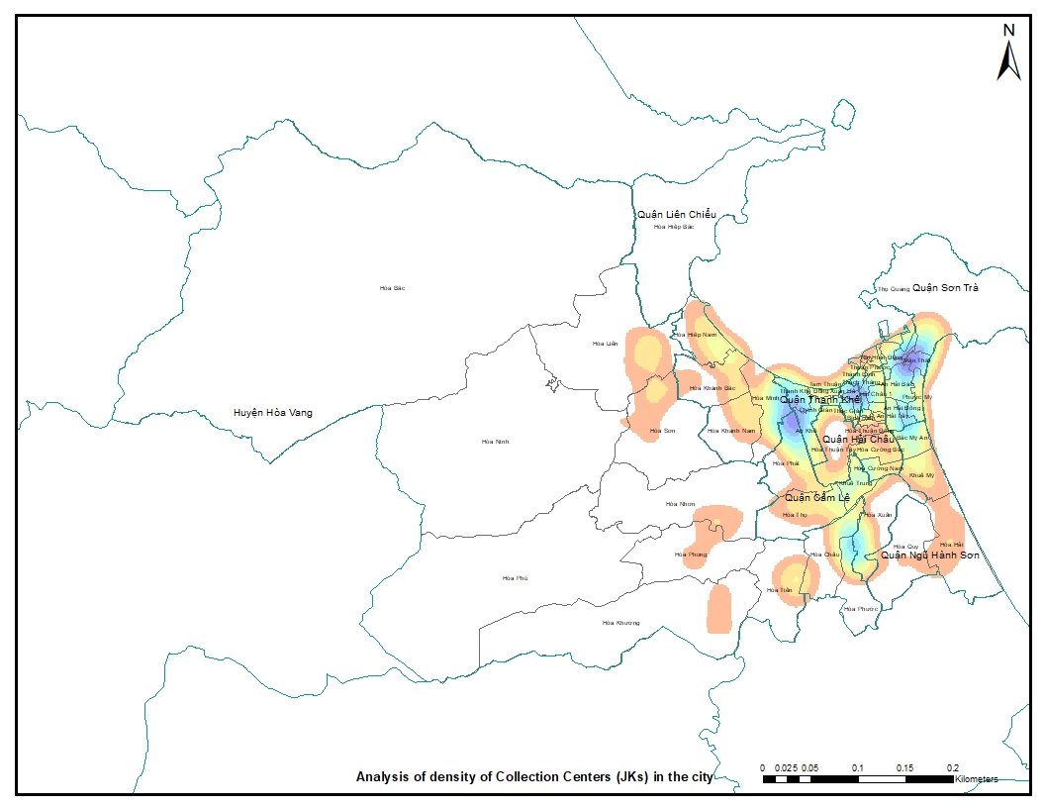
Software: What are the costs?
Various software applications are available. The table below shows the comparison of commonly used GIS software:
The estimated costs should be part of the project’s MERL or implementation budget. Consider the following cost items:
 | QGIS | ArcGIS | Google Earth Pro
Level of GIS expertise | High | High | Low
Data management | Advanced | Advanced | Challenging
Data analysis | Advanced | Advanced | Basic
Licence fees | No | Yes | No
Map creation | Yes | Yes | No
Visualization | Plugins available | Basemaps provided | Set of high-resolution data available
GIS equipment: This includes smartphones, tablets, GPS devices, or
simple GPS trackers.
Software license: it is estimated that between US$621 and
US$2,200 is typically needed per year to support GIS data collection
activities, and about twice these amounts for very large projects.
Training on GIS: Training may be needed for staff on new software
Packages.
Surveys: The costs of travel and accommodation for data collection
missions need to be factored in.
Software interface of ArcGIS: Visualizing the density of collection centers (JKs) in Danang
Quotation of 1 year subscription license for ArcGIS
Notes:
Choosing the Right GIS Software
Discuss the top GIS software packages the industry is adopting.
Highlight the factors to consider when choosing a GIS software.

Slide 14
iGIS case study

Slide 15
iGIS in Plastic with Purpose (PwP) Project: A case study
Implemented | Product
Expertise | Trained and improved our GIS expertise; shared with iDE Vietnam Piloted iGIS into existing projects (plastic & agriculture)
Procedures | Set up the iGIS procedure. Developed the guideline and tools for further uses.
Standards | Data standard and hardware
Indicators | Missed. It is still find the ways to set up the indicators for future projects. Developing list of reference indicators.
Data collection | With PwP (and Glimer project is progressing) Collection points (Junk shops) - 237 Municipal collection points - 353 Illegal dumpsite - 383 Mini-MRF - 11 Municipal transfer station - 1 Aggregators - 1
Software | QGIS (free) and ArcGIS (need a license)
Hardware | 2 laptop and 4 tablets
Reporting | Mapping and data share
Notes:
Choosing the Right GIS Software
Discuss the top GIS software packages the industry is adopting.
Highlight the factors to consider when choosing a GIS software.

Slide 16
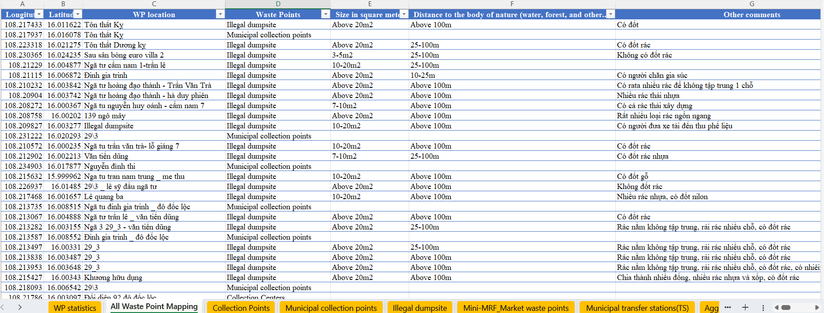
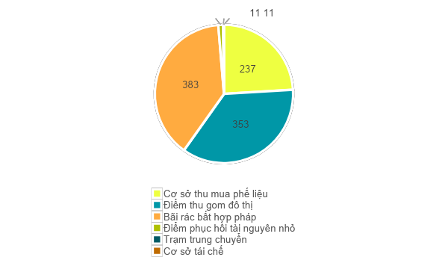
iGIS in PwP Project: Some results
Data Frame and attribute
Type of point | No of points | %
Collection points (Junk shops) | 237 | 24.0
Municipal collection points | 353 | 35.8
Illegal dumpsite | 383 | 38.8
Mini-MRF | 11 | 1.1
Municipal transfer station | 1 | 0.1
Aggregators | 1 | 0.1
Total | 986 | 100.0
Notes:
Choosing the Right GIS Software
Discuss the top GIS software packages the industry is adopting.
Highlight the factors to consider when choosing a GIS software.

Slide 17
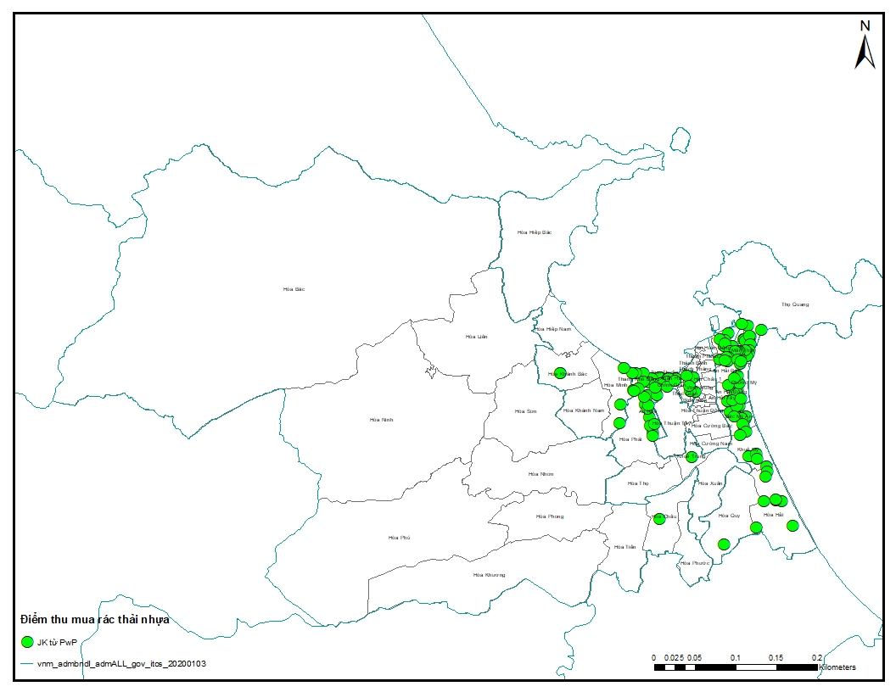
iGIS in PwP Project: Some results for decision making
Visualizing the density of collection centers (JKs) in Danang
Notes:
Choosing the Right GIS Software
Discuss the top GIS software packages the industry is adopting.
Highlight the factors to consider when choosing a GIS software.

Slide 18
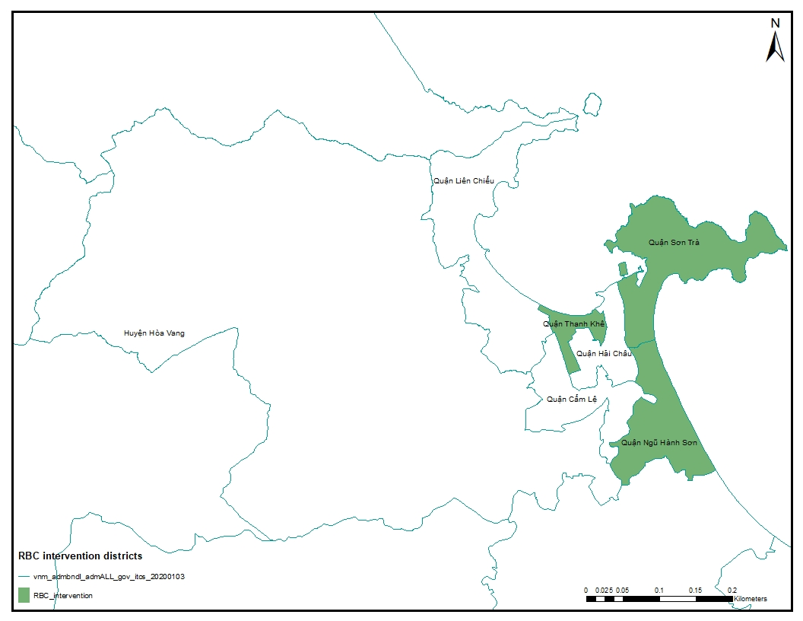
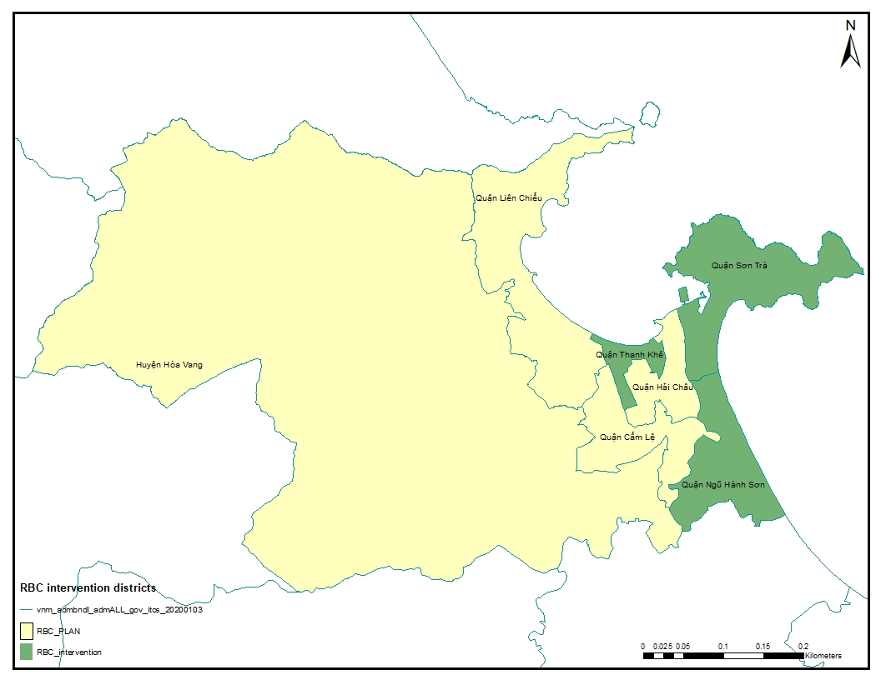
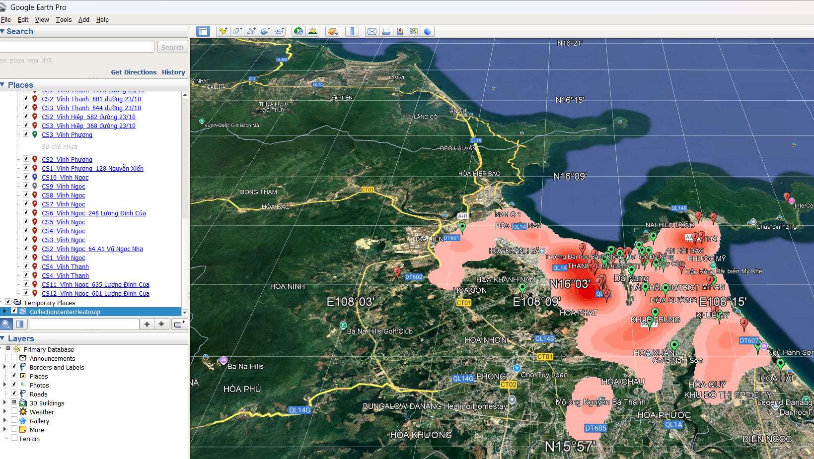
iGIS in PwP Project: Some results for decision making
Notes:
Choosing the Right GIS Software
Discuss the top GIS software packages the industry is adopting.
Highlight the factors to consider when choosing a GIS software.

Slide 19
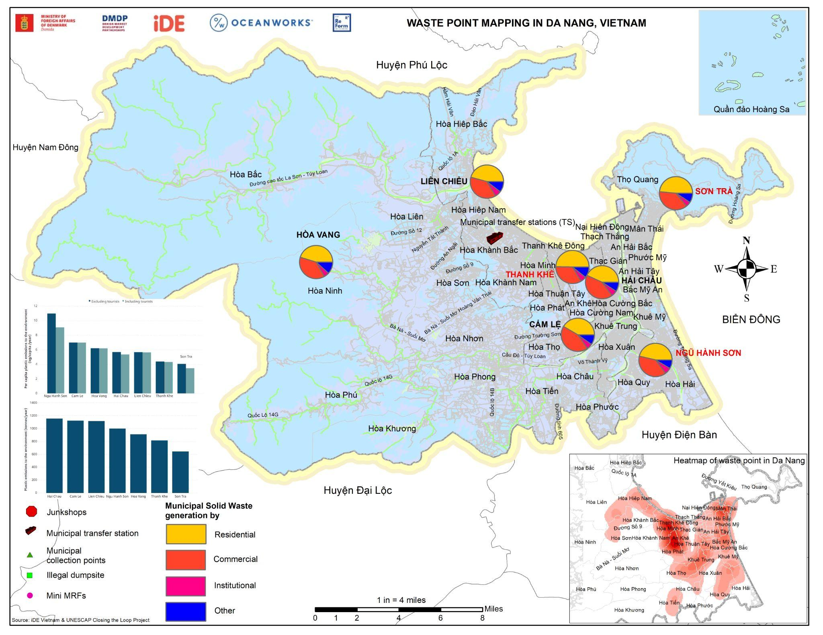
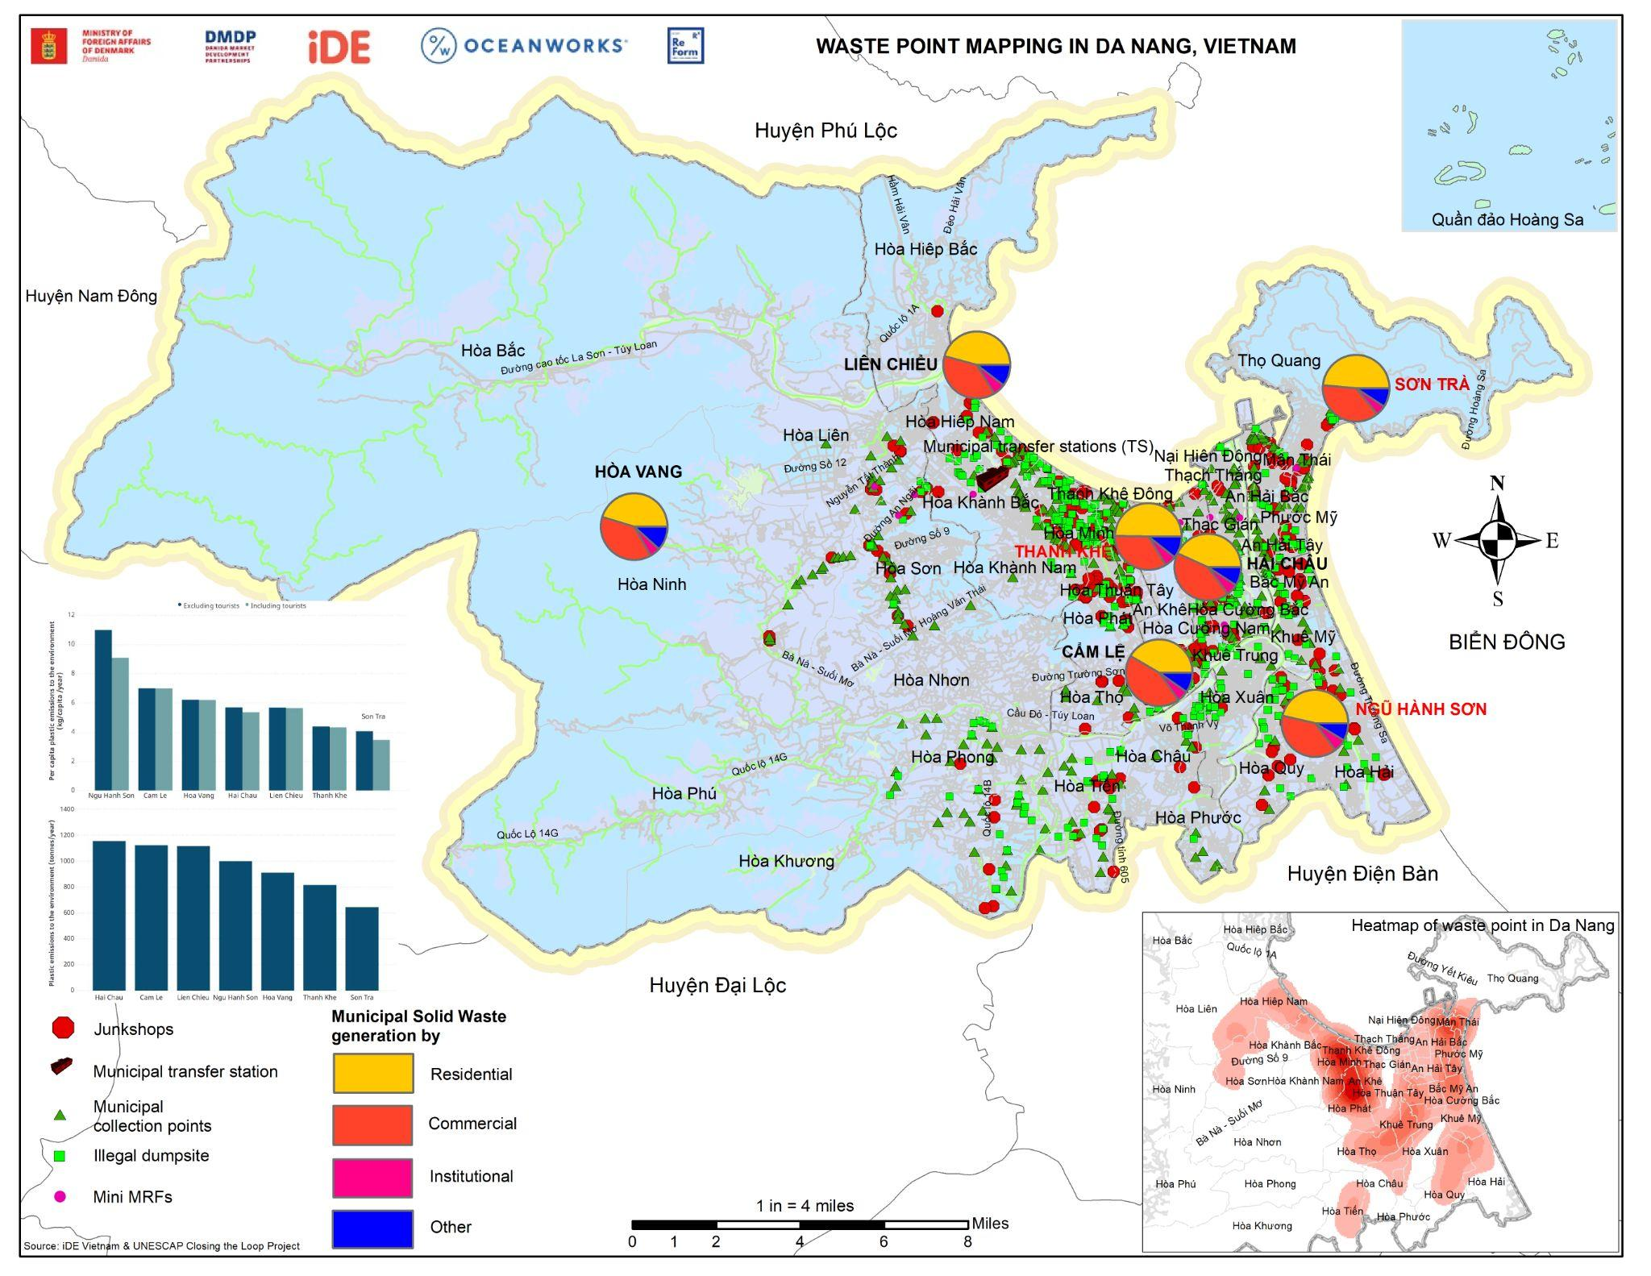
iGIS in PwP Project: Data visualization
Project reporting and visualization
Notes:
Choosing the Right GIS Software
Discuss the top GIS software packages the industry is adopting.
Highlight the factors to consider when choosing a GIS software.

Slide 20
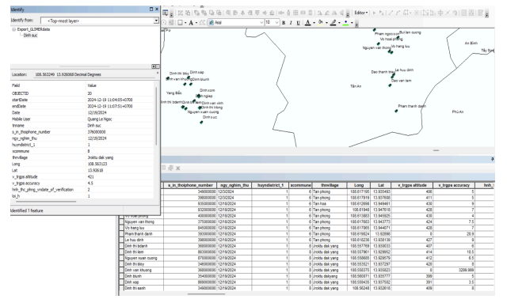
iGIS in GLIMER Project: Data Performance and Validation
iGIS was used to monitor the adoption of smart subsidy programs for households engaged in agriculture under the MIT model. By visualizing the distribution of participating households, project teams could assess regional engagement levels and adjust promotional efforts accordingly. Additionally, iGIS facilitated the initial data analysis for business development, supporting the identification of market trends and informing potential proposals for future interventions.
Notes:
Choosing the Right GIS Software
Discuss the top GIS software packages the industry is adopting.
Highlight the factors to consider when choosing a GIS software.

Slide 21
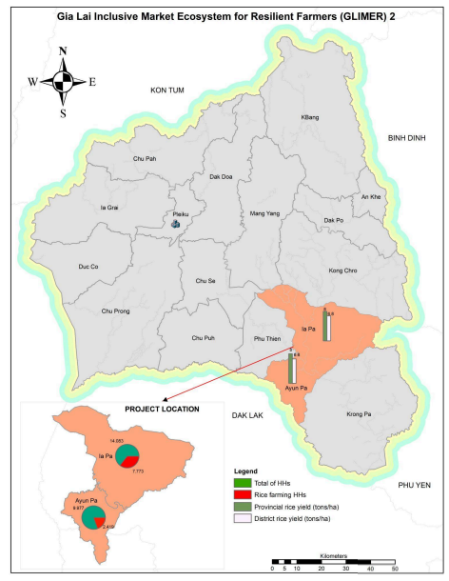
iGIS in Business Development: Data Analysis
Notes:
Choosing the Right GIS Software
Discuss the top GIS software packages the industry is adopting.
Highlight the factors to consider when choosing a GIS software.

Slide 22
iGIS knowledge dissemination and products

Slide 23
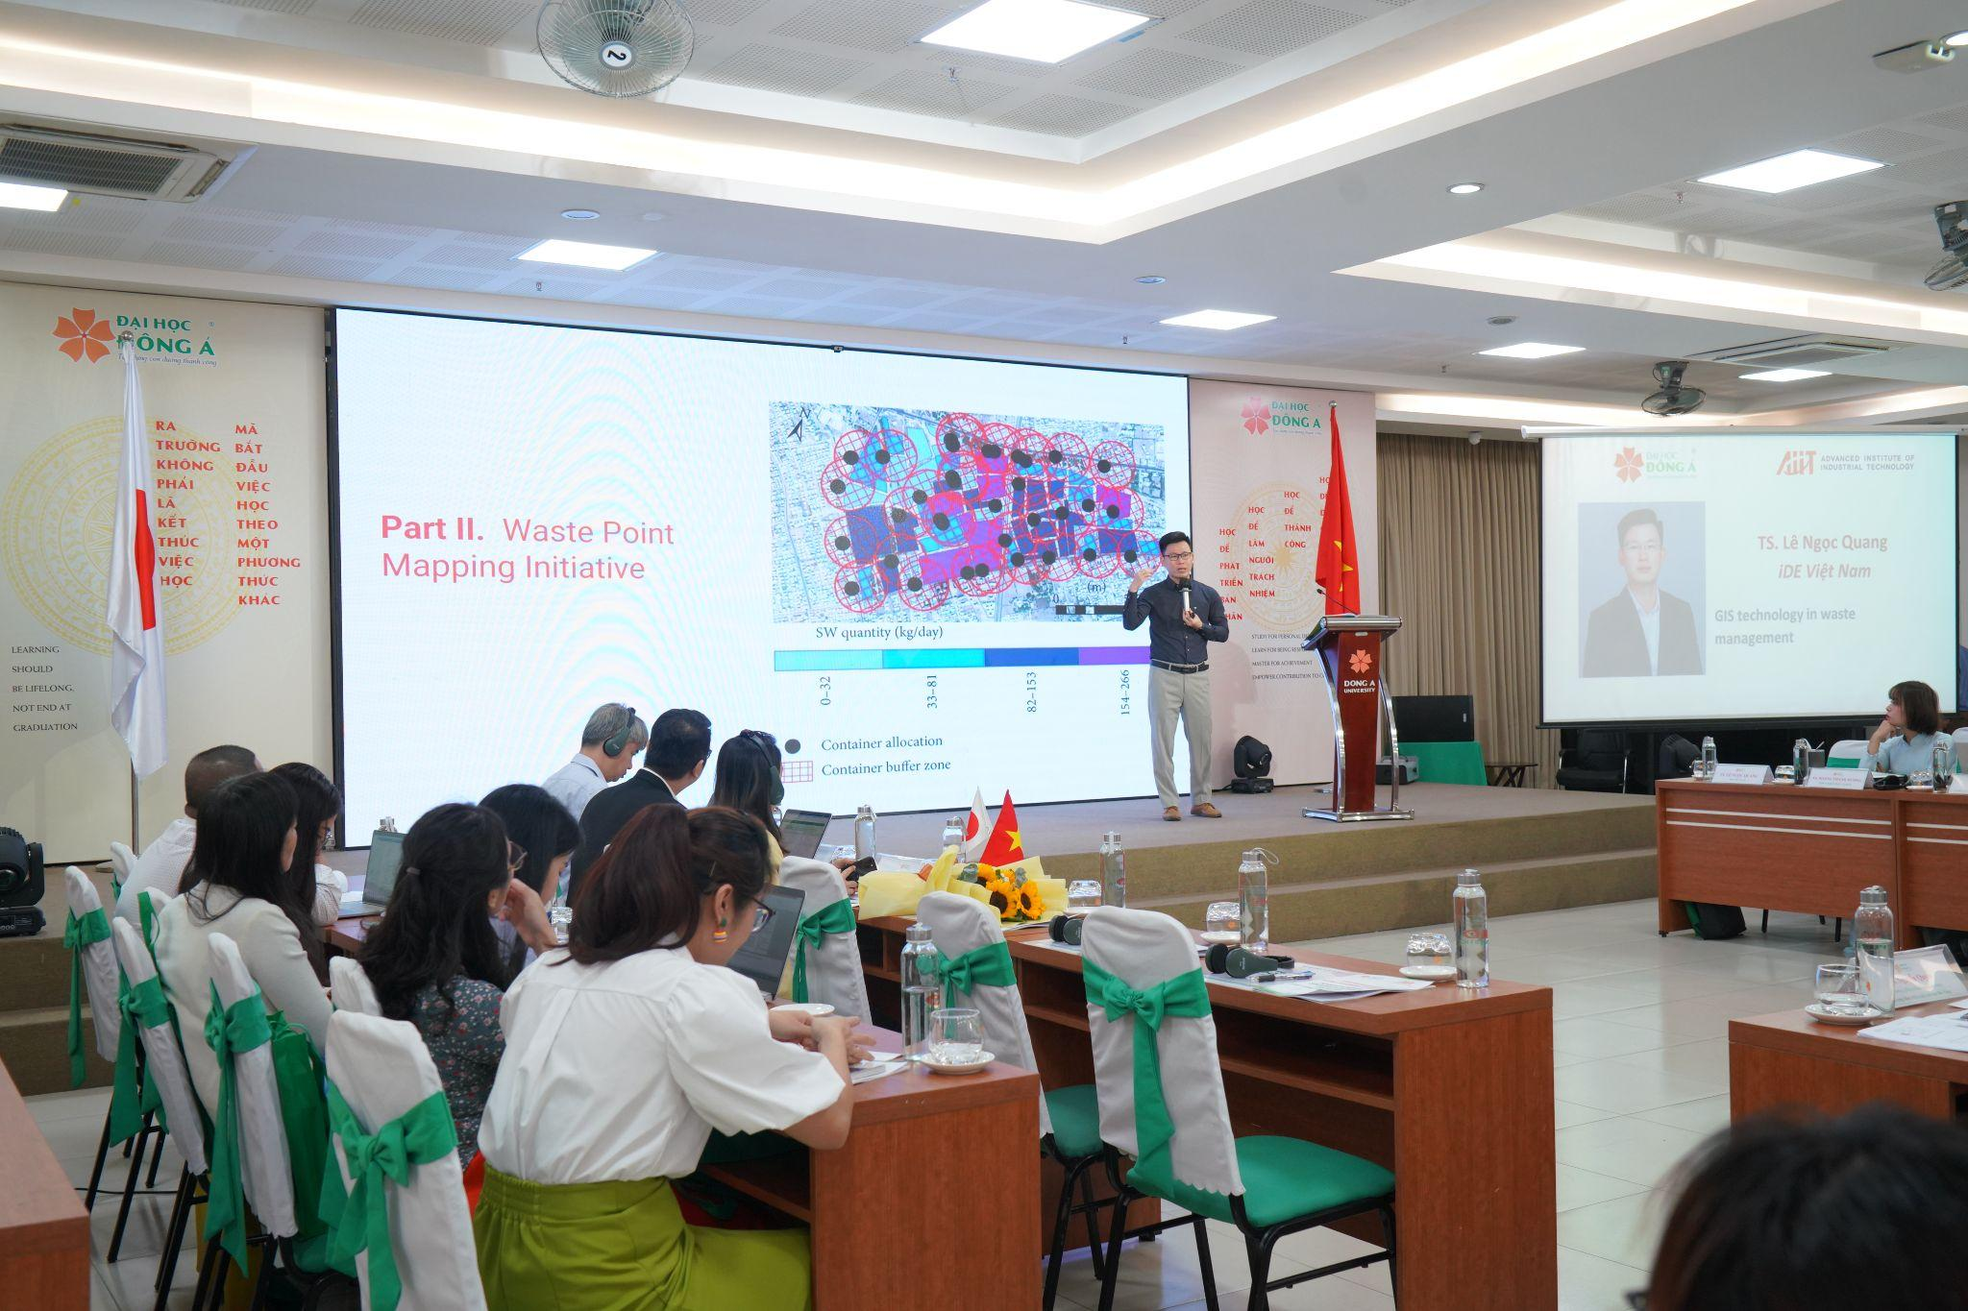
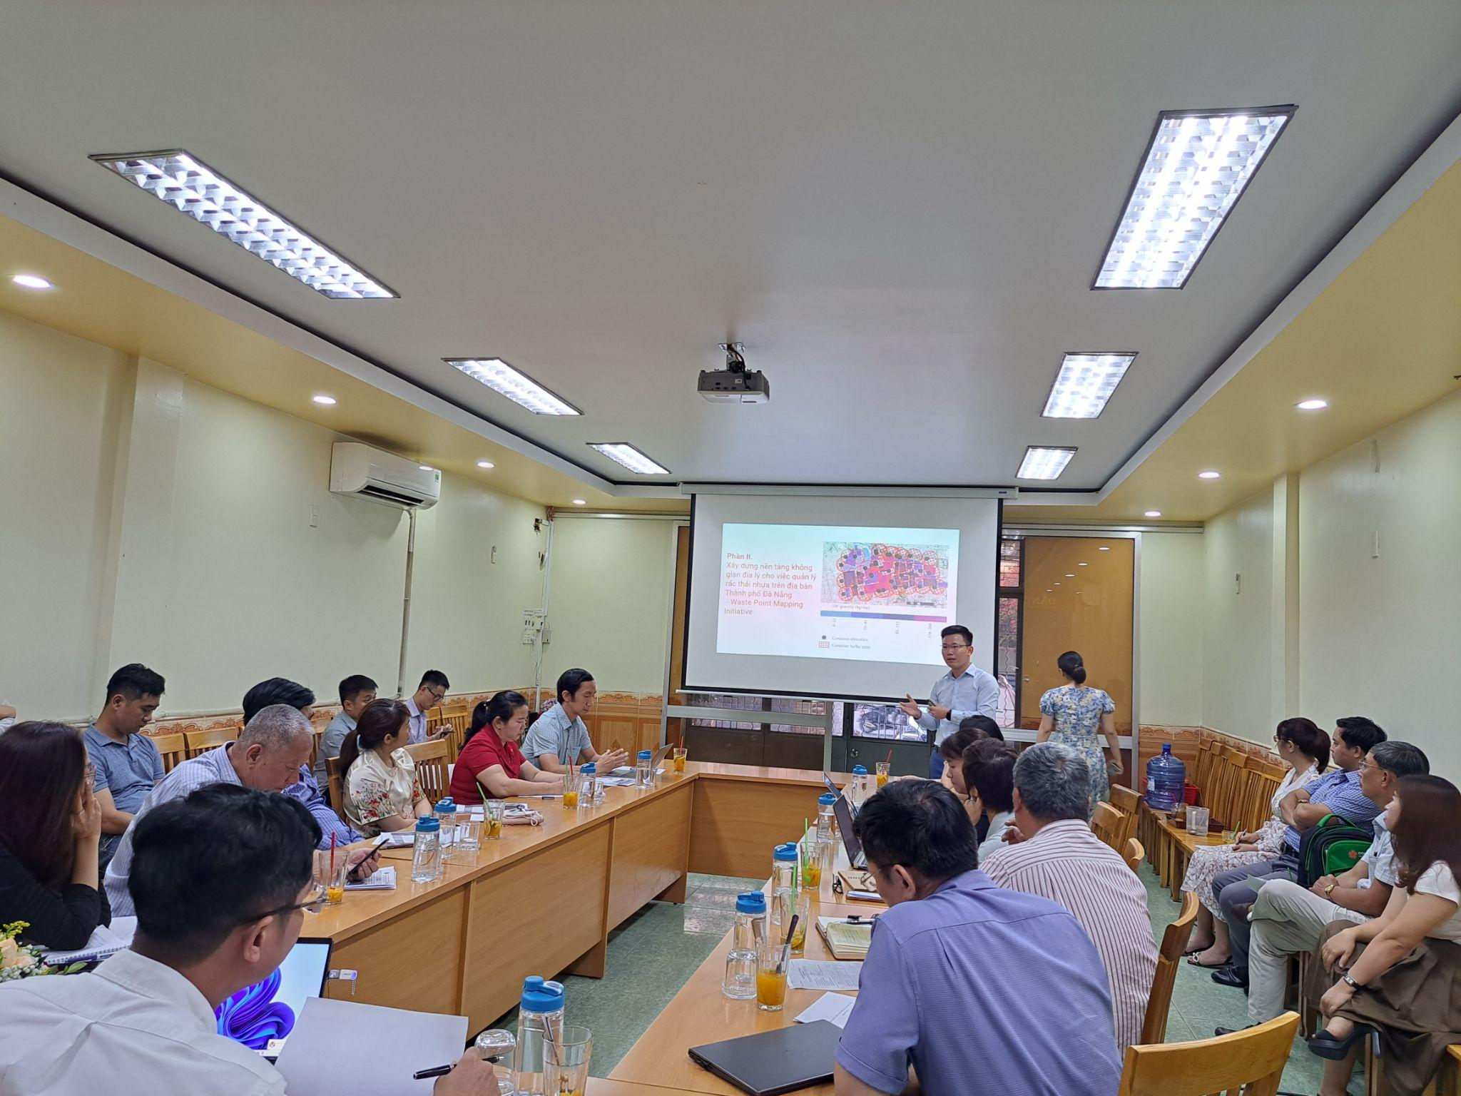
iGIS Knowledge Sharing
WPM initiative
WPM knowledge sharing at international workshop
Notes:
Choosing the Right GIS Software
Discuss the top GIS software packages the industry is adopting.
Highlight the factors to consider when choosing a GIS software.

Slide 24
iGIS Knowledge products
iGIS data attributes
iGIS indicator
iGIS data review checklist
iGIS guideline
iGIS package
iGIS video manual/CoP
Notes:
Choosing the Right GIS Software
Discuss the top GIS software packages the industry is adopting.
Highlight the factors to consider when choosing a GIS software.

Slide 25
Q&A session

Slide 26
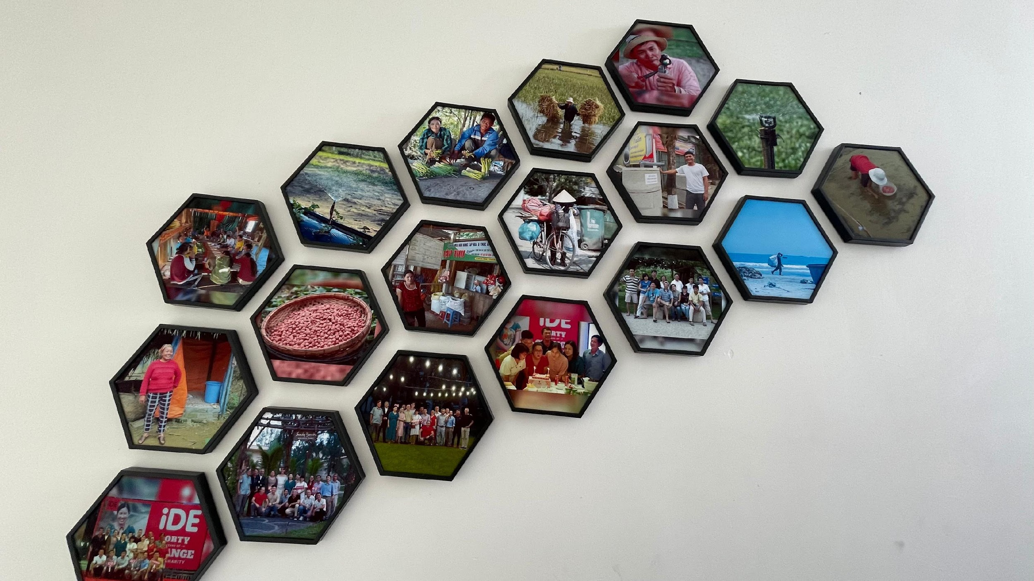






OUR TEAM
Quang Ngoc Le, Ph.D
MERL Manager
+84 343 014 783
lnquang@ideglobal.org
Danang 55000, Vietnam
Hoang Kim Minh
MERL Officer
+84 905 289 745
hkminh@ideglobal.org
Danang 55000, Vietnam
Enumerators
Collect information using digital or paper collection modes that are designed to capture information around a research or evaluation question.

Slide 27

global
evaluation
initiative
Thank you!
www.glocalevalweek.org

