Slide 1


03-06-2025
Measuring Strategic Priorities
Testing a new approach with adoption ladders
Sanne de Boer and Peter Das
www.glocalevalweek.org

Slide 2
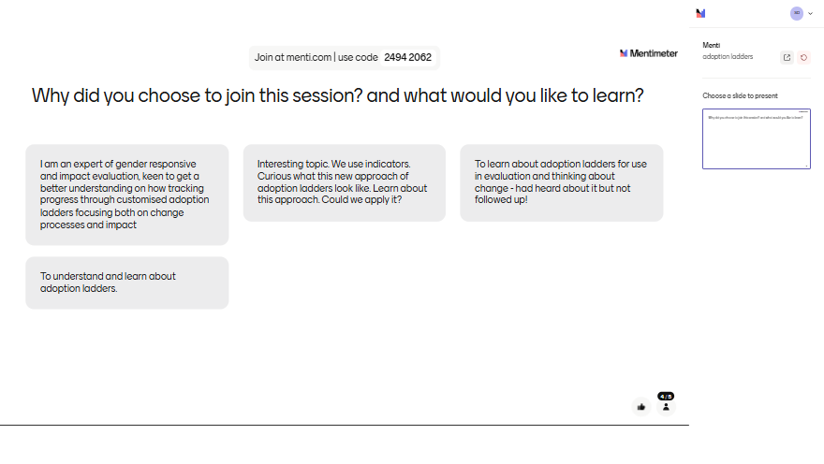

Slide 3

Introduction
Please introduce yourself by sharing:
Your name
Your organisation
Your position in your organisation
www.glocalevalweek.org

Slide 4
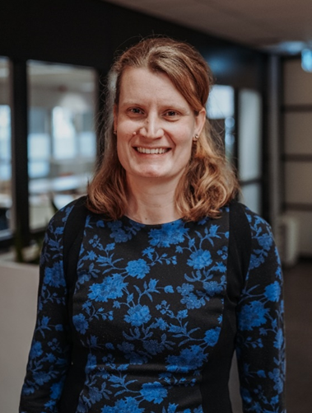

Introductions
  Peter Das: p.das@zoa.ngo
  Sanne de Boer: s.deboer@zoa.ngo
www.glocalevalweek.org
Notes:
peter

Slide 5
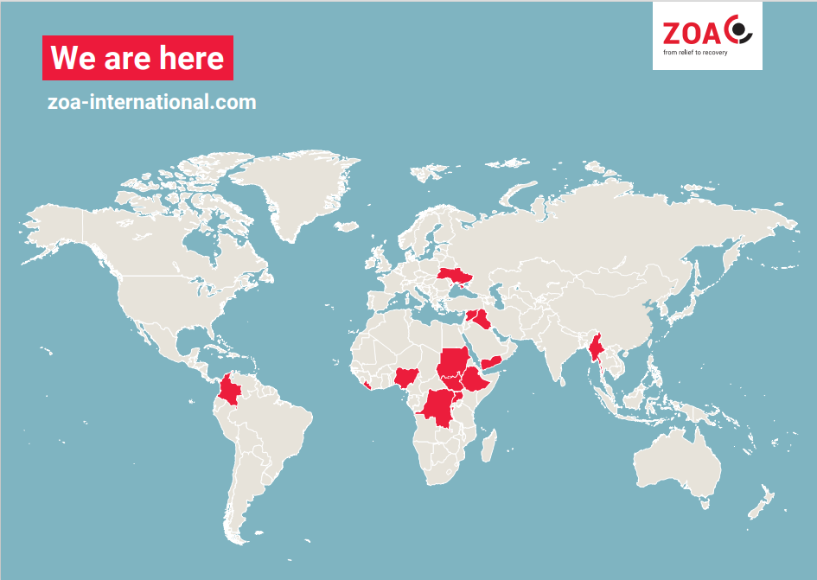
ZOA
www.glocalevalweek.org

Slide 6





ZOA
  From relief to recovery, with a multisectoral approach:
  More information: https://www.zoa-international.com/
www.glocalevalweek.org

Slide 7
Outline
  What prompted us to start using adoption ladders?
  What are adoption ladders?
  What we do with adoption ladders?
  Use of a dashboard based on the adoption ladders
  What do we do to complement the adoption ladders?
  Possible other use cases
www.glocalevalweek.org

Slide 8

What prompted us to start using adoption ladders?
  ZOA’s strategic plan 2023 – 2026:
  Peace Nexus
  Localisation
  Climate Resilience
  Gender, Diversity and Inclusion
www.glocalevalweek.org

Slide 9
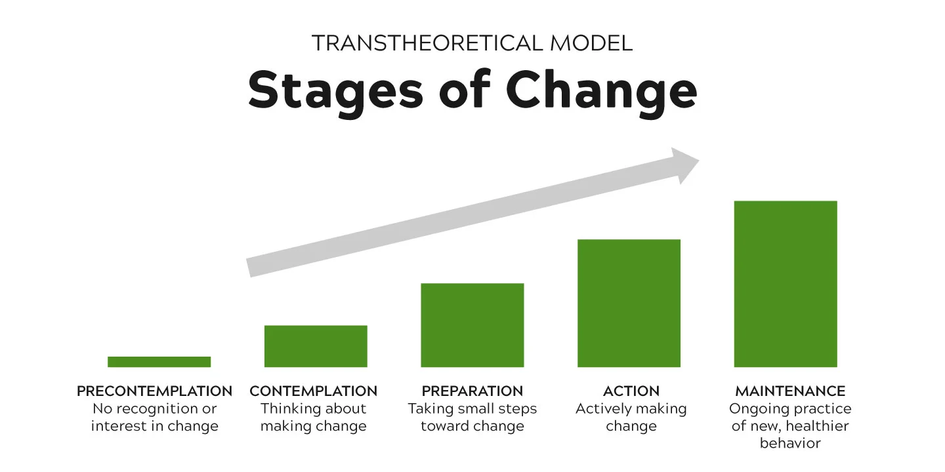
What are adoption ladders
  Transtheoretical model of behaviour change:
  MEAL to measure change
  MEAL to promote change
www.glocalevalweek.org

Slide 10
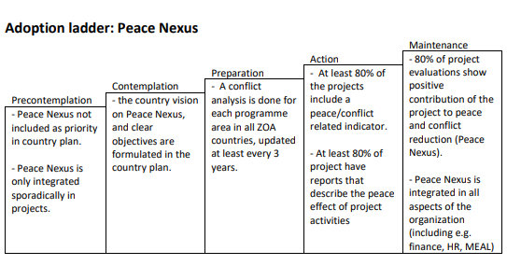
What are adoption ladders
  An example:
www.glocalevalweek.org

Slide 11
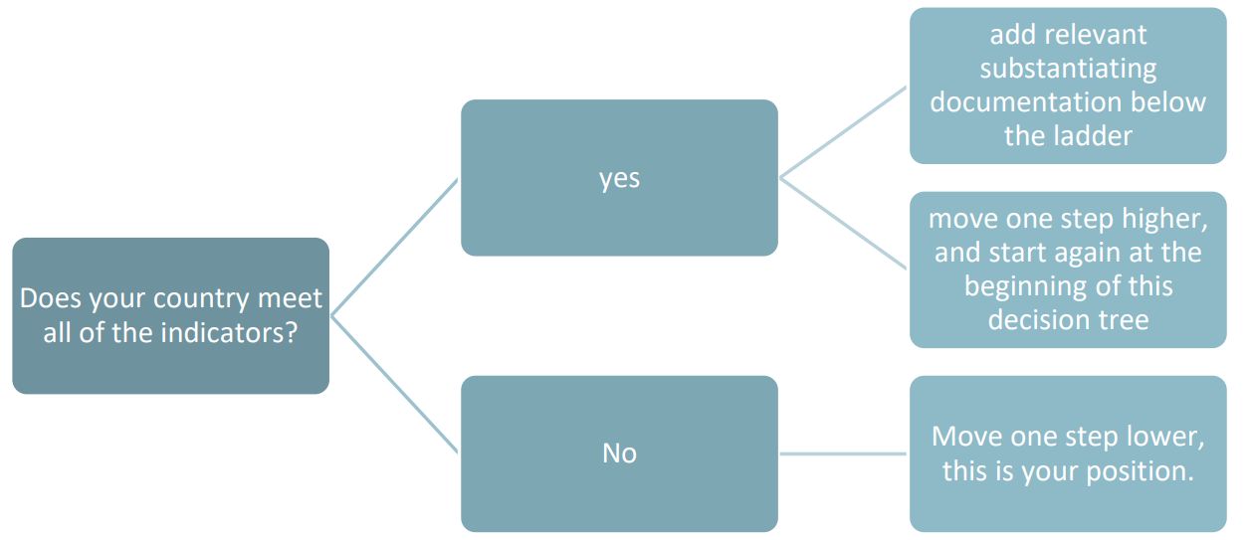
What to do with adoption ladders?
  Evaluate your position
  Develop a strategy to get to the next step

Slide 12
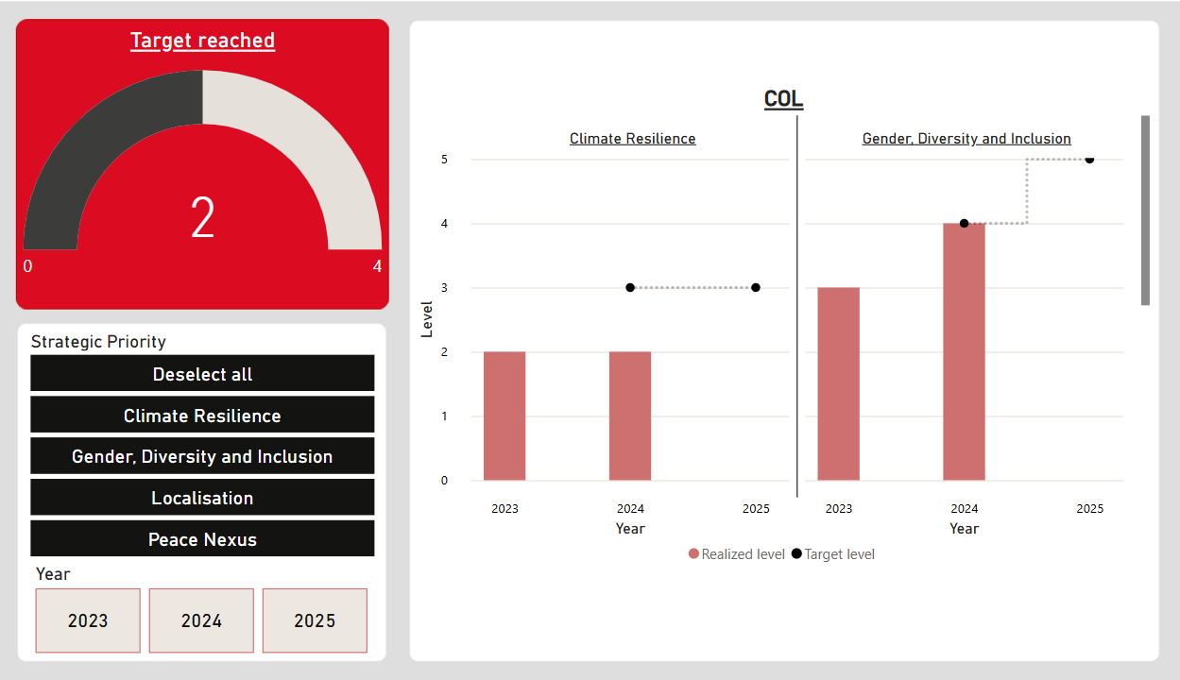
Dashboarding
  Add print screen
www.glocalevalweek.org

Slide 13
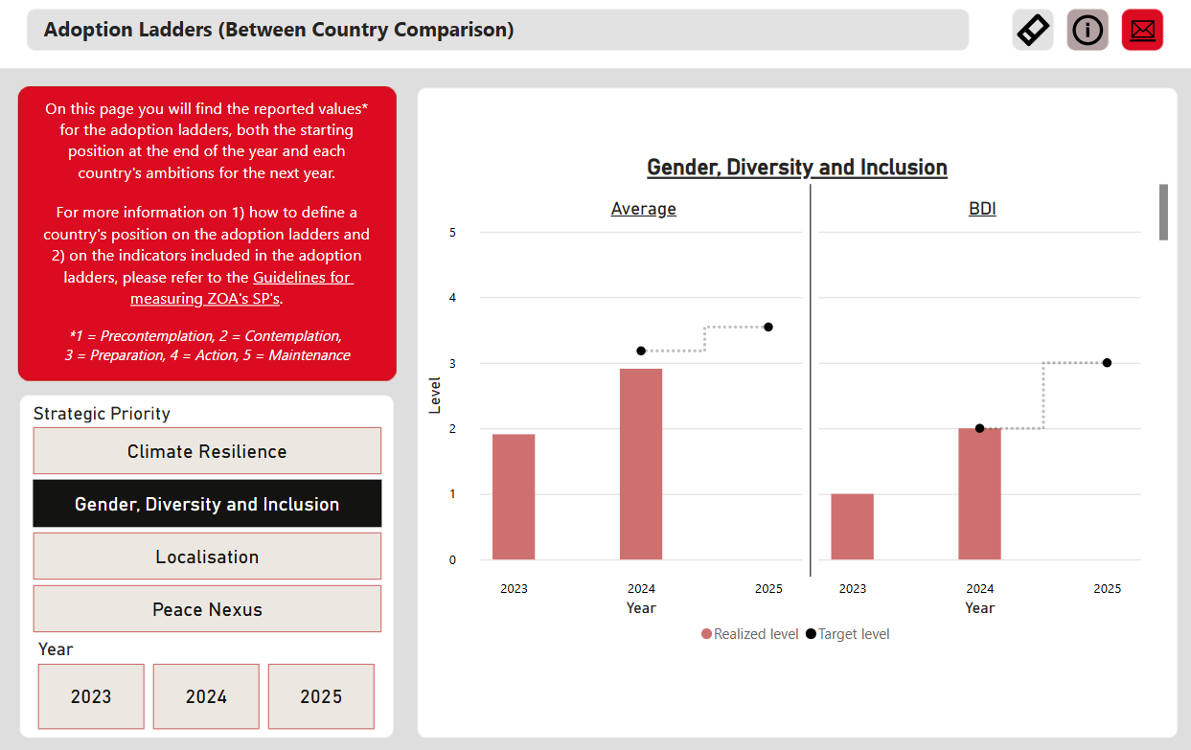
Dashboarding
  Add print screen
www.glocalevalweek.org

Slide 14
Questions?

Slide 15
To complement the adoption ladders we...
Report on quarterly indicators: for steering
E.g. % of current projects that include a peace/conflict related indicator
% of project evaluations that include a question related to Peace Nexus
External evaluation
To assess whether the adoption of the Strategic Priorities leads to results that go beyond implementing the SP-activities.

Slide 16
Group work / plenary discussion
  Based on what was presented about the adoption ladders:
  What are possible other applications of adoption ladders?
  In your situation, what would be advantages and disadvantages of using adoption ladders?
www.glocalevalweek.org

Slide 17
Questions?

Slide 18

global
evaluation
initiative
Thank you!
www.glocalevalweek.org

