Slide 1





Adaptive MEL from Theory to Practice:
A Toolbox
5 June 2025

Slide 2

Session Objectives
Today’s discussion focuses on the following issues:
What is Adaptive MEL and what does it look like in practice?
Why is Adaptive MEL important?
How does Adaptive MEL strengthen locally-led development?

Slide 3
Adaptive MEL in Practice
What is Adaptive MEL?
Principle-based MEL systems and frameworks
Designed to adapt to changing priorities, emerging change, and changes in context without losing sight of the objective of the program and intended outcomes
Brings together a ‘toolbox’ of options to utilise to measure progress, particularly for complex programs and those programs focusing on systems change
Tools need to be able to:
  Continually measure outcomes
  Accommodate reflection and inquiry
  Track emergent change, particularly unexpected/unanticipated change
  Ensure a clear change of evidence of results and contributions

Slide 4
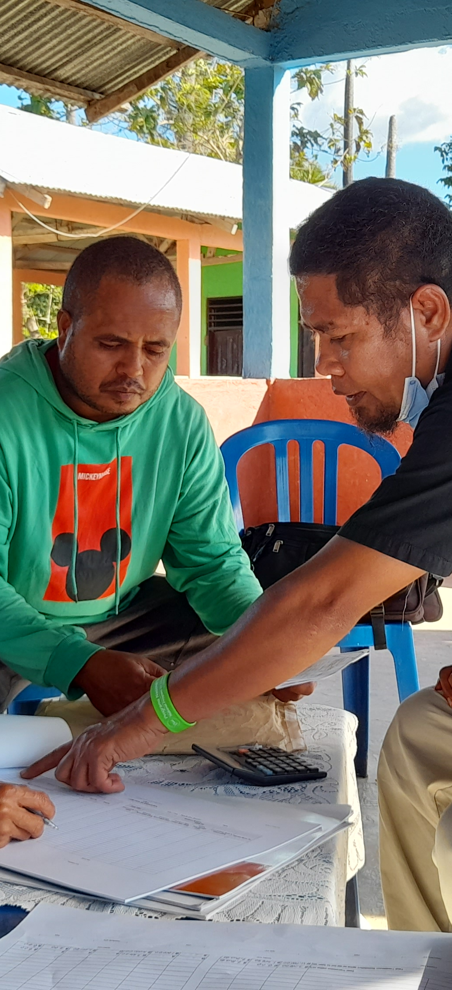
Tools for Adaptive MEL
Have a strong Theory of Change:
  be able to deconstruct the variables of what change looks like vis a vis the program’s intended outcomes. Design indicators using those variables.
  as program implementation progresses, re-evaluate what change might look like based on the changes observed and update indicators as necessary, so that you can continually measure outcomes
  Tools: Theory of Change, Outcome Harvesting, Outcome Rubric

Slide 5
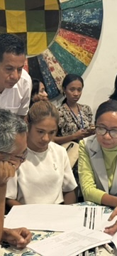
Have measurement tools that can be used for many purposes:
  can be used across different activities, so that you are not creating tools for individual activities, which creates more work as activities change and evolve
  tools should also be able to capture emerging/unexpected/unanticipated change
  Tools: training forms that capture knowledge transfer / use; meeting minutes and notes to file to capture observations in stakeholder commitments/behaviour change, etc.; quantitative data
  Have tools that accommodate reflection and inquiry:
    capture nuance and ‘intangible’ elements of change and emerging pathways
    Tools: Observation Form/Checklist; After Action Review; Internal/Partner Reflection; Quality Assurance Scorecards
.

Slide 6
Adaptive MEL for Complex Development
Why is Adaptive MEL important?
Development programs deal increasingly in complexity
problem-solution strategies are not enough; need be aware of the limitations of linear thinking
work within / support change of complex systems; analytical thinking means understanding change across parts of the system, as well as seeing the whole system and the new parts emerging within it
When a program is complex, its MEL framework needs to be simple and clear: processes, tools, roles, and deliverables
  as change is emergent, adaptive MEL brings a toolbox of tools to the table to respond to emerging needs of a program based on results and ways forward, without constantly changing the MEL framework
  provides a framework to ensure the program doesn’t lose sight of the big picture, but also provide evidence for shifts and adjustments at the strategy, outcome and activity levels

Slide 7
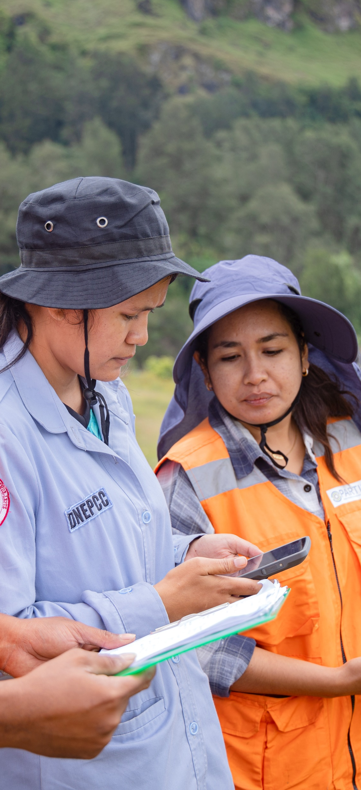
  Complex program necessitate availability different tools for different situations
when context changes and a change in approach is required (thinking/working politically)
when the type of data required to track change shifts as results emerge and activity implementation becomes iteratives
options in situations where access to stakeholders or data availability can be inconsistent
Adaptive MEL frameworks enable development programs to continuously measure change and contribution and maintain a rigorous chain of evidence even as pathways to change and what change looks like shift and adapt to changing context
.

Slide 8
Adaptive MEL for Locally-Led Development
How does Adaptive MEL strengthen locally led development?
Implementation of adaptive MEL is a collective responsibility, not just of program staff but also of stakeholders/partners
measurement is participatory with significant space for reflection
creates space to work out which tools work best not only for the program, but for different stakeholders to ensure their meaningful participation
creates a framework for stakeholders/partners to have a say in what works well, what does not, and what is ‘good enough’

Slide 9
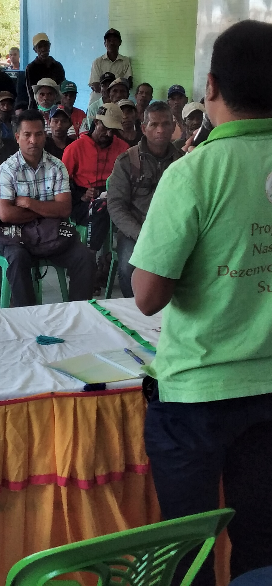
Adaptive MEL creates a framework to re-evaluate what change looks like as a program progresses
reflection and learning mean that stakeholders/partners are part of the process of determining what change looks like as the program progresses and outcomes emerge
Creates a framework for collaborative measurement that enhances equitable partnerships
local evidence is more meaningful for local context and ownership of program implementation and results
.

Slide 10
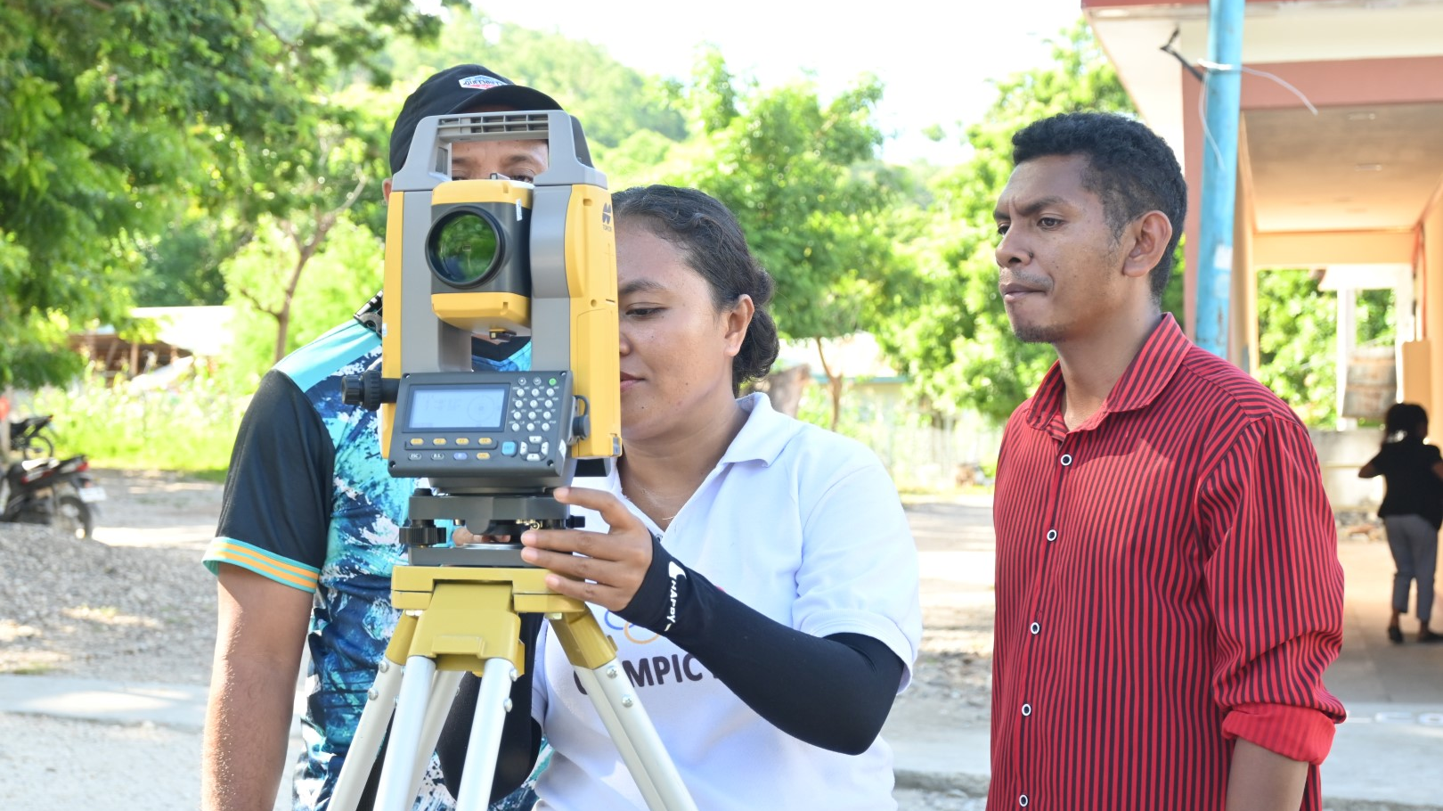
DISCUSSION

Slide 11
Wrap Up
Key take aways
Emerging lessons
Food for thought and ideas to explore

Slide 12

Thank You

