Slide 1


Evaluating for the Better Future: Inclusive and Ethical Practices of Evaluation
Monitoring, Evaluation & Learning Professionals Association
MELPA
Tbilisi, Georgia
Session: SDG Country Reports – New Methodologies and Opportunities for Georgia
Nea-Mari Heinonen
Lead Evaluation Specialist / Deputy Director
Development Evaluation Unit
Ministry for Foreign Affairs of Finland
www.glocalevalweek.org

Slide 2


Nea-Mari Heinonen
Lead Evaluation Specialist / Deputy Director at the
Development Evaluation Unit of the Ministry for Foreign Affairs of Finland
Nea-Mari Heinonen (MSSc; MA) has 15 years of experience in international development policy and cooperation, with specialization in planning, monitoring, evaluation and learning (PMEL).
Working as Lead Evaluation Specialist, she manages external centralized and strategic evaluations commissioned by the independent Development Evaluation Unit of the MFA of Finland. She has developed various tools, guidelines and trainings for increased quality and learning within the Ministry. Nea-Mari is part of various international networks and working groups on development evaluation.
Between 2008–2010 she served in the UNFPA Uganda Country office as an M&E Officer. Furthermore, she has developed results-based management (RBM) and PME frameworks, systems, guidelines and tools for different organizations.

Slide 3
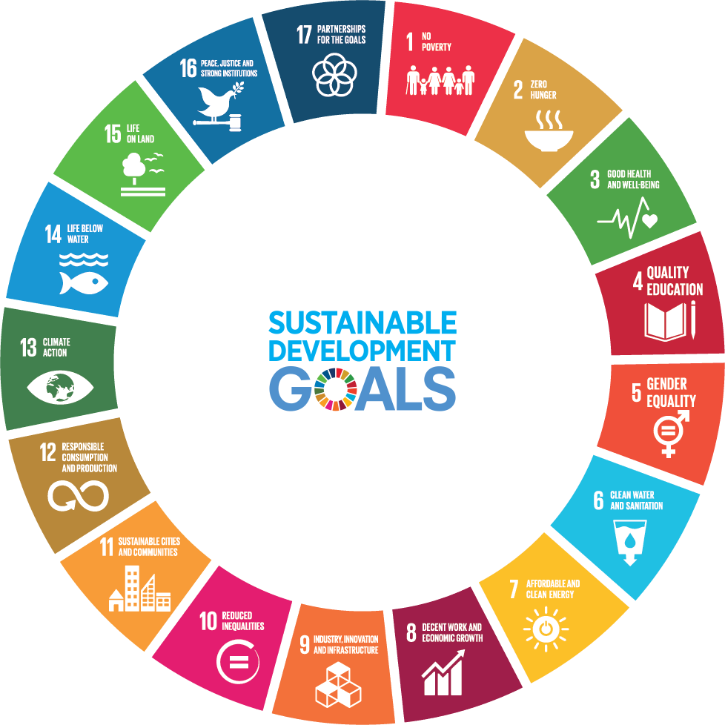
Evaluations of the 2030 Agenda and the SDGs
10 years in, there is a low number of national evaluations of the 2030 Agenda and SDG attainment.
Call to implement the UN GA Resolution 77/283 on “Strengthening VNRs through country-led evaluation”
www.glocalevalweek.org

Slide 4
What does country-led mean?
Evaluations that are managed and used by governments with the participation of broad sectors of society; and usually with the cooperation of development agencies.
Although they are led and managed by governments, these evaluations should be conducted in an inclusive process open to key national stakeholders.
Considering that progress towards the 2030 Agenda is led, managed, and monitored at the national level, its evaluation must also be country-led to ensure that countries are at the helm of their own development.
www.glocalevalweek.org

Slide 5
What is an evaluation of the
2030 Agenda and the SDGs?
Determines the merit, worth, significance and sustainability of national strategies, policies and programmes that contribute to the achievement of the SDGs.
Investigates the complex interactions between the human, economic and natural systems.
Looks at the effects of laws, regulations and procedures within and beyond the geographic boundaries in which they are adopted.
www.glocalevalweek.org

Slide 6
Evaluations of the 2030 Agenda and the SDGs:
Not your regular evaluations
They are complex evaluations: multi-linear rather than linear causality
(social, political, environmental dimensions, legal frameworks, etc.)
Require a systems thinking*
Unit of analysis: public policies or national plans or strategies
They are multidimensional and involve several actors (in line with the 2030 Agenda)
They are based upon internationally agreed criteria and standards as well as by the principles of the 2030 Agenda
The principles of the 2030 Agenda guide both the design, the management arrangements, and the evaluation approach. The participatory approach is "non-negotiable"
Use of evaluation: linked to good governance and to better and more equitable public policies
*Systems thinking is a holistic approach to analysis that focuses on the way different parts of a system interact and how they influence one another within a whole.

Slide 7
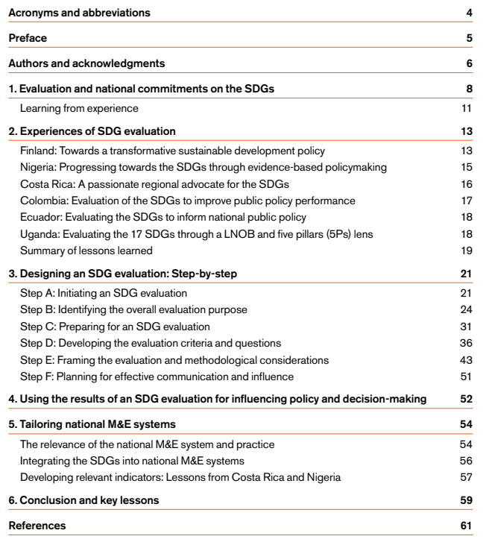
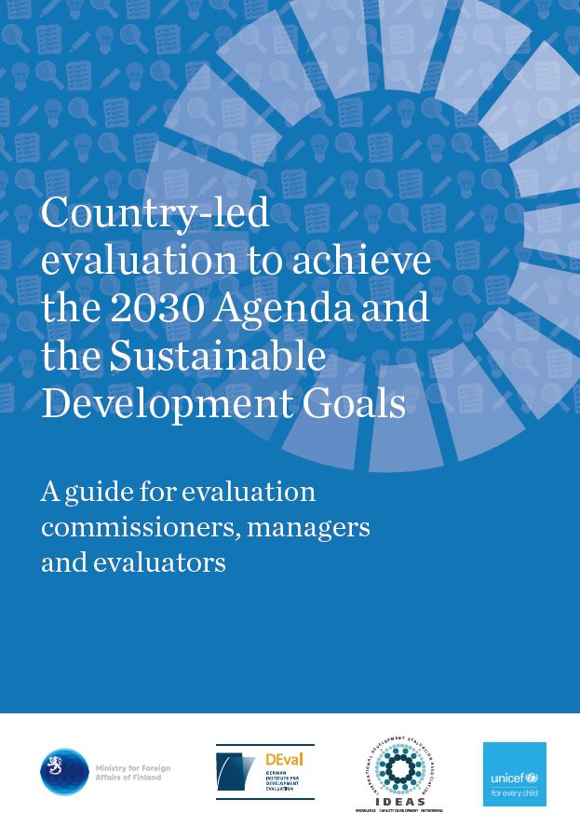
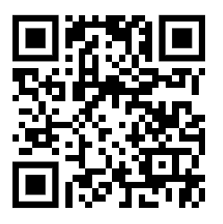
Second edition of a guidebook is out!
Partners: IDEAS, DEval, Unicef, Ministry for Foreign Affairs of Finland
http://urn.fi/URN:ISBN:978-952-281-833-1

Slide 8
Selected key lessons from the Guidebook
Initiate the evaluation process with policy dialogues with the aim to prompt high-level decision-makers, to undertake the SDG evaluation.
Emphasize the relevance and potential benefits of SDG evaluation for the country and in its unique context.
Foster partnerships between government, international cooperation agencies, parliamentarians and Voluntary Organization for Professional Evaluations to kick-start the evaluation process.
Identify and define the SDG evaluation objectives, scope and focus of SDG evaluation through participatory processes.
Use the principles that underpin the 2030 Agenda such as LNOB, equity and others, as evaluative criteria and to inform the evaluation questions.
Frame the evaluation around the logic that underpins complex policies and interventions relevant to your context.
Plan for the evaluation use, communication and influence early on
Use evaluations of the SDGs to strengthen the country´s VNRs, as called for by UNGA Resolution 77/283.

Slide 9
Finland Case

Slide 10
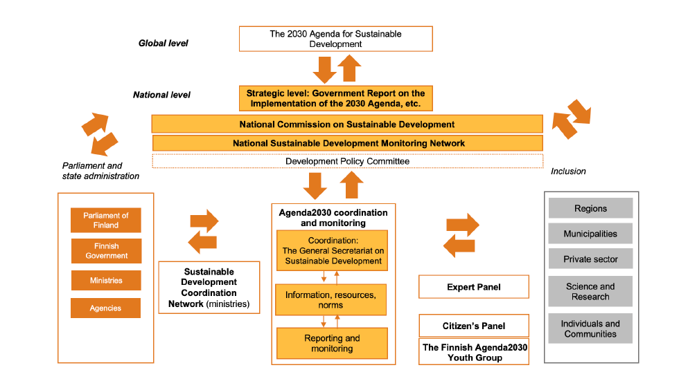
Context and key actors of the national implementation of the 2030 Agenda in Finland
Source: Evaluation 2022, Policy Brief

Slide 11
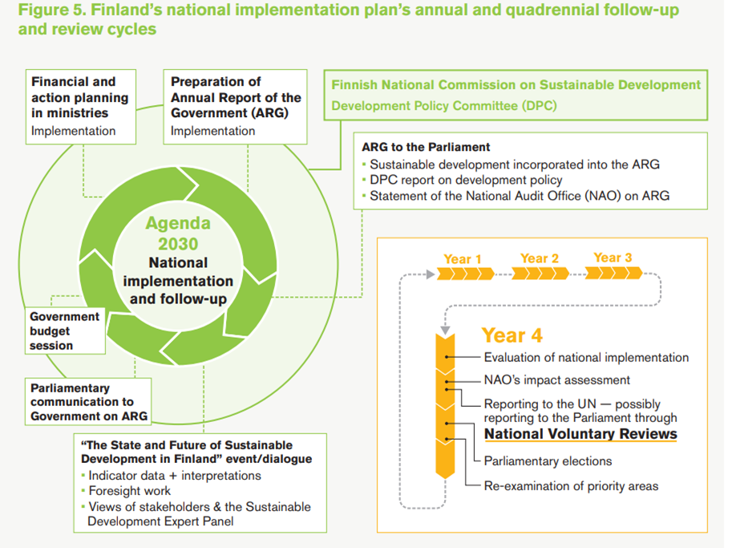
Cycle of Sustainable Development Policy Framework
Source: Guidebook

Slide 12
Evaluations and VNRs informing each other
Track record
Benefits
2019 evaluation of the nation´s sustainable development policy
…was used in Finland´s VNR in 2020
…was used in the 2022 evaluation
…used in 2025 VNR of Finland.
Informing Policy Decisions: Results were shared during key election periods. Provided key insights into the relevance, efficiency, and sustainability of policies for Finland’s Government Programme planning.
Strengthened evidence-base for VNRs: Sequential cycle allowed learning. (Cf. Resolution)
Increased Visibility: Using evaluations in VNRs raises their domestic visibility and boosts policy impact.
International Collaboration: Finland has shared insights from these evaluations globally, fostering international collaboration and leading to resources like the Guidebook on SDG evaluations.
www.glocalevalweek.org

Slide 13
Two rounds of evaluation - Objectives
2019 Evaluation
2022 Assesment
To produce an independent and comprehensive evaluation on sustainable development policy, especially regarding Finland's national policy, the national implementation of the 2030 Agenda and Finland's foreign policy.
To produce concrete recommendations on the future directions of Finland's sustainable development policy (taking into account different timespans and levels of ambition) as well as ways to evaluate it.
To analyze
1) the progress made in the implementation of Agenda2030 since the previous evaluation published in 2019, and
2) the extent of central government guidance and direction supporting the achievement of Agenda2030's goals.
www.glocalevalweek.org

Slide 14
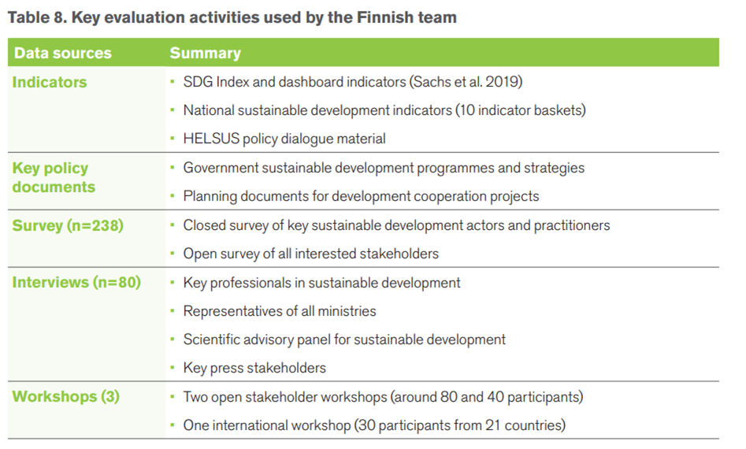
Two rounds of evaluation - Methodology
2019 Evaluation
2022 Assessment
similar methods
+ benchmark analysis of three reference countries (the Netherlands, Sweden and Germany).
Both: Participatory and consultative approach!
Source: Guidebook: Evaluation to connect national priorities with the SDGs

Slide 15
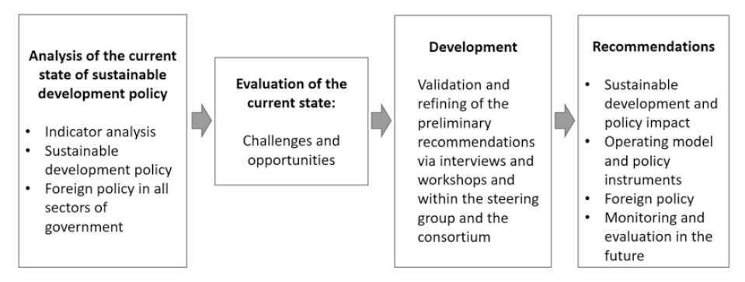
The results and recommendations widely discussed with stakeholders
Process example: 2019 PATH2030 Evaluation
Oversight by government steering group
Support group
6 discussions with political parties
4 parliamentary committees discussed the results together
Presentations and discussions in several ministries
Workshop of national commission on SD
Government negotiations: the leading party had SDG’s as a basis of the programme draft.
Source: Räkköläinen and Saxén 2022
6 mo
www.glocalevalweek.org

Slide 16
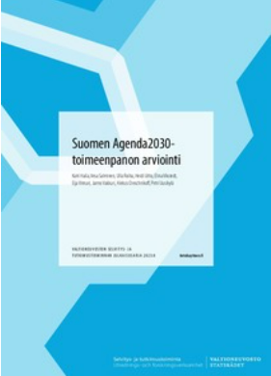
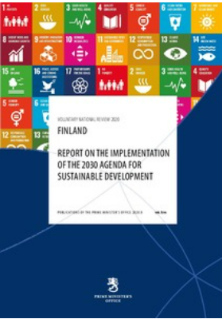
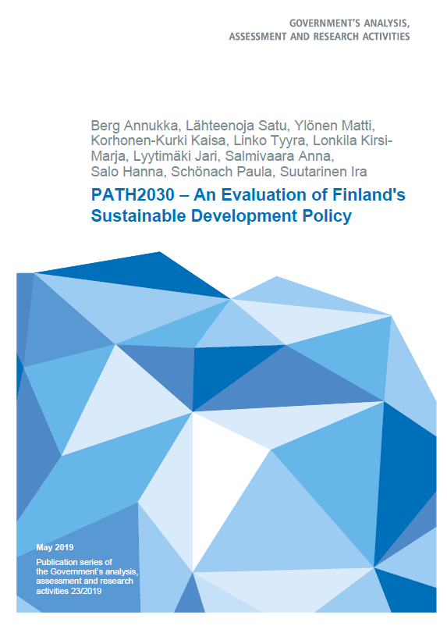
Sources and links
Evaluation 2022:
Report (in Finnish only): Link
Policy Brief (EN): Link
VNR 2020 (EN): Link
Evaluation 2019:
Report (in Finnish only): Link
Policy Brief (EN): Link
Räkköläinen M and Saxén A (2022). ”Pathway to the Transformative Policy of Agenda 2030: Evaluation of Finland’s Sustainable Development Policy. In: Uitto, J.I., Batra, G. (eds) Transformational Change for People and the Planet. Sustainable Development Goals Series. Springer, Cham. Link
Finnish National Commission on Sustainable Development: Link
Press release 2023, Development Policy Committee’s message to government-formation negotiations Link
MFA (2023) Practical Tips for Supporting Evaluation Capacity and Systems in Partner Countries. Link
Finland case in Guidebook: Evaluation to connect national priorities with the SDGs. Link
A briefing paper “Evaluating sustainable development: how the 2030 Agenda can help” Link

Slide 17


global
evaluation
initiative
Thank you!
www.glocalevalweek.org

