Slide 1


03-06-2025
From Theory to Action: Enhancing Public Policy Evaluations through (TBE) Approach
“Every program is based on an underlying theory about how and why the program will work.” -- Carol H. Weiss (1995)
Event participants
www.glocalevalweek.org

Slide 2
Who are we?
47 years of experience
Social and economic
analysis studies
Colombian Consulting
Firm
Over 1000 studies
developed and executed
Multidisciplinary team with qualified professional members
Over 20 countries
Qualitative and Quantitative Methodologies
Over 300 clients

Slide 4
Our Services
Financial analysis
and
Economic
Valuation
Evaluation
Macroeconomic
and sectorial
analysis
Market analysis
and
business plans
Regulation
Organizational
analysis
Plan, program
and projects
design
Design of
public policy
guidelines
Design of
methodologies,
information
systems
and monitoring
Diagnosis studies
www.glocalevalweek.org
Notes:
QR Y ENLACE DIRECTO A ECONOMETRIA

Slide 5
Workshop Content
2. Context of program.
Context of program Amazon Vision Colombia and principal elements.
3. Exercice in Breakrooms.
Separation into Breakrooms by groups to reconstruct the program's theory of change
4. Comparison theories of change.
Presentation of the reconstructed theory of change back in plenary session.
1. TBE Overview.
Why does public policy need theory?
What is Theory Based Evaluation (TBE)
Basic Methodological Aspects to take into Account
Theory Dimensions
5. Presentation of the theory of change of the Amazon Vision program by Econometria consultants.

Slide 6
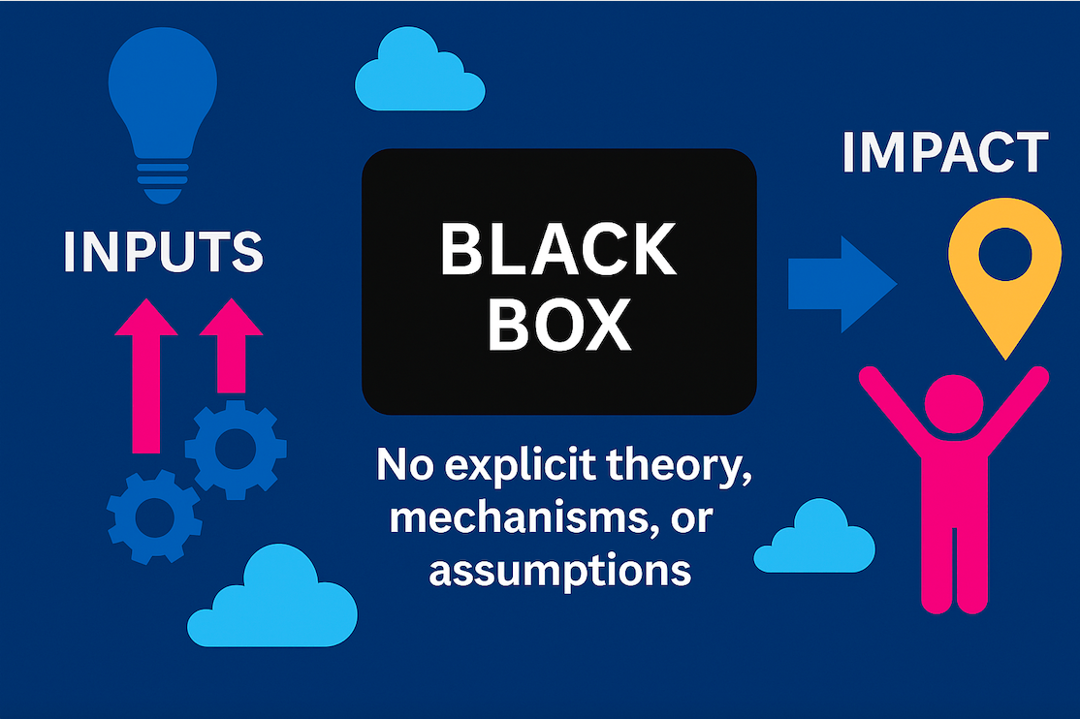
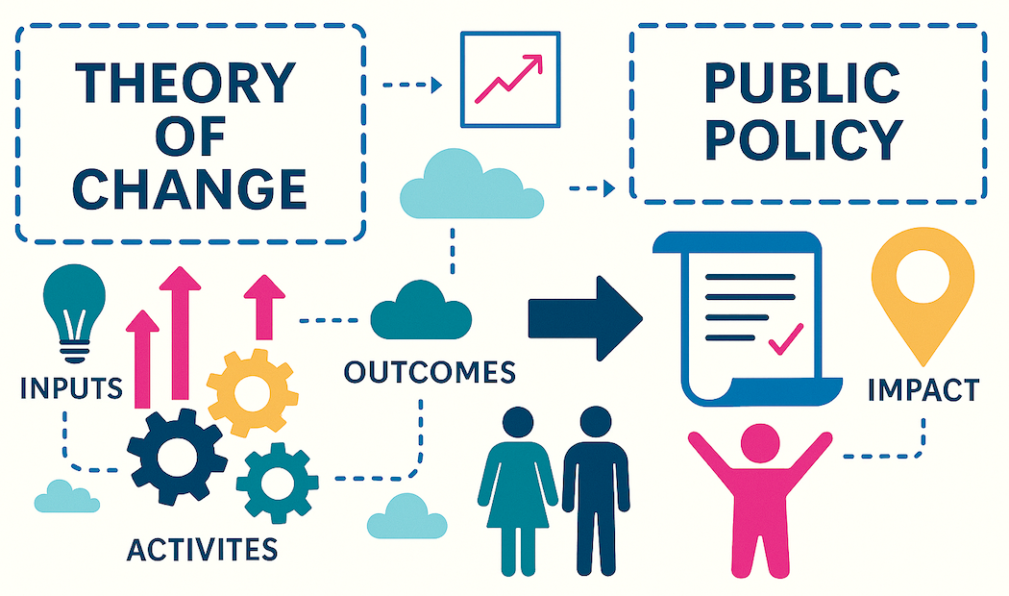
Beyond the black box: Why does public policy need theory?
Black Box Evaluation
Focuses on inputs and final outcomes, but ignores the complex dynamics and contextual realities between them.
Evaluates and assesses the intervention without making explicit the rationale behind, the assumptions, nor mechanisms of change.
Might fall in misunderstanding public policies as universally applicable, overlooking variation in population needs and implementation environments.
Theory-Based Evaluation (TBE)
Builds a theory of change to explain how (the specific “steps” and assumptions) interventions produce change in specific contexts.
Makes the causal logic and assumptions explicit to make it evaluable, and aligning policy rationale with specific context complexity.
Responds to the diverse but specific needs and realities of the specific population and context, enabling adaptive learning and specificity.
Notes:
Public policies and interventions are usually multicomponent, multilevel, its should be intrinsically context driven. Given that they are politically accountable to the public and are made to address issues within society, they require a clear structure and planning, methodology and all of these factors working towards a specific goal.
Many evaluations focus on outputs and final results without explaining how change actually occurred.
They often treat interventions as "black boxes":
Inputs → [???] → Outcomes
TBE aims to understand the logic, rationale, assumptions,mechanisms and context that are part of the structure and planning of the intervention or the policy. This by :
- Providing an explicit framework (multiple components and levels) to understand policy or intervention logic
- Helping trace intermediate steps and assumptions
- Improving transparency, learning, and accountability

Slide 7
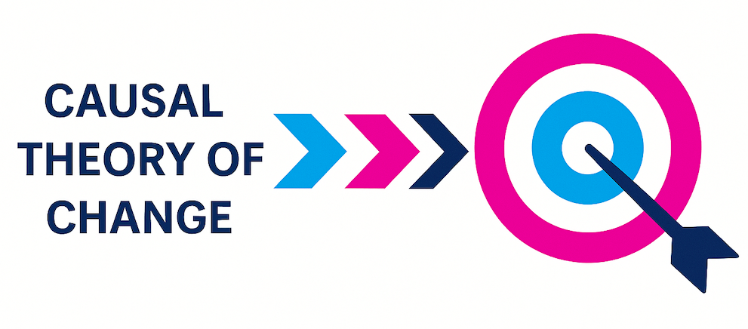
What is Theory Based Evaluation (TBE)?
Theory Based Evaluation (TBE) aims to understand not only what worked and what outcomes resulted but how, why, for whom, and under what circumstances. Social science’s adaptation of value chains and productive processes.
TBE is an evaluation aims to understand the logic behind the intervention through a causal inference and contribution logic, which seeks to understand how an intervention produces change by making explicit its implementation model and testing its causal theory of change, analyzing:
The mechanisms of change,
The contextual conditions under which they operate,
The assumptions and rationale behind the intervention
And the sequential pathways from inputs to outcomes.
It focuses on causal contribution of each aspect of the Theory of Change through the systematic validation and evaluation of program logic and underlying assumptions.

Slide 8
Basic Methodological Aspects to take into Account
Reconstruction of Theory of Change (ToC):
Maps the expected causal pathways, outcomes, assumptions, and contextual factors and serves as the basis for the evaluation. Uses evidence to revise the ToC, support decision-making, and improve policy evaluation.
Causal Mechanism Analysis:
Identifies how and why the intervention is expected to work ( motivation, incentives, expected institutional shifts).
Contextual Conditions:
Examines under what conditions mechanisms are intended to work, by recognizing what outcomes vary across different contexts, and what specifics within the context determine the feasibility and success of the intervention.
Contribution Analysis:
Assesses the plausibility of the program’s influence on outcomes, focusing on causal contribution and not attribution.(Not causation)

Slide 9
Theory Dimensions
Theory Dimension | Role in TBE
Program Sub Theory | The overall logic—why the policy/intervention is expected to work. TBE evaluates this as a causal model.
Implementation Sub Theory | How delivery is expected to happen. TBE checks whether implementation enables causal pathway.
Triggering Mechanisms | The mechanisms/instruments that produce change (e.g., incentives, norms, motivation). TBE identifies and evaluates these.
Action Sub Theory | The choice of specific activities to trigger mechanisms. TBE assesses their strategic pertinence.
Theory of Change (ToC) | The integrated framework that connects all of the above. TBE uses the ToC to organize, test, and revise the full causal pathway.
TBE integrates program logic, delivery strategies, and change mechanisms into a coherent, testable Theory of Change.
It examines how these elements interact to assess the plausibility and effectiveness of a policy’s causal pathway.
Notes:
TBE integrates multiple theoretical layers—program logic, delivery strategy, change mechanisms, and assumptions—into a single, testable Theory of Change.
Rather than treating theories separately, TBE examines how they interact to produce outcomes and uses this integrated model to evaluate the coherence, feasibility, and effectiveness of a policy or intervention.

Slide 10
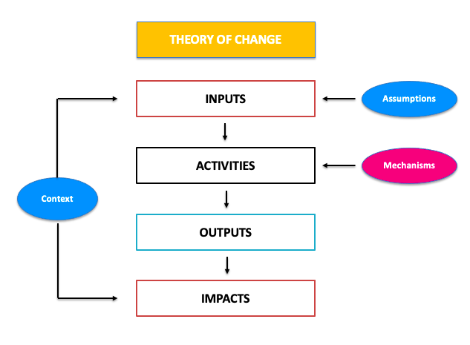
Theory of Change (ToC)
In TBE, the ToC is both a hypothesis (Construction) and a tool for analysis (Reconstruction) and it is used to test causal logic, identify assumptions, and breakpoints in the chain.
A robust ToC includes:
Causal links between activities, outputs, and outcomes
Mechanisms of change (Activities)
Assumptions and risks
Contextual factors that affect implementation and results
TBE uses the ToC to guide:
Evaluation questions
Data collection
Interpretation of findings
Theory refinement
Notes:
In TBE, the Theory of Change is the centerpiece—it’s where policy logic is made visible and testable.
We don’t just accept the ToC—we interrogate it. Is each link supported by evidence? Are assumptions holding? Are results emerging in all contexts or only some? That’s how we move from descriptive evaluation to causal explanation

Slide 11
Methodological Phases
Phase 1: Reconstruction of Theory of Change
Rebuild the logic behind the intervention and how it is expected to lead to results over time.
Phase 2: Identify Assumptions and Mechanisms
Clarify the assumptions that must hold for each causal link and the mechanisms that drive change
Phase 3: Develop Evaluation Questions
Formulate evaluation questions directly linked to the ToC, targeting causal relationships, contextual factors, and areas of uncertainty.
Analyze project documents, policy plans and evaluations (Secondary information)
Through interviews and workshops with key stakeholders
Visually mapping causal pathways, assumptions and outcomes
Facilitate structured discussions with the evaluation team
Use prior relevant research to identify common or previously used mechanisms
Use context analysis and assumptions mapping to account for specific local realities
Align questions with ToC links, aiming to identify relations between inputs, outputs and outcomes
ToC revision with stakeholders to validate and prioritize evaluation insights
Use underlying guiding questions
Phase 4: Gather and Analyze Evidence
Collect and interpret data to assess whether the causal pathways, assumptions, and mechanisms are playing out as expected.
Use mixed methods: interviews, focus groups, work shops, surveys and administrative data
Apply contribution analysis, process tracing and comparative case analysis
Triangulate findings across methods, sites and stakeholders perspectives
Phase 5: Refine the theory and socialization
Based on the findings, refine the ToC to reflect what was confirmed, modified, or disproven.
Revise the ToC to reflect evidence-supported and broken causal links
Present findings through participatory learning and socialization sessions
Develop practical, theory-informed recommendations for improvement
Notes:
Phase 1: The Theory of Change (ToC) becomes the analytical foundation for the evaluation.
Phase 2: This step ensures that the logic behind expected outcomes is realistic and evidence-informed.
Phase 3: These questions guide data collection and analytical focus. Underlying questions: What works, how, for whom, and under what conditions?
Phase 4: The goal is to test the validity and strength of the ToC empirically.
Phase 5: This step closes the loop by producing lessons for policy adaptation, scale-up, or redesign.
The theory of change can be addressed both for construction and reconstruction. When one constructs the theory of change its an analysis of a framework of actions.
On the other hand, reconstruction is more an evaluative approach

Slide 12
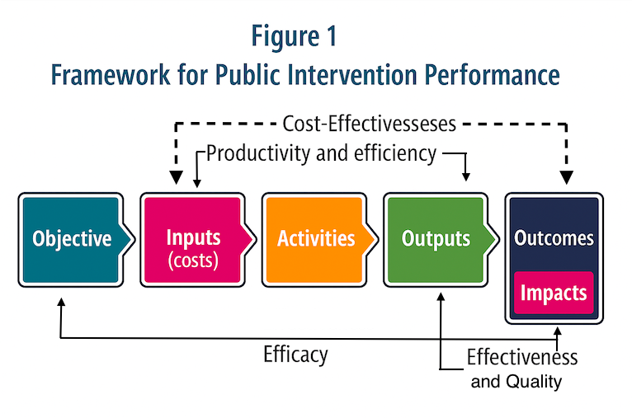
Dimensions Along the Theory of Change
Each stage of the theory of change—inputs, activities, outputs, results—can be analyzed and entail different dimensions of evaluation
For example, efficiency applies to how well inputs are turned into outputs, while effectiveness and impact relate to whether results and long-term goals are achieved.
Concepts like quality, productivity, cost-effectiveness, and efficacy help tailor evaluations to specific levels of an intervention.
This framework shows that evaluation is not one-size-fits-all—it should match the specific causal link being assessed and the needs of the client or assignment.
DNP, Departamento Nacional de Planeación. Guía metodológica para el Seguimiento y. Accessed May 24, 2025. https://colaboracion.dnp.gov.co/CDT/Sinergia/Documentos/Cartilla Guia para Seguimiento y Evaluación Ago 13.pdf.

Slide 13
Pre- implementation Assumptions
There is a commitment to address a determined issue through a specific causal pathway, meaning that the intervention should be guided (Explicitly or Implicitly) by the idea that change can be produced through a sequence of actions, outcomes, and contextual conditions.
There has to be sufficient Access to program documentation, including program design documents, stakeholder insights, and existing monitoring or administrative data.
There should be a willingness to challenge internal logics, revisit assumptions, and accept complexity, therefore the main stakeholders should be open to reflective processes and construction discussions
Explanation and learning should be central to the evaluation’s purpose. The goal is not limited to verifying whether outcomes were achieved, but to understand how and why change occurs, under what conditions, and through which mechanisms. This orientation supports meaningful learning for policy refinement.
Notes:
1. A theory of change can be constructed or reconstructed as part of the evaluation

Slide 14
Design Considerations
This approach addresses multi-level interventions, pilot programs, or policy scaling or adaptation, where change unfolds through multiple pathways.
During the design phase, the process of constructing or refining the Theory of Change should allow the evaluators to identify where in the causal chain to focus the analysis and determining whether to conduct operations, institutional, results, or impact evaluations.
Early con continuous engagement with key actors is essential to co-construct and validate the ToC, surface implicit assumptions, and establish feedback loops for real-time learning and adjustment.
The approach requires expertise in causal reasoning and TIME to perform rigorous desk reviews, unpack mechanisms, and anticipate potential unintended outcomes in dynamic policy environments.
To enrich methodological robustness and validity, it's important to incorporate mixed methods (quantitative and qualitative) in the data collection, both of secondary information and primary sources, and analysis.
Notes:
TBE is most valuable when policies are complex, outcomes are uncertain, and there is a real need to understand how and why change occurs—not just whether it did.
“Not all evaluations need to be theory-based, but when the goal is to understand complexity, adaptation, or contribution, TBE becomes a powerful tool.
However, it requires the right conditions—mainly access to logic, people, and data—and a willingness to learn, not just measure.”

Slide 15
Strengths and Limitations
Strengths
Limitations and Challenges
Explains not just what happened, but how, why and in what context
Enables deeper understanding of causal pathways and what drives change
Supports learning and adaptive policymaking
Helps refine strategies, scale effective components, and redesign weak ones
Captures complexity and variation
Works well for multi-level, multi-actor, or context-sensitive policies
Engages stakeholders in evaluative thinking
Promotes ownership, reflection, and use of findings
Links evidence to strategic decisions
Guides resource allocation and program refinement using theory-informed insights
Requires time, data, and analytical capacity
Not well-suited for rapid or resource-light evaluations
Heavily dependent on quality of the ToC
Existent constructed or reconstructed ToC
Can be complex to communicate to non-technical audiences
Explanatory models may be harder to summarize than simple outcome metrics
Does not provide definitive attribution
Focuses on contribution, not counterfactual proof
Risk of confirmation bias if ToC is not critically interrogated
Without systematic testing, it can validate flawed logic
Notes:
TBE is most powerful when used as a learning and decision-support tool in complex policy contexts—but it requires rigor, openness, and resources to be done well.
“TBE expands the value of evaluation beyond judgment—it helps explain and improve policy logic.
But it’s not a light-touch tool. It requires access, collaboration, and methodological care. The good news? Its payoff in actionable learning often justifies the investment.”

Slide 16
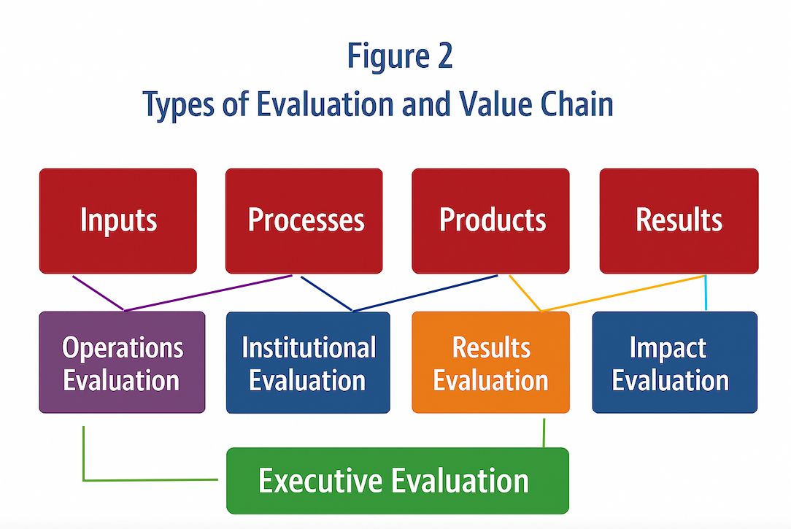
Other Uses of Theory of Change in Evaluation
A well-structured Theory of Change allows us to design different types of evaluations, each focused on a specific part of the causal pathway.
By analyzing inputs, processes, outputs, or results separately, we can conduct operations, institutional, results, or impact evaluations. (Figure 2)
The ToC acts as a map for selecting the right evaluative questions to specifically asses what we are trying to understand or improve?
This approach ensures that evaluation efforts are targeted, relevant, and methodologically coherent.
DNP, Departamento Nacional de Planeación. Guía metodológica para el Seguimiento y. Accessed May 24, 2025. https://colaboracion.dnp.gov.co/CDT/Sinergia/Documentos/Cartilla Guia para Seguimiento y Evaluación Ago 13.pdf.
Notes:
Th general approach of this presentation and the general approach of Econometria is from the evaluator side, we construct or reconstruct the ToC in order to assess how those dynamics are working in the intervention.
Nevertheless, this graph shows how the moments of the ToC (Imputs, processes, products and results) can be usefull for designing evaluations and for the validation part of the evaluation.

Slide 17
From Theory to Action
TBE enhances public policy evaluation by explaining how, why, and under what conditions change occurs—not just whether it did.
It treats the Theory of Change as a testable model, linking design, delivery, mechanisms, and outcomes.
TBE is especially valuable in complex, adaptive, or high-stakes policy contexts, where learning matters as much as measurement.

Slide 18
Vision Amazonia project

Slide 19

Context of program: Visión Amazonía
In 2015, in the context of the Paris Summit, the governments of Germany, Norway, the UK and Colombia signed the Joint Declaration of Intent (JIU) in 2015, aiming to support the reduction GHG emissions from human actions such as deforestation and forest degradation.
In the same line the agreement set a line of action towards advancing in restoration, adaptation, sustainable development and low-carbon energy solutions, interventions and initiatives.
The JIU proposed two payment strategies to achieve its goal:
  Conditional monetary transfers attached to meeting policy milestones.
  Specific transfers tied verified emission reductions at the national level.
Under this agreement, the REDD Early Movers (REM) launched the Colombia Amazon Vision program, in 2016, which, under the first strategy, promotes the use of economic and financial incentives to conserve forests, encourage the legal and sustainable use of forest products and strengthen forest governance.
Notes:
En el marco de la Cumbre de París, los gobiernos de Alemania, Noruega, Reino Unido y Colombia firmaron en 2015 la Declaración de Intención Conjunta (DCI), con el objetivo de reducir emisiones de GEI por deforestación y degradación forestal, avanzar en restauración, desarrollo sostenible y un desarrollo rural bajo en carbono.
La DCI propuso un esquema de pagos por resultados en dos modalidades:
Modalidad 1: Pagos condicionados al cumplimiento de hitos de política.
Modalidad 2: Pagos por reducciones verificadas de emisiones a nivel nacional.
Gracias a este acuerdo se lanzó en 2016 el programa REDD Early Movers (REM) Colombia Visión Amazonía, que, bajo la Modalidad 1, promovió el uso de incentivos económicos y financieros para conservar los bosques, fomentar el aprovechamiento legal y sostenible de productos forestales y fortalecer la gobernanza forestal.

Slide 20
Generalities of the Program
Following the peace agreement with FARC in Colombia, among the commitments that were established, some where regarding environmental services and the creation of incentives to address conflicts between land use and land vocation. However, deforestation in the Amazon has increased since 2017.
For this reason, the program identified the following drivers of deforestation this year:
Changing the use of the land from Amazon forest to pastureland and unsustainable extensive cattle ranching practices.
Illicit activities, including illegal crops, mining, and logging.
Unplanned expansion of transportation infrastructure.
Encroachment of the agricultural frontier into restricted or environmentally protected areas.
In response, the program has developed a series of economic and financial instruments tailored to the region. These instruments include:
Conservation incentives:
  Amazon Forest Incentive (AFI):
  A monetary transfer mechanism based on payments for environmental services (PES), designed in 2018.
  It compensates local actors for the opportunity cost of refraining from agricultural expansion in areas of high conservation value.
Financial instruments:
  Sustainable Productive Transformation Instrument (SPTI): A credit line that promotes the release of degraded or illegally used land for ecological restoration and transition to sustainable land use.
  Green Financial Instrument (GFI): A capital-based incentive scheme offering differentiated credit products aimed at:
    Establishing commercial forestry plantations
    Supporting the conversion of traditional livestock systems
    Financing aquaculture ventures using native Amazonian species
Notes:
El acuerdo de paz con las FARC en colombia definió compromisos para servicios ambientales y la creación de incentivos para solucionar conflictos entre la vocación y el uso de la tierra. No obstánte, desde 2017 se aumento la deforestación en la Amazonía. Por tanto, para este año el programa identifico como causas de la deforestación:
- Praderización del bosque amazónico y malas prácticas de ganadería extensiva.
- Cultivos de uso ilícito, minería y tala ilegal.
- Ampliación no planificada de infraestructura de transporte.
- Ampliación de la frontera agricola en áreas no permitidas.
Estos elementos, llevo a que el programa estableciera instrumentos económicos y financieros diseñados para la región. Estos instrumentos son:
- Incentivos de conservación: 1) Incentivo forestal amazónico (IFA) es un pago por servicios ambientales diseñado desde 2018. Corresponde al costo de oportunidad de actividades agropecuarios.
- Instrumentos financieros: 1) instrumento de transformacionales productiva sostenible, es un crédito que busca incentivar la liberación de áreas para restauración. 2) Instrumento financiero verde es un incentivo al capital donde a través de diferentes líneas de crédito dirigidas a siembra de plantaciones forestales, reconversión ganadera y actividades de piscicultura con especies amazónicas buscan mitigar efectos de la deforestación.

Slide 21
Practical Excercise

Slide 22

Practical Exercise – Reconstructing a Theory of Change
Objective
To construct together a Theory of Change (ToC) for one of the strategies of the Vision Amazonia program, applying the principles of theory-based evaluation in real time.
How It Works
We will break up into rooms, and each group receives a set of elements (activities, outcomes, assumptions)
The task: organize them logically within a ToC framework
After the Breakout
We’ll compare the ToCs built by each group as a whole
Reflect and discuss on different causal logics and placement decisions
Contrast group work with the official Vision Amazonia ToC

Slide 23

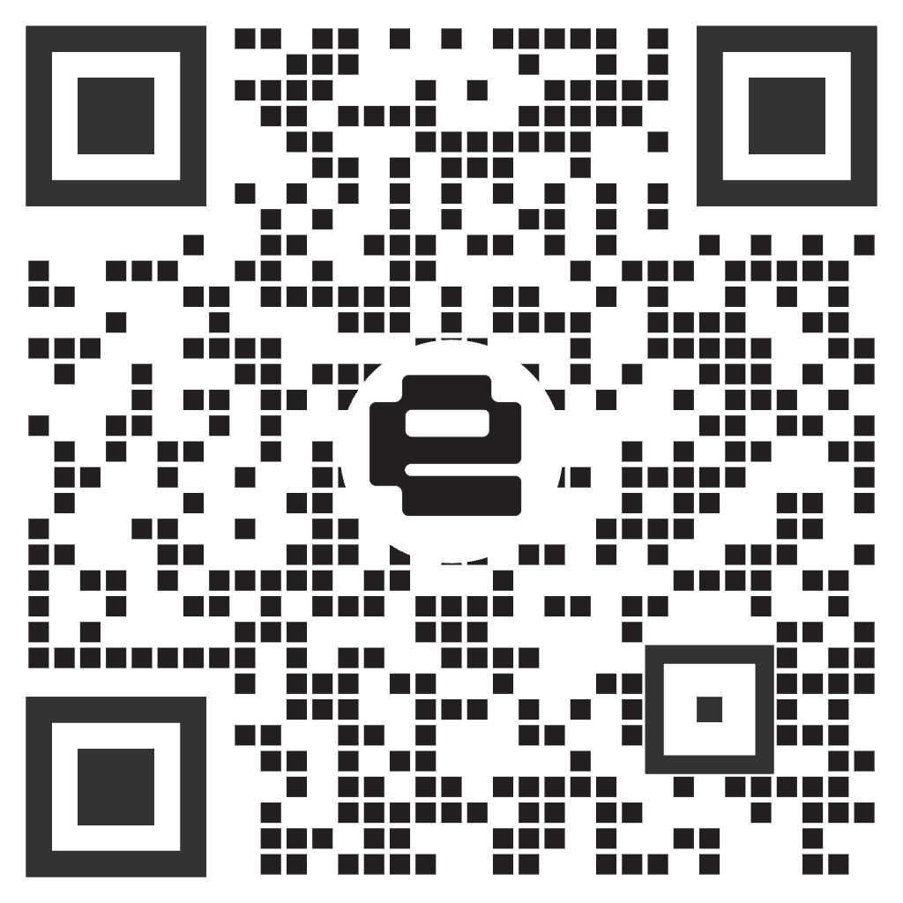
global
evaluation
initiative
Thank you!
Event participants
Contact us
www.glocalevalweek.org

