Slide 1


Evaluating for the Better Future: Inclusive and Ethical Practices of Evaluation
Monitoring, Evaluation & Learning Professionals Association
MELPA
Tbilisi, Georgia
Lessons from the Tolerance and Diversity Institute (TDI) Ekaterine Chitanava
www.glocalevalweek.org

Slide 2

Introduction
TDI Founded in 2013 in Georgia to promote equality, nondiscrimination, FoRB, and civic integration
Focus areas: The rights of religious and ethnic minorities and migrants
Importance of M&E: accountability, informed decisions, advocacy effectiveness
www.glocalevalweek.org

Slide 3
TDI’s M&E Methodology

Slide 4
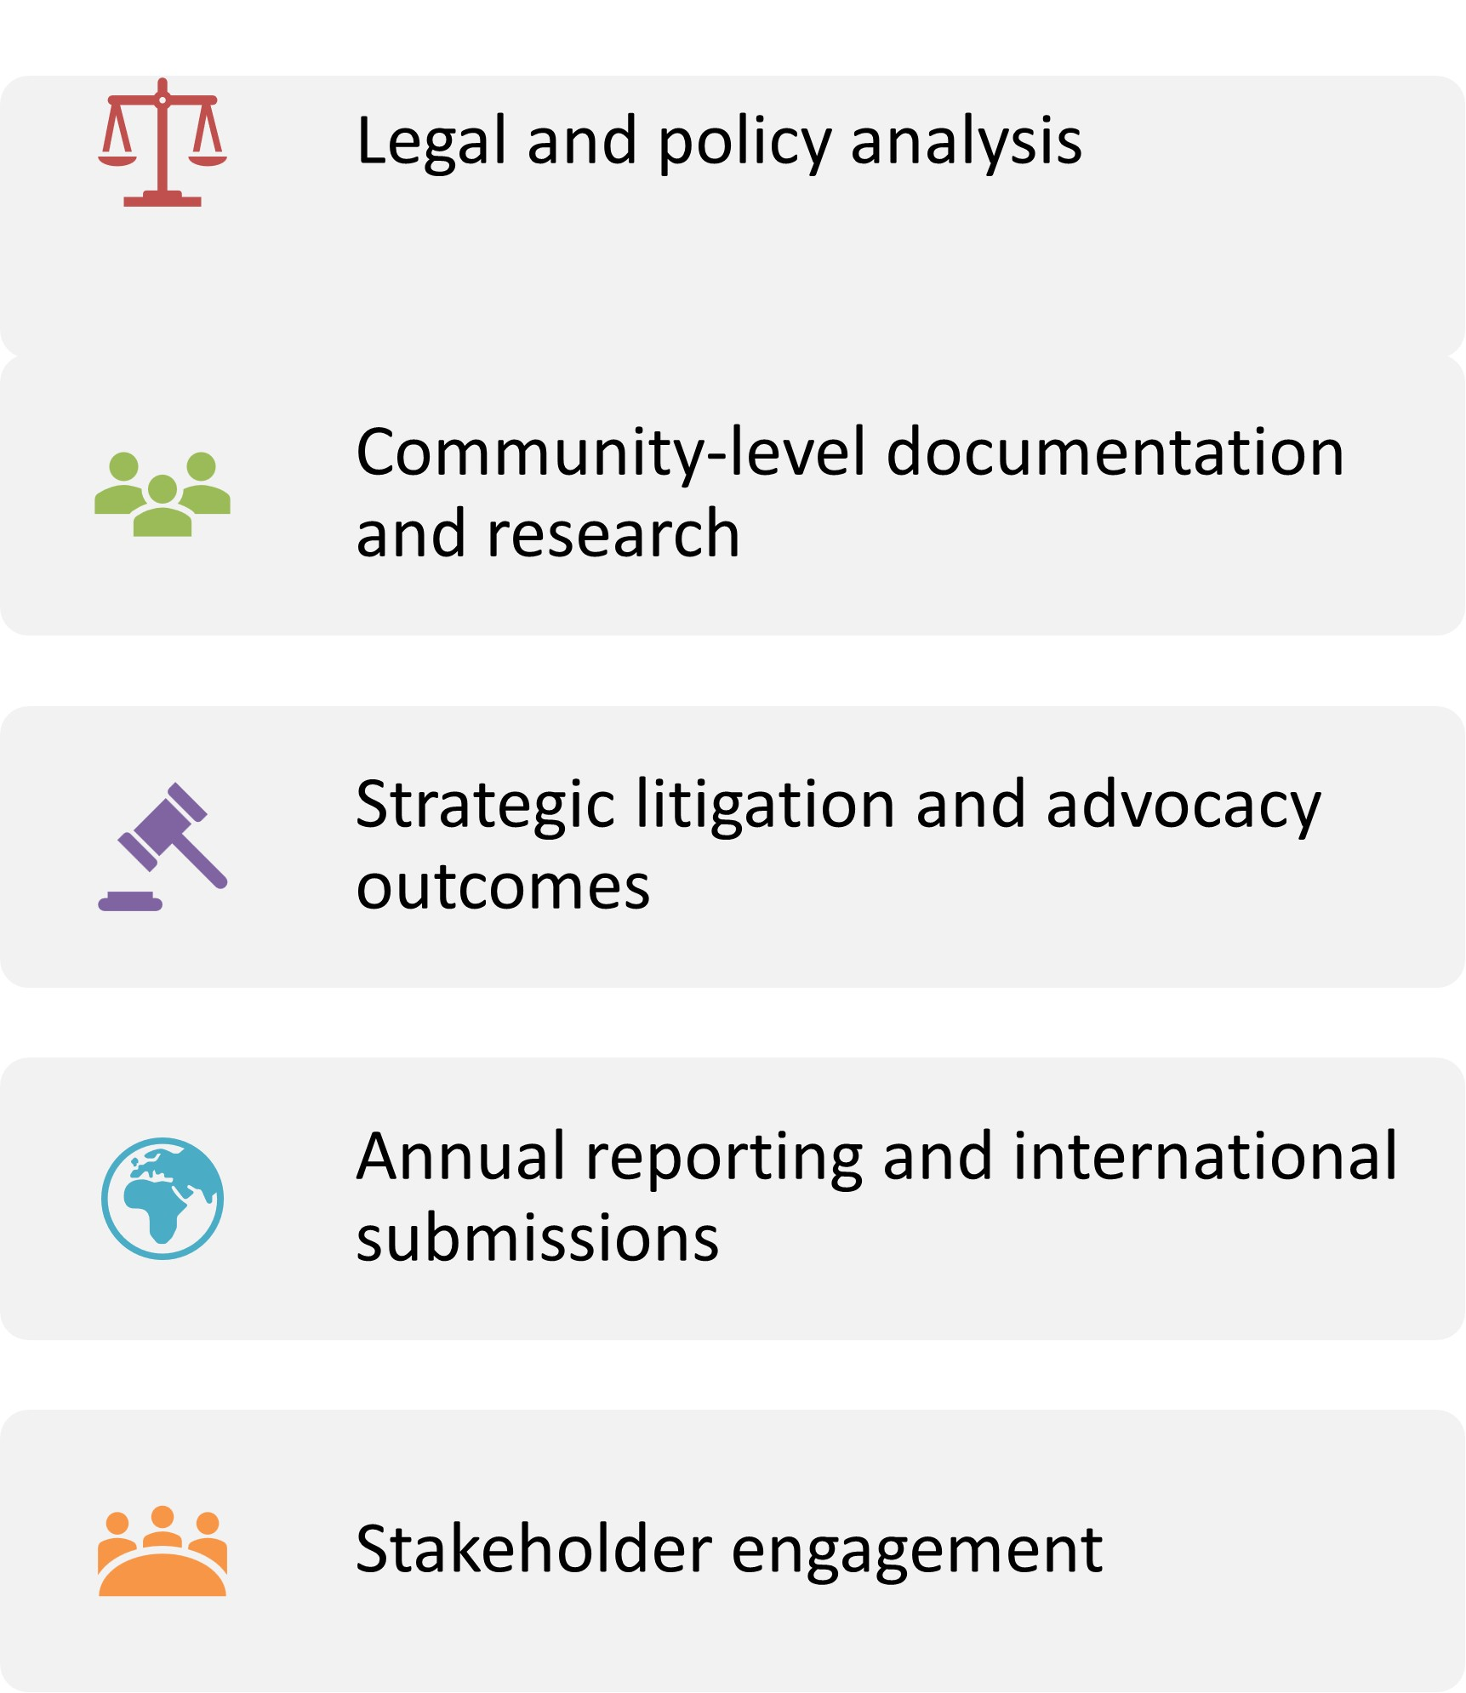
www.glocalevalweek.org

Slide 5
Monitoring Freedom of Religion or Belief

Slide 6

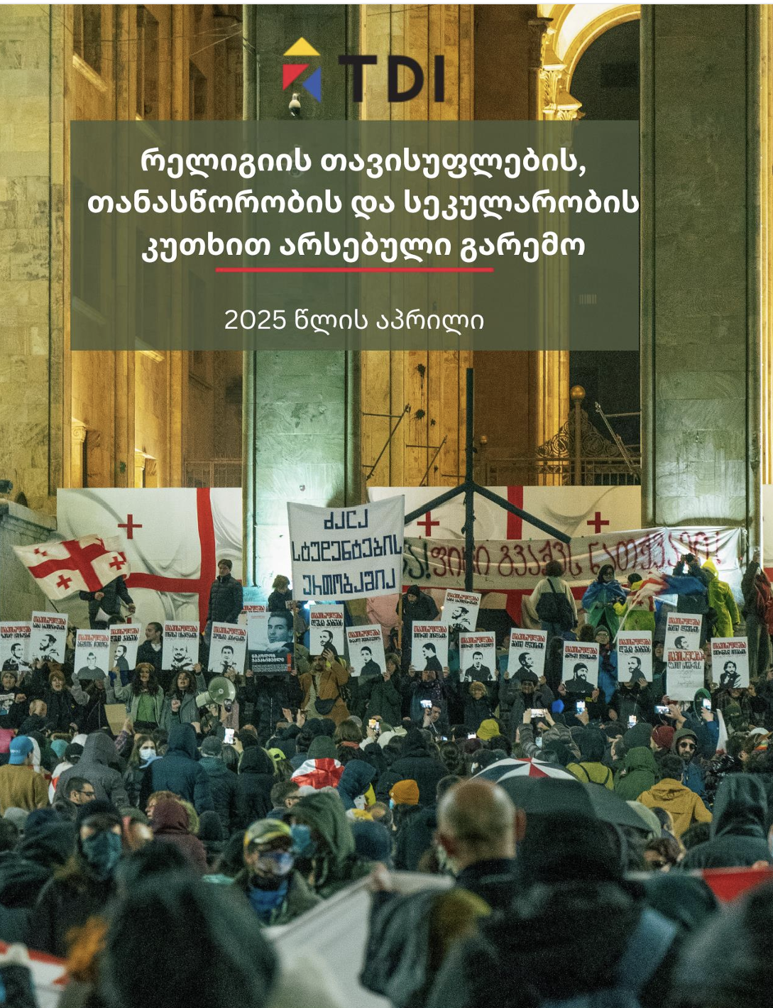
Policy and legislation monitoring and analysis, desk research, interviews and case tracking
www.glocalevalweek.org

Slide 7
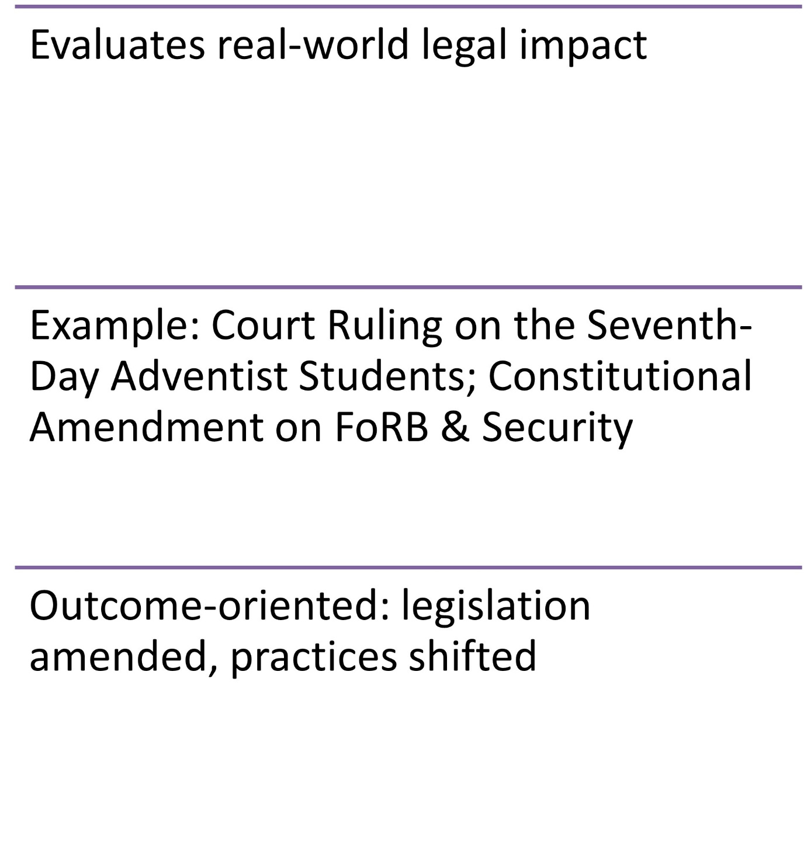
Strategic Litigation and advocacy as a Monitoring Tool
www.glocalevalweek.org

Slide 8
Ethnic and Racial Discrimination

Slide 9
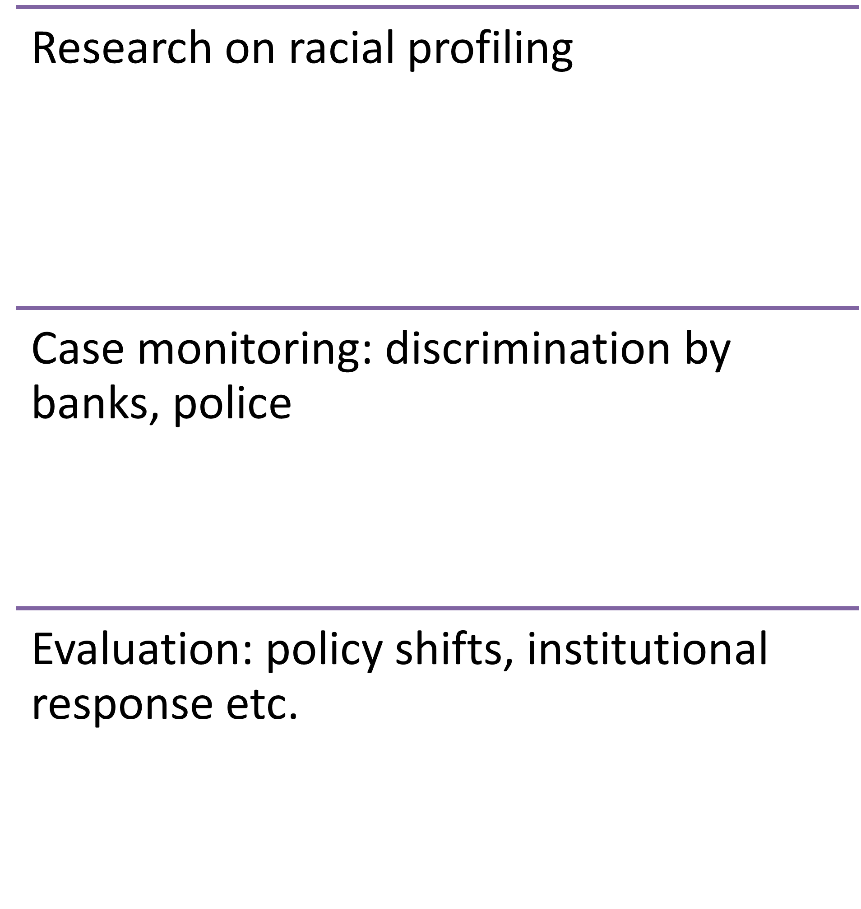
Addressing Racial and Ethnic Discrimination
www.glocalevalweek.org

Slide 10
Education and Awareness-raising campaigns

Slide 11
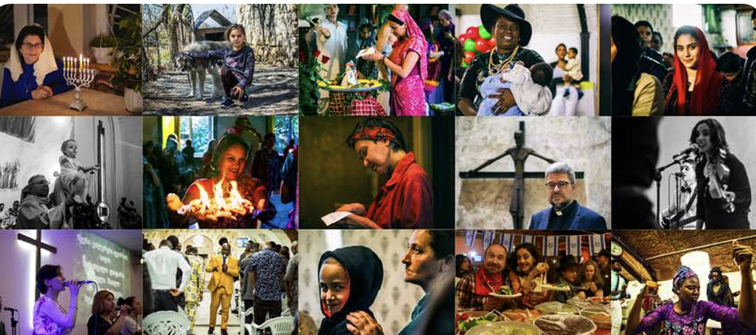
-Textbook reform to reduce religious, ethnic and cultural bias
-Platforms promoting tolerance and pluralism
-M&E Indicators: feedback, curriculum analysis, engagement levels
www.glocalevalweek.org

Slide 12
Challenges

Slide 13
- Political environment and shrinking space for CSOs, changing context
- Achieving impact in short-term
- Limited resources for conducting baseline and after-intervention studies
www.glocalevalweek.org

Slide 14
Final Reflections

Slide 15
HRBA-M&E focuses on rights fulfillment and contextual analysis, not just metrics
www.glocalevalweek.org

Slide 16


global
evaluation
initiative
Thank you!
www.glocalevalweek.org

