Slide 1


Evaluations can help travel the ‘Last Mile’ first
BEING THE CHANGE: Towards greater inclusion and diversity in international development evaluation
3 June 2024

Slide 2

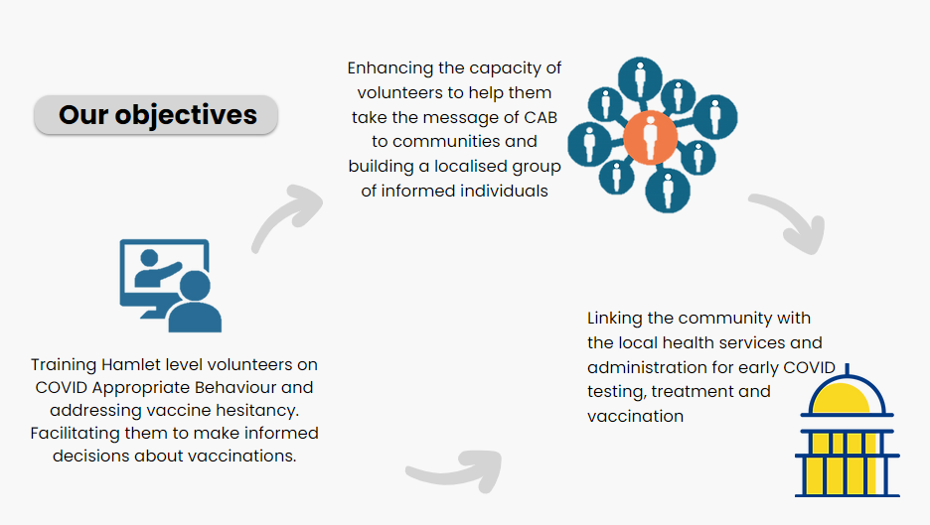

COLLECT: Community-Led Local Claims and Entitlements Tracker
India
11
States
70
Districts

Slide 3
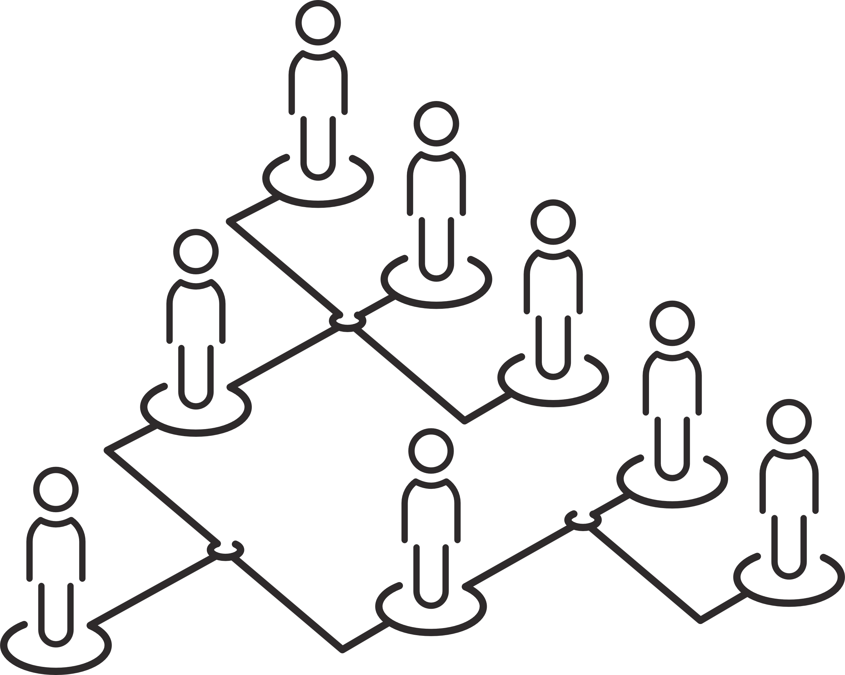
COLLECT: Community-Led Local Claims and Entitlements Tracker
70
Coordinators
560
Hamlet researchers
Scheduled Tribes
Scheduled Castes
Minorities
Identities in Focus
Denotified & Nomadic Tribes
Non-binary and Trans community
those further marginalised because of identities of age (children, elderly), gender and disability.​

Slide 4
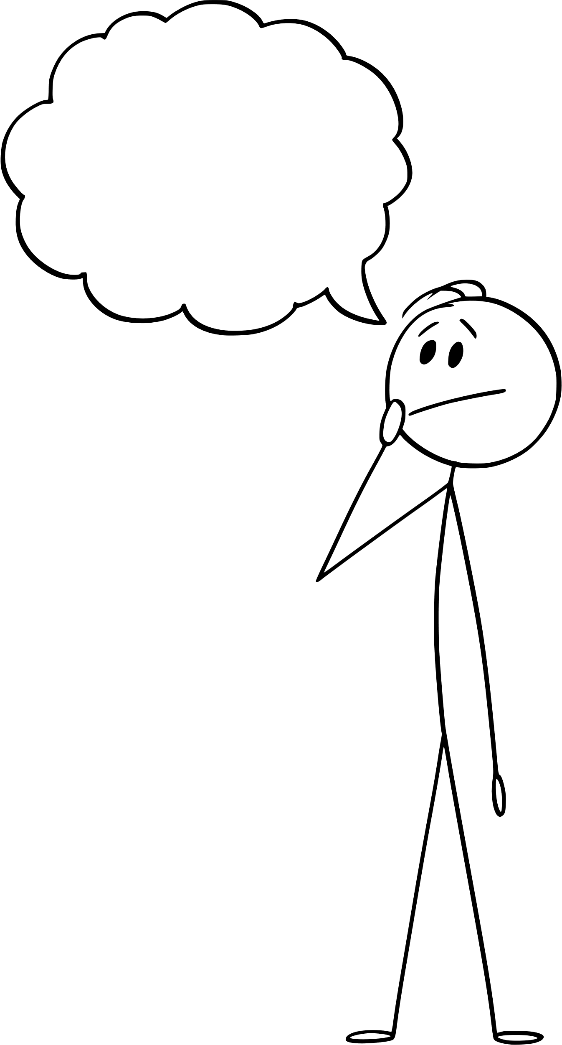
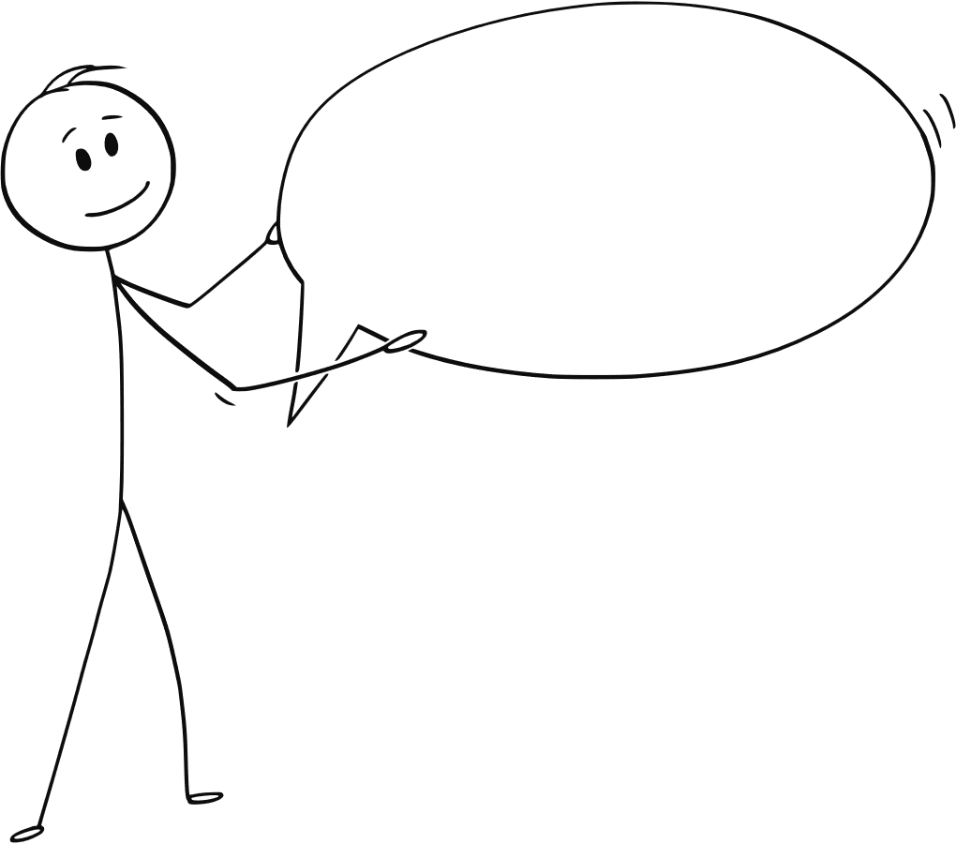
BLINDSPOT: The ‘Last Mile’
What does the ‘last mile’ look like?

Slide 5
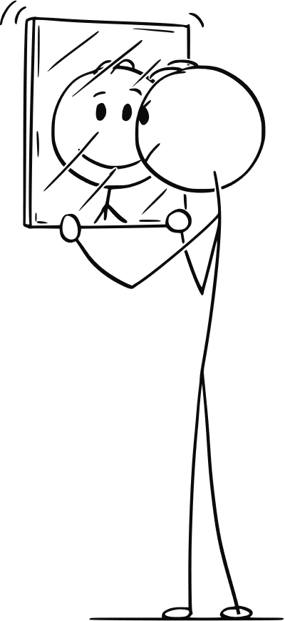
BLINDSPOT: The ‘Last Mile’
How does the top-down gaze look at the last mile?
  Unreached and unreachable owing to reasons of infrastructure and logistics.
  As those living in the last mile lack stable sources of income, they are seen to have lower purchasing power.
  Stereotypes of what the communities that live in the last mile are like – low awareness; that they are highly superstitious; and they believe on information without any rational understanding.
Are these stereotypes true for the ‘upper’ class citizenry?
The gaze from the last mile
  A homogenous sub-locality within a village, which itself has poor infrastructure and poor access.. ghettoization – based on caste, sexuality, religion, criminalisation and/or occupation
  Homogenous in terms of one identity, this group also has a number of last miles based on patriarchy, stigma, and indignity associated with sub-castes, gender, disability and age.
Its view of the top - a system ‘manned’ by the dominant class/caste

Slide 6

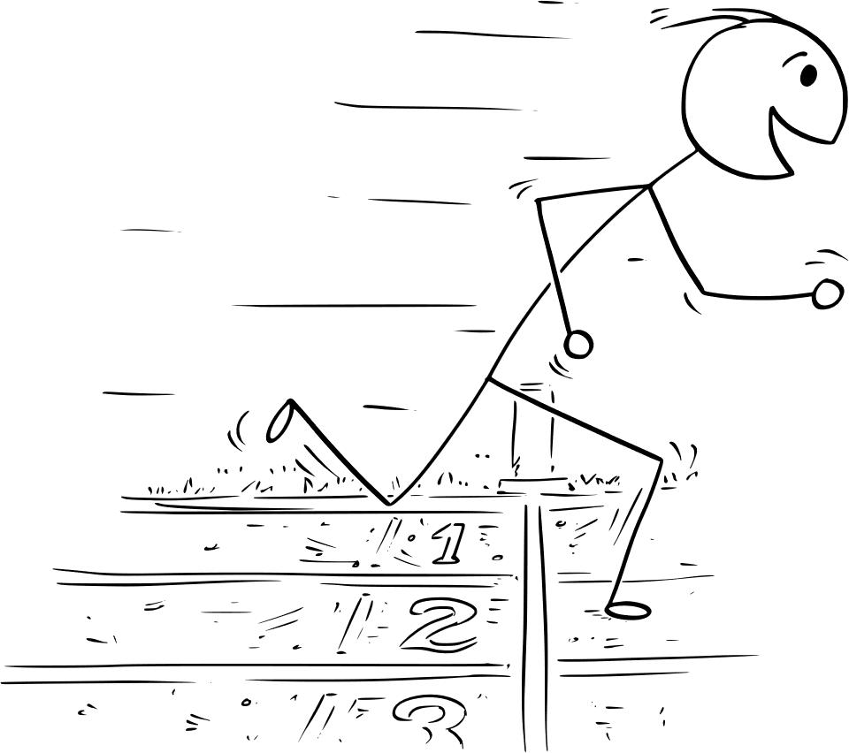
BLINDSPOT: The ‘Last Mile’
(a) The privilege of early vaccinators: Creating a ‘first mile’
Members from the marginalised communities did not have the luxury of being early vaccinators or seeing their neighbours accessing vaccinations or any information about what the side effects could be/how they should handle any side-effects. This, by design, re-creates a first mile, which gradually creates the last mile.
(b) Those left behind in the Frontline: The last mile within the first
In terms of those who constitute the ‘Frontline’, the doctors and nurses, deservedly, were the focus. Sanitation workers or morgue workers, undeservedly, were left behind. There is a last mile, even within the first mile.
(c) The outliers: Not in the running
As the vaccination drive made far-reaching roadways, a number of the most marginalised communities were faced with a dilemma - The same system that had previously discriminated against them and remained inaccessible for them, was the same one that was now delivering vaccines.

Slide 7
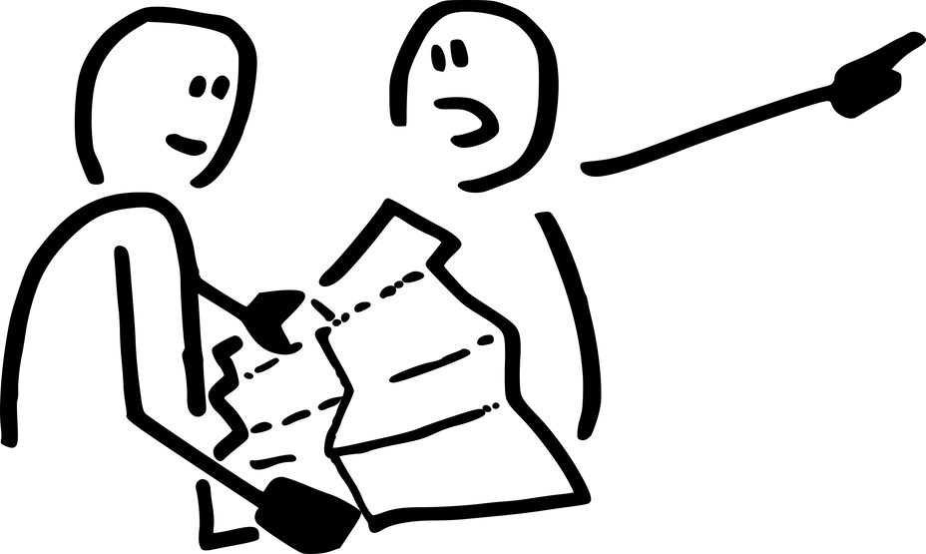
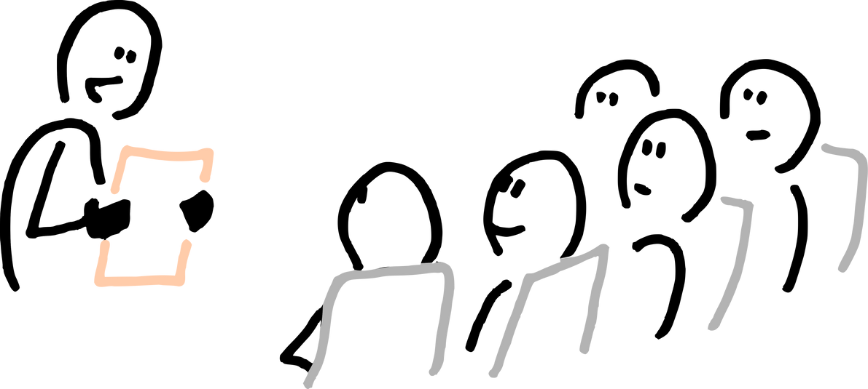
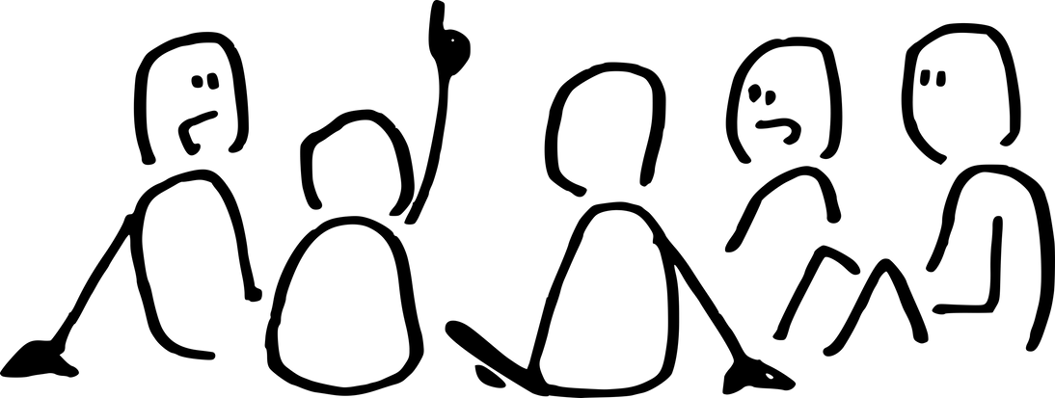
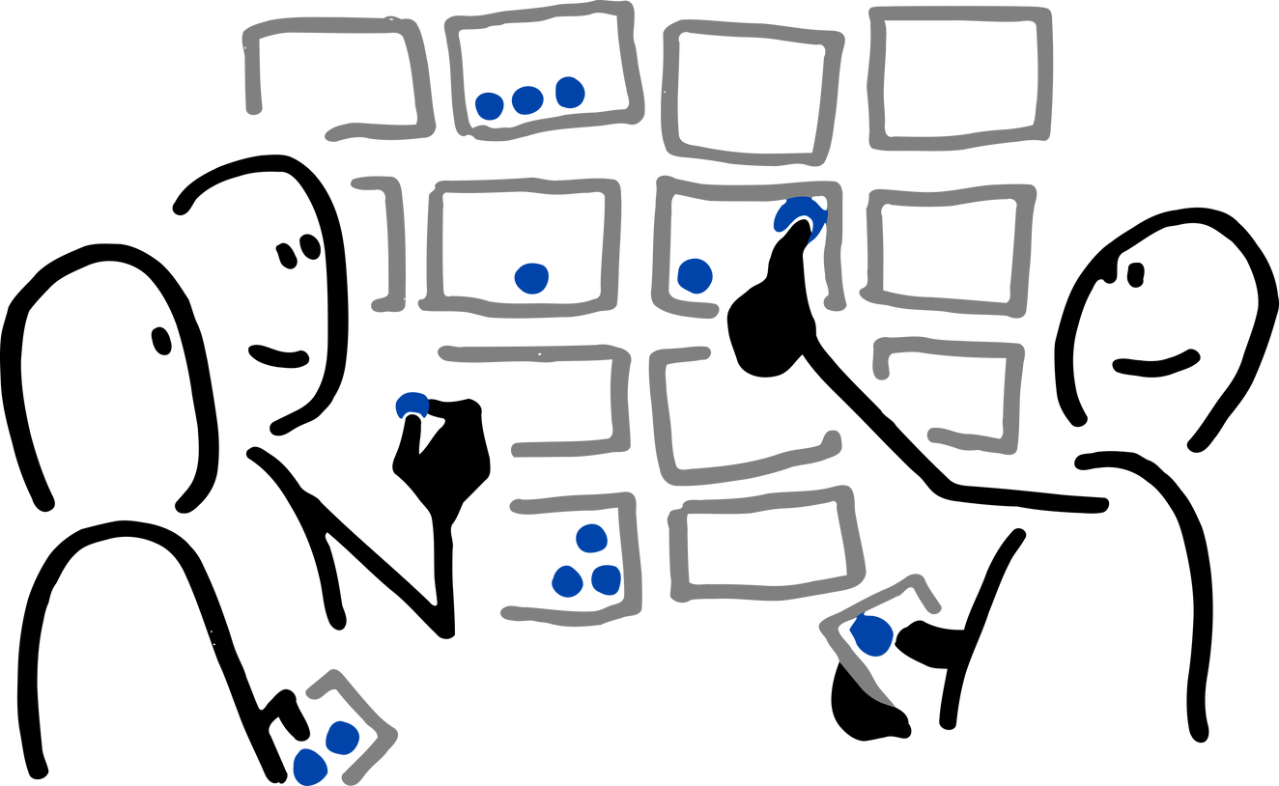
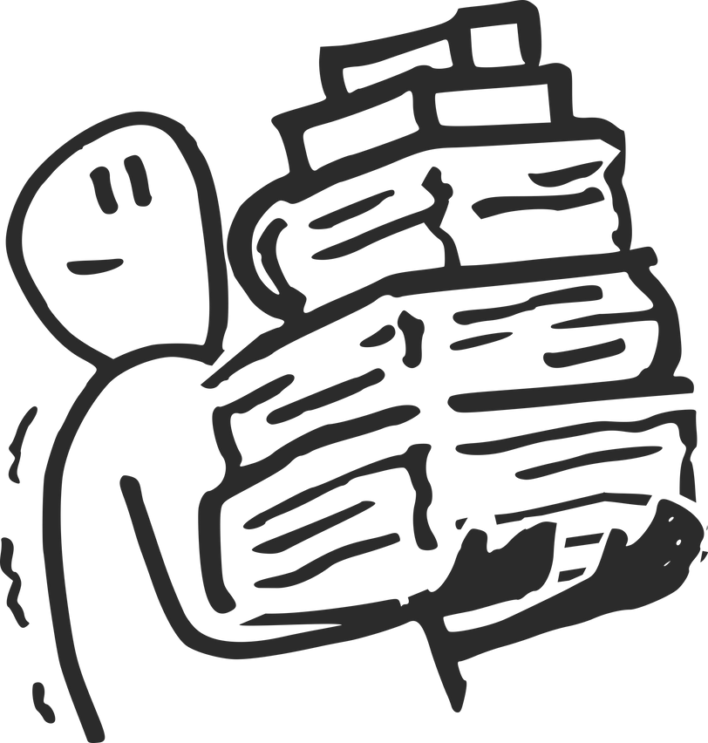
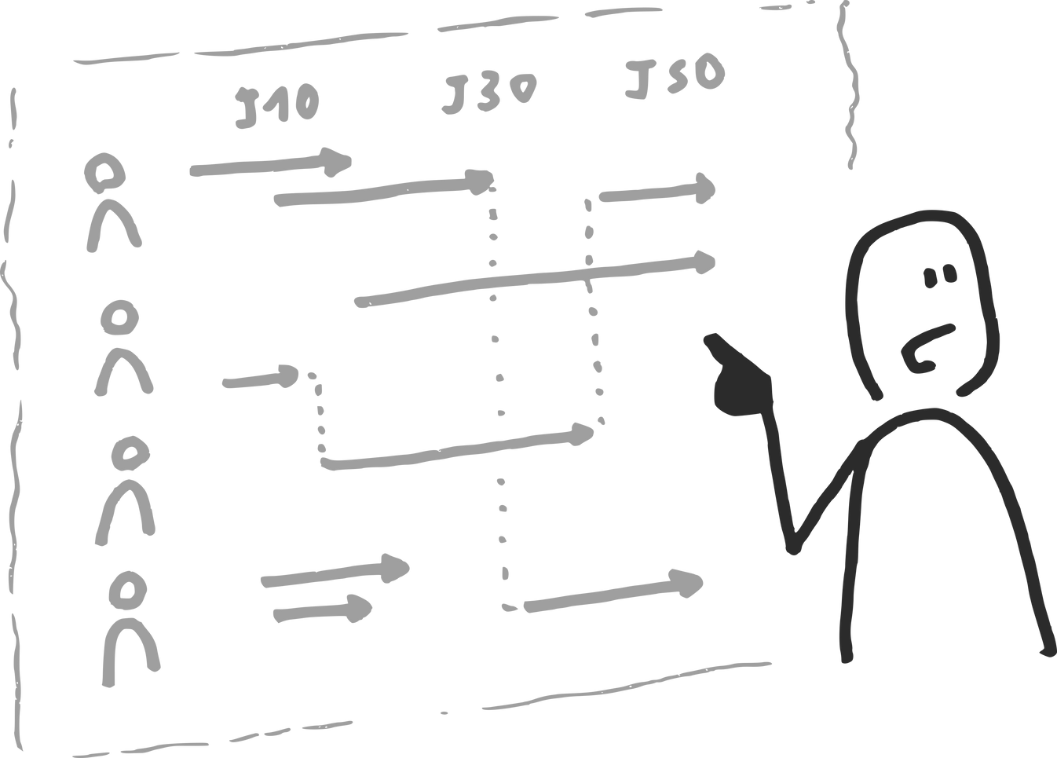
COLLECT: Community-Led Local Claims and Entitlements Tracker
Targeting the potential last mile first
Creating capacities within communities
Hamlet collectives
Facilitating solidarity at macro-level
People-Science Model
Engaging with the demand side

Slide 8



FINDINGS
The common definition of the ‘last mile’ suffers from the top-down colonial gaze.
It is a violent and undemocratic gaze.
Common Assumptions about the solutions
That it is a mere logistical and infrastructural issue. Once those in the ‘last mile’ have been provided with the information, the gap is closed.
It is often assumed that market-based models could pierce into the last mile
Philanthropy based empathy could replace the dysfunctional accountability system of the public health system.
The colonial gaze fails to recognise that persons ‘manning’ all the three models are often the same class, caste and gender identity.

Slide 9




3 - 7 June 2024

