Slide 1


Measuring Collectivisation
BEING THE CHANGE: Towards greater inclusion and diversity in international development evaluation
3 June 2024

Slide 2

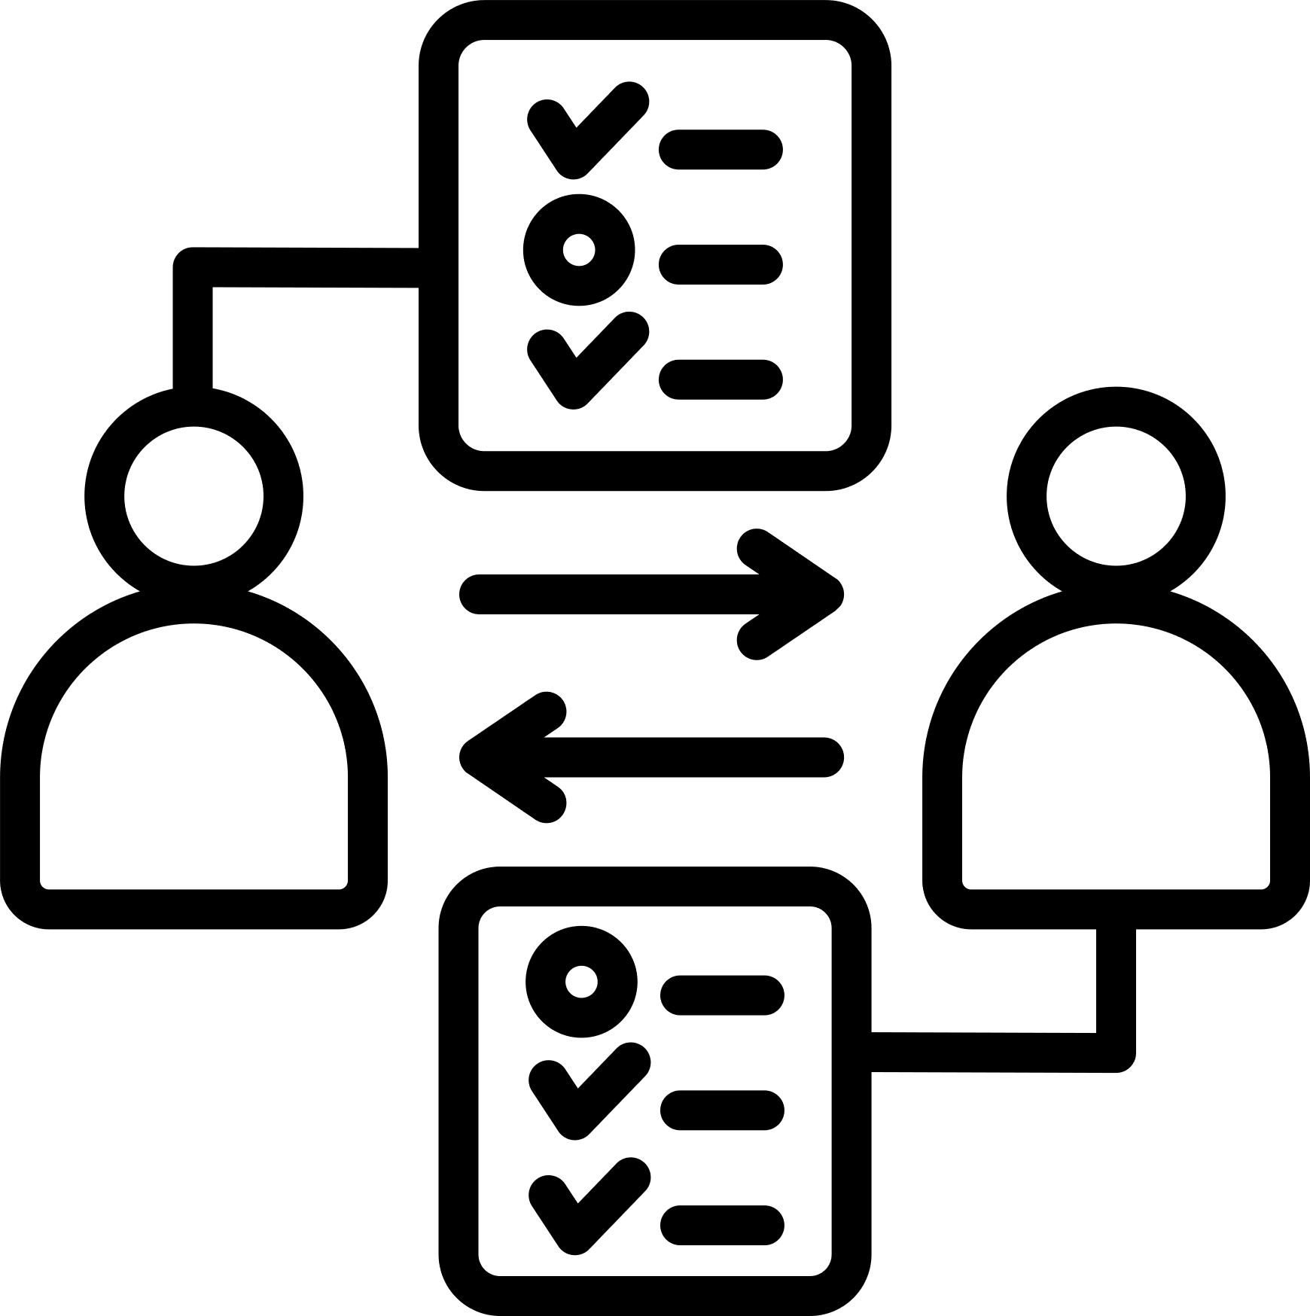


Programme and Evaluation
Collectives and articulated voices from the community

Slide 3



Collective and Grantmaker Interface
What is your sustainability plan? If we do not fund next year, would you be able to survive?
What is your second-line leadership? Why are there no women in the leadership?
Collectives
Where are the youth in your leadership?
Grantmakers
How diverse is your board?
How wide is your membership?

Slide 4
Collective and Grantmaker Interface
What is your second-line leadership? Why are there no women in the leadership?
How diverse is your board?
How wide is your membership?
What is your sustainability plan? If we do not fund next year, would you be able to survive?
Where are the youth in your leadership?
Collectives
Collectives
Grantmakers
Membership and Engagement
Financial Management and Sustainability
Diversity and Inclusion

Slide 5





Self-diagnostic Measurement Tool
1
Articulation
2
Birds eye view
Collectives
Grantmakers

Slide 6
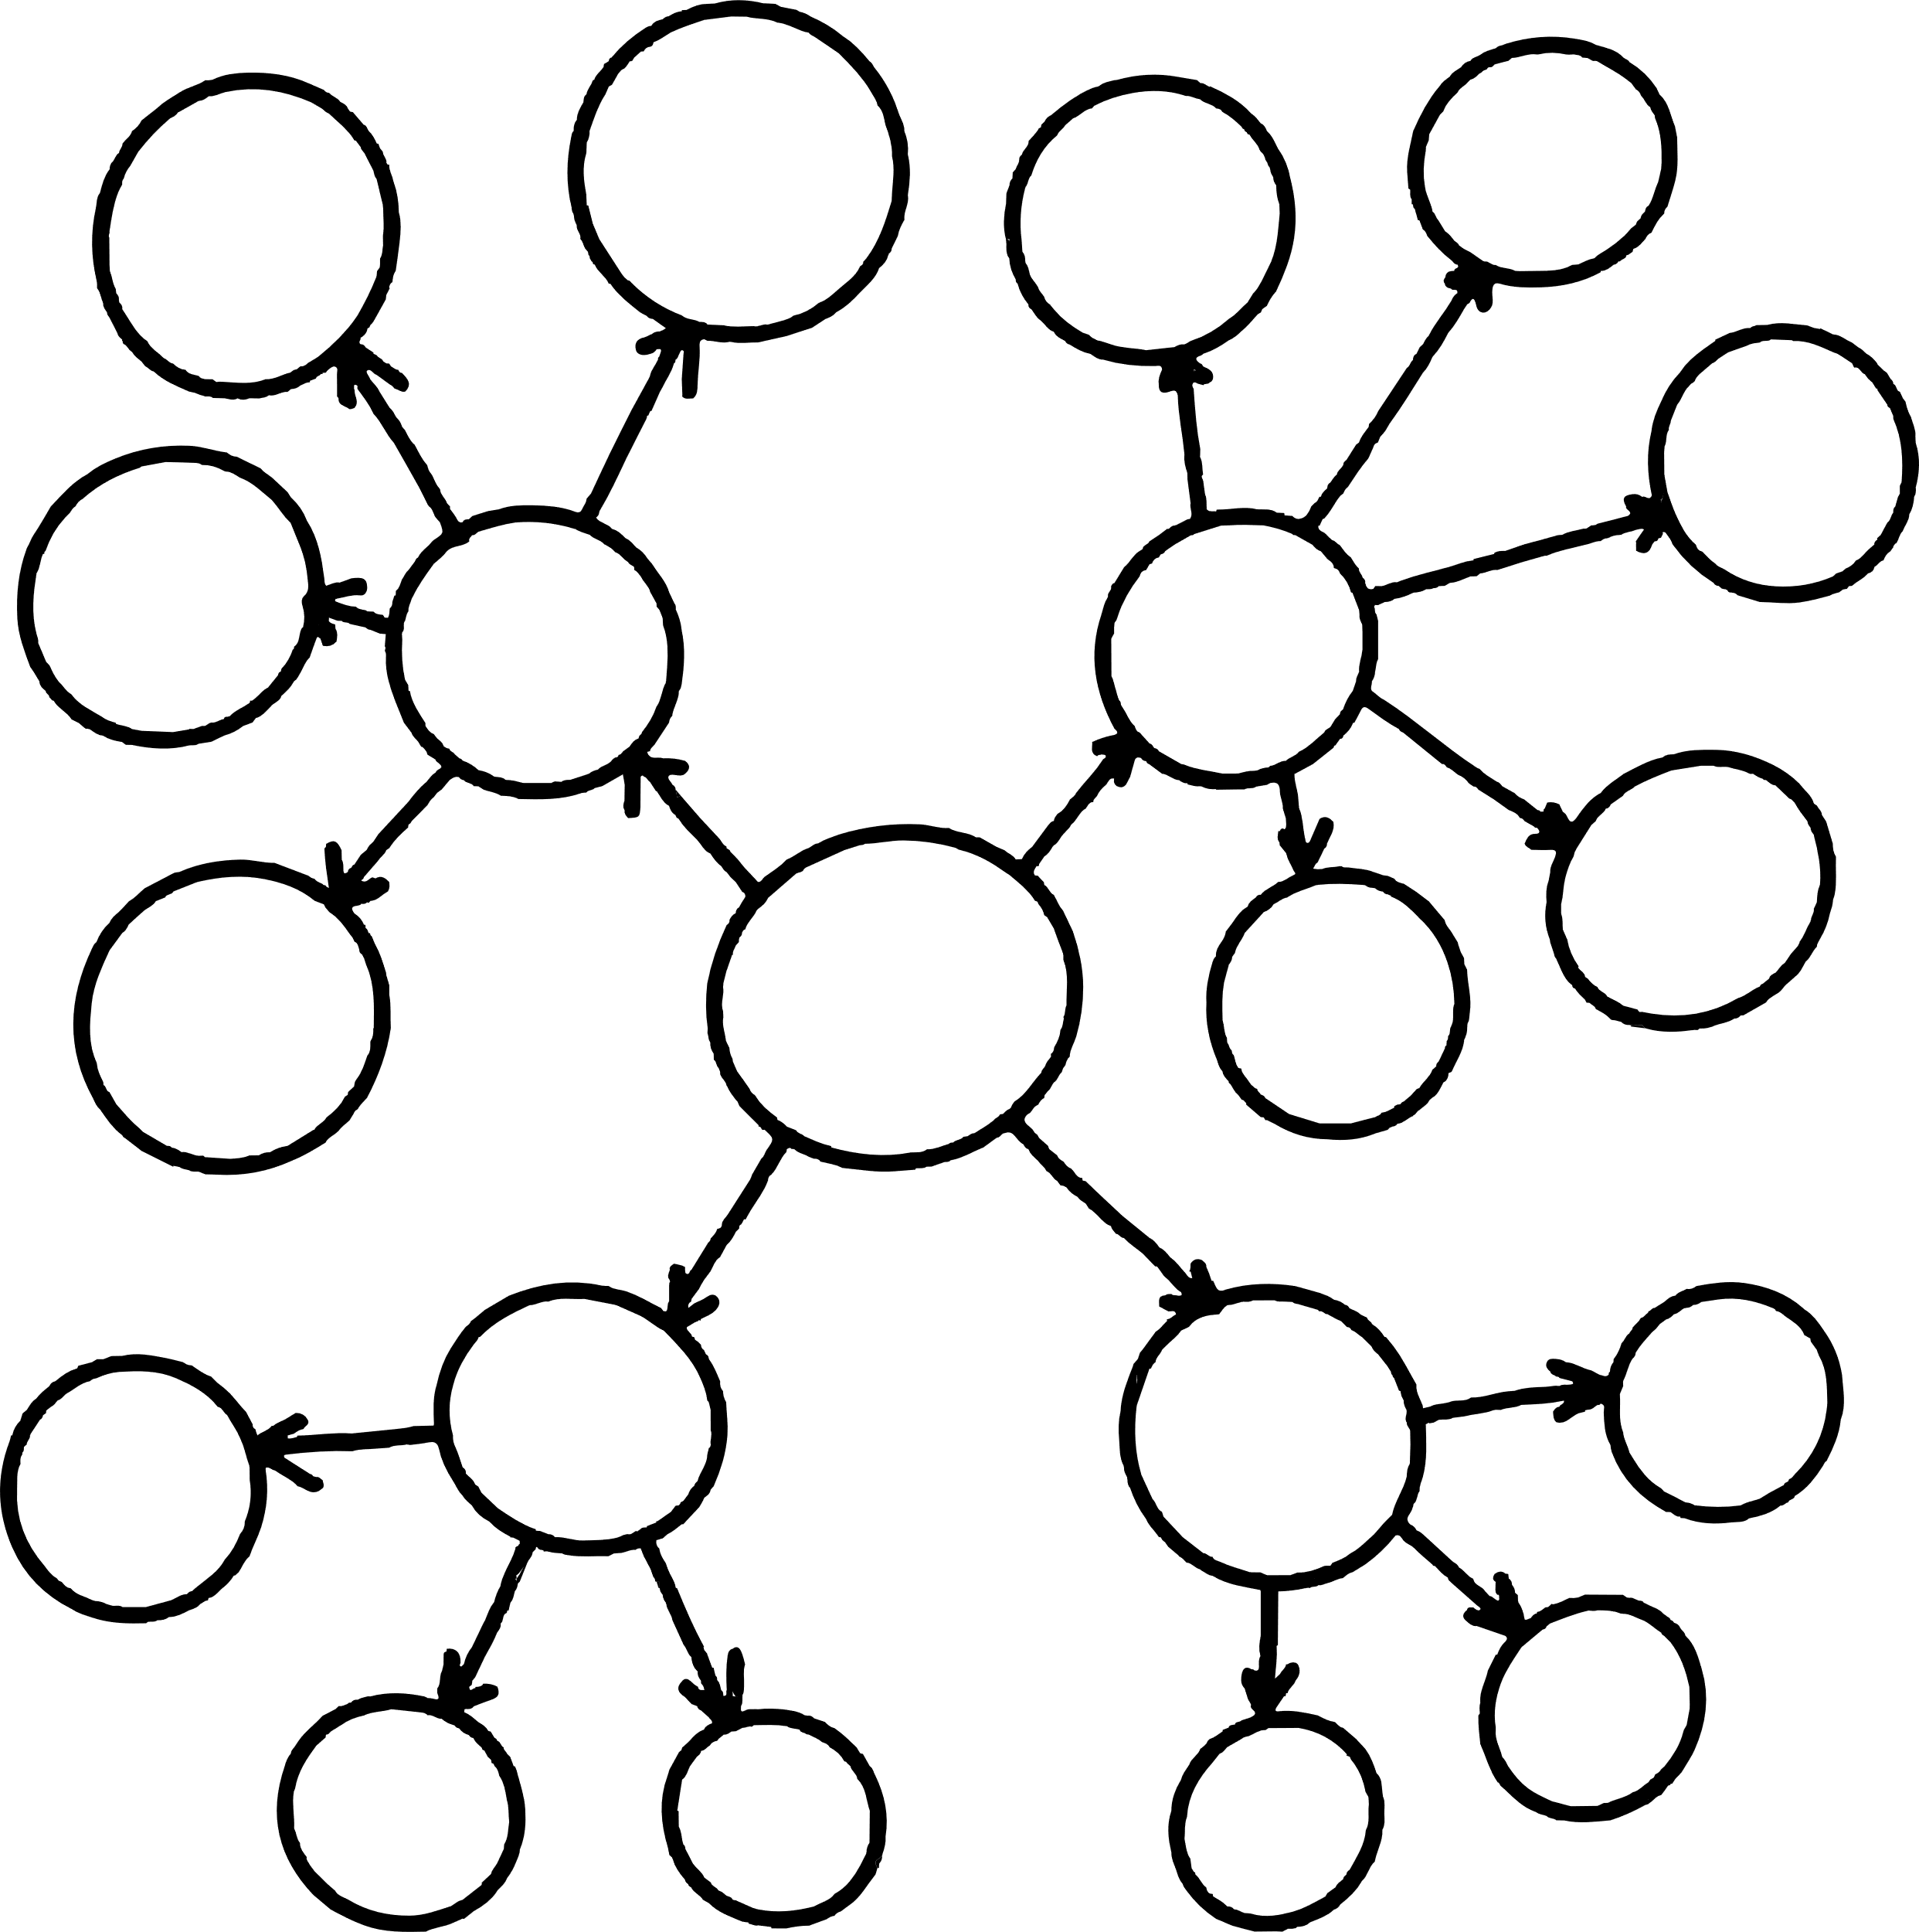
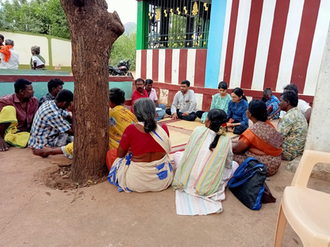

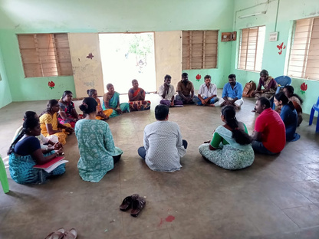







Our process
4
1
Collectives
3
2
Self-Diagnostic Tool
Discussion papers
Deep Dive: Sanitation workers collective
6
5
Reflection meetings
Key concepts that helped arrive at the tool indicators

Slide 7

Evolving the Theory of Change
Sustainability: Fear of NGO-isation
சிந்தனை
Critical Reflection as a core attribute of Collectivisation
Critical Reflection on Interface with Grant Making
Critical Reflection on Collectivisation
Developing Monitoring Indicators
Ethics

Slide 8
Evolving the Theory of Change
சிந்தனை
Critical Reflection as a core attribute of Collectivisation
Critical Reflection on Interface with Grant Making
Critical Reflection on Collectivisation

Slide 9






Understanding the problem
1
2
Manifestation
Center
Periphery (Margins)
Intervention
trigger causes
Stakeholders
root causes
  Change within system
2. Systemic change
3. Structural change
Imagining Change
Long term
Mid term
Short term/ Urgency
Evolving Theory of Change
3
4

Slide 10









Social Movement
Mainstream
Chess pieces:
Institutions
[ministries/religious places/schools]
Rules:
Ways of working are subject to the ways of the pattern
[the rigid processes and procedures in these institutions]
Board:
Structure gives a base, as well as a pattern (black and white)
[Patriarchy, capitalism, etc.]

Slide 11
சிந்தனை
Critical Reflection as a core attribute of Collectivisation
Critical Reflection on Interface with Grant Making
Critical Reflection on Collectivisation
Developing Monitoring Indicators

Slide 12




Key Stages
Stage 1
Preparing
Stage 5
Stage 2
Collective retreats or pauses
Stage 1
Stage 5
Claiming entitlements
Stage 4
Stage 3
Stage 2
Stage 1
Stage 5
Stage 2
Stage 4
Retaliation by mainstream
Stage 3
Stage 4
Agitation for structural change
Stage 3
Stage 1
Multiple Cycles and Pathways
Stage 5
Stage 2
Stage 4
Stage 3

Slide 13












Evolving a Self-Assessment Framework to Assess the Collective’s Alignment with the Social Movement Approach
Collective Belongs to communities of the Margins
It is a Living Collective
Collective is evolving its own ideology and politics
Collective is well-networked
Collective is self-reliant

Slide 14
Sustainability: Fear of NGO-isation
சிந்தனை
Critical Reflection as a core attribute of Collectivisation
Critical Reflection on Interface with Grant Making
Critical Reflection on Collectivisation

Slide 15




Fund Angiogram
Seeking entitlements
Meeting/Training costs
Activities
Travel costs (for all levels)
Hamlet volunteers
Shift in
Narratives
Evaluation team
Reporting skill >= Mobilising skill
Skills
Programme Coordinator
The different clusters of where the funds are spent are plotted against each nerve of the angiogram. This represents the spread of the funds across different aspects.
Managerial skill >= leadership skills
People
Communication
skills >= Programme knowledge
Equipment
Assets
Rented Office

Slide 16

Shift in Focus
From People-owned Collective
Collective ‘serving’ people
From demanding for representative administration
Claiming rights from non-representative administration
From structural and systemic transformation
Claiming rights and entitlements from existing system
From people-led advocacy
Leaders’ network dependent advocacy
From local leadership-blooming collective
Singular leadership model (hero worship)
From primacy to community-mobilising skill
Primacy to English and documentation
Exi(s)t strategy

Slide 17
சிந்தனை
Critical Reflection as a core attribute of Collectivisation
Critical Reflection on Interface with Grant Making
Critical Reflection on Collectivisation
Ethics

Slide 18

Community-led Ethical Review Boards
  Ongoing monitoring and community engagement
  Ground Level Panels
  Community Evaluators

Slide 19
சிந்தனை (Sindhanai) [Tamil]
English translation: Critical thinking
The ability to think clearly and rationally about complex issues. It involves examining assumptions, evaluating evidence, and drawing sound conclusions. Critical thinking is essential for social movements to be able to understand the root causes of indignity and intersectionality, and to develop effective strategies for addressing them.

Slide 20




3 - 7 June 2024

