Slide 1



Lessons from Conducting a Formative Evaluation on LNOB at UNDP
BEING THE CHANGE:
Towards greater inclusion and diversity in international development evaluation
3 June 2024
  Tina Tordjman-Nebe, PhD
  Independent Evaluation Office (UNDP)
  UNEG Working Group on Ethics
Notes:
Dual ambition:
Assess a “contentious topic”
Do it right, in terms of process

Slide 2

Aspiration: Putting the UNEG Ethical Guidelines for Evaluation into Action
Based on four core principles: integrity, accountability, respect, beneficence
Includes guidelines for implementing the principles, for entity leadership, those who organize evaluations and those who conduct evaluations, along with checklists
“Pledge of Conduct” in Annex which can be detached and signed

Slide 3


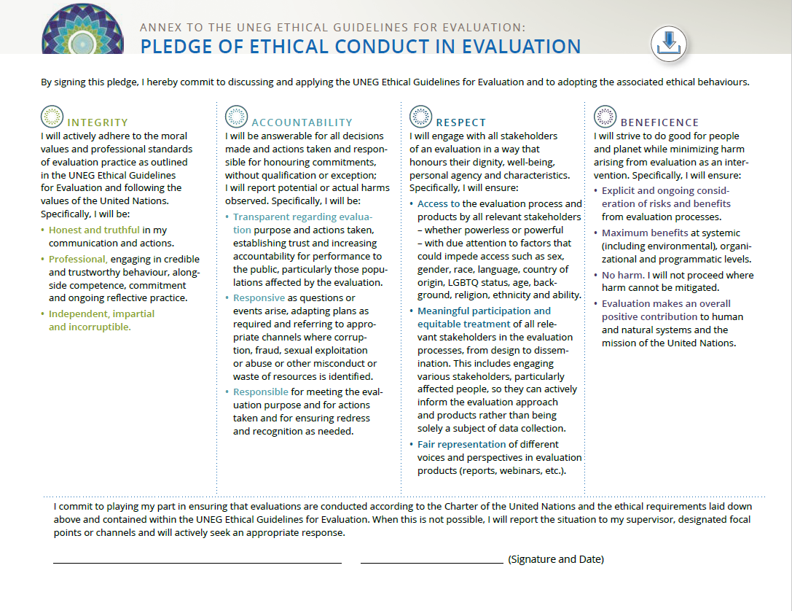

FULL NAME
Role, Organization

Slide 4
Context: Conducting Evaluations at the IEO
Corporate & thematic evaluations – to assess the effectiveness of UNDP’s contribution to development results globally
Timeframe – ca. 9 months from evaluation launch to finish
Conducted in-house with consultant support
Recommendations – Made only to UNDP management (not partners), on both programmatic issues and questions of institutional effectiveness and efficiency
Budget – about $200,000 for consultancy support, travel, external reviewers, software and tools (excl. staff costs)
Notes:
- Breadth vs depth: careful design choices
- Little time for participatory methods, obliged to cut corners
- Tendency to fall back on individual consultants who know our way of working
- Recommendations often meaningless at local/national level: too far removed

Slide 5
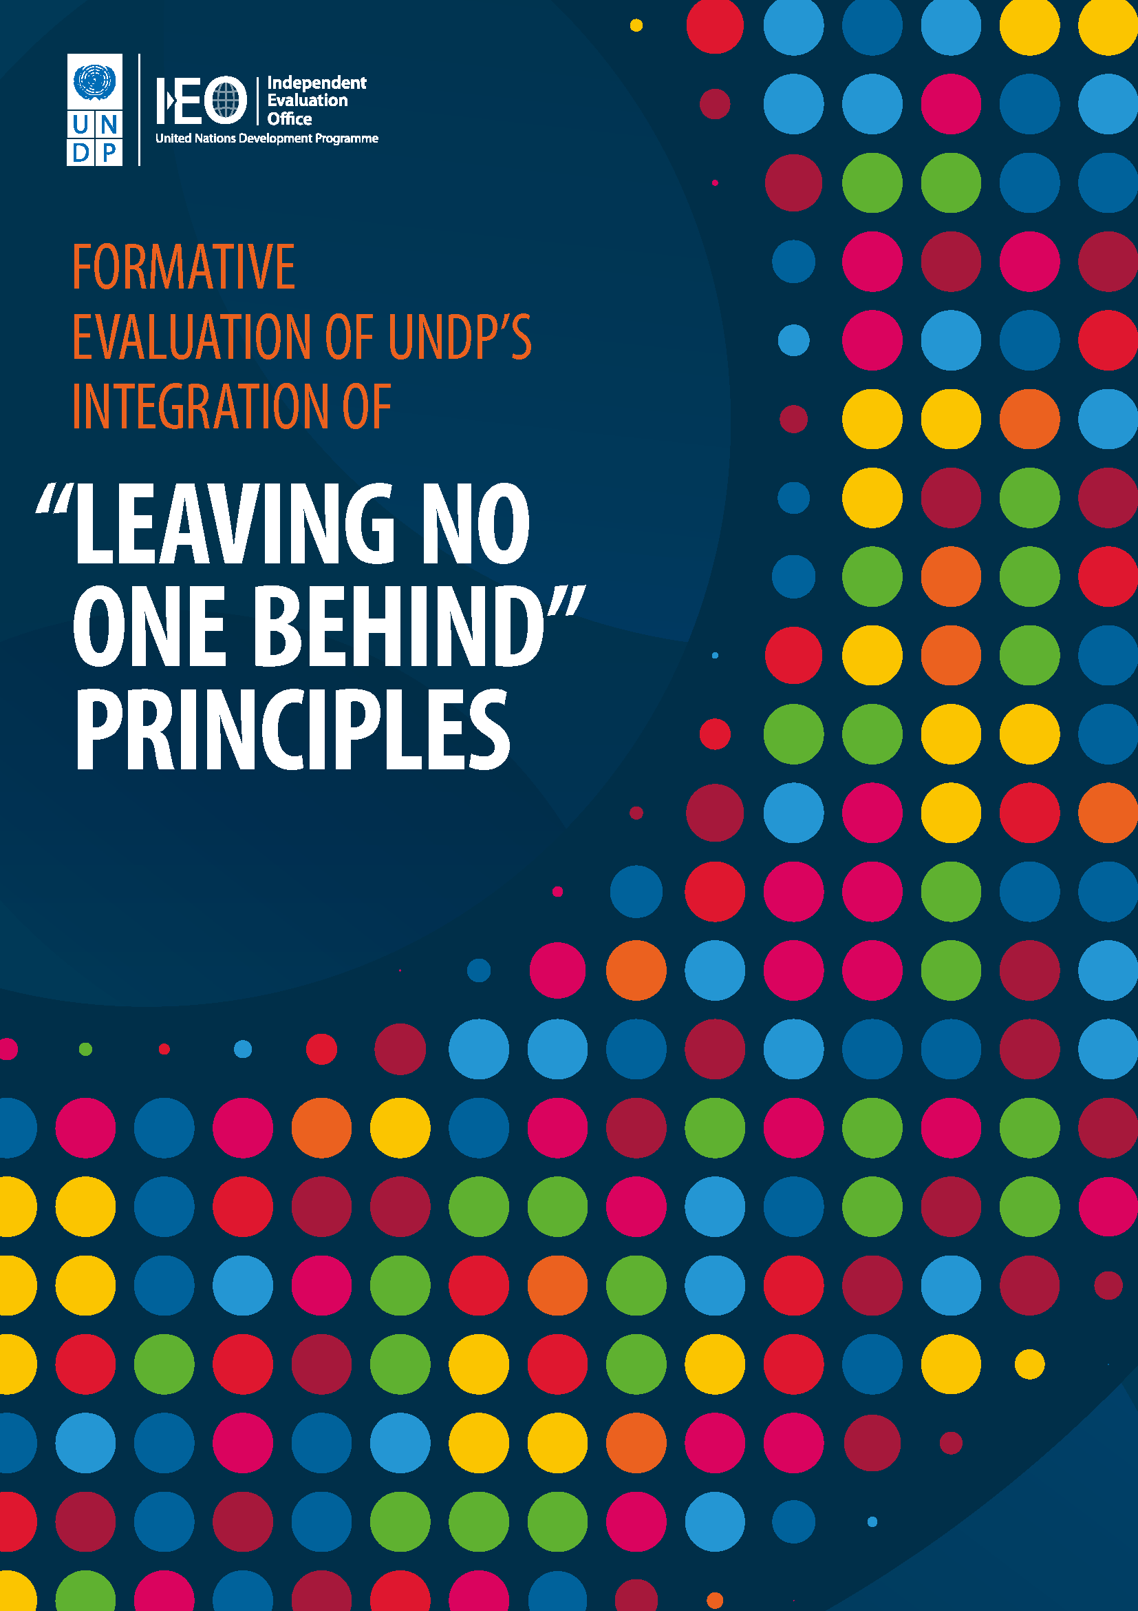
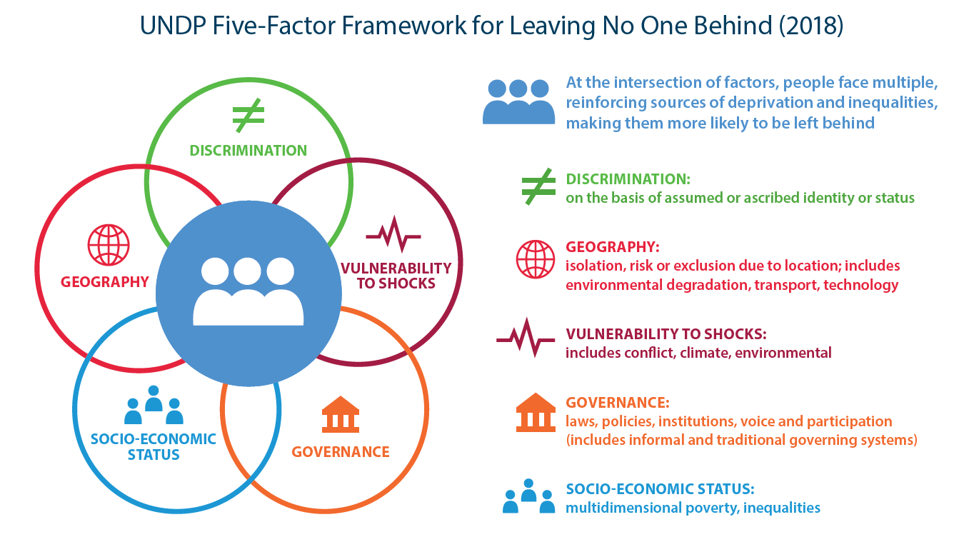
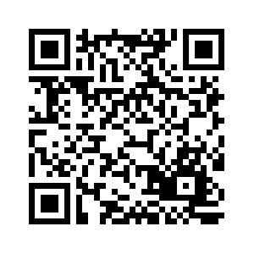
UNDP’s LNOB Evaluation
Notes:
1. ‘Leaving no one behind’ (LNOB) is a central transformative promise of the 2030 Agenda for Sustainable Development and its Sustainable Development Goals (SDGs).
2. ‘Reaching the furthest behind first’ is the second part of the pledge – and key to achieving LNOB.
3. The UNDP strategic plan 2022-2025 elevates LNOB to one of three “directions of change”.

Slide 6





Some Findings
UNDP well-positioned to help bring clarity, leadership and practical approaches
Emphasis on equity and equality intrinsic to UNDP, less focus on non-discrimination
Cautious approach – limited efforts to address power relations and social norms
Growing understanding of heterogeneity within targeted populations, and of intersectionality
Capacity to bring diverse stakeholders together not fully leveraged for LNOB with non-government actors

Slide 7
Lessons on Ethical Conduct of Evaluation
Integrity – Independence both structural and behavioural (hire diverse and impartial people; train them on specific ethics requirements); commitment and ongoing reflective practice – people on the ground to interpret culture and context
Accountability – Transparency & responsiveness (meet purpose, feed information back), downward accountability (incomplete)
Respect – Honour dignity, meaningful participation (external ethical review board - safeguards; clear language), fair representation (?)
Beneficence – Good for people and planet (no air travel – COVID-19), no harm (disincentives for hired consultants to stop collecting data), evaluation as an intervention

Slide 8
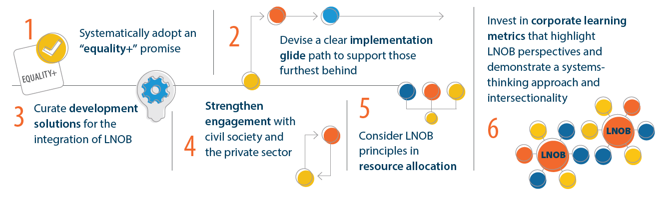
LNOB Evaluation Recommendations to UNDP Management

Slide 9


3 - 7 June 2024

