Slide 1

Resources
Treasury Board of Canada Secretariat. Theory-Based Approaches to Evaluation: Concepts and Practices. https://www.canada.ca/en/treasury-board-secretariat/services/audit-evaluation/evaluation-government-canada/theory-based-approaches-evaluation-concepts-practices.html
John Mayne (2018). The COM-B Theory of Change Model. Working Paper. https://www.researchgate.net/publication/323868561_The_COMB_ToC_Model4
Itad (2020). Measuring political access and influence in fragile and conflict-affected settings. https://www.itad.com/article/measuring-political-access-influence-fragile-conflict-affected-settings/
Itad (2023).You can’t achieve system change without investing in advocacy. Blog on systems change and advocacy. https://www.itad.com/article/you-cant-achieve-system-change-without-investing-in-advocacy/

Slide 2
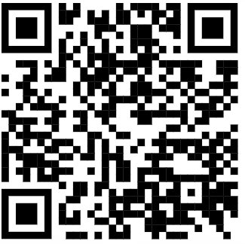
Resources
Better Evaluation. Evaluating capacity development. https://www.betterevaluation.org/methods-approaches/themes/evaluating-capacity-development
Tom Aston (2020). Boundaries, relationships, and incremental change. Blog on Outcome Mapping and actor-based change frameworks. https://thomasmtaston.medium.com/boundaries-relationships-and-incremental-change-31cd69882fcd
Drew Koleros et al.(2020). Actor-based Change Framework: A Pragmatic Approach to Developing Program Theory for Interventions in Complex Systems. American Journal of Evaluation. https://journals.sagepub.com/doi/full/10.1177/1098214018786462
Koleros, D. & Forrester, E. (2022). Introduction to System Change Evaluation in Teen Pregnancy Prevention. U.S. Department of Health and Human Services. https://rhntc.org/sites/default/files/resources/opa_intro_sys_change_eval_sheet_1-26-2023.pdf
www.actorbasedchange.com

Slide 3



Connect with us
evaluation@international.gc.ca
https://www.international.gc.ca/gac-amc/publications/evaluation/index.aspx
Mathieu Audet
Director
Evaluation Division

