Slide 1

Landscape Analysis on Equity-oriented Evaluation
The urgent need to transform unfair power dynamics
=
Cecilia Milesi | Global Change Center | www.globalchange.center
Research commissioned by Ford Foundation and developed in collaboration with eight Global South organizations

Slide 2
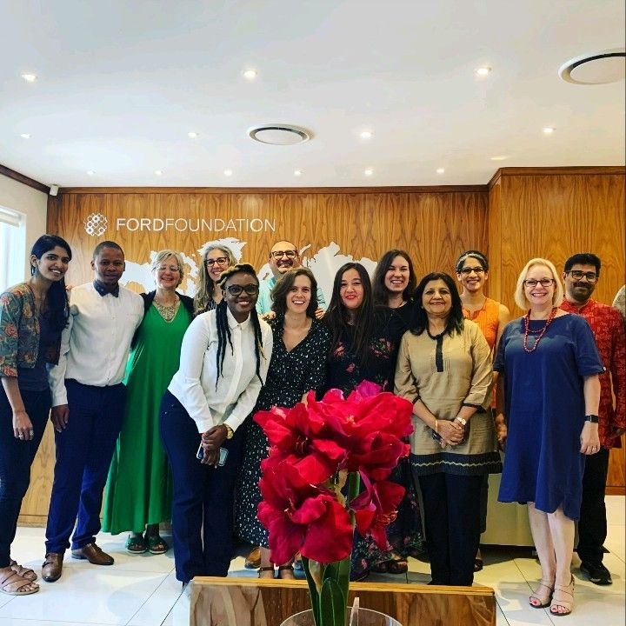
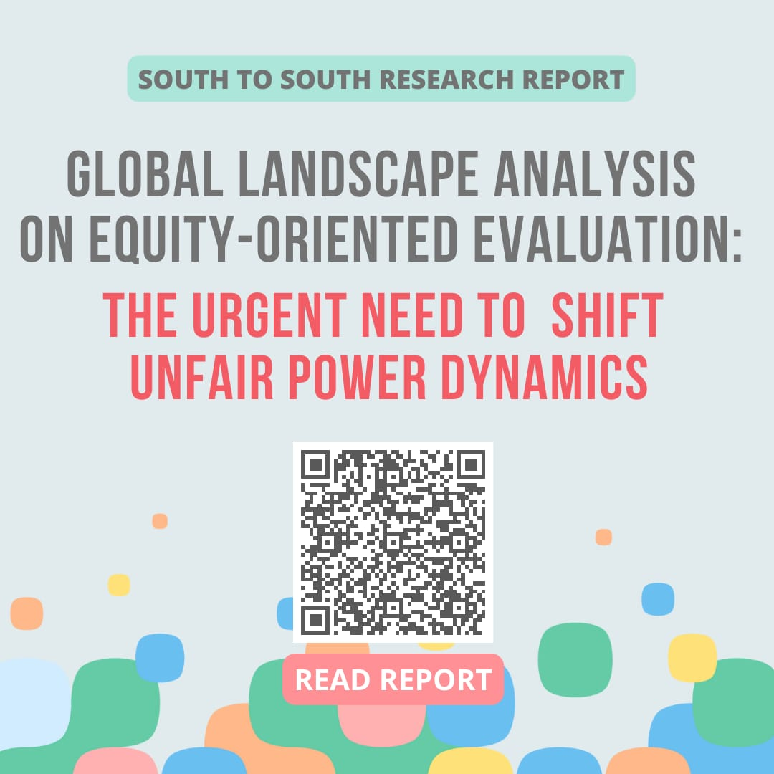

Slide 3

Conclusion
The way that international cooperation initiatives are evaluated perpetuates structural and historical inequities at the global, regional, national, and local level.
These injustices are –proactively or subtly– reinforced by institutional day-to-day decisions regarding how evaluations are designed, funded, commissioned, implemented, and disseminated worldwide.
.

Slide 4
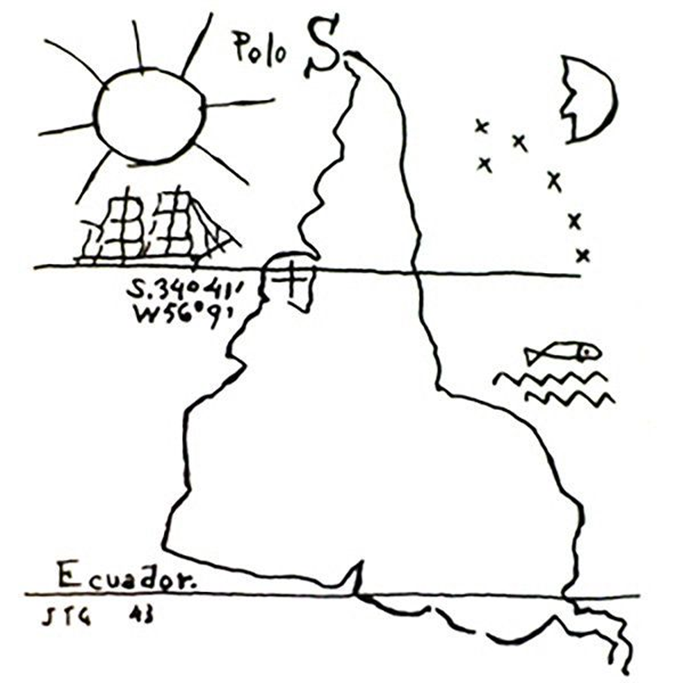
POWER
*turning the map up-side-down

Slide 5
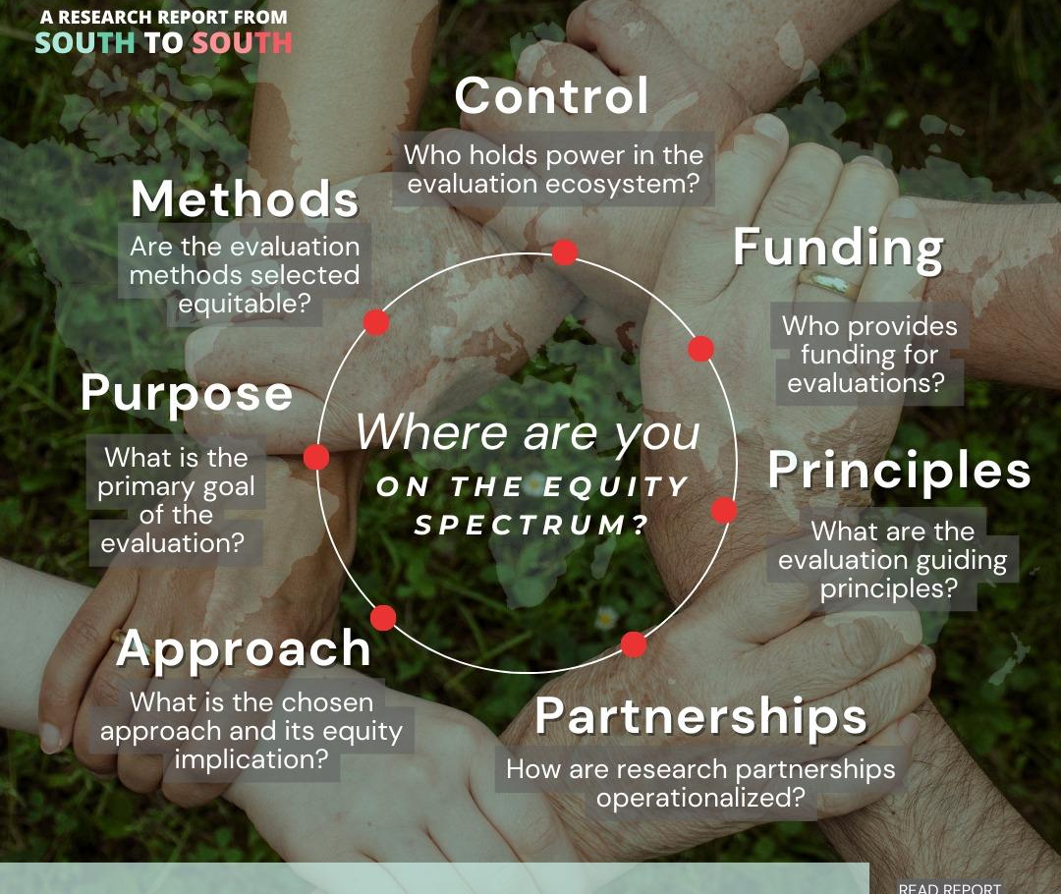
THE SPECTRUM OF EQUITY

Slide 6
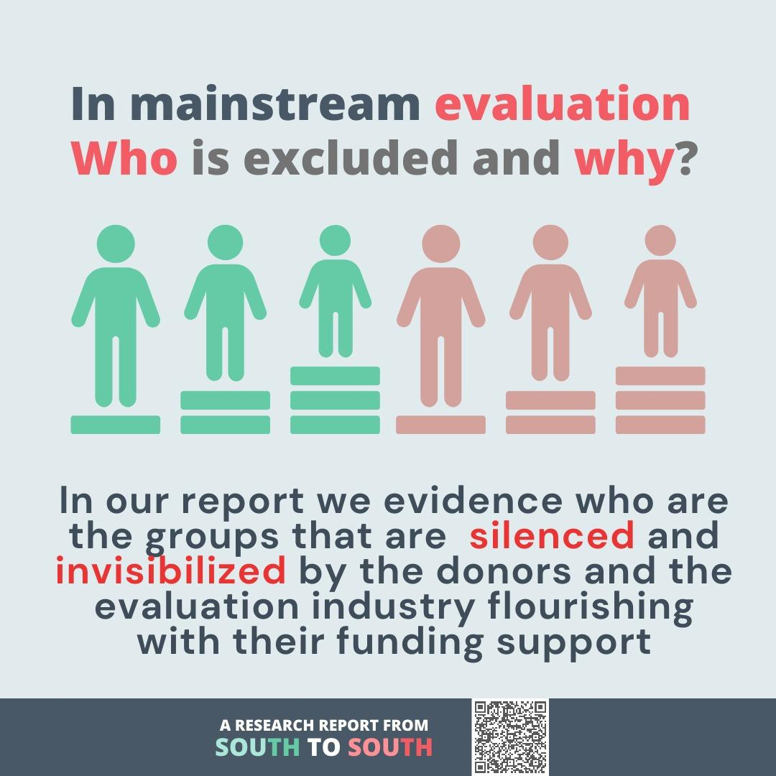
WHO IS EXCLUDED
Systemic exclusion

Slide 7
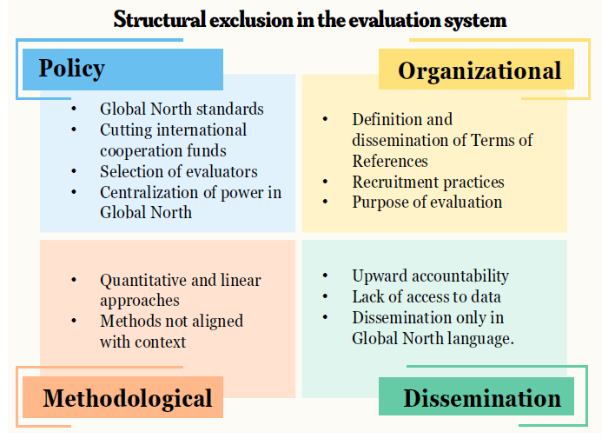
HOW EXCLUSION HAPPENS
Ecosystem and institutional-wide barriers

Slide 8
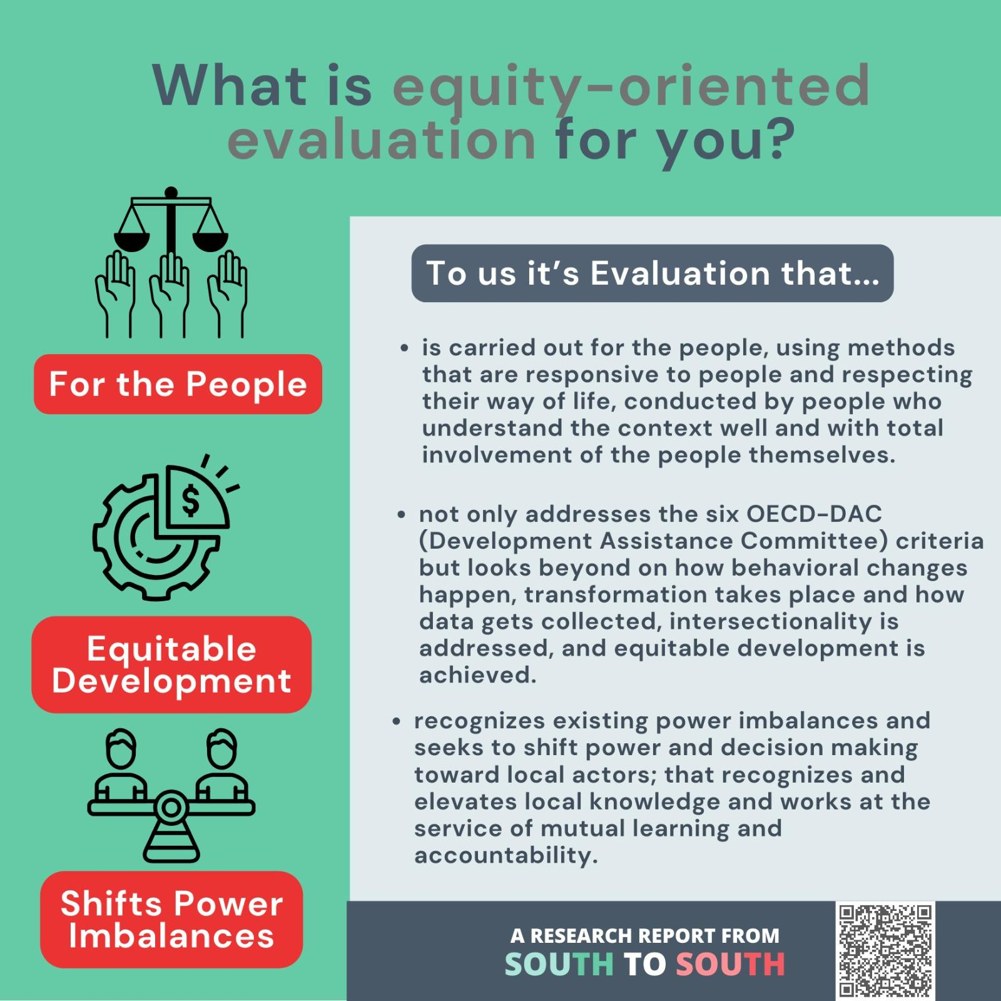
OUR VISION
EQUITY-CENTERED EVALUATION

Slide 9
JOURNEYS OF CHANGE

Slide 10

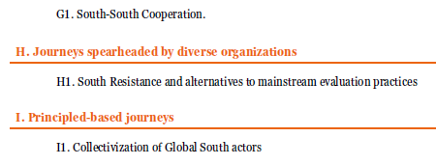

Slide 11
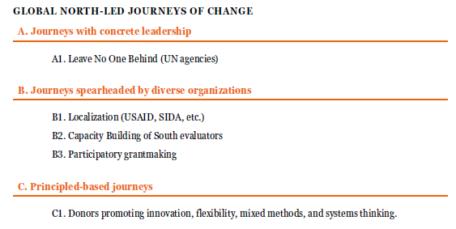

Slide 12
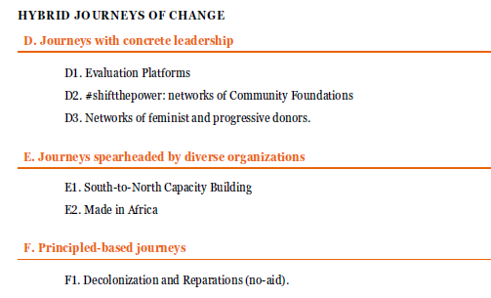

Slide 13
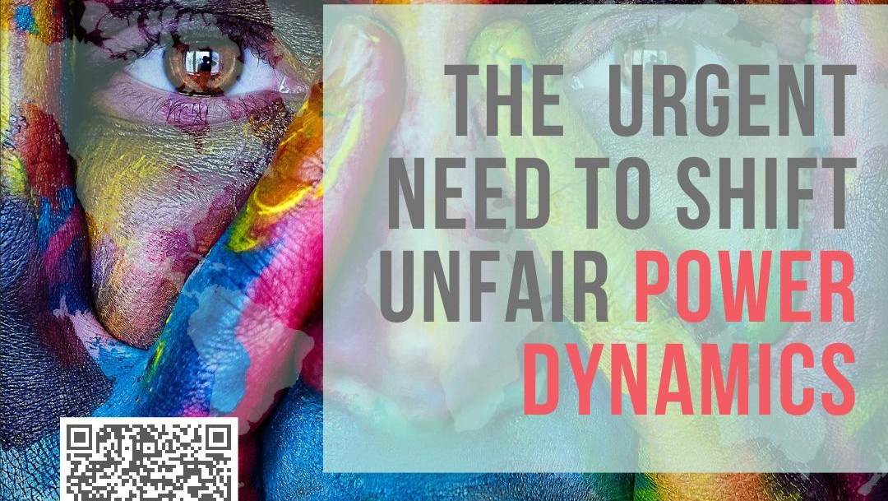
RECOMMENDATIONS

Slide 14
The Report
Full report: https://globalchange.center/wp-content/uploads/2023/08/Landscape-Analysis_Equity-Oriented-Evaluation-Full-Report-Final_August23.pdf
Executive Summary: https://www.fordfoundation.org/work/learning/program-evaluations/an-analysis-on-equity-centered-evaluation-in-international-cooperation/

