Slide 1



EVALUATION OF COMPREHENSIVE
CAPACITY DEVELOPMENT PROJECTS: PERFORMANCE DETERMINANT FACTORS
Oliver Serfling, Taisiya Lebedeva

Slide 2
Agenda
Capacity Development (CD) as a Concept
Discussion
Quantitative Significance of CD
CD Evaluation Outcomes
Discussion
Theoretical Foundations
Outlook: Empirical Test
Discussion

Slide 3
Capacity Development as a concept
‘Capacity Building’ or ‘Capacity Development’ (CD) has gained considerable prominence
  not only in the Development Arena
  but it seems that the term rests on shallow grounds
  foundations of the concept are vague, basic principles unknown
Rigorous research needed:
  Identification of a common definition for CD
    Common process description for CD
    Differences accross academic disciplines and
    practitioners, i.e. development agencies.
  Quantitative Significance in Development Practice
  Meta-Evaluation of CD projects

Slide 4
History of Capacity Development
The literature on CD dates back
to the early 1980s
  With some authors pointing to predecessors on institutional strengthening in 70s
Majority of publications after 1990,
in the 2000s
Influenced by the ideas of Douglas C. North on the role of formal / informal institutions in the development process
Gained official recognition by The Paris Declaration on Aid Effectiveness in 2005 and the Accra Agenda for Action 2008:
„Without robust capacity – strong institutions, systems, and local expertise – developing countries cannot fully own
and manage their development processes. We agreed in the Paris Declaration that capacity development is the responsibility
of developing countries, with donors playing a supportive role, and that technical
co-operation is one means among others
to develop capacity.“
(OECD, 2005/2008, p.16).

Slide 5
Towards a Definition
UNESCO, 2010:
Capacity building/development
is the process by which individuals, groups, organizations, institutions and societies increase their abilities to: (a) perform core functions, solve problems, define and achieve objectives; and
(b) understand and deal with their development needs in a broad context and in a sustainable manner.
Even though recognized
by OECD-DAC any ‘official’ definition is lacking
The literature only agrees on
  complexity, multidimensionality
  being means and end
  lack of a common definition is obstacle to effective implementation
CD a “wide currency
in the development community”

Slide 6

Discussion
What were your encounters with CD?
Tell us about the projects you were involved in that contained a CD component
What is your experience with designing, implementing and evaluating CD?
What in your opinion is the relevance of CD for development interventions in general?
Image: ”flaticone.com”

Slide 7

Data Collection
Quantitative Significance
of Capacity Building
The first quantified contribution to CD for Sustainable Development discourse.
Identification strategy
Computational Text Analysis of bi-grams based on a string search of word combinations of “capacity” with “building”, “development”, “strengthening”
and “enhancement” in either project title
or in the description
We have harmonized all publicly available data
on development projects of 5 major multilateral development banks and organizations
with the following information per 74238 project:
  title,
  description,
  country (and region),
  sector,
  date of approval and project duration,
  allotted budget.
7.6% of all projects are related to CD, claiming 7% of the earmarked budget
Image: ”flaticone.com”
Notes:
The World Bank Group (WB, 2022),
Asian Development Bank (ADB, 2022),
African Development Bank Group (AfDB, 2022),
Inter-American Development Bank (IADB, 2022),
United Nations Development Program (UNDP, 2022).

Slide 8
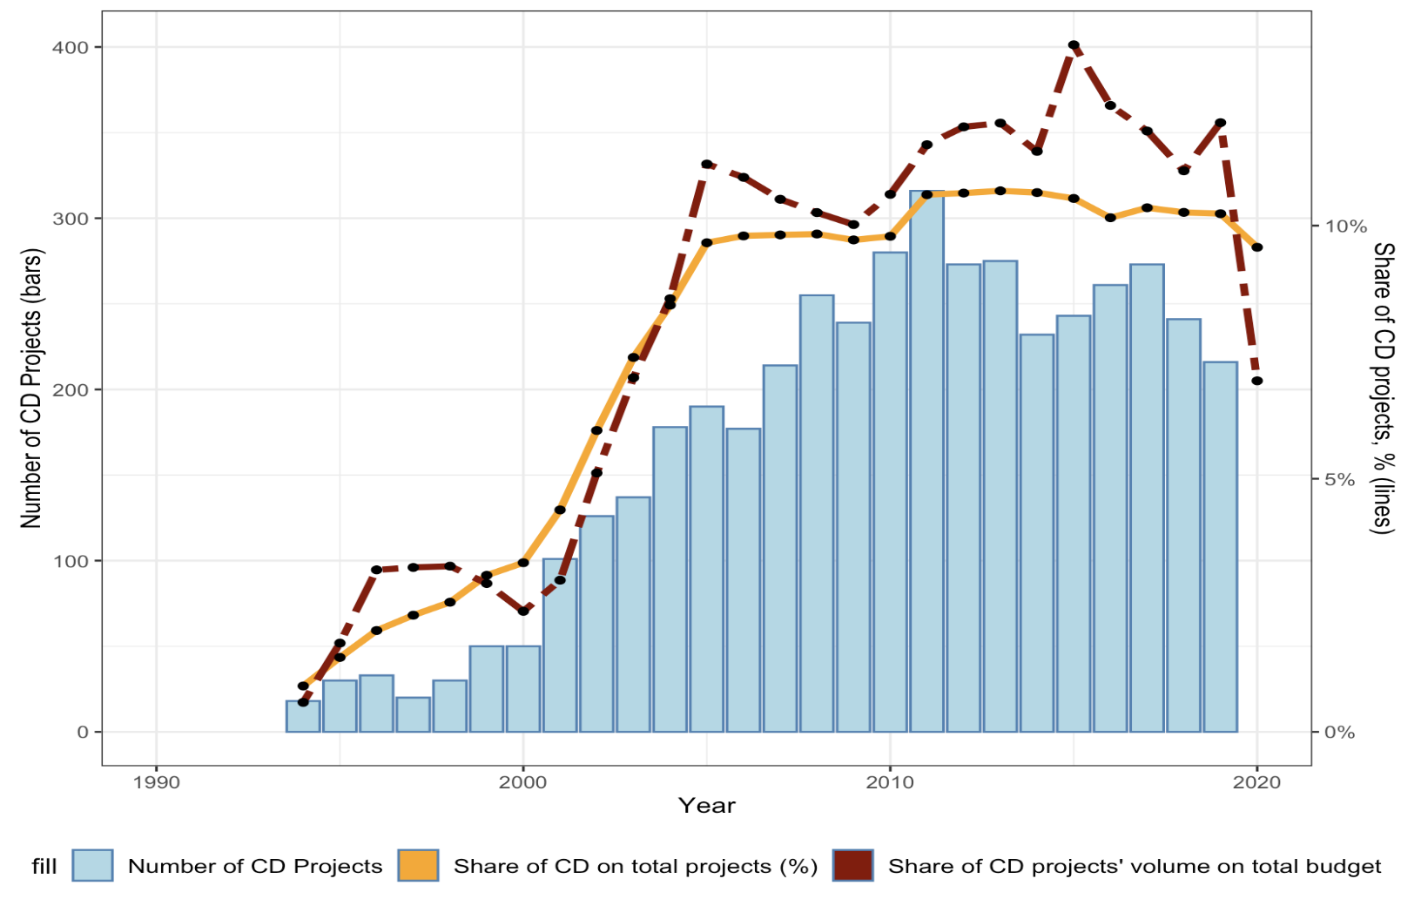
Increasing Significance of CD over time
the first project identified as CD by us was exactly registered in the year 1990
increasing share of projects and their budget in the decade 2000-2010
In the third decade, both shares and absolute number of CD projects remain on a high, but slightly declining level
5-year moving average
Notes:
-> corroborates the notion found in the literature that the concept made its way into development practice in the 1990s

Slide 9
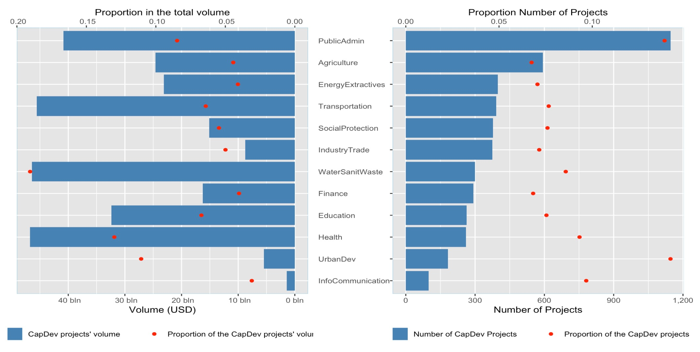
Number and Volume by Sector
Notes:
Public Administration is the leading sector both in absolute number of CD projectes with over 400 as well as in terms of total CD project volume. The largest share of number and volume belongs to the urban development sector

Slide 10
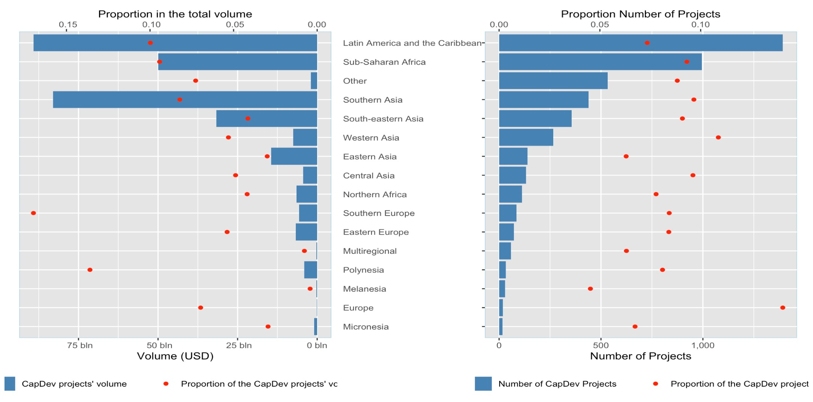
Number and Volume by Region
Notes:
Sub-Saharan Africa stands out having the largest number
and the highest volume of CD projects.

Slide 11
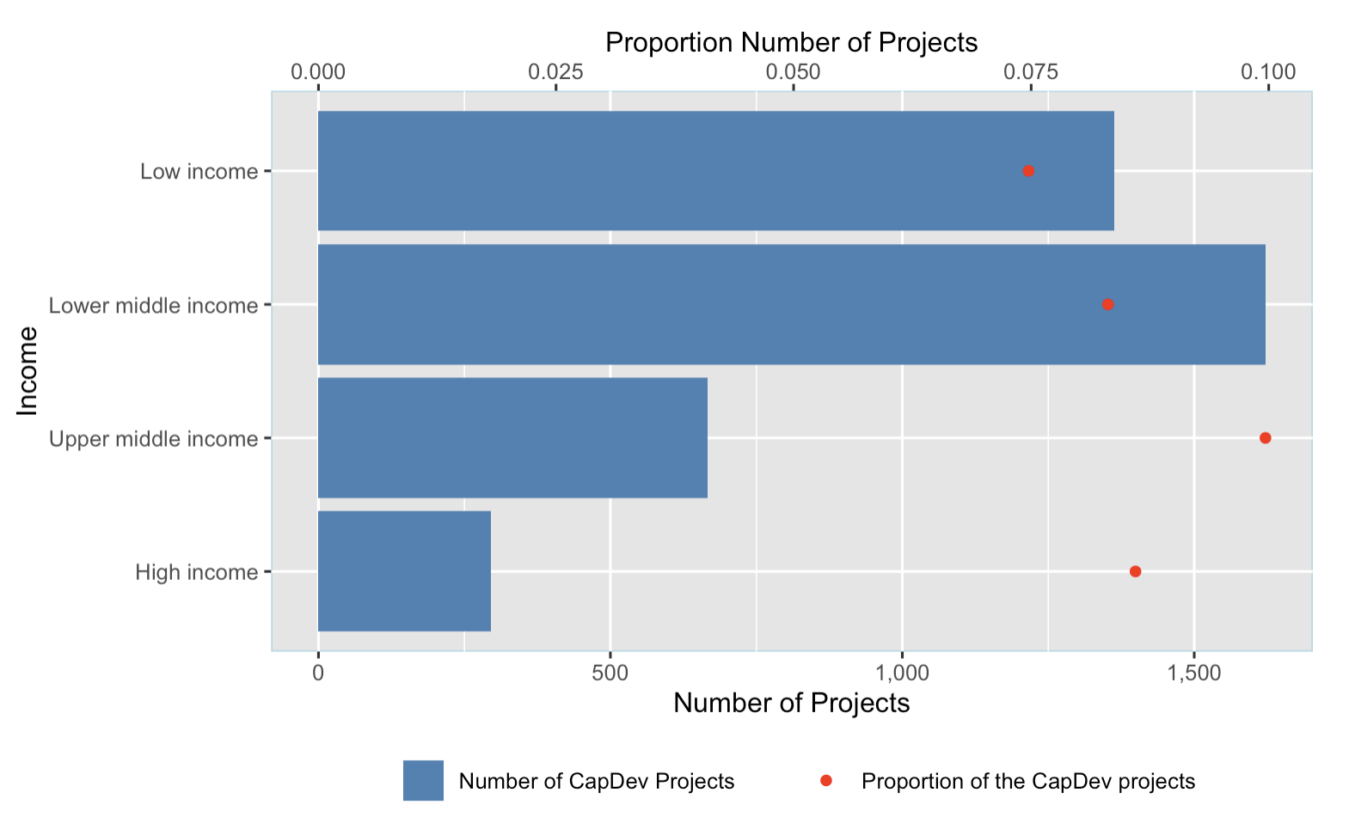
Inverse to state of development
The importance of CD in development is reciprocal
to the state of development of a country.
declining share of projects and their volumes the higher the income, and thus capacities, in the recipient country
But a certain level of capacities should exist in order to develop these further

Slide 12
CD worse evaluation outcomes
WB IEG evaluation outcomes
Mean evaluation outcome
3 dimensions:
Relevance
Efficacy
Effectiveness
0.28 for CD
VS
1.5 | Highly satisfactory
1 | Satisfactory
0.5 | Moderatly satisfactory
- 0.5 | Moderatly unsatisfactory
- 1 | Unsatisfactory
- 1.5 | Highly unsatisfactory
0.41 for non-CD
Wilcoxon-Mann-Whitney test
p-value = 0.00000000001096
(World Bank 2023, p.3)

Slide 13
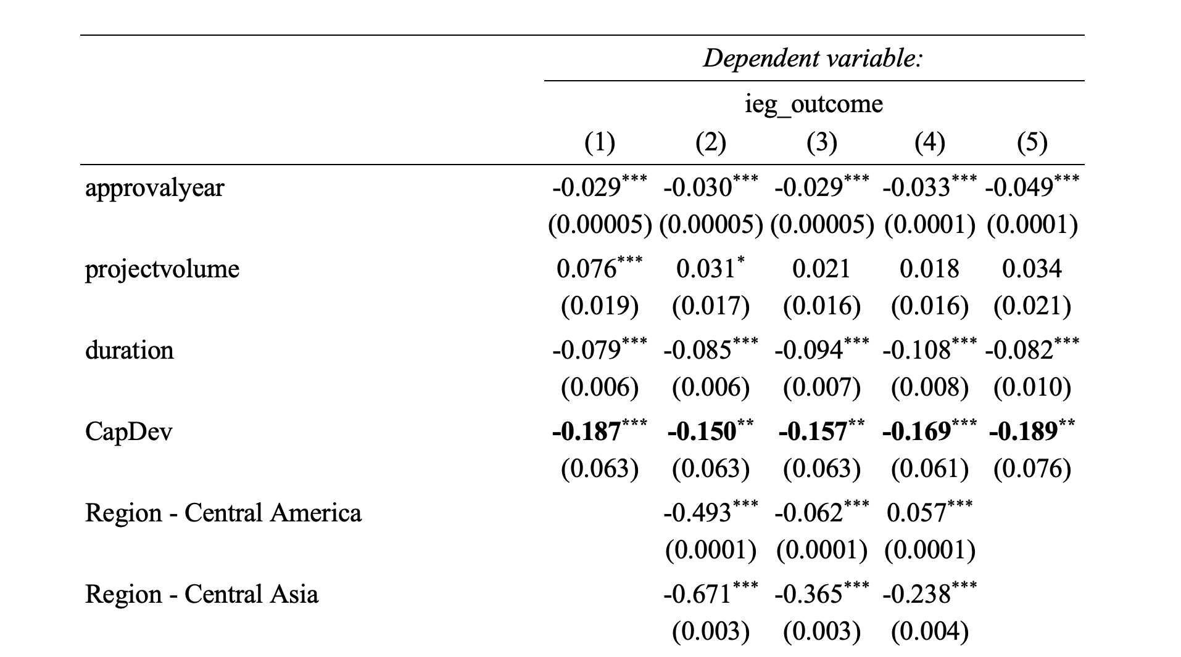

CD lower evaluation outcomes
Full regression table

Slide 14
Discussion
Reflect on the presented results:
are they in line with your expectations?
What confirmed your ideas?
What did you find surprising?
How would you conceptualize capacity
and capacity development?
Image: ”flaticone.com”

Slide 15
Complementarity of CD interventions
z
Macro Systems
A holistic CD Intervention exists on three levels that
are interconnected and highly complementary to each other.
Meso Organisational
Micro
Individual
Own representation, based on Common Framework on Capacity Development for Agricultural Innovation Systems: Conceptual Background - Scientific Figure on ResearchGate. Available from: https://www.researchgate.net/figure/The-3-dimensions-of-Capacity-Development_fig4_305956313 [accessed 12 Oct, 2020]

Slide 16
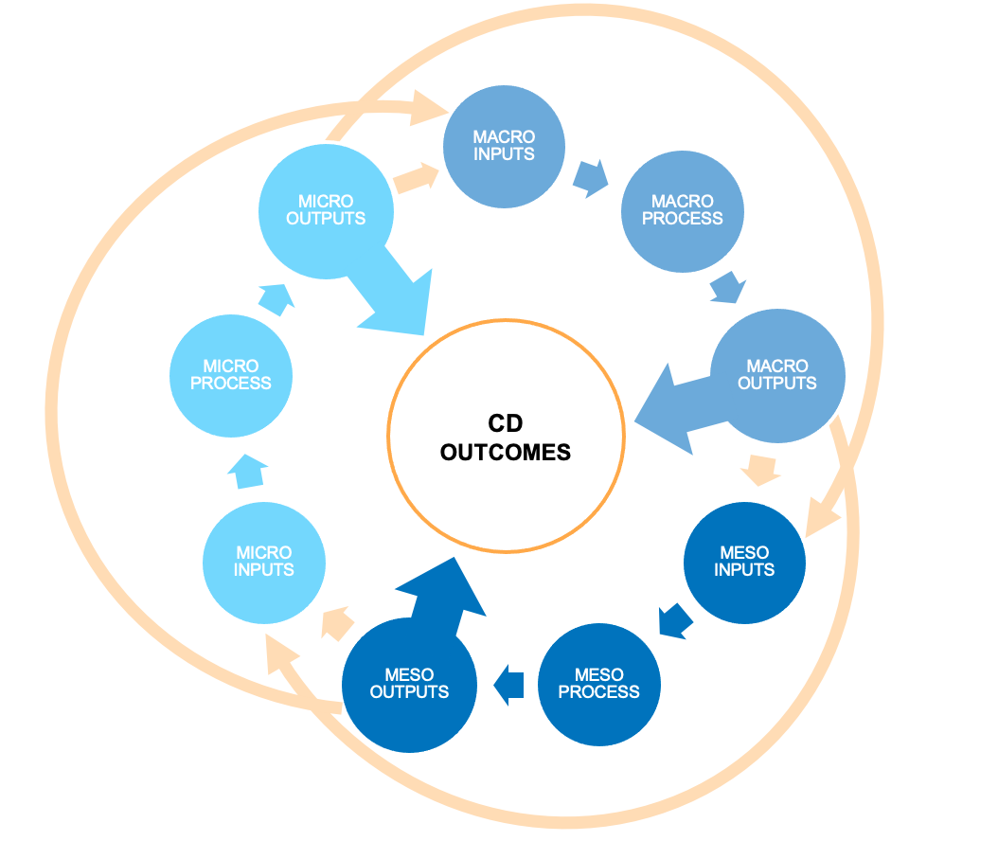
CD Results Chain
Non-linear
Outputs of each level also serve as inputs
to other levels
CD outcomes depend on the outputs at each level together

Slide 17
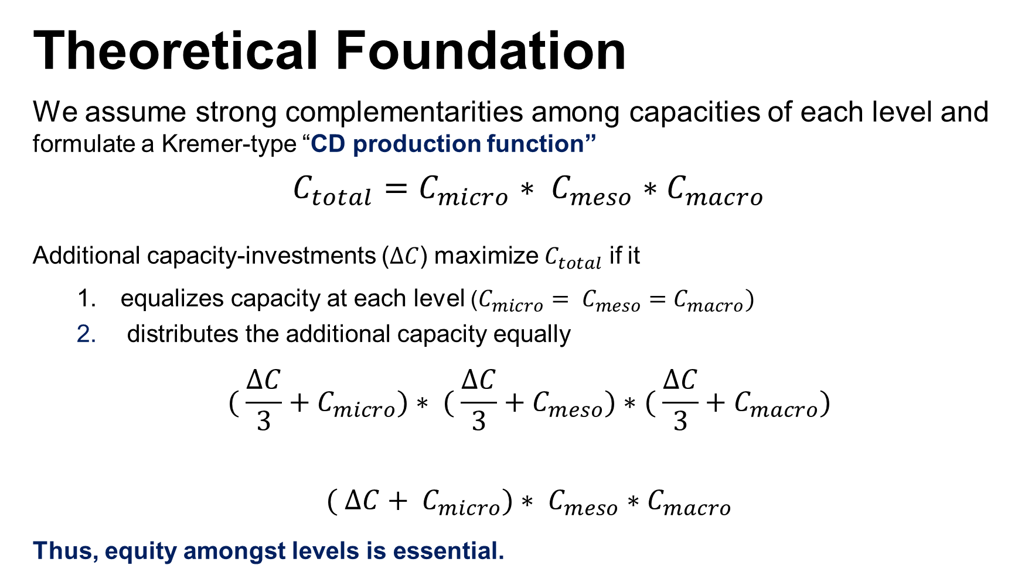
Theoretical Foundation
We assume strong complementarities among capacities of each level and formulate a Kremer-type “CD production function”
$$C_{total}=C_{micro}∗ C_{meso}∗C_{macro}$$
Additional capacity-investments ($∆C$) maximize $C_{total}$ if it
  equalizes capacity at each level ($C_{micro}= C_{meso}=C_{macro})$
  distributes the additional capacity equally
$${( \frac{∆C}{3}+C}_{micro})∗ {( \frac{∆C}{3}+C}_{meso})∗{( \frac{∆C}{3}+C}_{macro})$$
$${( ∆C+ C}_{micro})∗ C_{meso}∗C_{macro}$$
Thus, equity amongst levels is essential.
>

Slide 18
Outlook: Empirical Test
Hypothesis | Holistic CD interventions, i.e. those addressing the complementarity amongst all levels, achieve better evaluation outcomes
Data | The World Bank Project Appraisal Documents (PADs) IEG Project Evaluation Outcomes Database
Methodology | Step 1. Classification of projects based on the number of addressed levels using a computational text analysis methods (CTA) Step 2: Regression analysis with number of addressed levels as an independent variable
Limitations | Proper identification of CD-projects (wording) Measurement of the intensity how a certain level is addressed in an intervention (alt. Procurement Data?)

Slide 19
Discussion
Reflect on the theoretical foundations presented:
How is it in your experience? How often do projects conduct activities at all three levels?
Do you have an impression that these are more successful? Or more sustainable in the long run?
Image: ”flaticone.com”

Slide 20

Contacts
Prof. Dr. Oliver Serfling
Professor of Economic Policy
and Development Economics
Faculty of Society and Economics
Head of Degree Program
M.A. Sustainable Development Management
a
oliver.serfling@
hochschule-rhein-waal.de
Taisiya Lebedeva, M.A.
M.A. Sustainable
Development Management
Junior Researcher
Capacity Building global TransRegInt Project
a
taisiya.lebedeva@
hochschule-rhein-waal.de

