Slide 1


EMPOWERING DATA-DRIVEN DECISION-MAKING IN DEVELOPMENT PROJECTS USING BUSINESS INTELLIGENCE (POWER BI)
Presented by Constance Lambert,
Monitoring, Evaluation and Learning Advisor
June 4, 2024

Slide 2
Agenda
SOCODEVI Monitoring and Evaluation
Power BI and Data Analysis Essentials
Power BI for collaborative and efficient project management
Integrating PBI data analysis into MEL system

Slide 3

SOCODEVI
SOCODEVI supports cooperatives and helps them to consolidate as catalysts of inclusive, sustainable socio-economic development.
Our ultimate goal: To improve the living conditions of families in developing countries.
Notes:
Let me start by presenting the international development NGO for wich I work : SOCODEVI
In 1985, cooperatives and mutuals in Québec came together to form an organization that would enable them to share their experiences and expertise with organizations of the global South.
The result was SOCODEVI, the Société de coopération pour le développement international, a Canadian non-profit corporation.

Slide 4




SOCODEVI - Our Data Collections Tools
Mobile Application and Web Platform for Monitoring and Assessing Projects
Cooperative entreprises Change Management Approach and Web Platform
Notes:
We also have Co Up : Web platform and mobile application to strengthen the link between cooperatives and their members
And JGO which is a Project Financial Management Software
But for the sake of this presentation, the demonstrations will mainly be on the ImpactCoop/PerformCoop data base.

Slide 5
SOCODEVI - Our Data Collections Tools
Software created in 2018 by SOCODEVI
To collect and store household data
The Objectives:
Reduce time and costs related to project monitoring
Eliminate the risks associated with paper-based data collection
Centralize data in a secure location (SQL server)
Customized to the needs of each project
Notes:
We also have Co Up : Web platform and mobile application to strengthen the link between cooperatives and their members
And JGO which is a Project Financial Management Software
But for the sake of this presentation, the demonstrations will mainly be on the ImpactCoop/PerformCoop data base.

Slide 6






SOCODEVI - Our Data Structure
Other entities:
Land
Infrastructure
Extension visit
Training
Attendance
Household Level
Person
Registry

Slide 7

Integrating PBI data analysis into MEL system

Slide 8
Integrating PBI data analysis into MEL system
Intermediate Evaluation PBI Report
Impact Assessment PBI Report
Activity monitoring Dashboard
Final Evaluation PBI Report
Baseline PBI Report
Project development
Planification
Closing of the project
Implementation
Post-mortem

Slide 9
Integrating PBI data analysis into MEL system
Ultimate Outcomes
Intermediate Outcomes
Immediate Outcomes
Output
Result Based Management
Project Planification
Baseline Report
Project Closure
Final Evaluation Report
Implementation Phase
Intermediate Report
Implementation Phase
Monitoring Dashboard
Notes:
10 minutes
Results-based management (RBM) is a program/project life cycle approach to management

Slide 10
Baseline Power Bi Report
Integrating PBI data analysis into MEL system
Template with the SQL database architecture simplified including report pages common to all project:
Survey Monitoring
Socio-demographic Data
Ultimate Outcomes integrated in our template

Slide 11
Monitoring Dashboard
Integrating PBI data analysis into MEL system
Template with the SQL database architecture simplified including:
Training monitoring
Data cleaning tool
Custom addition:
Immediate outcome unique for each project (Annual data collection)

Slide 12
Final/Intermediate Evaluation Report
Integrating PBI data analysis into MEL system
No template for now, but generally include:
Survey Monitoring
Socio-demographic Data
Ultimate Outcomes (Final) and/or Intermediate Outcomes (Intermediate)
Statistical comparison test (Chi Square and t-test in DAX)

Slide 13
Other uses
Integrating PBI data analysis into MEL system
Institutional Analysis
Human Resource – Hours dedicated to each project by each employee
Institutional indicators (ex: Total number of beneficiaries)
Interesting insights for the communication team to share
Cooperative level Analysis
Dashboard template to allow retrieving of all cooperative level data from the PerformCoop database

Slide 14

Power BI and Data Analysis Essentials

Slide 15
Three Versions of Power BI
Power BI and Data Analysis Essentials
Microsoft Power BI Free/Desktop provides business insights with visualizations
Microsoft Power BI Pro is the full version with unlimited reporting, sharing and viewing
Microsoft Power BI Premium provides a dedicated unit of capacity for all users in the organization
The biggest difference between Pro and Free is the ability to share data, reports and dashboards with large number of users
Notes:
Power BI currently comes in three versions: Microsoft Power BI Free/Desktop – This version is for users who want to get business insights from their data with visualizations. Microsoft Power BI Pro – This is the full version of Power BI. It allows users unlimited reporting, sharing, and viewing of reports. Microsoft Power BI Premium – This version provides a license for all users in an organization. The biggest difference between Pro and Free is the ability to share data, reports, and dashboards with a large number of users that also have a Power BI Pro license while also being able to create an app based workspace.

Slide 16
Overview of Power BI features and capabilities for data visualization and analysis.
Power BI and Data Analysis Essentials
Demonstration
Project TogetHER in Ghana: We want to create a report.
We have been asked to show a summary of the socio demographic data from the Baseline survey and to calculate one indicator from the PMF
The indicator: 1100-1 Percentage of women who control the allocation of economic resources for themselves and their household
Notes:
20 minutes
Prepare an anonymous data set, an indicator to calculate and demonstrate
Transform
Overview
Dashboard
Sharing

Slide 17
Overview of Power BI features and capabilities for data visualization and analysis.
Power BI and Data Analysis Essentials
Useful for Kobo Toolbox users: https://im.unhcr.org/kobosupport/
Notes:
20 minutes
Prepare an anonymous data set, an indicator to calculate and demonstrate
Transform
Overview
Dashboard
Sharing

Slide 18

Power BI for collaborative and efficient project management

Slide 19

Enhanced Communication and Collaboration
The importance of data accessibility for enhancing project management, outcomes, and decision-making
Power BI for collaborative and efficient project management
Transparency and Alignment: Keeps everyone informed and on the same page.
Results Validation: Quick and easy validation of data and results by the team
Seamless Sharing: Facilitates teamwork and information exchange.
Notes:
1. Improved Communication and Collaboration
Transparency: When data is easily accessible, all stakeholders can stay informed about the project's progress and current status, fostering transparency.
Alignment: It ensures that everyone is on the same page, reducing misunderstandings and miscommunications.
Collaboration: Facilitates better teamwork by allowing all parties to access and share information seamlessly.

Slide 20
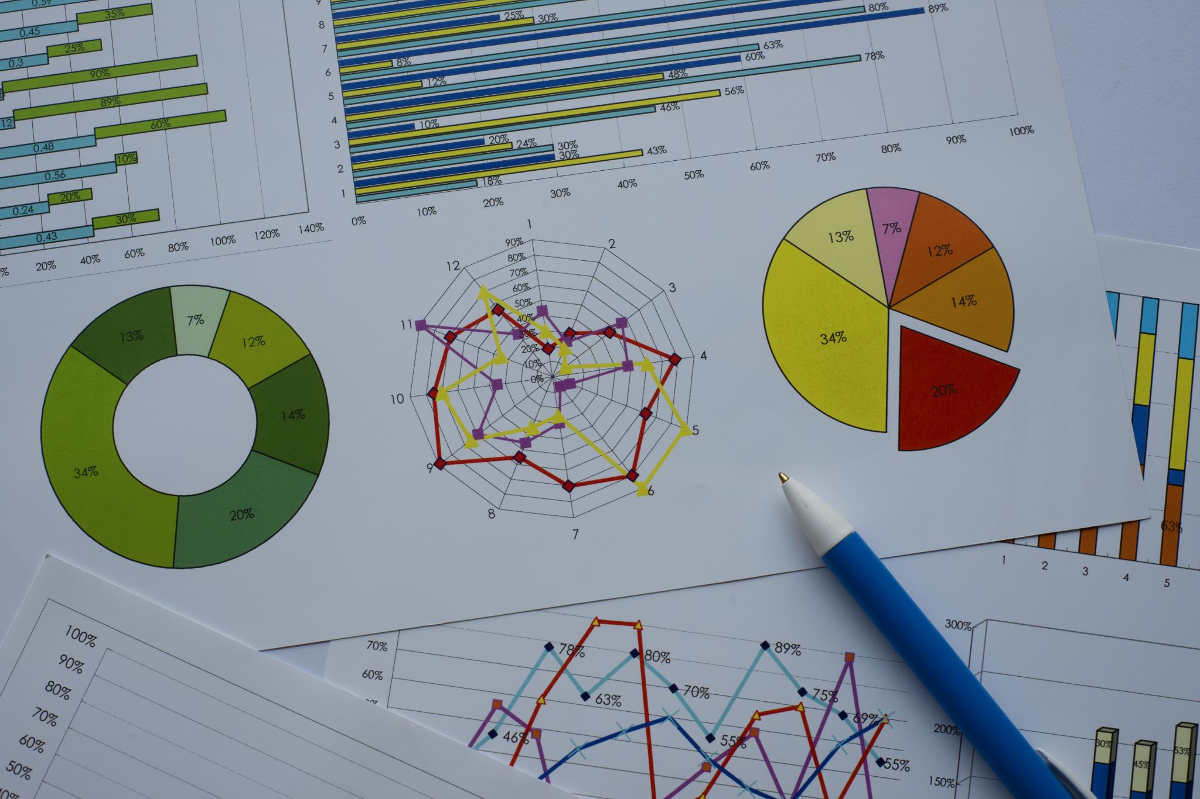
Informed Decision-Making
Real-Time Data: Enables well-informed decisions and strategic planning.
Early Risk Detection: Identifies trends and potential issues promptly.
Notes:
Enhanced Decision-Making
Informed Decisions: Accessible data allows for informed decision-making based on real-time information and comprehensive data analysis.
Predictive Insights: Helps in identifying trends, patterns, and potential risks early, enabling proactive measures.
Data-Driven Strategies: Enables the development of strategies backed by solid data, improving the chances of successful outcomes.
Risk Management
Early Detection: Accessible data can help in the early detection of potential issues or risks, allowing for timely interventions.
Mitigation Strategies: Provides the necessary information to develop and implement risk mitigation strategies effectively.

Slide 21

Efficient Management
Resource and Time Optimization: Improves resource allocation and timeline tracking.
Cost Control: Ensures effective budget management.
Notes:
Efficient Project Management
Resource Management: Facilitates better allocation and utilization of resources by providing insights into resource availability and needs.
Time Management: Helps in tracking timelines and milestones accurately, ensuring that the project stays on schedule.
Cost Management: Enables effective budget tracking and cost control by providing up-to-date financial data.

Slide 22

Accountability and Traceability
Clear Responsibilities: Promotes accountability
Audit Trails: Provides a comprehensive record of project updates.
Notes:
Accountability and Traceability
Audit Trails: Ensures that all changes and updates are documented, providing a clear audit trail.
Accountability: Promotes accountability by making it clear who is responsible for what tasks and deliverables.

Slide 23

Stakeholder Satisfaction and Continuous Improvement
Trust and Engagement: Builds trust through transparency and keeps stakeholders engaged.
Learning and Innovation: Access to past data encourages continuous improvement.
Notes:
Stakeholder Satisfaction
Trust Building: Transparency and open communication foster trust among stakeholders.
Engagement: Keeps stakeholders engaged and informed, which can lead to higher satisfaction and support for the project.
Innovation and Continuous Improvement
Access to Best Practices: Easier access to past project data can provide insights into best practices and lessons learned.
Continuous Learning: Encourages a culture of continuous improvement by facilitating easy access to knowledge and information.

Slide 24
The importance of data accessibility for enhancing project management, outcomes, and decision-making
Power BI for collaborative and efficient project management
How do we insure data accessibility within our organisation?
Main project reports are published on the SharePoint home page of each project
All project reports are shared with the M&E counterpart, headquarter specialists and project manager
The M&E counterpart has the responsibility to popularize the PBI with the local team
Real-time monitoring of data collection progression: Data refresh can be programmed and automatized

Slide 25
Tips on how to use Power BI empower local agents
Power BI for collaborative and efficient project management
Training for M&E counterpart on how to navigate visualisation so that they can present and discuss results to local team and beneficiaries
If M&E counterpart have some data analysis skills, we can invest time in training them in Power BI so they can manage themselves the data analysis
Data cleaning tool allow them to manage the database quality themselves
Report construction as an iterative process with constant input of local agent
Notes:
Revision by the headquarter is necessary to ensure indicators are well calculated.
What do they want to see?
What type of filter/desegregation is relevant for the project?
Is there information that is useful for the local team in their day-to-day operation?

Slide 26

Questions?
logos

Slide 27
Thank you!
For any questions: c.lambert@socodevi.org
logos

