Slide 1
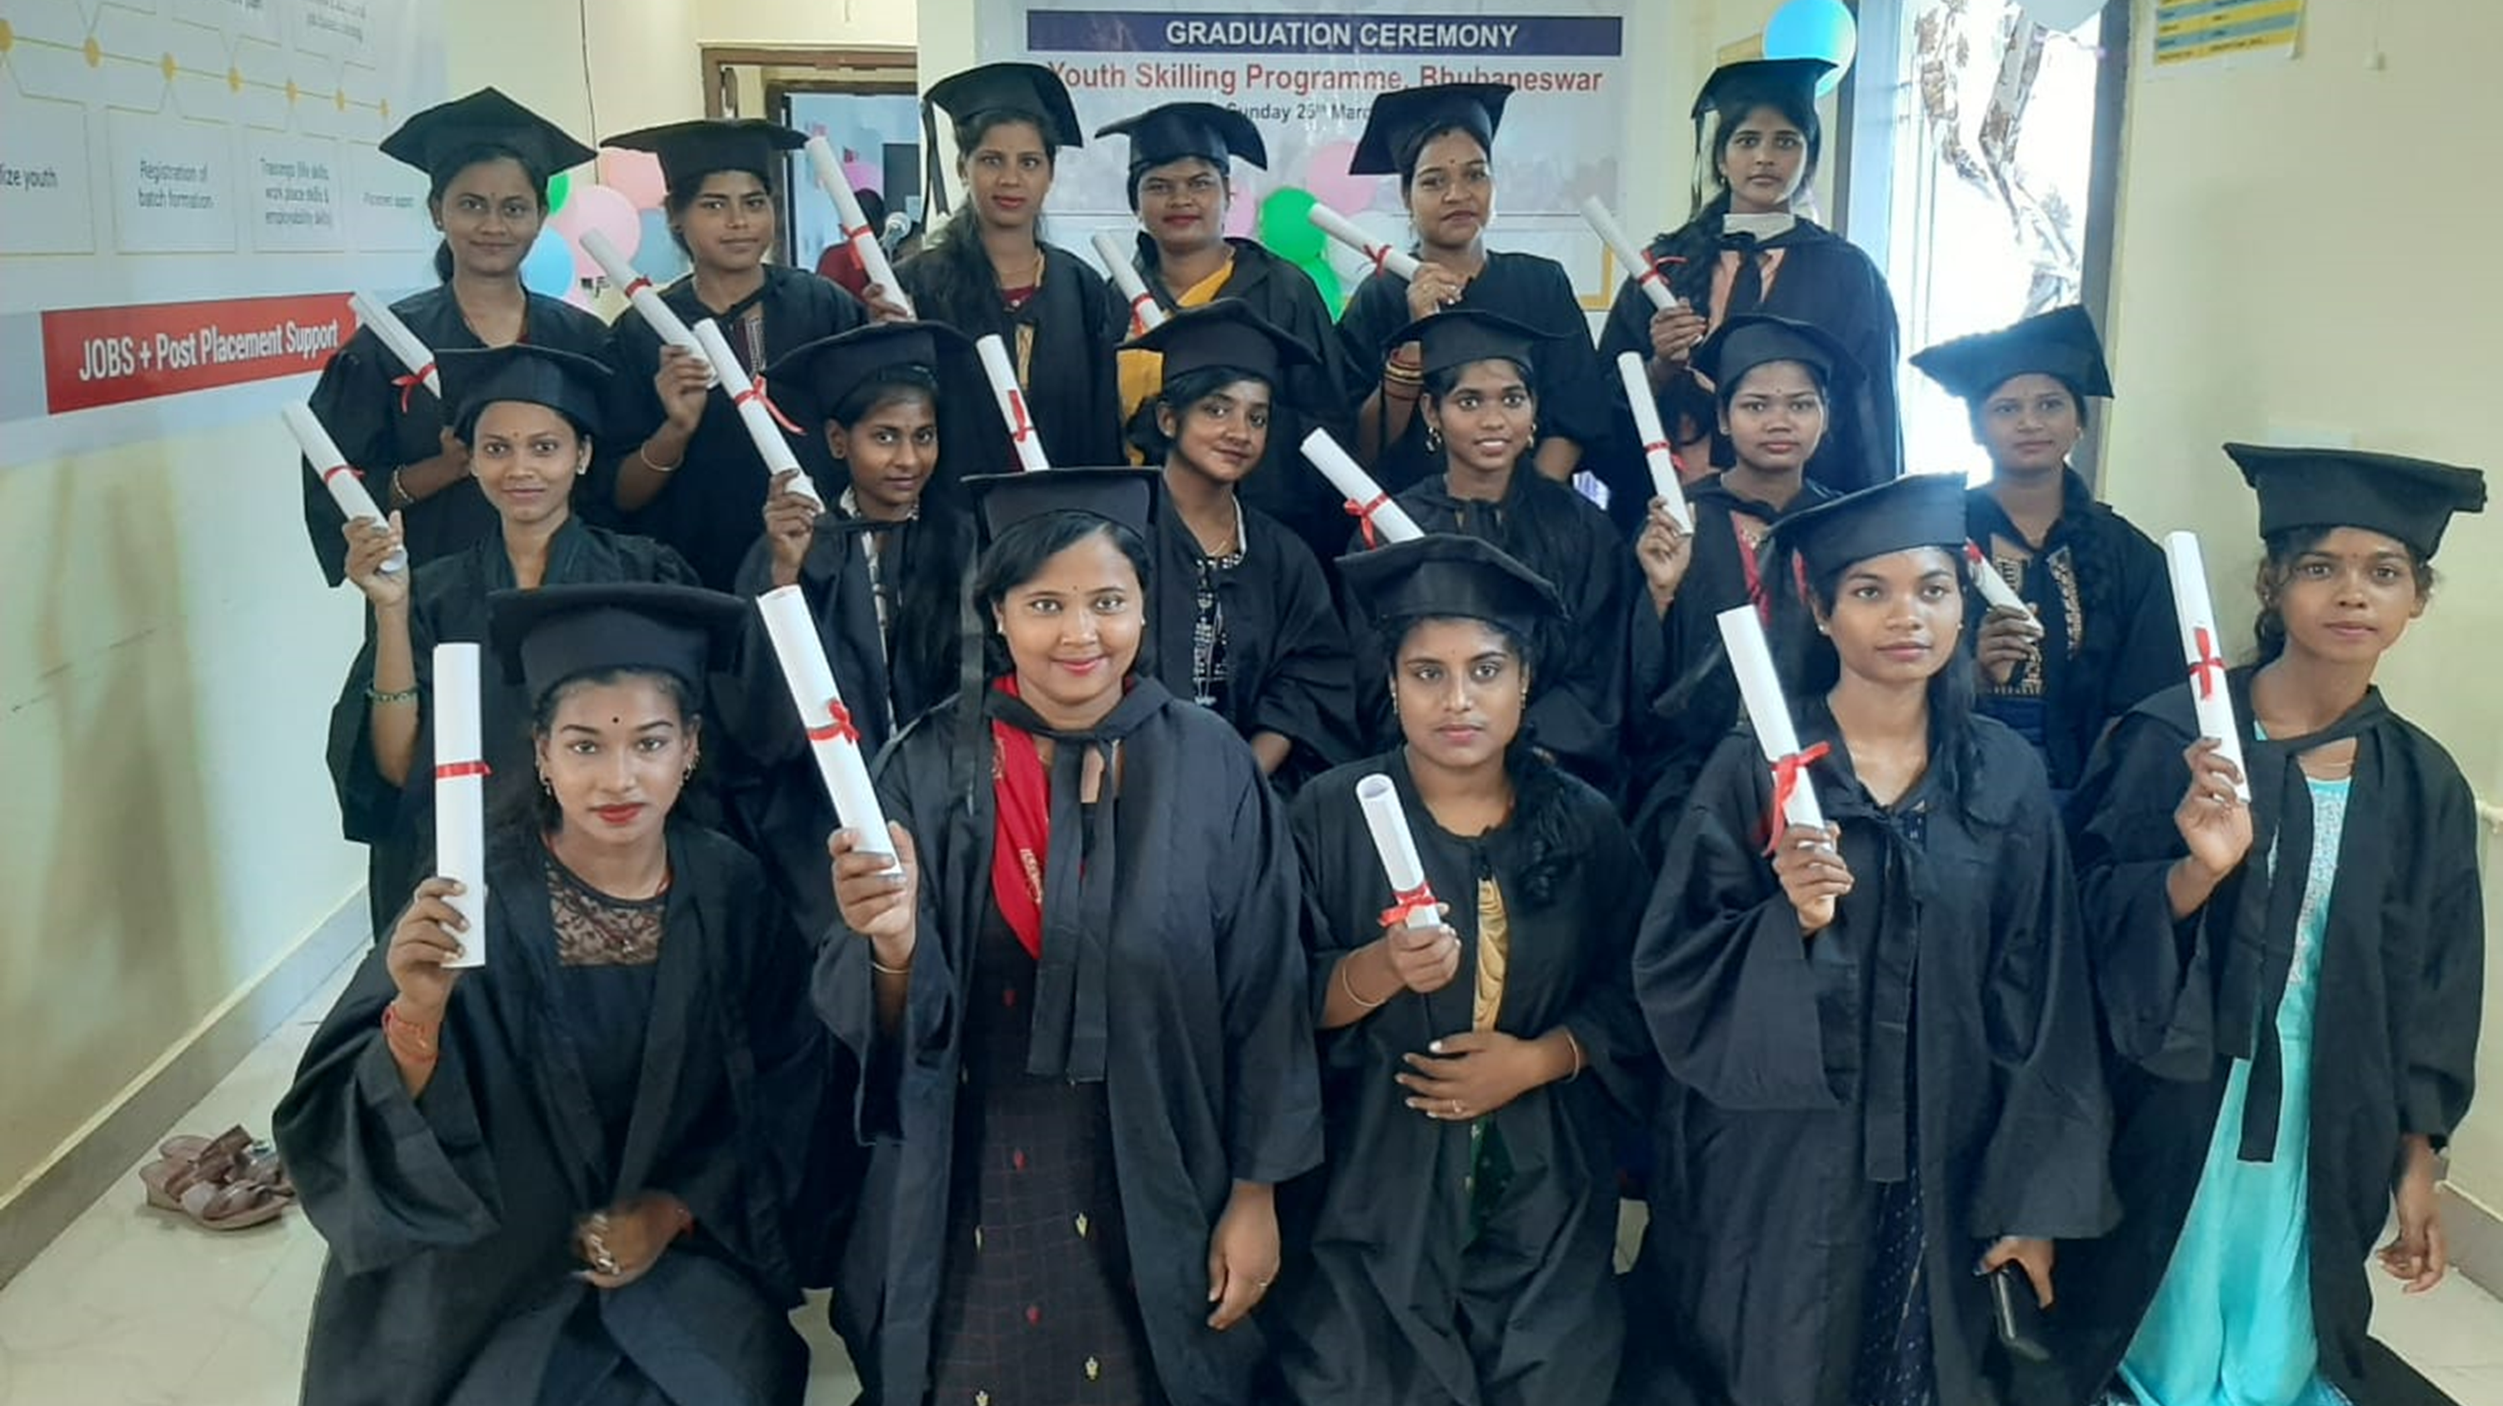


5th June; 1430 hrs
Mumbai, India
Life and Employability Skills – Impacting the life of Young People

Slide 2
Master Class Outline
Part I
About Magic Bus & History of Livelihood Programme
Livelihood Programmes – Portfolio
Journey of Youth
How Magic Bus Empowers Youth
Livelihood Framework & Curriculum
Part II
Key M&E Structure & Monitoring Mechanism
Sixer class
Regular & Dynamic Dashboards - MIS Weekly / fortnightly / Monthly Dashboard
Balanced Score Card
Good Governance
Part III
Results & Impact
Case Story
Q & A
Include your logos here

Slide 3
Programme

Slide 4








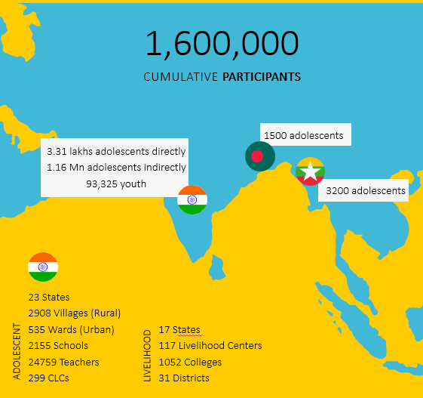

About Magic Bus
2015-2017
Started in Mumbai in 1999, with a pan India presence in 2024 .
One of the top NGOs in the Life and Employability skills arena in India
Largest Skilling Agency
In a year more than one lakh youth Skilled and Placed
The beginning
  Center-based program for undergraduates
  Strategic partnership with MSDF
2017-2019
Gearing Up
  Strategic partnership with KTI
  ISO Certification (Training)
  SixerClass DMS
2019-21
Pandemic
  1st to go Virtual. URP & RRP
  College-based program for graduates
  All-women batches launched
2021-24
Scaling & Innovations
  1st Skill Impact Bond - NSDC, BAT, CIFF, etc.
  Piloted App-Based Blended Program
  Technical Partnerships with AWS, Microsoft, UNICEF YuWaah
  Cloud Application, Tally, for science & engineering graduates
Notes:
Growth story to be changed

Slide 5
Livelihood Programme Portfolio
Type | Centre Based | College Based | College Based
Segment | Under Graduates | Graduates | Science & Engineers Graduates
Programme Framework | 21st Century Transferrable Life & Employability Skills | 21st Century Transferable Life & Employability Skills | 21st Century Transferrable Life & Employability Skills + Technical Skills
Salary Range | USD 134 – USD 200 p.m. INR 12000 – 16500 p.m. | USD 188 – USD 250 p.m. INR 15000 – 20000 p.m. | USD 313 – USD 500 p.m. INR 25000 – 40000 p.m.
Placement Target | 70% | 95% | 60%
Workforce | Grey-Collar | Grey-Collar | White-Collar

Slide 6
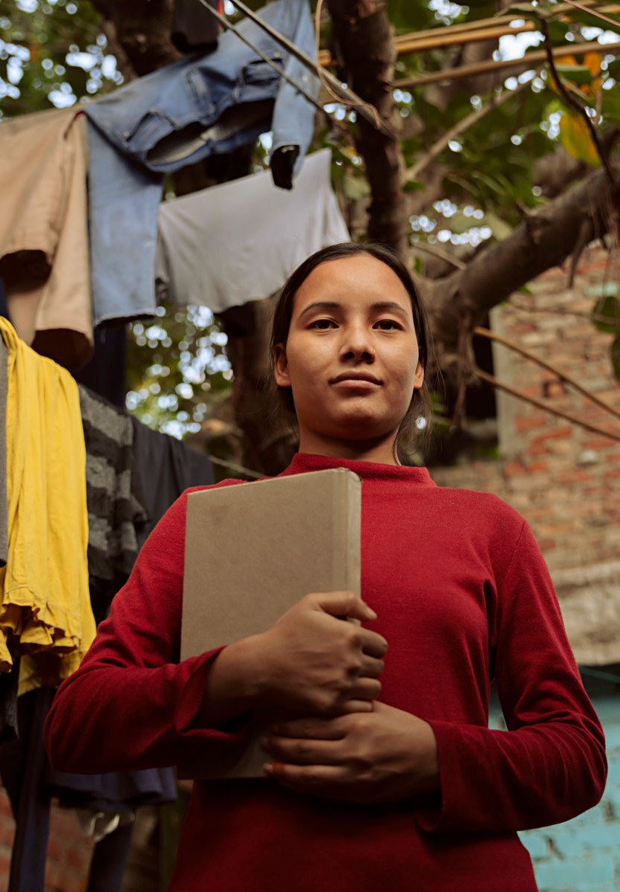



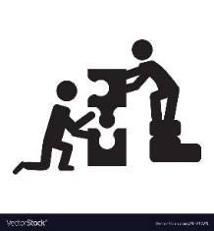



Journey of Youth
Mobilisation
Selection & Enrolment
Training
Work Readiness
Career Support
Guided Journey
Identifying Youth from Community
Selecting Youth from identified list
2 Months Skill Training
Facilitating Interview preparation
Job Placement
Guided Journey and alumni connect
To move the needle on:
Workplace Success
Job Satisfaction: Long-term income performance at workplace
Job Attainment
Placement:
Placement in aspirational job roles and, Retention​
Life & Employability Skills
Career Readiness:
21st century life and employability skills ​
Special focus on young women’s workforce participation
Notes:
Seconds - 30

Slide 7
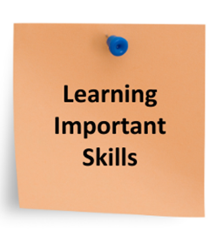


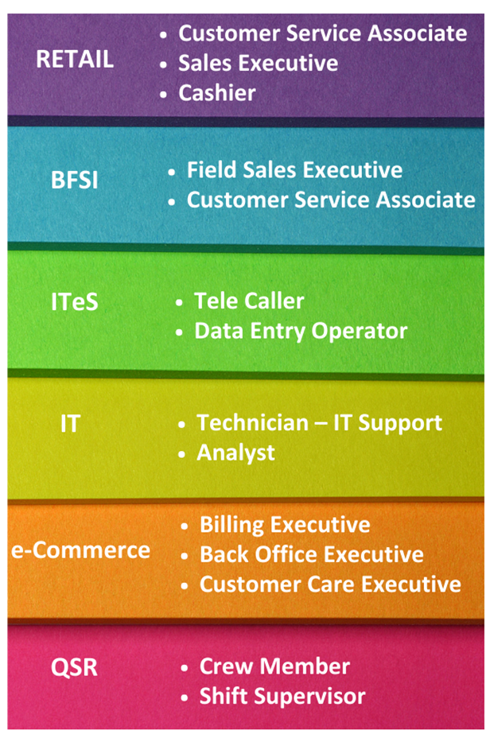
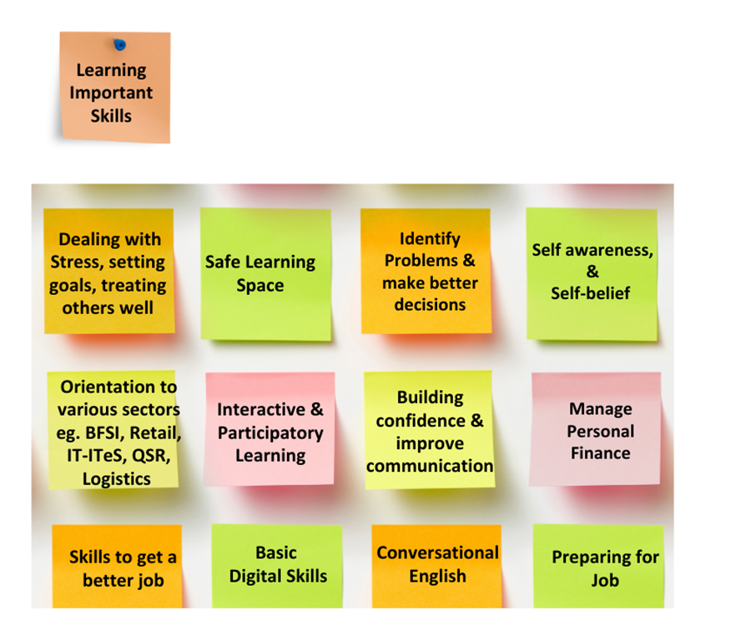


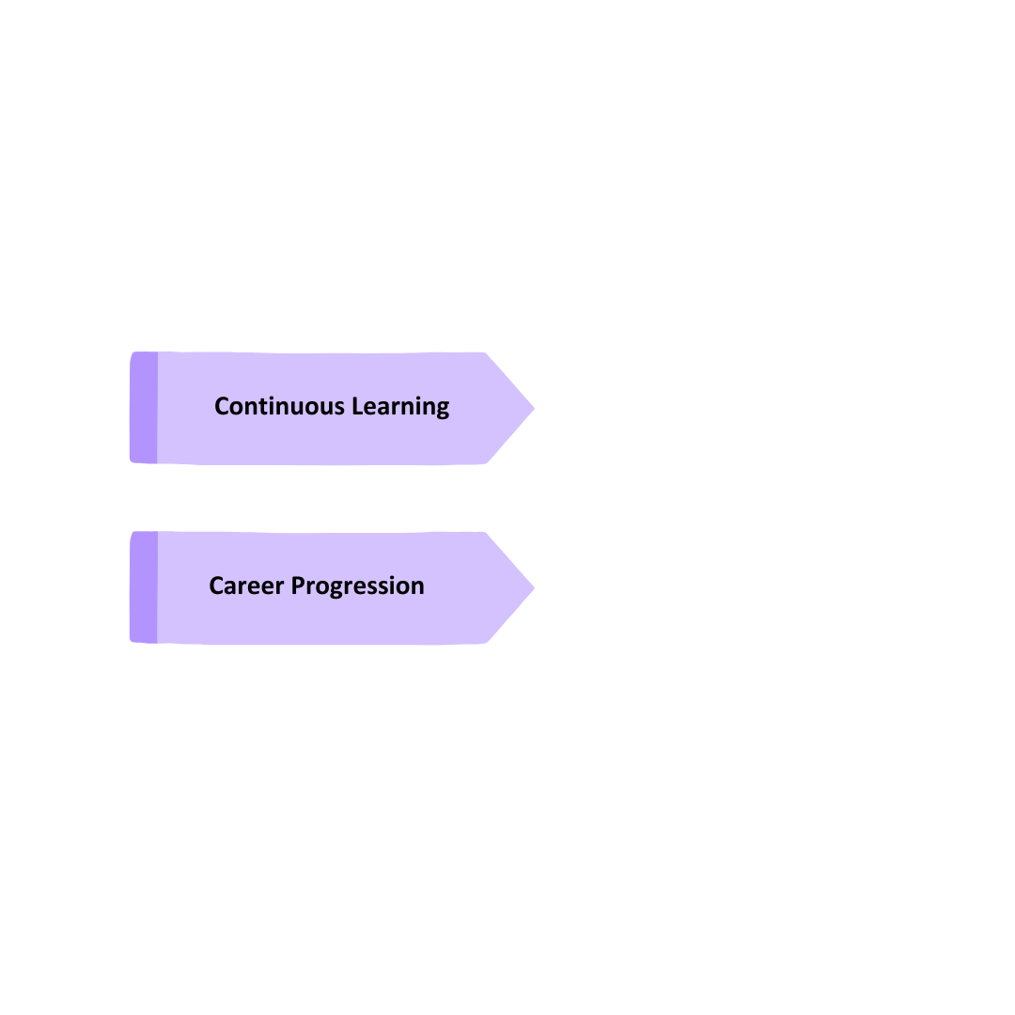
How Magic Bus Empowers Young People

Slide 8
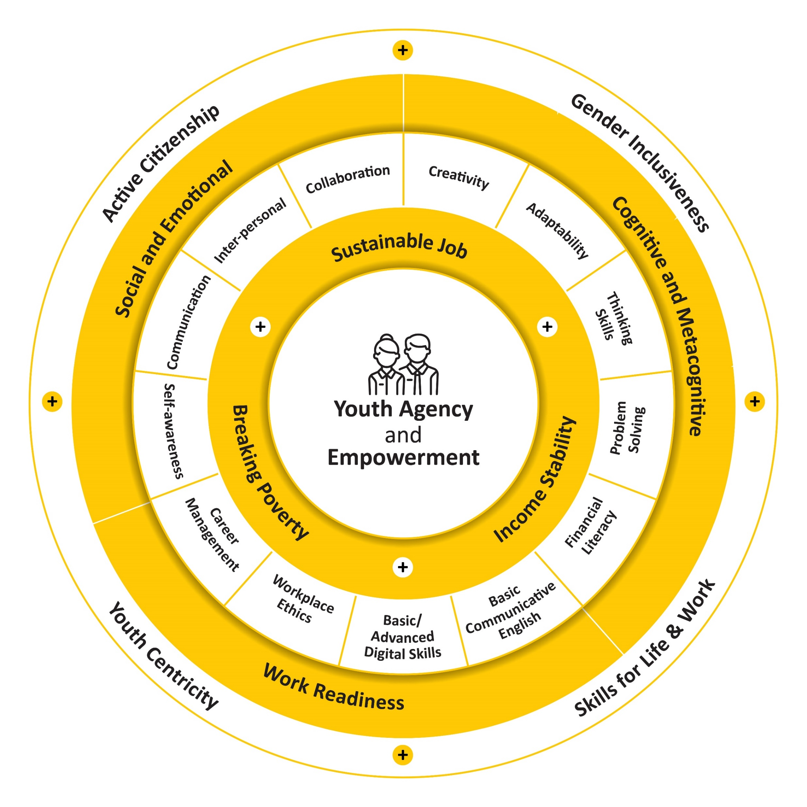
Livelihood Programme Framework
Reimagined Livelihood Framework
26 national and international frameworks identified
Mapped MB curriculum against 16 frameworks
MB Framework aligns with ILO and NOS
Notes:
Seconds - 30

Slide 9
Curriculum Framework - 21st Century Transferrable Life & Employability, Technical Skills
Social & Emotional Skills
Cognitive & Meta Cognitive
Work Readiness Skills
Self-awareness
Communication
Inter-personal Skills
Collaboration
Creativity
Adaptability
Thinking Skills
Problem-solving
Financial Literacy
Basic Communicative English
Understanding & Managing Emotions
Active Listening
Empathy
Teamwork
Learning agility
Optimism
Critical Analytical) thinking
Decision-making
Budgeting & Savings
Basic / Advanced Digital Skills
Awareness of strengths and limitation
Assertiveness
Respect for Diversity
Conflict Resolution
Growth Mindset
Reflective thinking
Financial Goal Setting
Creative Thinking
Negotiation
Relationship Skills
Responsibility
Resilience
Workplace Ethics
(Basic Green Skills)
Self-esteem
Demonstration of Verbal & Non-verbal
Career Management
Self-confidence
Giving & Receiving Feedback
Self-management
Dealing with Criticism
Goal Setting
Notes:
Green Skills
Active Citizenship

Slide 10

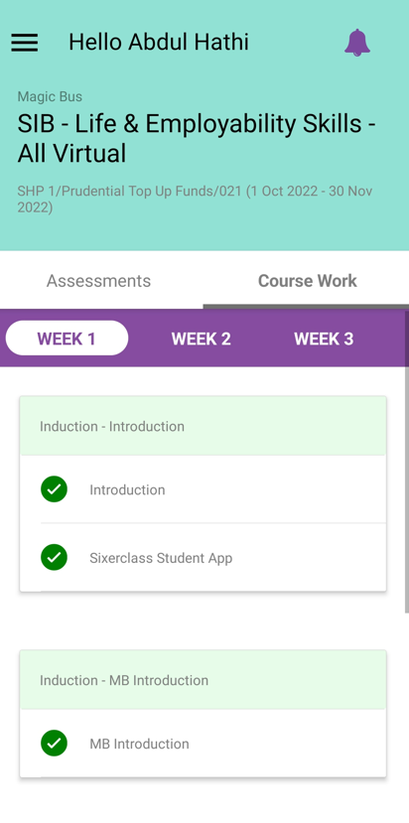
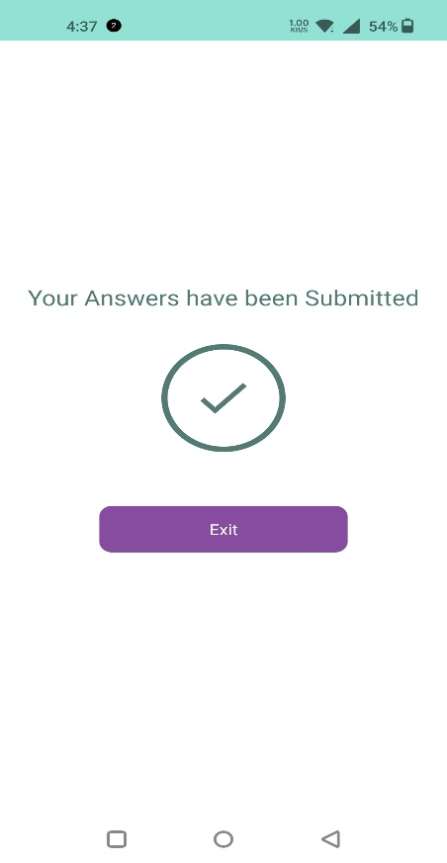
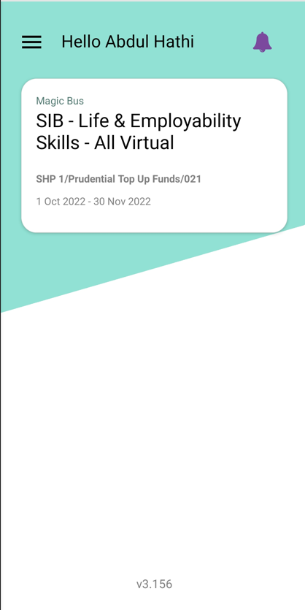
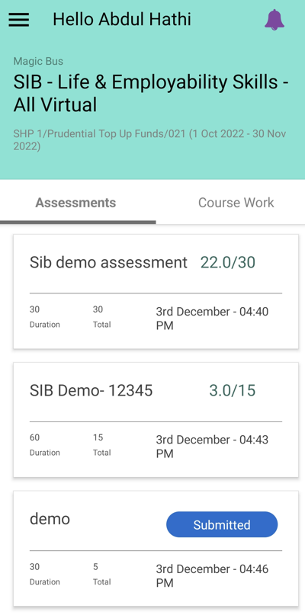
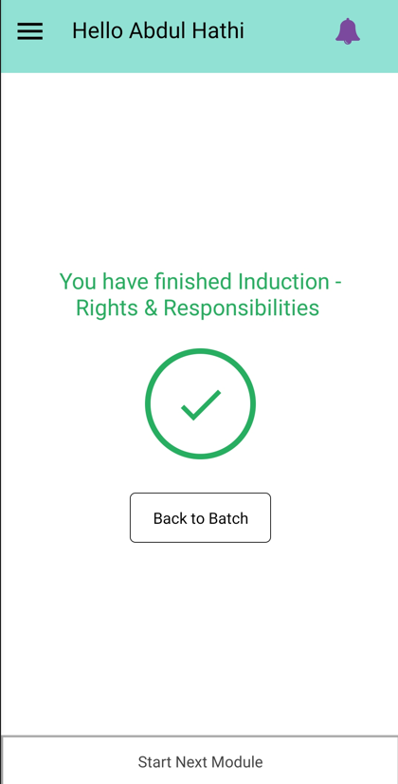
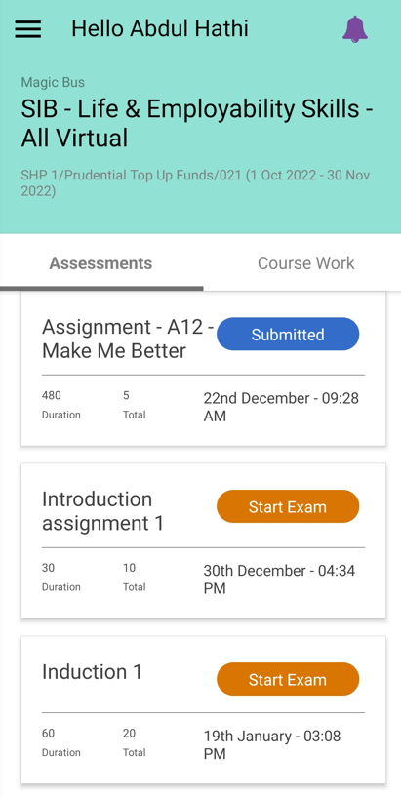
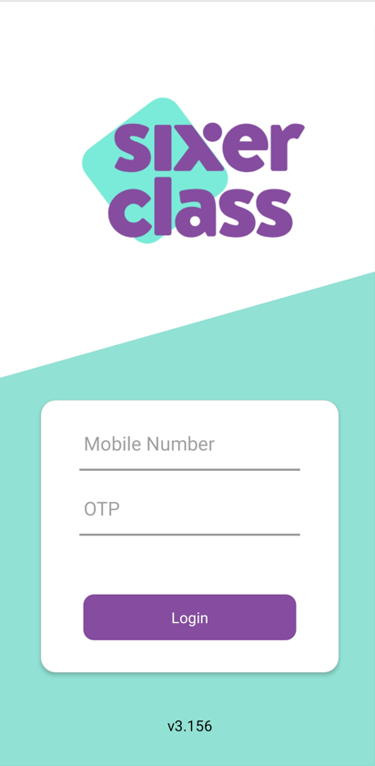
Learning Management System
Announcement / Notification
Assessment Submission
Notification
Course Work
Course enrolled
for
Notification on completion of one module
Assessment Score
Assessments
Login Screen

Slide 11



Slide 12
Process

Slide 13

Key M&E Structure & Monitoring Mechanism
Process
Platforms & Tools
Data Collection Methods
Monitoring Tools
Evaluation Framework
Regular Review & Monitoring
Sixer Class Platform
Stakeholder feedback tool
Dashboard
Balanced Score Card
Report
Regular Reporting
Data Analysis

Slide 14
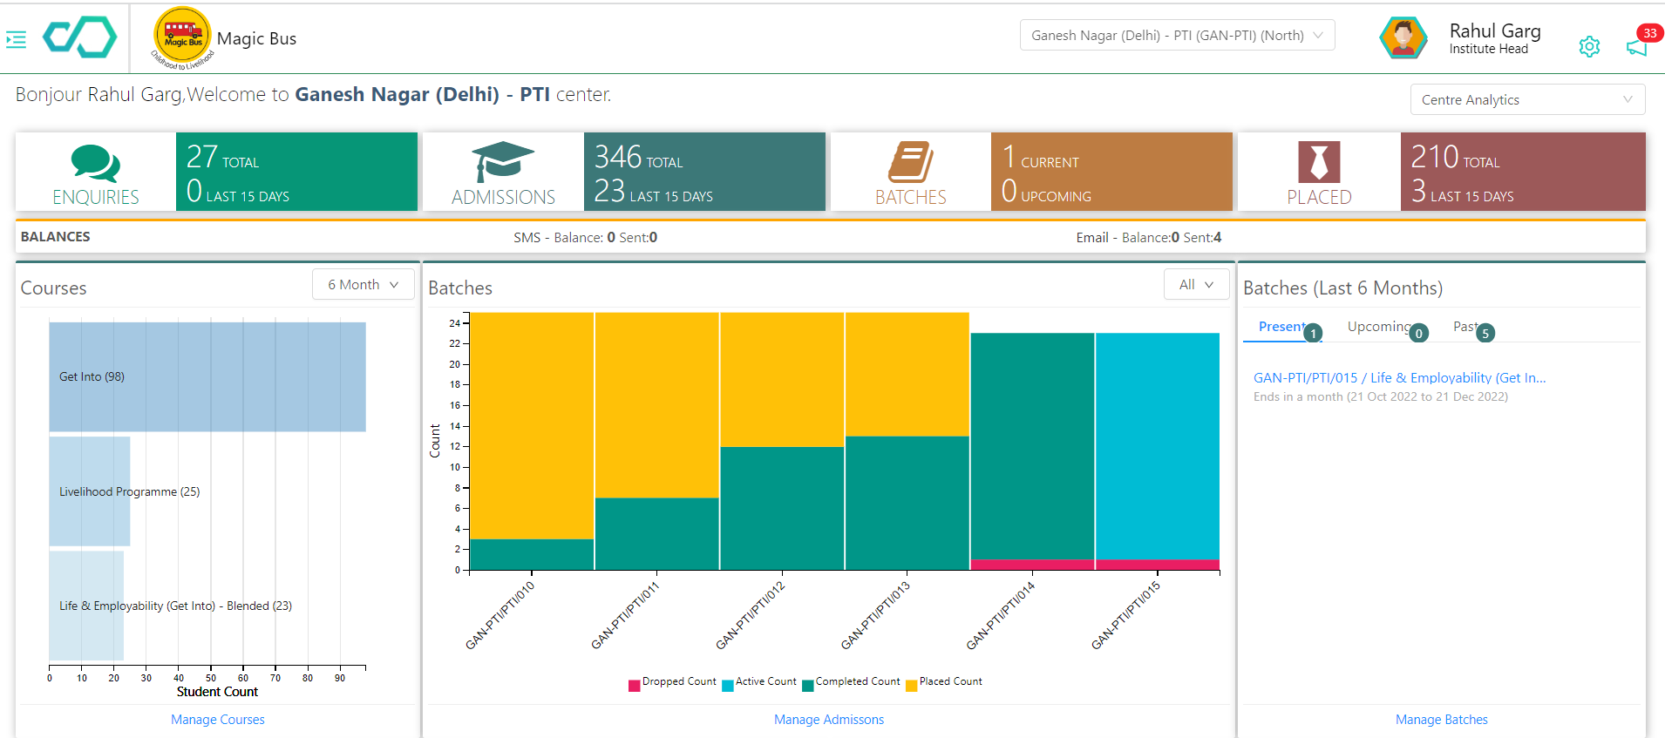
Sixer Class - Regular & Dynamic Dashboards
  I. SIXERCLASS
Robust system
High accuracy & integrity
Monitoring and evaluating the quality of all
programs
Access by field team to Sr. Management
  II. DATA INPUT & SOURCING
Training Details
Youth’s Details
Supporting Proofs
Placement Details
Retention Details
  III. DATA OUTPUT
Dynamic MIS
Monthly reports
Realtime Dashboard
Supporting documents

Slide 15
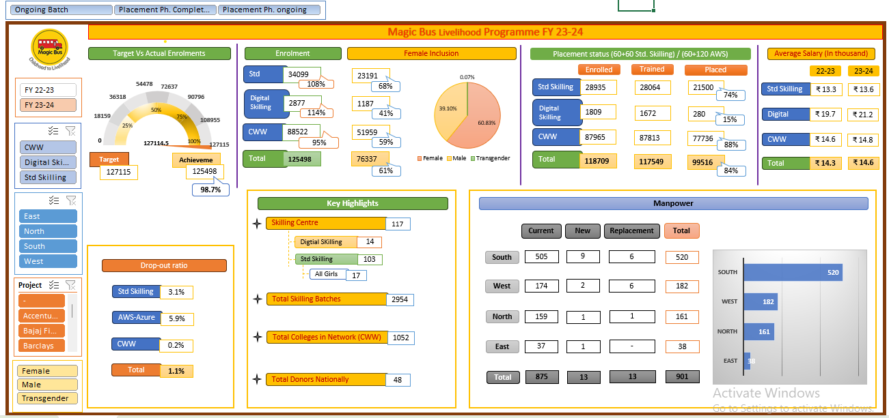
Dashboard:
Representative Image

Slide 16
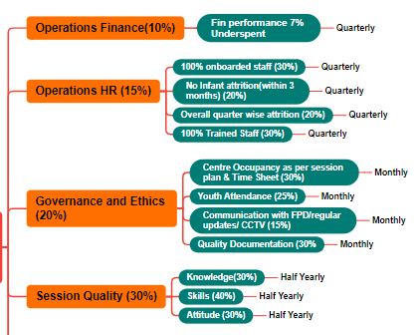
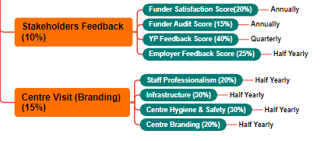
Balanced Score Card
Programme Performance Parameters
100% Enrolment (20%)
50% women youth enrolment (15%)
Sixer Class
Monthly
Monthly
Individual Youth Attendance (10%)
Sixer Class
Monthly
5% Youth Drop Out(15%)
Sixer Class
Youth Placement (15%)
Monthly
Sixer Class
Monthly
Demand Driven Batches (10%)
Sixer Class
Monthly
Youth Retention(Post placement) –(15%)
Sixer Class
Monthly
Sixer Class
Balanced Score Card
Quality and efficacy Parameters
Quarterly Reports
Final Score
Final Score Weightage:
70% Programme Performance Parameter Score
30% Quality and efficacy Parameter Score
Score>95% - Platinum (best 5)
Score>85% - Gold
Score 85%>=65% - Silver
Score <65% - Bronze

Slide 17
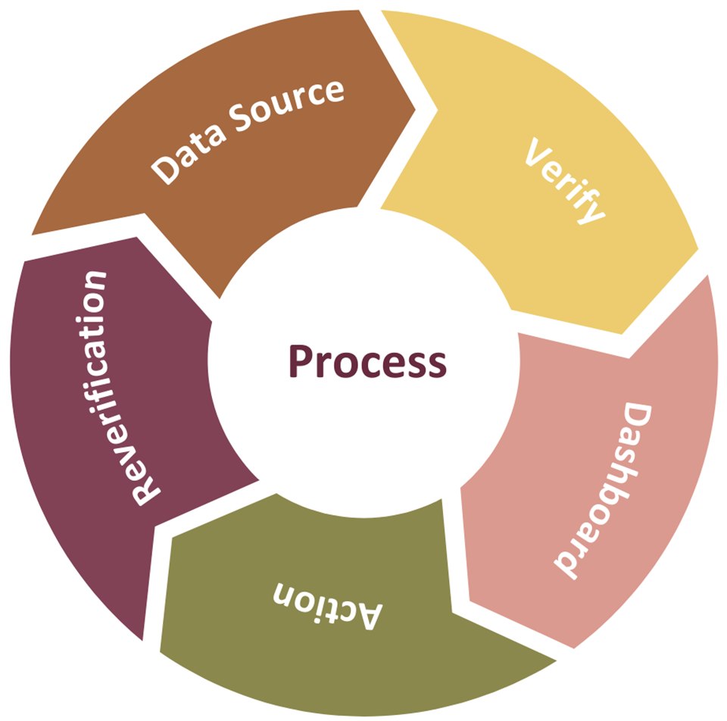
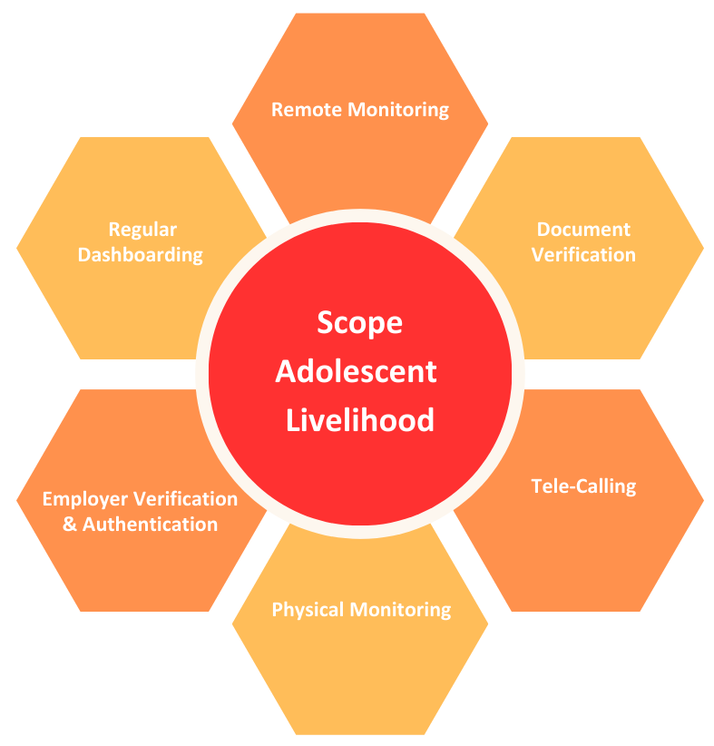
Good Governance
Fraud Prevention & Detection

Slide 18

FPD Video

Slide 19
Result & Impact

Slide 20
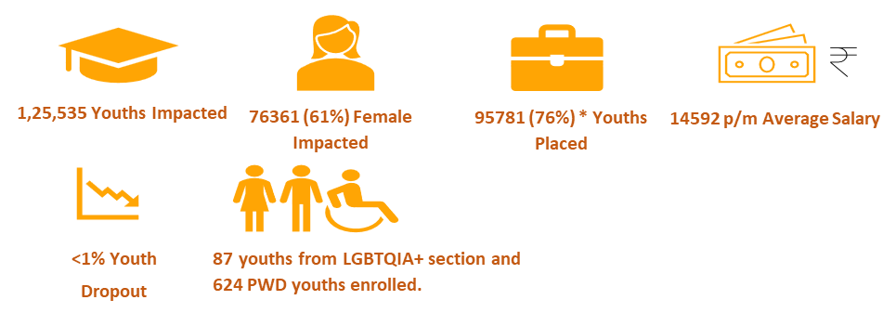
Magic Bus Livelihood Programme– Geographical Reach
Present in 17 states and 31 districts
117 Livelihood Centres established across 17
states,
17 centres out of 117 livelihood centres are “All Girls Centres”.
Collaboration with over 1052 colleges for
the Undergraduate & Digital Skilling
Programme”,
Notes:
Magic Bus Livelihood Programme– Decadal Impact at Glance
Magic Bus has experienced significant growth over the past decade in the enrollment of youth in the Life and Employability Skill Program, as well as their successful transition into the workforce.
371406 youths’ lives impacted through Livelihood Programmes
Over the past decade, a total of 205430 female youths’ lives have been impacted, constituting 55% of the total youth enrolment, thereby contributing significantly to the advancement of women's empowerment initiatives.
300370 young people, which is 81% of the total youth enrolled are successfully placed post-completion of the training programme.
Magic Bus has expanded its reach to encompass 17 states and 31 districts across India, demonstrating its widespread impact and commitment to empowering communities nationwide.
A network of 117 Livelihood Centres has been established across 17 states, serving as crucial hubs for enhancing employment opportunities and fostering economic empowerment within local communities.
17 centres out of 117 livelihood centres are “All Girls Centres”.
Our collaboration extends to over 1052 colleges in the “Connect With Work” and “Digital
Skilling Programme”, amplifying our reach and impact in empowering individuals through
skill development.

Slide 21
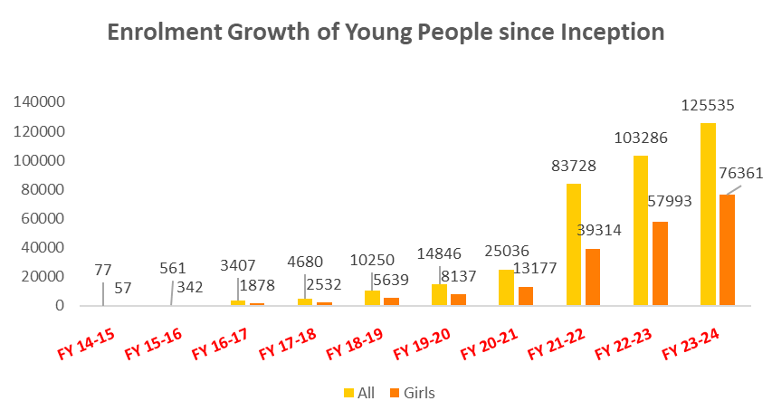
Enrolment
For FY 2023-24 125535 youths were impacted through the Life and Employability Skills Development Programme of which 61% are women

Slide 22
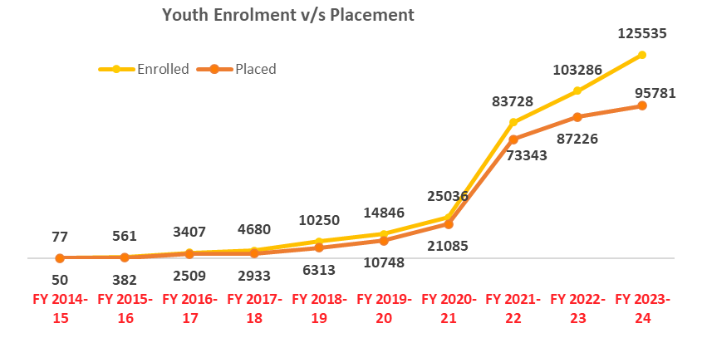
Enrolment v/s Placement
76% (95781) of youths were successfully placed in FY 2023-24
Over the last 1 decade 300370 young people out of 371406 are successfully placed impacting their lives.

Slide 23
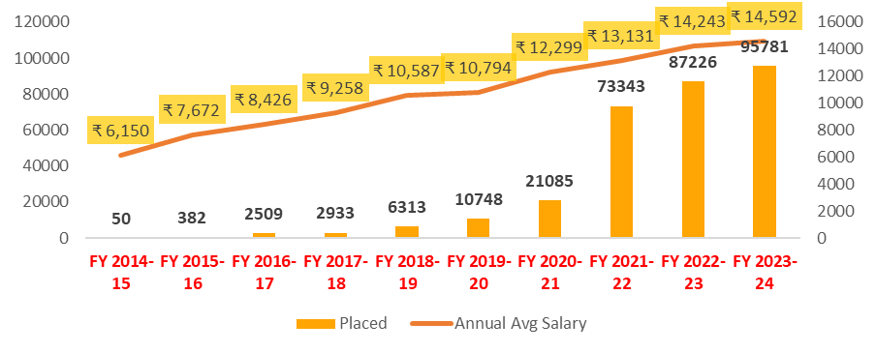
Placement & Average Salary
Annual Placement and Average Salary (INR) increase since the Inception of the programme.
An average of 10% growth is observed in the average salary being offered to youth.
Notes:
Impact on Income Generation

Slide 24
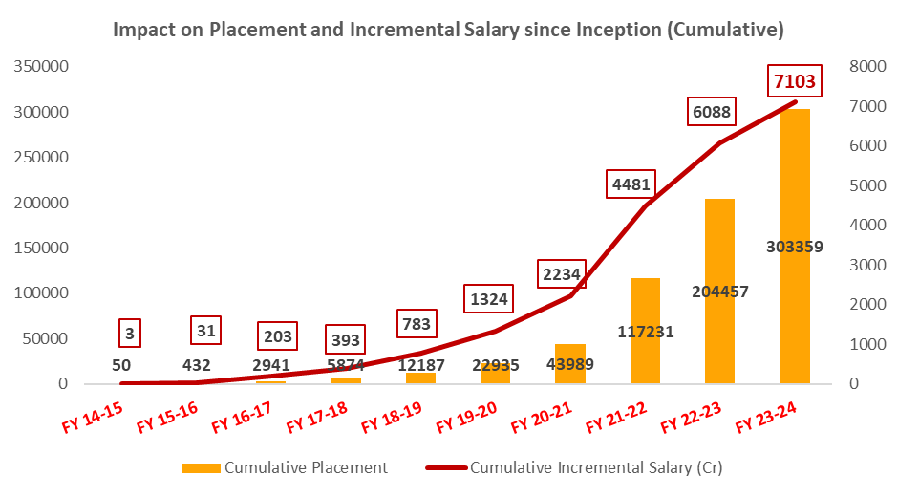
Impact on Income Generation
Over the last 10 years, MB Livelihood Programmes impacted the lives of 3,03,359 youths and their families with a cumulative income of INR 7103 cr
.
*Data is calculated as *8% annual increment in average monthly salary.
Notes:
Impact on Income Generation

Slide 25
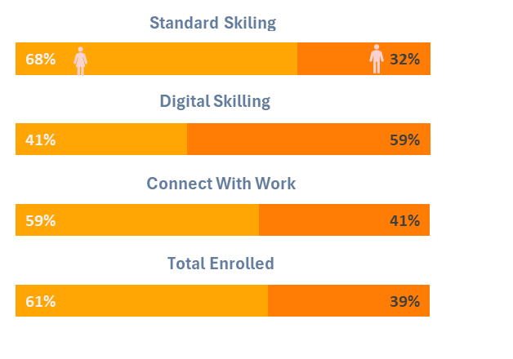
Female Enrolment
Female/Male youth enrolment in FY 2023-24.
Magic Bus's commitment to gender-inclusive empowerment.
76361 female young people which is 61%
Jumped from 56% to 61% for FY 23-24
Notes:
3% & 6%

Slide 26
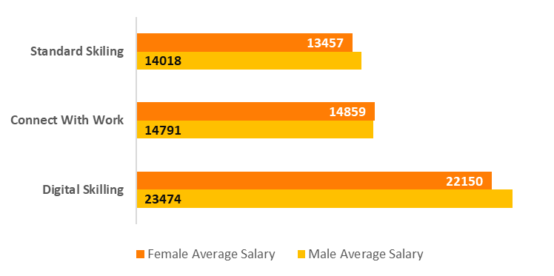
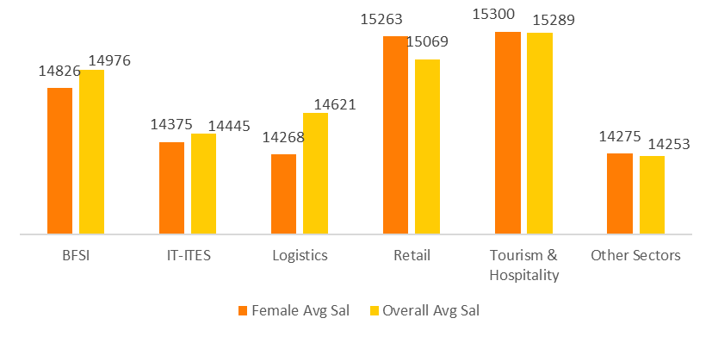
Female Salary
Female/Male Average salary in FY 2023-24
Female Average Salary v/s Overall Average Salary in each Sector
Magic Bus programme reduced the gender parity in income/salary
Uniformity in income across sectors
Average salary higher than overall salary in Retail and Tourism & Hospitality sectors.
Notes:
3% & 6%

Slide 27
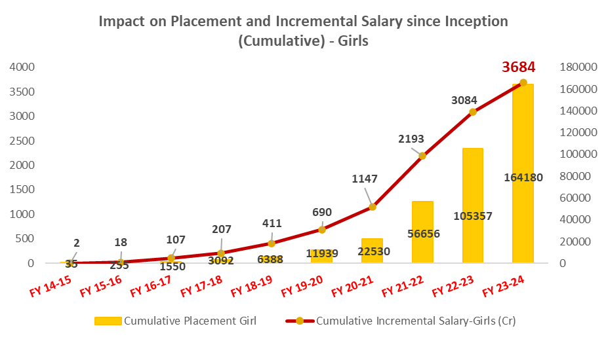
Female Avg. Salary
Over the last 10 years, MB Livelihood Programmes impacted the lives of 1,64,180 young girls and their families with a cumulative income of INR 3684 cr.
*Data is calculated as *8% annual increment in average monthly salary.

Slide 28
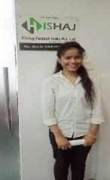
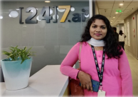
Case Story
Shilpa’s Odyssey From Dependant to Independent
Khushi's Journey of Triumph
“Magic Bus taught me not just skills but life lessons. I learned how to interact with people confidently and set goals. It wasn’t just about finding a job but transforming myself.”
“Before, I would hesitate when stepping outside and engaging with strangers. The training has equipped me with invaluable problem-solving and communication skills to navigate social situations confidently.”

Slide 29
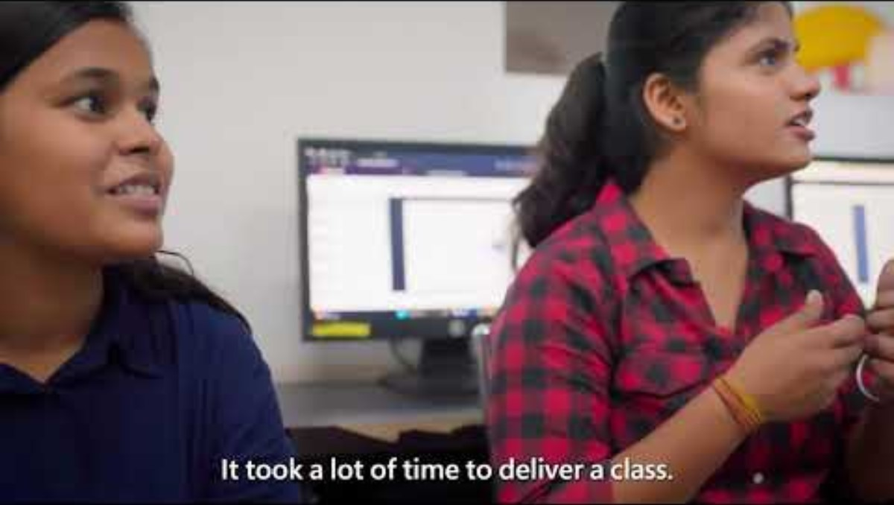
Microsoft
Livelihood Prog. Collabration

Slide 30
Q & A

Slide 31



3 - 7 June 2024
logos

