Slide 1

Using Theory of Change in the Iterative Evaluation of the ASPIRE Intervention to Address the Black PhD Leaky Pipeline in UK Higher Education Institutions
Dr Florence Reedy
Dr Ifedapo Francis Awolowo
Notes:
-FR and FA introduce themselves, roles, responsibility in the ASPIRE programme/evaluation, intro to Advance HE, and what to expect from the session.

Slide 2
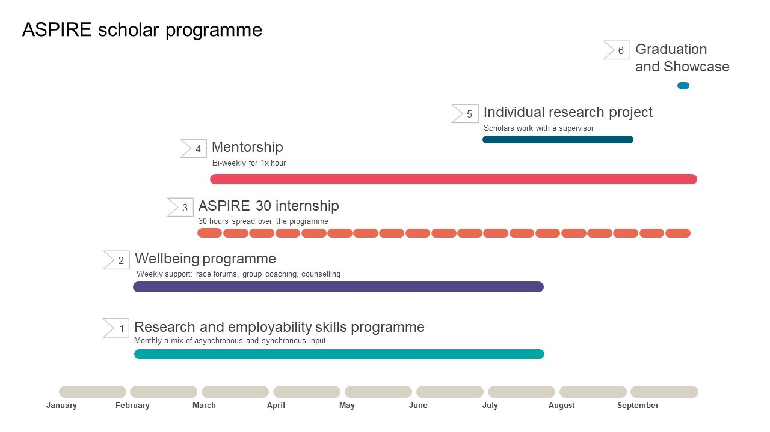

ASPIRE
Notes:
FA ASPIRE introduction 15 minutes

Slide 3
ASPIRE evaluation
Process evaluation proving insights into what makes the programme successful, what works well and aspects that need adaptation or change
Impact evaluation provides insights into whether the ASPIRE programme works to improve:
Experiences (of Black and Black heritage students, staff, other students)
Engagement (of Black and Black heritage students, staff, other students)
Future study or career prospects (of Black and Black heritage students who take part in ASPIRE).
Notes:
FR evaluation introduction 5 minutes

Slide 4
Research questions
Primary research questions | Does the ASPIRE programme increase confidence and resilience in Black and Black heritage students? Does attending the ASPIRE programme improve doctoral applications among Black and Black heritage students? Does engagement with the ASPIRE programme increase Black and Black heritage students work-readiness for doctoral level study?
Secondary research questions | Identify the structural barriers that exist for Black and Black heritage students. Does ASPIRE increase confidence/resilience more in Black and Black heritage female students (and any other groups)?
Process evaluation research questions | Was the ASPIRE programme delivered the way we expected? Does the ASPIRE programme address identified structural barriers? Are we targeting the right students? What is the cost-effectiveness of the programme? Are Black students (and all staff) in the region more aware of ASPIRE programme and its benefits?
Notes:
FR evaluation introduction 5 minutes

Slide 5
Theory of Change
A Theory of Change (ToC) can be described as a “a visual representation of a programme’s inputs, activities, outputs, outcomes […, impacts…] and underlying causal mechanisms” (TASO, 2022)
A Theory of Change describes the underlying assumptions about how planned activities will lead to intended outcomes.
A Theory of Change model allows you to:
• describe the need you are trying to address
• the changes you want to make (your outcomes); and
• how you plan to achieve these changes (your activities)
Notes:
-FR to introduce ToC and its purpose 5 mins

Slide 6
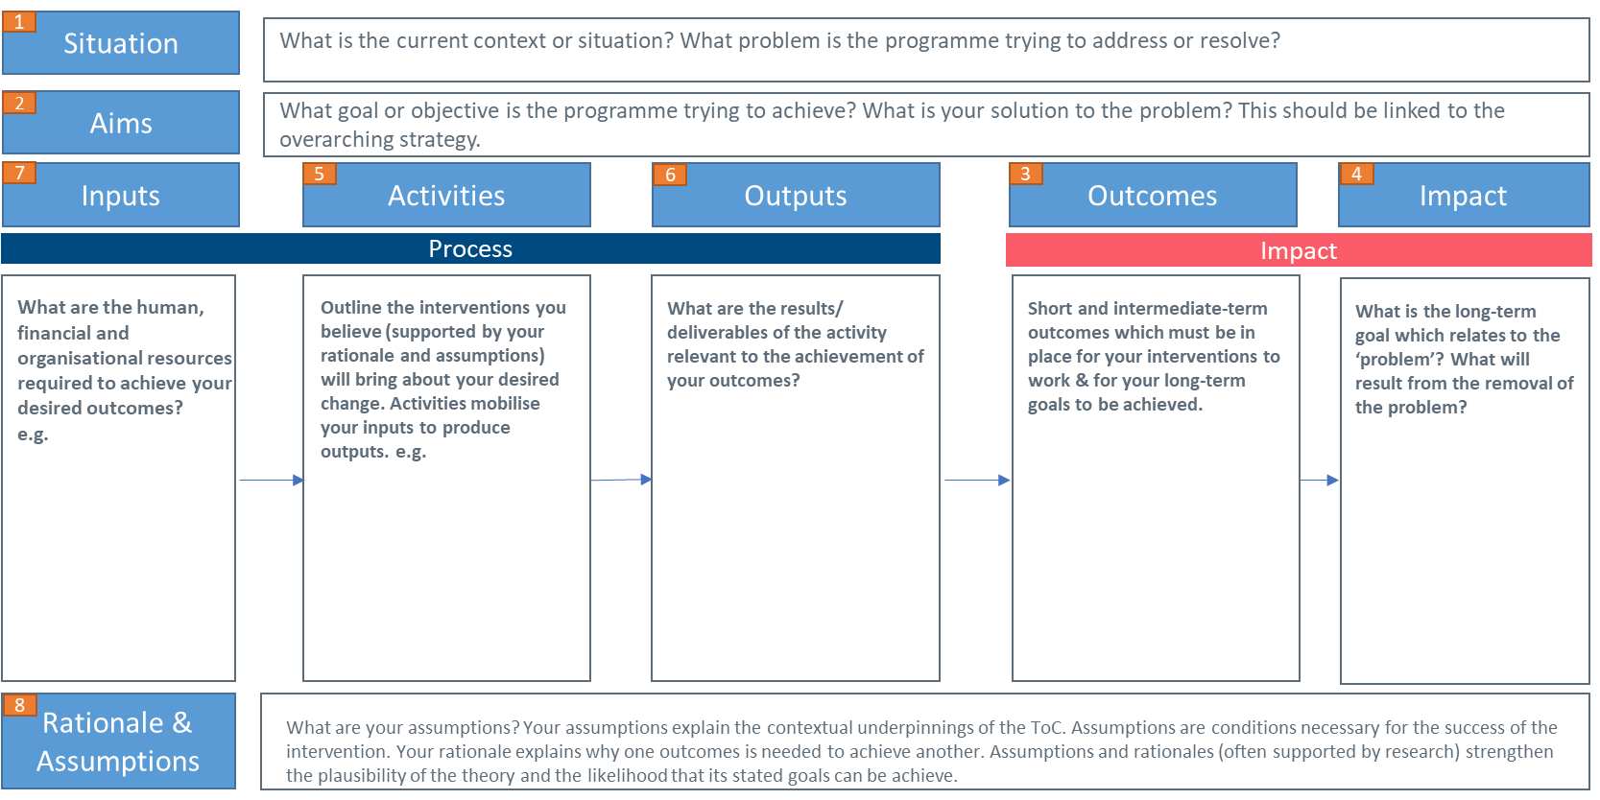
Theory of Change
Notes:
-FR to introduce ToC and its purpose 5 mins

Slide 7
Situation
The ASPIRE programme is a response to the research “It does matter if you’re Black or White” findings that Black students often lacked confidence in accessing spaces within university communities and broader society., often due to a sense of being ‘othered’ (de-positioned because they do not conform to the norms of the community). The ASPIRE programme is designed to build confidence and resilience, work-readiness, and academic skills in participating Black students (herein referred to as scholars) interested in doctoral level study, so that they can better navigate these spaces.
1
Aims
1- Develop an impactful inclusive targeted research mentorship and well-being programme designed specifically to increase confidence and resilience of Black students interested in accessing doctoral level study.
2- Discover and unpack structural barriers to accessing doctoral study for Black students and evaluate the ways in which these can be overcome through participation in the ASPIRE programme.
3- Determine whether participation in the ASPIRE programme leads to improved work-readiness and academic skills (level 5/6) of Black students to access doctoral level study or career.
4- Improve the understanding, attitudes, perceptions of PGR supervisors of the specific, racialised needs (student led) of Black students interested in accessing doctoral study and impact behavioural change into the ways in which Black students can be best supported.
2
4
5
Outcomes
Impact
7
Activities
Outputs
3
Inputs
6
Process
Impact
Promotional material
Participation from collaborating institutions and other organisations (e.g. charities)
Expertise of collaborators
Buy-in from senior leadership
External buy-in (from other higher education institutions and employers)
Subject knowledge, academic and research skills
Lived experience
Reputation (of the institutions and delivery team members)
ASPIRE team staff & expertise
Supervisor staff
Collaborators & partners
Budget
Venues
Licenses
Enhancement/innovation/digital support
Students as co-creators
PGR consultants, mentors
Advance HE Researchers
1- Scholars – theory-based programme
Academic skills
Administrative responsibilities
Assessment
Asynchronous training
Career training
Career workshop
Coaching
Community building
Live storytelling
Internship
Inspirational speaker session
Mental health and wellbeing
Networking
PhD hidden curriculum
Research skills
Role models
Talk about race conversations
Work hidden curriculum
Work readiness
Programme workbook
Workshop
Writing skills, study skills
Journal club
3- Administration
Manage project finances
Prepare the reporting materials for Research England
Organise Delivery Executive Board and Steering Board meetings (draft agendas, prepare items, send invitations, take minutes and action points)
Act as a central point of contact for all enquiries and communications with scholars and suppliers
Assist the project lead with recruitment and planning of each cohort's activities
Process payments and expense claims for partners and suppliers
Book rooms and catering for workshops
Book accommodation and travel for workshop facilitators
Organise showcase events
Manage social media
ASPIRE programme materials (e.g. asynchronous content, and synchronous content)
ASPIRE programme network capital (i.e. directories)
ASPIRE framework (with accompanying toolkit)
Recognition through ASPIRE micro-credential/badges/accreditation
ACE Training for coaches
Identify and create a good practice academic supervision guide/framework.
Build and create a Black academic network (that is accessible to students).
ASPIRE podcast
Media articles
Academic journal articles
Increased PGR writing opportunities
Increased PGR networking opportunities
Increased opportunities for collaborations across academic community
Evaluation reports
Collaboration with Leeds Trinity to deliver critical whiteness session
Blog posts
Data on progression, completion, continuation and PGR destinations from MMU and SHU provided to KCL EDIT evaluation team
Outcomes for scholars:
Increase the number of Black students applying to PhD programmes and accepted onto PhD programmes at participating institutions
Increase scholars’ confidence to apply to doctoral study
Increase scholars’ confidence to apply to work
Increase scholars’ understanding and awareness of funding opportunities for PGR studies, what is required of PGR students, and what the PGR student experience is like
Increased sense of community and belonging amongst scholars (in academic spaces)
Increased sense of social support amongst scholars
Creation of a psychologically safe space for all staff/students
Increased awareness of strengths (skills) of Black students
Scholars will have a better awareness and understanding of doctoral application procedures and requirements
Increase scholars’ work-readiness skills
Increased scholars’ academic skills
Outcomes for supervisors and mentors:
Extend the network capital for staff and students involved in ASPIRE
Upskill PGRs by giving co-supervision opportunity
Increased coaching capacity within Black community
Support the establishment of a Black coaching network
Sharing expertise across student services (to better support Black students)
Increased supervisors’ and mentors’ knowledge and confidence to support Black students in developing resilience and confidence
Increased mentoring capability of early career academics (PGRs)
Increased understanding of the humanity journey and the idea of shared living amongst supervisors and mentors
Increased empathy amongst supervisors and mentors to the diversity of human/student experiences
Increased motivation amongst supervisors and mentors to take the knowledge and awareness gained from participating in the programme and translating this into their current practice
Increased sense of shared responsibility for implementing and contributing to change (removing barriers and supporting students and colleagues from diverse backgrounds)
Increased social capital
Increased community engagement
Increased number of PhD/DBA places (more opportunities and availability)
More diversified sector-wide PhD/DBA student body
Increased sense of belonging amongst Black students
A more welcoming and inclusive environment at MMU and SHU
Increased visibility & representation of Black researchers in the academy
Improved academic supervision practice, confidence, and expertise
Improved access to psychologically safe spaces
Improved awareness and understanding of career options (confidence)
Demystification of doctoral level study (practicalities)
Improved knowledge-transfer paths within the community (e.g., the Leeds Trinity knowledge exchange)
Improved mentoring capability of early career academics
Impact that has transcended both institutions in terms of external engagement and support for the programme as well as traction for continuing the programme funding
Impact on employers (raising awareness of these issues, embedding EDI into their recruitment practices, acting more intentionally to improve representation and the experiences of their staff)
National attention for the programme from parliamentary members
Increased awareness raising of the need for a shift in how we address structural and systemic racial inequalities, and our approach to these
4- PhD Project
Accessible directory of Black academics
Funded PhD opportunities
5- Employers
Live commercial project
Guest lectures
Funding DBA/PhD/sponsorship/paid internships
2- Supervisors – theory-based programme
Ubuntu session
Assignment to scholars
Asynchronous training
Community support
Critical whiteness session
Mental health and wellbeing
Coaching
Networking
PGR community reflections
Race equity activities
Race equity training
Research supervision
Supervisor role training
Talk about Race conversations
Workbooks
JEDI and introspection workshops (JEDI)
6- Evaluation
Pre- and post-programme surveys (scholars)
Control group survey (students)
Listening rooms (scholars, mentors)
Interviews (supervisors, ASPIRE programme leads)
Review of reflective diaries
Observations from celebration event
Data analysis and synthesis
Report writing and development
7- Dissemination
Academic journal articles
Media articles and blogs
Conference presentations
ASPIRE podcast
Engaging MPs in parliament
8- Internship (x30 March)
Rationale & Assumptions
8
Rationale:
ASPIRE programme creating equality of opportunity through targeted intervention
ASPIRE programme address structural barriers (identified by students) and other barriers which cause the leaky pipeline
ASPIRE programme will develop good practice framework for academic supervision
Assumptions:
Assuming structural barriers and inequity of opportunity
Assuming pipeline leaks are caused by what ASPIRE programme is targeting
Assuming problems with doctoral level supervisory model
Assuming coaching will be effective at increasing confidence and resilience
Assuming lived experience of PGRs will make them effective mentors
Overarching theme: support development of life skills being for work (not just PhD/DBA), enabling the development of life wide transferable skills (use to access doctoral/career opportunities)
Notes:
-FR to introduce ToC and its purpose 5 mins

Slide 8
Activities
1- Scholars
Academic skills
Administrative responsibilities
Assessment
Asynchronous training
Career training
Career workshop
Coaching
Community building
Live storytelling
Internship
Inspirational speaker session
Mental health and wellbeing
Networking
PhD hidden curriculum
Research skills
Role models
Talk about race conversations
Work hidden curriculum
Work readiness
Programme workbook
Workshop
Writing skills, study skills
Journal club
2- Supervisors
Ubuntu session
Assignment to scholars
Asynchronous training
Community support
Critical whiteness session
Mental health and wellbeing
Coaching
Networking
PGR community reflections
Race equity activities
Race equity training
Research supervision
Supervisor role training
Talk about Race conversations
Workbooks
JEDI and introspection workshops (JEDI)
3- Administration
Manage project finances
Prepare the reporting materials for Research England
Organise Delivery Executive Board and Steering Board meetings (draft agendas, prepare items, send invitations, take minutes and action points)
Act as a central point of contact for all enquiries and communications with scholars and suppliers
Assist the project lead with recruitment and planning of each cohort's activities
Process payments and expense claims for partners and suppliers
Book rooms and catering for workshops
Book accommodation and travel for workshop facilitators
Organise showcase events
Manage social media
4- PhD Project
Accessible directory of Black academics
Funded PhD opportunities
5- Employers
Live commercial project
Guest lectures
Funding DBA/PhD/sponsorship
/paid internships
6- Evaluation
Pre- and post-programme surveys (scholars)
Control group survey (students)
Listening rooms (scholars, mentors)
Interviews (supervisors, ASPIRE programme leads)
Review of reflective diaries
Observations from celebration event
Data analysis and synthesis
Report writing and development
7- Dissemination
Academic journal articles
Media articles and blogs
Conference presentations
ASPIRE podcast
Engaging MPs in parliament
8- Internship (x30 March)
Notes:
FA to present on activities 5 mins

Slide 9
Outcomes
Impact
Outcomes for scholars:
Increase the number of Black students applying to PhD programmes and accepted onto PhD programmes at participating institutions
Increase scholars’ confidence to apply to doctoral study
Increase scholars’ confidence to apply to work
Increase scholars’ understanding and awareness of funding opportunities for PGR studies, what is required of PGR students, and what the PGR student experience is like
Increased sense of community and belonging amongst scholars (in academic spaces)
Increased sense of social support amongst scholars
Creation of a psychologically safe space for all staff/students
Increased awareness of strengths (skills) of Black students
Scholars will have a better awareness and understanding of doctoral application procedures and requirements
Increase scholars’ work-readiness skills
Increased scholars’ academic skills
Outcomes for supervisors and mentors:
Extend the network capital for staff and students involved in ASPIRE
Upskill PGRs by giving co-supervision opportunity
Increased coaching capacity within Black community
Support the establishment of a Black coaching network
Sharing expertise across student services (to better support Black students)
Increased supervisors’ and mentors’ knowledge and confidence to support Black students in developing resilience and confidence
Increased mentoring capability of early career academics (PGRs)
Increased understanding of the humanity journey and the idea of shared living amongst supervisors and mentors
Increased empathy amongst supervisors and mentors to the diversity of human/student experiences
Increased motivation amongst supervisors and mentors to take the knowledge and awareness gained from participating in the programme and translating this into their current practice
Increased sense of shared responsibility for implementing and contributing to change (removing barriers and supporting students and colleagues from diverse backgrounds)
Increased social capital
Increased community engagement
Increased number of PhD/DBA places (more opportunities and availability)
More diversified sector-wide PhD/DBA student body
Increased sense of belonging amongst Black students
A more welcoming and inclusive environment at MMU and SHU
Increased visibility & representation of Black researchers in the academy
Improved academic supervision practice, confidence, and expertise
Improved access to psychologically safe spaces
Improved awareness and understanding of career options (confidence)
Demystification of doctoral level study (practicalities)
Improved knowledge-transfer paths within the community (e.g., the Leeds Trinity knowledge exchange)
Improved mentoring capability of early career academics
Impact that has transcended both institutions in terms of external engagement and support for the programme as well as traction for continuing the programme funding
Impact on employers (raising awareness of these issues, embedding EDI into their recruitment practices, acting more intentionally to improve representation and the experiences of their staff)
National attention for the programme from parliamentary members
Increased awareness raising of the need for a shift in how we address structural and systemic racial inequalities, and our approach to these
Notes:
FR to present on outcomes and impact 5 mins

Slide 10
Evaluation methods
Method | Participants
Pre-survey | Scholars
Post-survey | Scholars
Matched control survey | Black and black heritage students not involved in ASPIRE
Listening rooms | Scholars and mentors
Interviews | ASPIRE delivery team members Supervisors
Notes:
FR and FA to discuss how this fed into the evaluation, the process of this evolving over the three cohorts 5 mins

Slide 11
Process-what worked well
Strong relationships: having a shared lived experience (meaning a shared Black or Black heritage background) led to strong mentor relationships.
Skill development: the programme provided opportunities for skill development for scholars in a range of areas including research and writing skills, communication skills, networking skills.
Real-world experience: the internships facilitated scholars to develop real world experience and skills for future employment.
Behaviour change: the anti-racism workshops enabled supervisors and mentors to apply their learnings to practice.
Inherent value: the programme was highly valued by all participants
“Even the fact that she shares her life experience with me and I can resonate her journey with mine. So that helped me to say ‘Oh, if she can go through that and become somebody and make something positive out of the journey that she went through, there are possibilities and there are hopes, you can achieve’” (ASPIRE scholar)
Notes:
FR to present evaluation results 20 mins

Slide 12
Process-improvements
Communication: around the different roles of supervisors and mentors and between them to join up their working, ensure that scholars, mentors, and supervisors receive the same information.
Timing: flexibility in timing and commitment requirements to support those with external commitments such as family or employment, clear expectations of timing requirements for scholars, mentors, and supervisors so that commitments are maintained.
Recruitment/engagement: Consistency in the presence of the lead evaluator attending the initiation event for scholars, supervisors and mentors, offering them the opportunity to sign up to the evaluation process directly, sharing the goals of the evaluation, surveys to be shortened for accessibility and ease of completion, expanding qualitative data collection methods.
“So, I could see that there were a lot of external things that also impacted on her [supervisors] ability to follow through and on time” (ASPIRE mentor)
Notes:
FR to present evaluation results 20 mins

Slide 13
Impact
Confidence and resilience
Belonging
Knowledge of doctoral study
Work readiness/preparedness
Skill development
Improved experiences of study
Notes:
FR to present evaluation results 20 mins

Slide 14
Impact
“So the Aspire programme has prepared me for work and given me the confidence that I need, the confidence that I can be able to handle any situation, I can do anything. The belief in myself that I am worthy” (Aspire scholar)
“The programme. I have always said the programme can never be overemphasised, the programme has equipped us to succeed, irrespective of the barriers, irrespective of whatever comes our way. Whatever. It is achievable. It has upped our confidence level and everything is achievable.” (ASPIRE scholar)
“The programme taught us that as well as belonging to this programme, we belong to a society. We belong to the community. (ASPIRE scholar)
“I have been able to put in an application for a PhD, was shortlisted and successful through that process, so I am looking forward to starting up the doctoral research” (ASPIRE scholar)
Notes:
FR to present evaluation results 20 mins

Slide 15
Impact on stakeholders
Impact
10 PhD studentships
Shaping teaching practices in SHU & Man-Met
Anti-racist university agenda
University policies
Forbes
The conversation
Parliament
Collaboration (LTU, BCU)
Progressing towards increasing representation and fixing the broken pipeline for Black and mixed-Black heritage students
Notes:
FA to present on impact on stakeholders 20 mins

Slide 16

Award Recognition!
The Institute of Student Employers 2023, Outstanding University Partnership with an Employer and/or Supplier
Notes:
SUCCESSES AND HIGHLIGHTS

Slide 17
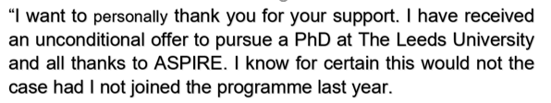

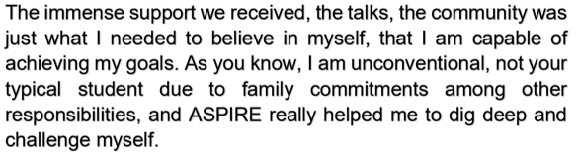

Notes:
Image source: Amazon.com

Slide 18

ASPIRE Podcast

Slide 19
Next steps
Explore additional funding beyond the current funding cycle to continue to support Black scholars towards doctoral education.
Continued engagement with senior leaders towards an anti-racist higher education.
Continued engagement with policymakers towards increasing access and participation for Black scholars.
Overarching evaluation report of all three cohorts
Notes:
FR and FA to present next steps for the evaluation 10 mins

Slide 20
Notes:
Questions 20 mins

