Slide 1






The Global SDG Synthesis Coalition
How can evaluation and synthesis be more centrally placed to achieve national and global goals?
5 June 2024

Slide 2
Session objectives
Overview of the Coalition
The value of evaluation synthesis and evidence maps for evidence informed decision making on the SDGs
Lessons learned from Coalition synthesis and evidence mapping efforts on the Partnership Pillar synthesis
Explore future approaches to co-production, engagement and uptake at the country and global levels
Include your logos here
Notes:
Will

Slide 3




The panel
John Lavis
Co-lead, Global Commission on Evidence to Address Societal Challenges
Will Moy
CEO, Campbell Collaboration
Shivit Bakrania
Senior Evaluation Synthesis Specialist, UNDP IEO
Kerry Albright
Principal Adviser/Deputy Director, UNICEF Evaluation Office
Include your logos here
Notes:
Will

Slide 4
Why? Collective failure
The world is far off track…​
140 targets with data show only about 12% are on track​
Close to half are moderately or severely off track​
30% have either seen no movement or regressed below the 2015 baseline. ​
Based on current trends, the world will not achieve any SDGs even by 2050​
​
2023 HLPF Political Declaration​
But it is possible to improve future prospects…​
Science that is multidisciplinary, equitably and inclusively produced, openly shared, widely trusted and embraced, and socially robust and relevant to society, provides the foundation for the transformations the world needs.​
​
Global Sustainable Development Report 2023
​
Notes:
Kerry
Why did UNDP IEO and UNICEF initiate work on the Global SDG Synthesis Coalition?​
We are already halfway to 2030, the supposed endline of the SDG, and we are far off track​
However, as the GSDR 2023 proclaims, it is possible to improve future prospects, through the use of science and evidence to inform decision-making​
There has also been a huge push and a call from the UNSG for the EOs of UN agencies to work together, in collating and making sense of the evaluative evidence base​
Within the UN system and externally, we have a huge evidence base to draw upon. So the lack of evidence is not the issue, it’s about collating this, making it accessible, and synthesizing to draw out key findings on where transformations can occur and where efforts can be directed​.
This is what the Global SDG Synthesis Coalition is about…​

Slide 5



Harnessing the power of evaluation and synthesis to accelerate the achievement of the 2030 agenda.
.
MISSION STATEMENT
Notes:
KERRY
Simply put, the Coalition’s mission is to ….​
​
To try and create a platform for the extensive evaluative evidence base that we have, to put it in the framework of the SDGs, and to provide clear lessons to inform decision-making on the SDGs​
​
To understand the scope of the evidence base we have within the UN evaluation system: since 2021, an average of 1000 evaluations has been published annually. The United Nations Evaluation Group database has nearly 25,000 records, and not all UN agency evaluations are uploaded there.
​
That is not even considering non UN research and evaluation reports that speak to the effectiveness of interventions and approaches to SDG targets and outcomes. ​
​
So the challenge for the international community is…how do we approach this and use this untapped super power that we have to turn into tangible actions to accelerate delivery/combat reversal of the SDGs?

Slide 6












Who?
Co-leads
Transitional Leadership
Co-chairs
Notes:
KERRY
The Coalition is co-led by UNDP’s and UNICEF’s Evaluation offices. Currently comprised of 46 UN agencies, multiple member states and other civil society and private sector entities.
We also count evaluation and synthesis networks as partners, including the Campbell Collaboration and the Global Commission on Evidence to Address Societal Challenges, who are part of the Coalition’s Transitional Leadership Group, as well as the newly formed UN SDG System Wide Address Societal Challenges, as well as the UN SDG System Wide Evaluation Office who collectively form part of the transitional leadership group as the Coalition evolves into the next phase of its thinking.
​There are far too many agencies to list or show here, on this slide are some of the co-Chairs of the various MGs. but we currently have 46 UN and UN adjacent agencies as partners, some of whom have contributed financially, and all of whom have contributed in-kind across the work of the Coalition​
​
We also have multiple member states involved. Canada has been particularly supportive, as has Spain, Ireland, Malawi, Panama and multiple others. ​
​
​

Slide 7






















How? The Pillar Approach
Partnership
Planet
Peace
People
Prosperity
Notes:
KERRY
The Coalition is organised around the five SDG Pillars: Partnerships, Planet, Peace, People, Prosperity
Why?
Focusing on the 5 pillars allows us to recognise the multidimensionality of sustainable development and the interlinkages between the SDGs
We know that all SDGs are inter-linked - progress on one target may act as an accelerator for another target, we can also recognise that there are trade-offs between progress in one area, which may have detrimental downstream effects on another area
So conceptually, the pillars encourage us to think in an integrative, systematic and harmonized way
Cutting across these pillars are the SDG principles of universality and leave no one behind
The Pillars allow the different partners of the Coalition to coalesce around their thematic areas of interest, so each pillar, in it’s own way, is a mini-Coalition
AN IMPORTANT POINT TO MAKE HERE: IS THAT WHEN THE COALITION KICKED OFF IN 2021, THE INTENTION WAS TO UNDERTAKE A MEGA-SYNTHESIS COVERING EACH PILLAR IN ENTIRITY. THE NEW STRATEGY GOING FORWARD, WHICH JOHN LAVIS HAS BEEN PART OF DEVELOPING, IS TO UNDERTAKE SEVERAL SYNTHESES IN EACH PILLAR THAT ARE NARROW IN SCOPE AND THAT FOCUS ON SPECIFIC ACCELERATOR TOPICS OR THEMES
THIS IS BASED ON LEARNING FROM THE FIRST OF THE COALITION’S SYNTHESIS, WHICH WAS ON THE PARTNERSHIP PILLAR

Slide 8
Where are we? What’s next?
  Partnership pillar synthesis launched in 2023
  The first Peace pillar synthesis (violence prevention and peacebuilding)
  The first People pillar synthesis (social protection approaches to leaving no one behind)
  Keeping the syntheses ‘living’ to 2030 and beyond
  An online, interactive SDG open evidence portal utilizing AI
  Towards a global evidence ecosystem for accelerating progress on the SDGs and beyond…
Include your logos here
Notes:
Kerry
SDG Summit, 2023.
Summit of the Future, 2024
World Social Summit/Second World Summit for Social Development 2025

Slide 9
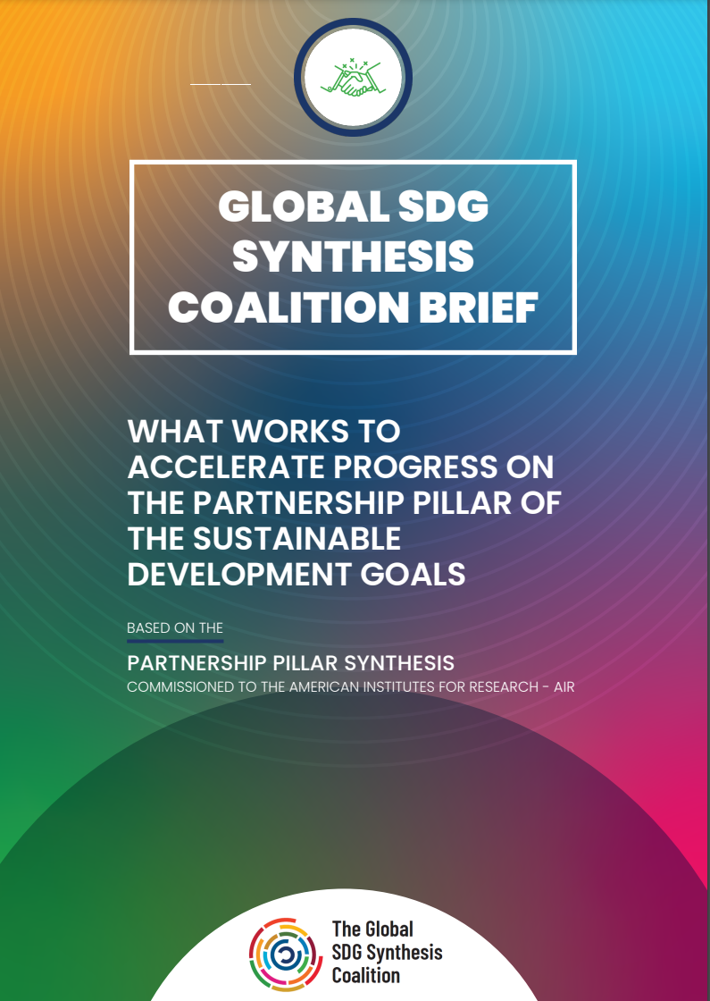
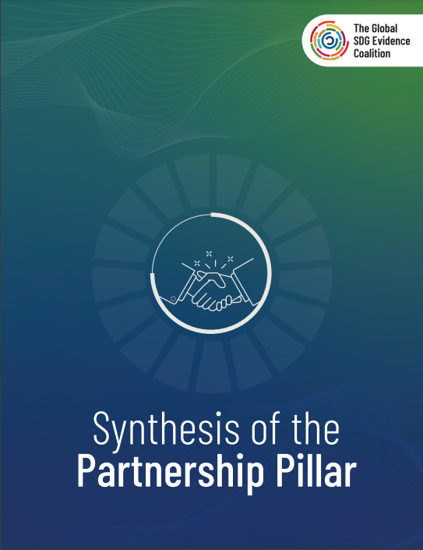
The Partnership Pillar synthesis
Notes:
SHIV
I will talk about the Coalition’s first synthesis on the Partnership Pillar, which was launched at the UN SDG Summit in September 2023
I want to give a sense of the methodological approach, the lessons learned, and the evidence maps we developed to accompany the synthesis, and how maps like these can be a valuable part of an evidence-informed approach to decision-making on how to accelerate progress towards the SDGs
Won't be going into the lessons from the synthesis itself, on which we've presented on at different forums recently

Slide 10
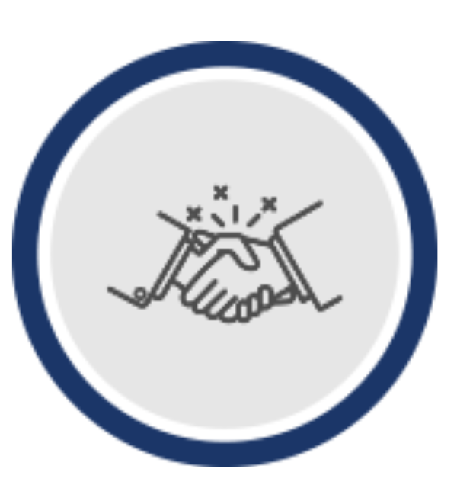
Why begin with the Partnership Pillar?
The Partnership Pillar consists of SDG-17, ‘to strengthen the means of implementation and revitalize Global Partnership for Sustainable Development’
The Partnership Pillar has an enabling role for accelerating all other SDGs
The 2023 UNGA SDG Summit called for a new paradigm to revitalize Global Partnerships
Targets cover partnerships in five key areas: trade, finance, technology, capacity building, and systemic issues
Notes:
SHIV

Slide 11
Methods and evidence
IMPACT EVALUATIONS/
SYSTEMATIC REVIEWS
Impact and effectiveness of interventions on SDG outcomes
Narrative synthesis
Meta-analysis (where possible)
External academic databases
PERFORMANCE AND PROCESS EVALUATIONS
Why and how interventions are more/less successful
Qualitative synthesis
UN, bilateral donors, member state repositories
VOLUNTARY NATIONAL REVIEWS
Themes in VNR data on progress and sentiment
SDG TRACKER DATA
Statistical analysis to determine outliers
Notes:
SHIV
Broadly reflects the approach going forward – focused on MIXED METHODS SYNTHESIS

Slide 12
Opportunities and challenges
Challenges
Methodological vs political considerations​
Smaller scope leads to more actionable and useful lessons
Syntheses need to more relevant and actionable at the regional and national levels
More thought needed on audience, uptake and use​
Opportunities
Value added of UN evaluations to answer 'how' or 'why' questions​
​Holistic, multidimensional and multisectoral perspective that joint syntheses can provide ​
Mandate and access of UN EOs to decision-makers at all levels ​
Collaboration with external entities is facilitating a renewed focus on evidence for the SDGs
Notes:
SHIV
Methods vs political:
Rigour vs representation: We made an effort to adopt best practice in rigour for conducting this synthesis. At the same time, we found that partner agencies in the exercise were concerned with issues of representation of their evidence.
Multi-agency benefits, not academic-bubble, and impacts: Given the nature of the coalition, a benefit was that this was a multi-agency exercise, this emphasises that we are not undertaking syntheses in an academic bubble. This also means that we had to spend considerable time building consensus on the scope and approach.
Smaller scope: Initial approach was to conduct these magnum opus syntheses at the global level encompassing the whole pillar. A lesson was that smaller, more narrowly defined syntheses might lead to more actionable and useful lessons
Regional and local – top down meeting needs: a challenge for the Coalition has been that with this top-down approach, how can we be more relevant to regional and local evidence needs and priorities. John later on...
UN evals: UN evaluations are distinct in the synthesis space, and they can add value for answering questions on things like implementation and design barriers and facilitators that determine effectiveness that academically published impact evaluations often cannot
Joint syntheses: We are really seeing the value of multi-agency syntheses at the UN. Both in terms of the knowledge and expertise we can draw on from across agencies, as well as the engagement and uptake opportunities
Mandate: In principle, the UN system becoming more intimately involved in global efforts to facilitate EIDM brings a lot of value. This is through the mandate that UN agencies
Collaboration: The vision of the Coalition, in terms of improving access to evidence, in a timely way, to decision-makers aligns with what much of the external evidence and synthesis community is attempting to do. We have recently experienced a renewed focus on this.

Slide 13
Evidence maps
Transparency: Providing a clear overview of the available evidence
Decision making: Visual representation of the existing evidence base, identifying the areas that have been well-evaluated and those that require further investigation
Increased accessibility: An accessible way for various stakeholders to understand the existing evidence
Evidence-informed practice: providing a clear overview of the available evidence, evidence gap maps promote the use of evidence-informed practice
Global to local contexts: Examples of co-production of maps with local and national policy makers
Notes:
SHIV
[Something about how evidence maps are not novel to the global evidence community, but are novel within the UN system. There is much movement on this: from attempts by the SWEO to map UN evaluations against the SDGs to efforts by individual agencies to use maps to help identify evaluation and research priorities. We expect to see much movement this year]
[Together with others, we are trying to socialise the use of evidence maps in the UN system as a tool for.....]

Slide 14
What works for achieving SDG17 evidence map
Impact EGM
Notes:
SHIV demos impact map

Slide 15
How partnerships work evidence map
Performance & Process EGM
Notes:
SHIV demos impact map

Slide 16
‘Use case’ for syntheses and maps at a local level
When policy windows open
  Policymakers need to match diverse forms of evidence and other types of information to a given policy context and issue
  Technical staff need to provide ultra-rapid evidence support (drawing on existing evidence) and use a ‘general contractor’ model (creating flows of new evidence)
Evidence synthesis, especially living evidence synthesis that make available downloadable datasets, is a game-changer for ultra-rapid evidence support
Notes:
John

Slide 17
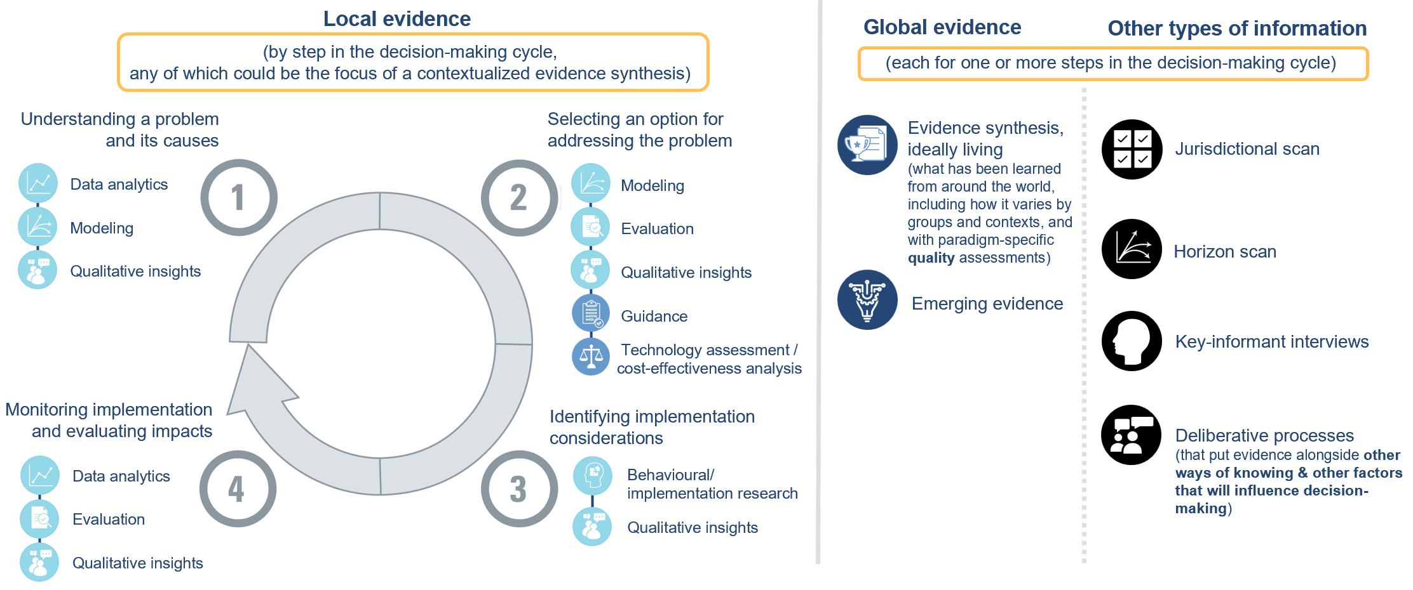
Mapping evidence to a given policy context and issue
Notes:
John
[to make point about how we need to match diverse forms of evidence and other types of information to a given policy context and issue, while foregrounding equity considerations, and to speak about how the Coalition fits into this, and mention the fact that this needs a reorientation from how the Coalition has been operating thus far]

Slide 18
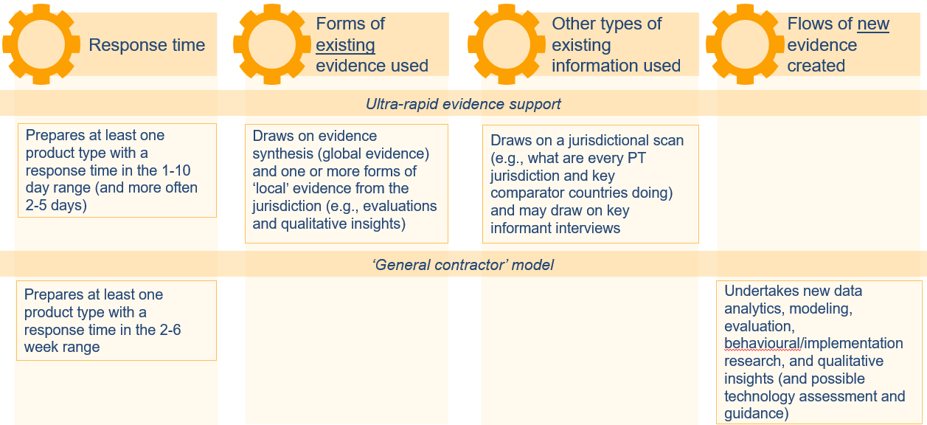
Providing timely, demand-driven evidence support
Notes:
John

Slide 19
‘Use case’ for syntheses and maps at a global level
When supporting national development agendas
  UN agencies need to ensure that the normative guidance and technical assistance they provide are based on the best available evidence and subjected to independent evaluation and learning
Evidence synthesis, both of independent evaluations and available scientific studies, is a game-changer for UN agencies and their work supporting member states
Notes:
John

Slide 20
Any questions or comments about what we've covered?
Overview of the Coalition
The value of evaluation synthesis and evidence maps for evidence informed decision making on the SDGs
Lessons learned from Coalition synthesis and evidence mapping efforts on the Partnership Pillar synthesis
Explore future approaches to co-production, engagement and uptake at the country and global levels
Include your logos here
Notes:
Will

Slide 21
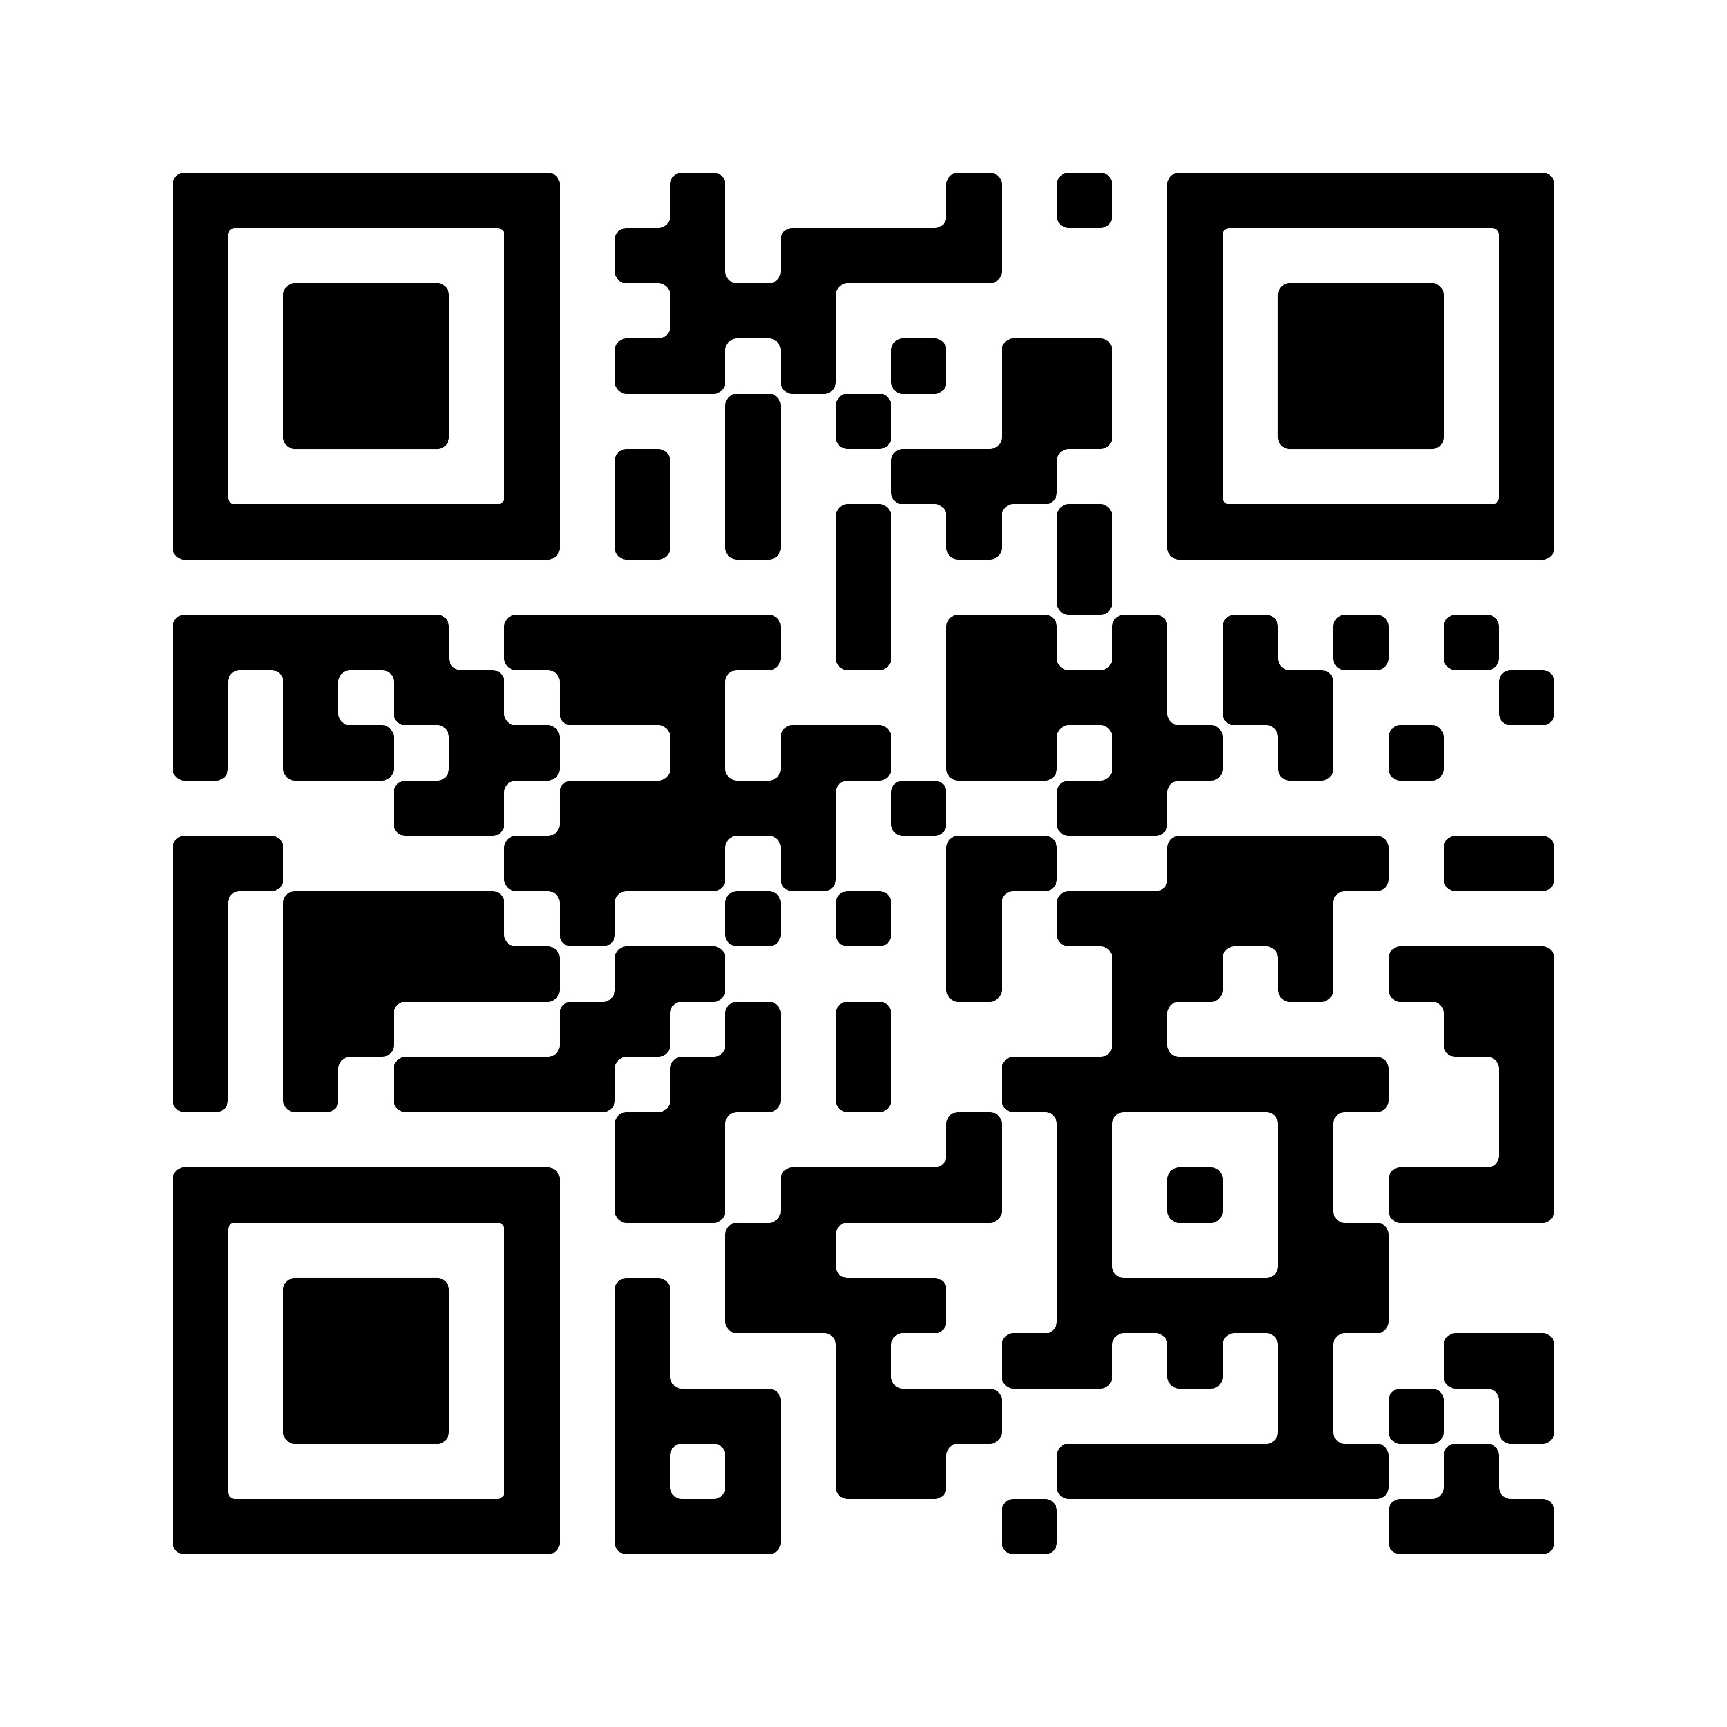



Thank you!
sdgsynthesiscoalition.org
@SDGSynthesis
The Global SDG Synthesis Coalition

Slide 22


3 - 7 June 2024
logos

