Slide 1




3-7 June 2024
Webinar on “Monitoring and Evaluation (M&E) Act 2024 of Nepal: The Way Forward”
Tuesday, 04 June 2024 – 4:00 PM Nepal Time (GMT+05:45)

Slide 2
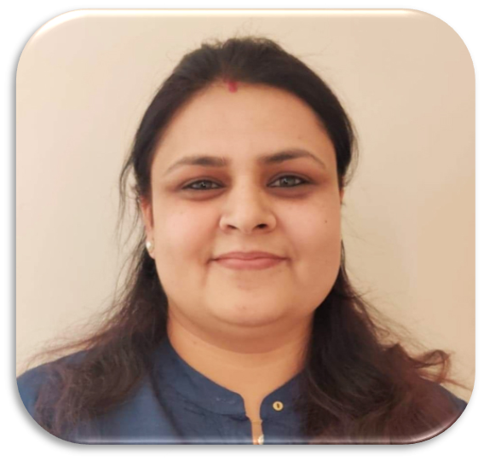


3-7 June 2024
Moderator
Sunaina Sharma
Independent Consultant-Evaluation Specialist
Treasurer-Community of Evaluators-Nepal
Webinar on “Monitoring and Evaluation (M&E) Act 2024 of Nepal: The Way Forward” - Tuesday, 04 June 2024 – 4:00 PM Nepal Time (GMT+05:45)

Slide 3


3-7 June 2024
Audience Reminders
Kindly keep your microphone and camera turned off to maintain the quality of the internet and avoid disturbances.
If you have any questions or concerns, please type them in the chat box.
Webinar on “Monitoring and Evaluation (M&E) Act 2024 of Nepal: The Way Forward” - Tuesday, 04 June 2024 – 4:00 PM Nepal Time (GMT+05:45)

Slide 4
3-7 June 2024
Agenda
Opening remarks
Presentations by three Speakers
Q&A
Closing remarks
Webinar on “Monitoring and Evaluation (M&E) Act 2024 of Nepal: The Way Forward” - Tuesday, 04 June 2024 – 4:00 PM Nepal Time (GMT+05:45)

Slide 5

3-7 June 2024
Opening Remarks
Mr. Prabin Chitrakar
Chairperson, Community of Evaluators- Nepal
Webinar on “Monitoring and Evaluation (M&E) Act 2024 of Nepal: The Way Forward” - Tuesday, 04 June 2024 – 4:00 PM Nepal Time (GMT+05:45)

Slide 6
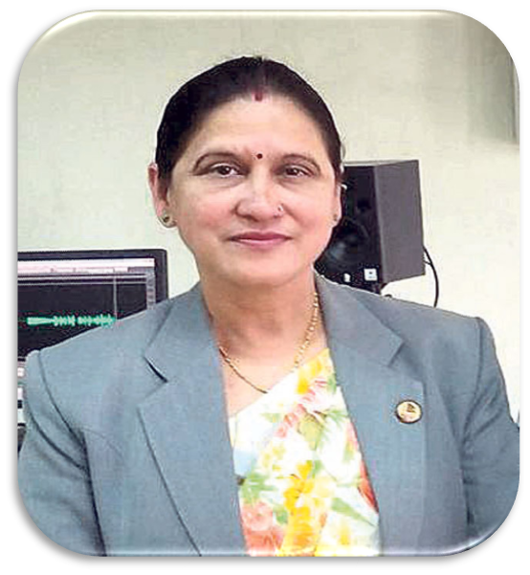
An overview of the M&E Act 2024 and its key provisions
3-7 June 2024
Speaker
Hon. Ranju Kumari Jha
Member- House of Representatives of Nepal
Webinar on “Monitoring and Evaluation (M&E) Act 2024 of Nepal: The Way Forward” - Tuesday, 04 June 2024 – 4:00 PM Nepal Time (GMT+05:45)

Slide 7
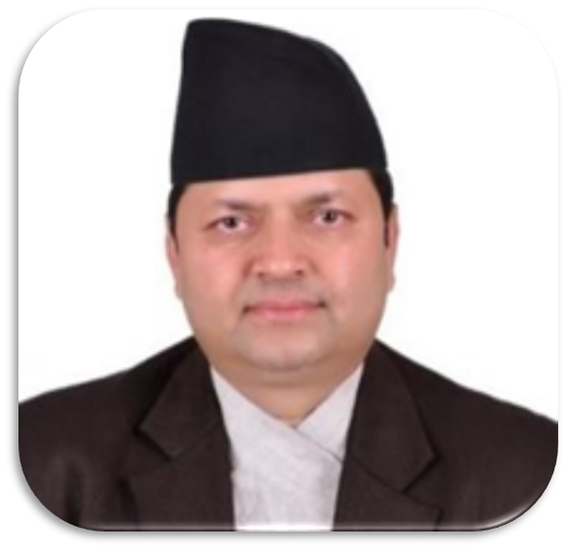
Effective Implementation of Monitoring and Evaluation (M&E) Act 2024
3-7 June 2024
Speaker
Hon. Dr. Ram Kumar Phuyal
Member
National Planning Commission, Government of Nepal
Webinar on “Monitoring and Evaluation (M&E) Act 2024 of Nepal: The Way Forward” - Tuesday, 04 June 2024 – 4:00 PM Nepal Time (GMT+05:45)

Slide 8
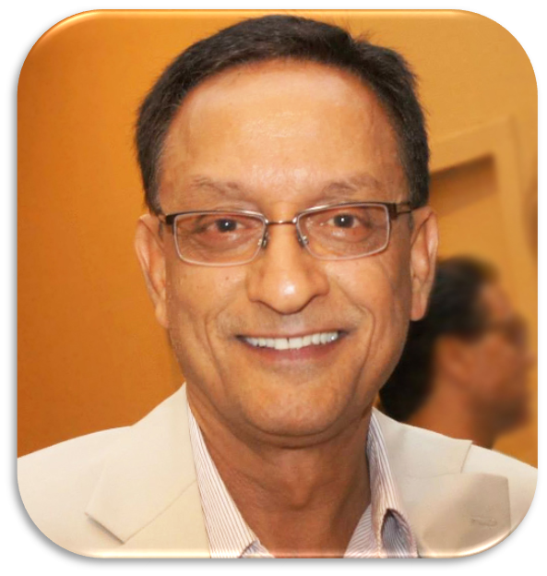
Stakeholder Engagement and Collaboration
3-7 June 2024
Speaker
Dr. Krishna Belbase
Life Member & Advisor-Community of Evaluators- Nepal
Webinar on “Monitoring and Evaluation (M&E) Act 2024 of Nepal: The Way Forward” - Tuesday, 04 June 2024 – 4:00 PM Nepal Time (GMT+05:45)

Slide 9

3-7 June 2024
Webinar on “Monitoring and Evaluation (M&E) Act 2024 of Nepal: The Way Forward” - Tuesday, 04 June 2024 – 4:00 PM Nepal Time (GMT+05:45)

Slide 10

3-7 June 2024
Group photo
Webinar on “Monitoring and Evaluation (M&E) Act 2024 of Nepal: The Way Forward” - Tuesday, 04 June 2024 – 4:00 PM Nepal Time (GMT+05:45)

Slide 11
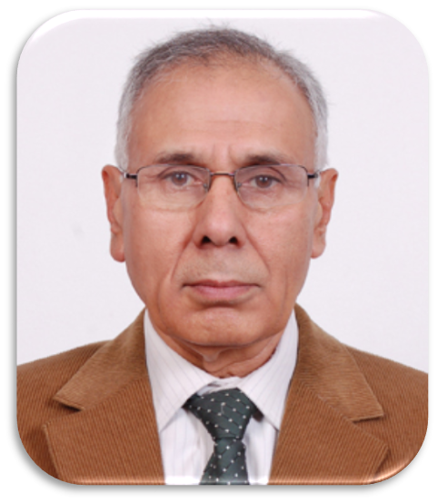

3-7 June 2024
Closing Remarks
Webinar on “Monitoring and Evaluation (M&E) Act 2024 of Nepal: The Way Forward” - Tuesday, 04 June 2024 – 4:00 PM Nepal Time (GMT+05:45)

Slide 12








3-7 June 2024
https://www.facebook.com/nepalcoe
https://x.com/coe_nepal
https://www.youtube.com/@coe-nepal
https://www.linkedin.com/in/coe-nepal-community-of-evaluators-nepal-a85a0324b/
info@coe-nepal.org.np, nepalcoen@gmail.com
www.coe-nepal.org.np
Webinar on “Monitoring and Evaluation (M&E) Act 2024 of Nepal: The Way Forward” - Tuesday, 04 June 2024 – 4:00 PM Nepal Time (GMT+05:45)

