Slide 1



Strengthening Monitoring, Evaluation and Learning (MEL) Systems in Tanzania
This presentation will explore how Tanzania can build robust MEL systems that leverage global best practices and local innovations to drive sustainable development for community-based projects.
By
Pantaleon Shoki
Executive Secretary
Tanzania Evaluation Association (TanEA)

Slide 2


Slide 3
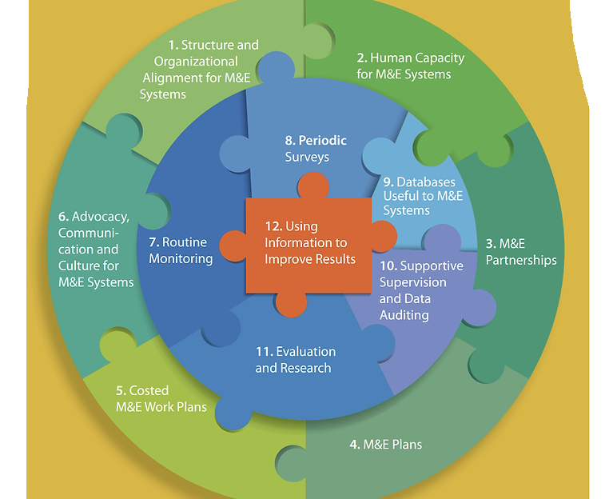

https://documents1.worldbank.org/curated/en/708391468331216900/pdf/533030PUB0moni101Official0Use0Only1.pdf

Slide 4
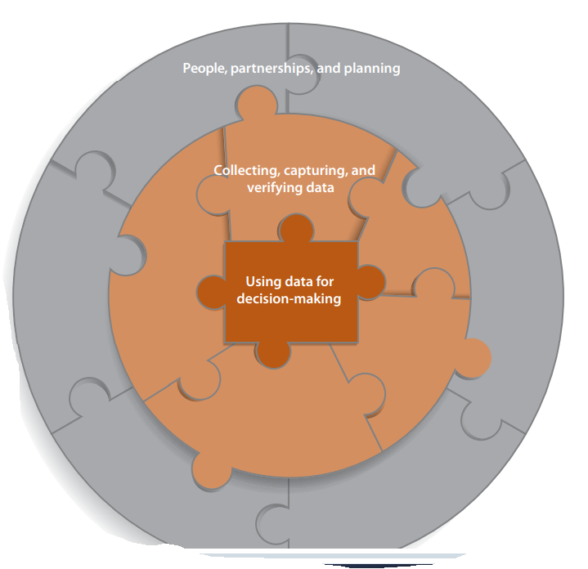

Slide 5

Importance of Participatory MEL for Local Project Sustainability
1
Community Ownership
2
Contextual Relevance
Engaging local stakeholders in the MEL process fosters a sense of ownership and commitment to project outcomes.
Participatory MEL ensures that monitoring and evaluation activities are tailored to the unique needs and challenges of the local community.
3
Sustained Impact
When communities actively participate in MEL, they are more likely to continue implementing effective practices long after the project's conclusion.

Slide 6
Leveraging Global Insights on Effective MEL Practices
Adaptive Management
Stakeholder Engagement
Technology Integration
Incorporating flexible, data-driven decision-making to respond to changing project needs and contexts.
Ensuring meaningful participation from all relevant stakeholders, including community members, government, and sector experts.
Leveraging digital tools and platforms to streamline data collection, analysis, and reporting for increased efficiency and transparency.

Slide 7
Identifying Local Innovations and Best Practices in Tanzania
Community-Led Monitoring
Peer-to-Peer Learning
Empowering local communities to design and implement their own MEL systems tailored to their needs.
Facilitating knowledge exchange between communities to share effective MEL approaches and problem-solving strategies.
Integrated Data Systems
Culturally Appropriate MEL
Developing centralized platforms to streamline data collection and analysis across various development initiatives.
Adapting MEL tools and methods to align with local customs, languages, and decision-making processes.

Slide 8




Engaging Stakeholders in the MEL Process
Community Members
Government Officials
Sector Experts
Implementing Partners
Leverage the knowledge and experience of development professionals, academics, and technical specialists.
Ensure meaningful participation of local beneficiaries in all stages of the MEL process.
Collaborate with local and national government agencies to align MEL efforts with policy priorities.
Foster transparency and accountability through joint MEL activities with project partners.

Slide 9
Building Capacity for Sustainable MEL Implementation
Training & Mentorship
Institutional Strengthening
Provide comprehensive training and ongoing mentorship to build the MEL skills of local staff and community members.
Support the development of institutional (including MDAs) systems, policies, and resources to sustain effective MEL practices.
1
2
3
Knowledge Sharing
Facilitate knowledge exchange opportunities and peer-to-peer learning (including inter Ministerial, Department and Agencies) to promote the adoption of best practices.

Slide 10




Monitoring and Evaluating the Impact of Strengthened MEL Systems
Baseline Assessment
Process Monitoring
Outcome Evaluation
Conduct a comprehensive baseline to understand the current state of MEL practices and identify areas for improvement.
Continuously track implementation of capacity-building efforts and stakeholder engagement activities.
Measure the long-term impact of strengthened MEL systems on project outcomes and community well-being.

Slide 11
MEL Systems for Sustainable Implementation of Tanzania's Third National Five Years Development Plan (FYDPIII)
Alignment with FYDPIII Priorities
Ensure that MEL efforts are closely linked to the strategic objectives and key performance indicators of the national development plan.
Data-Driven Decision Making
Leverage robust MEL systems to inform policy decisions and resource allocations for the successful implementation of FYDPIII.
Capacity Building for Local Stakeholders
Empower local government, civil society, and community organizations to effectively monitor and evaluate FYDPIII initiatives.

Slide 12


Tanzania's Third Five Year Development Plan (FYDP III)
The Third Five Year Development Plan (FYDP III) is a critical initiative aimed at propelling Tanzania towards its National Development Vision 2025 goals. This comprehensive plan outlines a strategic roadmap to transform Tanzania into a middle-income, industrialized nation with a high standard of living for its citizens.

Slide 13
Objectives of FYDP III
1
Building on Achievements
2
Enhancing Competitiveness
To build on the successes achieved towards the attainment of the Tanzania Development Vision 2025, making Tanzania a semi-industrialized, middle-income country by 2025.
To strengthen capacity building in science, technology, and innovation, enhancing the competitiveness and productivity across all sectors, especially the productive, manufacturing, and services industries.
3
Strengthening the Industrial Economy
4
Leveraging Strategic Opportunities
To strengthen the industrial economy as a basis for export-driven growth, investing in new products and markets, and positioning Tanzania as a production hub in the East, Central, and Southern African region.
To enhance Tanzania's benefits from its strategic geographical location through improved business environments and strengthening the country's regional position as a hub for production, trade, supply, and transportation.

Slide 14
Key Thrusts of FYDP III
Competitiveness
Industrialization
Trade and Investment
Interventions to improve the country's competitiveness, focusing on productivity, quality of products/services, and attractiveness for foreign investment. This includes enhancing human capital in science, technology, and innovation (STI) capabilities.
Deepening industrialization, driven by STI capabilities, to foster value addition in manufacturing and productive sectors such as agriculture, fishing, livestock, mining, and natural resources.
Increasing Tanzania's participation in global and regional trade, with a focus on exports that embody local value addition. Applying economic diplomacy to promote foreign investment and trade, while strengthening the private sector's capacity and engagement.

Slide 15
Reinforcing Social Development
1
Inclusive Growth
2
Quality of Services
3
Skills Development
Interventions to achieve inclusive economic growth through poverty reduction and social development strategies, as well as enhancing the productive capacity of youth, women, and people with disabilities.
Emphasis on improving the coverage, equity, and quality of social services to attain an inclusive economy, consistent with the high-level human development goals of the Tanzania Development Vision 2025.
Addressing the mismatch between the skills demanded by employers and the skills provided by academic institutions, with a focus on developing both hard and soft skills, including knowledge, creativity, persistence, self-drive, and attitude.

Slide 16



Strengthening Implementation
Prioritization
Strengthening the implementation of FYDP III, including prioritization, planning, integration, and alignment of implementation interventions.
Coordination
Ensuring cross-sector coordination and collaboration for the effective implementation of the sub-themes and interventions outlined in FYDP III.
Financing
Strengthening the country's capacity to finance development through coherent revenue strategies and a broadened tax base.

Slide 17



Leveraging Strategic Partnerships
Global Commitments
Local Government
Private Sector Engagement
Natural Resources Linkages
Strengthening the role of Local Government Authorities (LGAs) in driving development and increasing income at the community level.
Ensuring that regional and global agreements and commitments are fully integrated into the national development plan for the benefit of Tanzania.
Deepening the engagement and capacity of the private sector to facilitate the implementation of policies that attract domestic and foreign investment and trade.
Strengthening the relationship between sectors endowed with natural wealth and resources with other economic and social sectors.

Slide 18
Measuring Progress
Indicator
Target
GDP Growth Rate
6-8% per annum
Industrialization Contribution to GDP
30% by 2025
Poverty Reduction
Reduce by 2 percentage points annually
Human Development Index
Increase from 0.538 to 0.60 by 2025

Slide 19
Building a Prosperous Tanzania
A Modernized Economy
Improved Livelihoods
Increased Global Prominence
The plan also focuses on achieving inclusive economic growth, reducing poverty, and enhancing the quality of life for all Tanzanians through improved access to social services and opportunities for development.
By implementing the comprehensive strategies outlined in the FYDP III, Tanzania aims to become a semi-industrialized, middle-income country with a strong, diversified, and globally competitive economy.
Through strategic partnerships, effective leveraging of its geographical advantages, and deeper integration into regional and global trade networks, Tanzania seeks to strengthen its position as a hub for production, trade, and transportation in East, Central, and Southern Africa.

Slide 20




Conclusion and Next Steps
Scaling Up Best Practices
Identify successful MEL approaches and work to replicate and scale them across Tanzania for maximum impact.. See Examples at https://shorturl.at/aZZyh
Fostering Collaboration
Strengthen partnerships between government, professional organizations e.g., TanEA, civil society, development organizations to create a coordinated, nationwide MEL ecosystem. See Examples at https://shorturl.at/jSpK3
Securing Sustainable Funding
Explore diverse funding sources and innovative financing mechanisms to ensure the long-term sustainability of MEL systems. See Examples at https://shorturl.at/nje2T

Slide 21
Pantaleon Shoki (B.A; M.A; PhD Candidate)
Executive Secretary
Tanzania Evaluation Association (TanEA)
Mobile: +255765785383; +255685993590
Email: shokipn2000@gmail.com, pshoki@tanea.or.tz

