Slide 1



Introduction to Afghan Evaluation Society
Friday 7 June 2024 at 4:00PM Kabul
1:30PM CEST (Europe)
7:30AM EDT (US/Canada)
11:30AM GMT

Slide 2
Introduction
Non-profit and Afghan-led organization (VOPE)
Informally established as a VOPE in Sep 2013
Formally registered as an NGO, Sep 2015

Slide 3
Vision and Mission
Vision: Strengthened Evaluations for Sustainable Development in Afghanistan
Mission: To establish a leading platform for evaluation through capacity building, advocacy and networking for supporting evidence-based policy and decision-making for sustainable development in Afghanistan.

Slide 4
AfES’ Role
Working with Afghan government and partners
Advocacy for M&E
Institutional and individual capacity building

Slide 5
Board of Directors
  Samandar Mahmodi (Chairman)
  Huda Mustafawi (Board Member)
  Tooryalay Nasery (Board Member)
  Qudratullah Jahid (Board Member)
  Imad Haroon (Board Member)
  Raoof Modaqiq (Board Member)
  Baktash Musawre (Board Member)

Slide 6
Memberships, Partnerships and Collaborations
  Asia Pacific Evaluation Association (APEA)
  International Organization for Cooperation in Evaluation (IOCE)
  EvalPartners - The global movement for evaluation.
  Community of Evaluators South Asia (COE-SA)
  EvalYouth

Slide 7
Projects and Initiatives
  We have implemented nine (9) projects/initiatives to build capacity of Afghan MEL community, generate knowledge, and contribute to the field of evaluation. These include:
  Training Programs
  Building Grounds for NEP and National EvalAgenda2020
  SDGs Evaluation
  Evaluation in the context of Fragility, Conflict and Violence (EvalFCV)

Slide 8
Projects and Initiatives – Cont’d
Trained 200+ M&E professionals
40 paid members (2021)
Thematic Interest Groups (TIGs):
  TIG 1 - Evaluating Sustainable Development Goal (SDGs)
  TIG 2 - Young and Emerging M&E Professionals
Partnership with public and private universities
Partnership with regional and international VOPEs
Rapid M&E assessment tools
Resource sharing – mailing lists

Slide 9
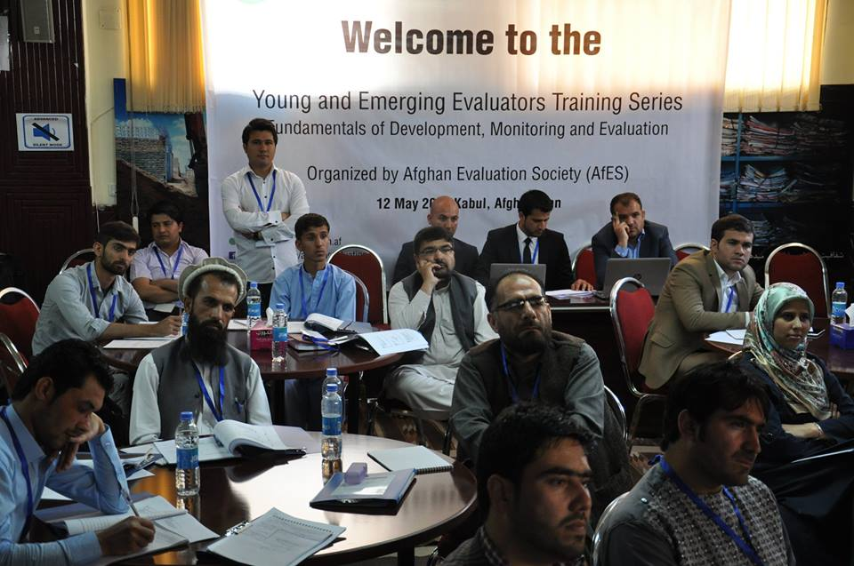
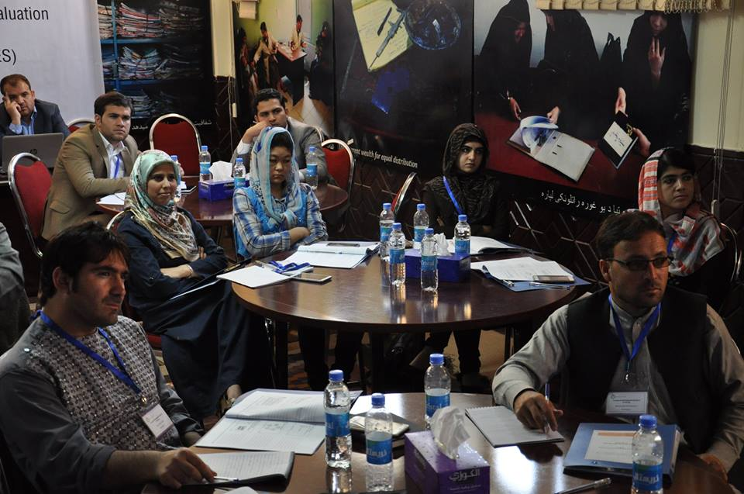
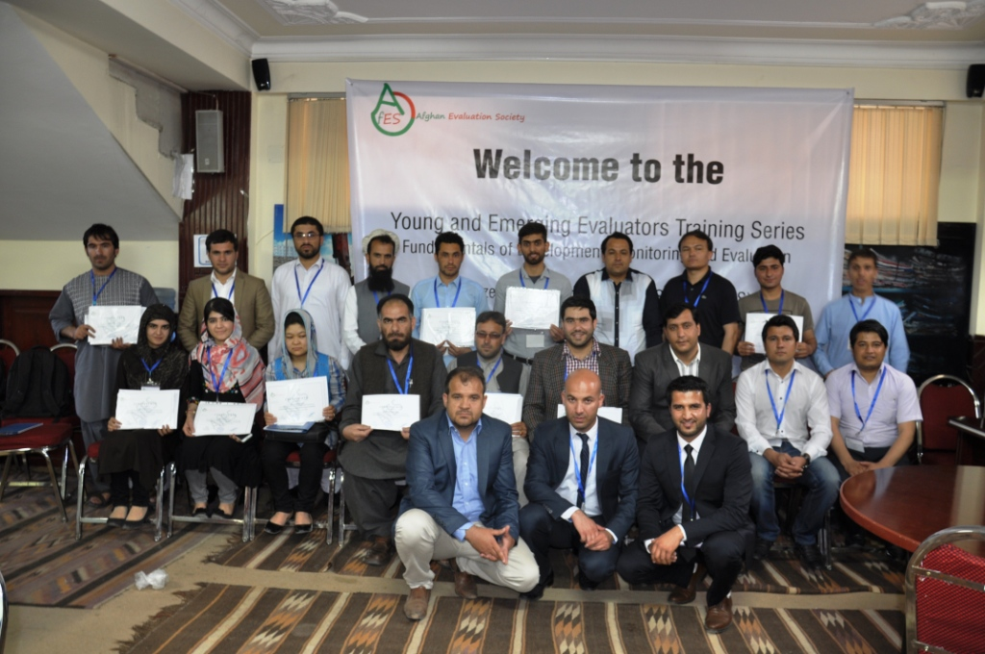

Slide 10
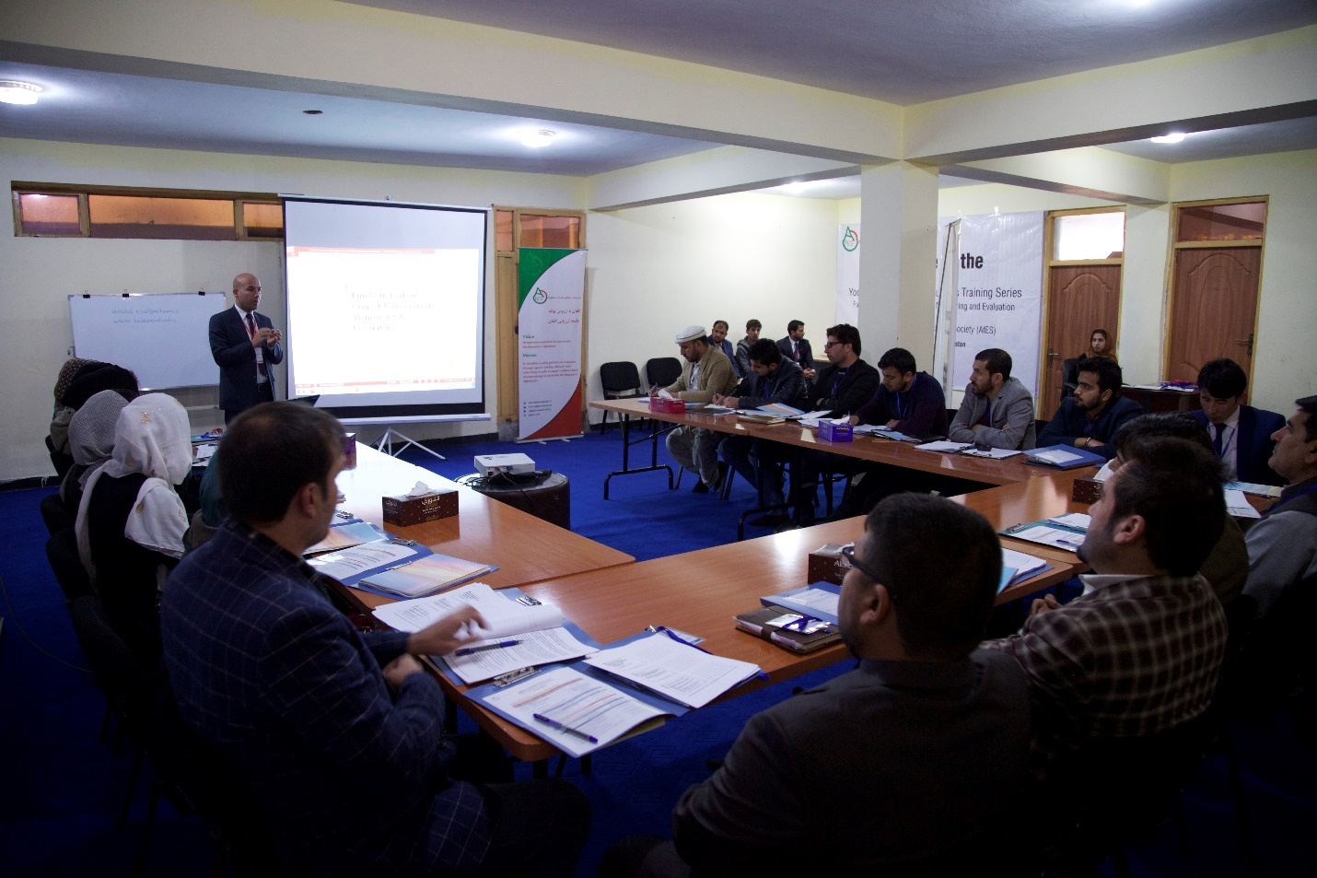

Slide 11
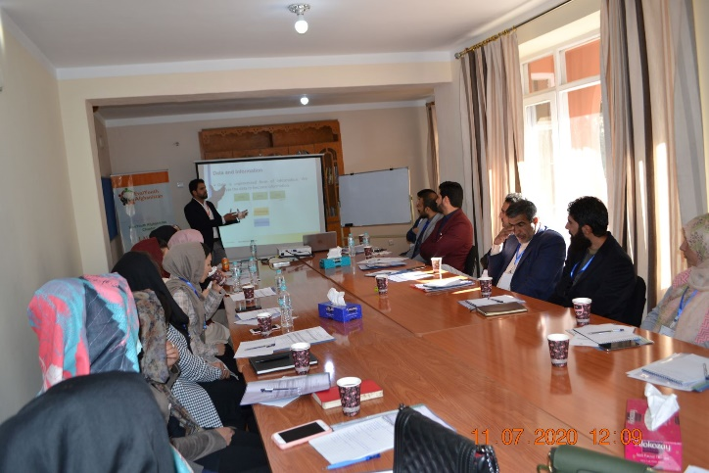
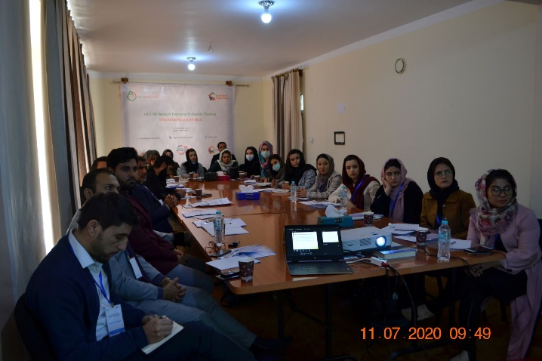

Slide 12


