Slide 1

Recent concepts on transformational change and its evaluation, focusing on climate change
Introduction to a panel discussion on 5th June 2024 in the framework of the gLocal week on transformational evaluation
By Ansgar Eussner, Eussner Consult
Notes:
c

Slide 2
Extracts by AE from Michael Quinn Patton article:
Evaluation Criteria for Evaluating Transformation: Implications for the Coronavirus Pandemic and the Global Climate Emergency, in: American Journal of Evaluation 2021, Vol. 42(1) p. 53-89, with literature list, at: https://journals.sagepub.com/doi/full/10.1177/1098214020933689;
The addition of “coherence” as a new criterion addresses some of the limitations of the original five DAC criteria—relevance, effectiveness, efficiency, impact, and sustainability .
But “coherence” doesn’t evoke or connote the nature of complexity or the magnitude and urgency of transformation.
Thus, the revised DAC criteria remain mired in the logic of “normal evaluation” fixated on effectiveness, efficiency, control, and continuity.
In contrast, “postnormal” evaluation acknowledges, confronts, and engages with complexity, unpredictability, wicked questions, incompleteness, contradictions, turbulence, instability, “a plurality of perspectives in value determination” (Schwandt, 2019, p. 317), systems thinking, and, quintessentially, transformation.
Transforming systems requires aligning, networking, and integrating multiple and diverse theories of change to build critical mass transformational tipping points. Transformation, then, is not an intervention, it is rather a movement creating synergies among multiple interventions (Patton, 2020a).

Slide 3

Extracts from Michael Patton cont.
Adaptive ecological sustainability has emerged as a priority criterion for evaluation (Julnes, 2019a; Ofir, 2018a, 2018c; Rowe, 2019; Uitto, 2019). Neither the original nor the revised DAC criteria address adaptive ecological sustainability as a priority.
Sustainability as adaptive resilience is dynamic, complex, and developmental in both formulation and evaluation (Patton, 2011, chapter 7).
Resilience is measured by the magnitude of disturbance that can be absorbed before the system changes its structure by changing the variables and processes that control behavior. (Gunderson & Holling, 2002, pp. 27–28)
Evaluate whether, how, and to what extent interconnections among people, networks, institutions, ideas, and movements are deepened and enhanced to support, nurture, catalyze, and accelerate transformational trajectories.
Evaluate whether, how, and to what extent dysfunctional and constraining interconnections are disrupted and broken to liberate positive transformational energy and momentum.
Transformation succeeds where multiple systems align. Transformation is undermined and fails where competing systems battle for control and domination rather than collaborate and integrate, at least that is the premise of the Blue Marble Evaluation theory of transformation (Patton, 2020a).

Slide 4

Some quotes on new evaluation criteria
OECD-DAC, 2020: We expect evaluations will look more and more at questions related to transformation, reflecting the growing interest in understanding transformational change and the imperative for transformation described in both Agenda 2030 and the Paris Agreement. The evaluation methods needed to answer these questions are still emerging. However, the evaluation criteria are intended to be used in evaluating an intervention are not a particularly useful tool for a descriptive analysis of transformative change or systems change.
Osvaldo Feinstein (2019): An intervention (say a policy) may be highly relevant and get high marks on the other four [DAC] criteria, and yet it may not change in any significant way the situation of the target population. Its actual effects, although positive, may be insignificant in terms of transformational change. (p. 19). Feinstein considers complexity as part of the context for transformation. “Structurally linear tools, such as log frames, should be replaced by an evaluation framework that takes complexity into account” (p. 25). He suggests that “significance” be a transformational criterion.
Picciotto (2020a) also advocates significance as a criterion. Drawing on the definition of evaluation as determining merit, worth, and significance, he would make significance the universal criterion for judging the transformative impact of interventions.
Andrew Natsios (2010): Administrator [Agency Head], U.S. AID from, 2001–2006: “Those development programs that are most precisely and easily measured are the least transformational, and those programs that are most transformational are the least measured.”
Quotes taken by AE from Michael Patton's article and literature listed in its annex.

Slide 5
Extracts from article by Juha Uitto, Geeta Batra, Kseniya Temnenko, Archi Rastogi, Zenda Ofir et al.:
Evaluating transformational change — Lessons from international environmental funds, chapter 7 see: https://ideas-global.org/wp-content/uploads/2019/11/2019-11-05-Final_IDEAS_EvaluationForTransformationalChange.pdf
Transformational change refers to deep, systemic, and sustainable changes with large-scale impacts in a significant area of concern, in the case of this chapter climate change and other global environmental issues, based on evaluative evidence of GCF, GEF, and CIF.
One of the GCF’s objectives is “to promote a paradigm shift towards low-emission and climate-resilient development pathways”. The GEF defines as Transformative Mechanism a mechanism to expand and sustain the impact of the intervention (through mainstreaming, demonstration – replication, or catalytic effects). CIF’s goal is to advance transformational change toward low-carbon, climate-resilient development. CIF established the Transformational Change Learning Partnership (TCLP) in 2017 to facilitate a collaborative, evidence-based learning process on transformational change in the CIF context.
The synthesis revealed that there is an overarching lack of sufficient research and analysis on the role climate finance institutions for transformational change.

Slide 6

Dimensions of transformational change, Independent Evaluation Group, World Bank/IEG 2016
Relevance
Addresses a major development challenge (or societal or global concern) such as poverty, equity.
Evidence from diagnostic or analytical work showing the constraint or problem addressed was of critical importance.
Depth of change
Causes or supports fundamental change in a system or market; addresses root causes to support a change in trajectory.
Evidence of market change, systemic change or behavioural change.
Scale of change
Causes large-scale impact at the national or global level.
Evidence of scaling up of approaches and innovations and replication; catalytic effects; demonstration effects; positive spill-overs and externalities; acceleration/discontinuity in a development indicator.
Sustainability
impact has been economically, financially, environmentally sustainable in the long run.
Evidence of financial, economic, environmental sustainability of results after engagement.

Slide 7
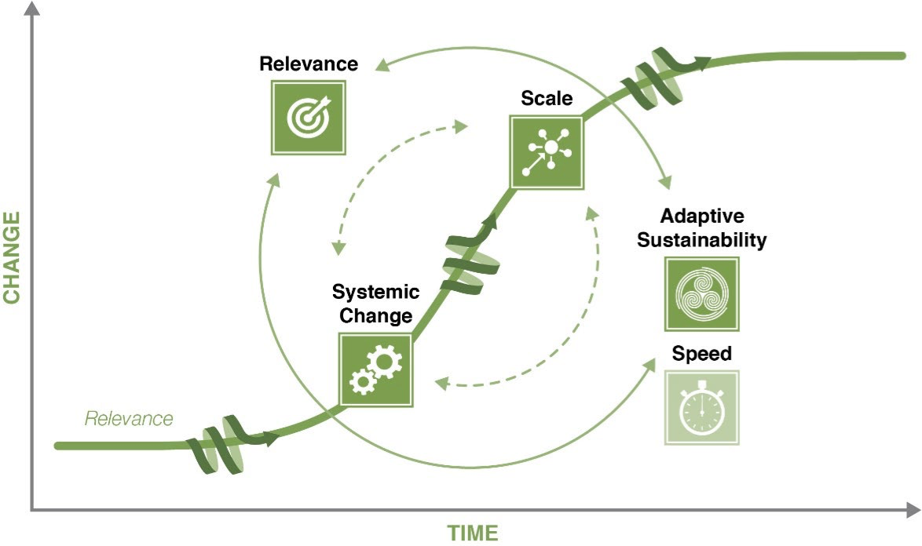
"S-curve" Model Using Dimensions to Track Transformational Change in Climate Action from the Climate Investment Funds (CIF) and Transformational Change Learning Partnership (TCLP), Transformational Change Concepts
Notes:
see: https://www.cif.org/sites/cif_enc/files/knowledge-documents/tclp_workshop_updated_tc_concepts_may2021.pdf
It is listed as the last item on the list of literature given on the last slide.
CIF's Evaluation and Learning Initiative established the Transformational Change Learning Partnership in 2017 to facilitate a collaborative, evidence-based learning process on transformational change and CIF’s role in supporting transformational change since 2008.

Slide 8

Just transitions from fossil to green energies
At and after COP26 in Glasgow, negotiations started with several countries like RSA, India, Indonesia, Senegal and Vietnam to facilitate transitions away from coal to green energies.
These Just Energy Transition Partnerships (JETP) were/are negotiated on top government levels with a group of bilateral donor countries from the G7.
The distinctive feature is the large volume of funding offered of several billions of US$ in each case with some in double digits, mostly for subsidized loans, and relatively little grants for technical assistance.
Another key element is the inclusive approach for compensating fossil fuel companies and their workers for their revenue losses and assisting them to develop alternative activities and incomes.
The negotiations were long and arduous and haven’t concluded yet in all cases. It remains to be seen whether the large funding offered will generate sufficient leverage to achieve the intended transformational change.
The main features are massive funding, high-level negotiations, mostly among state actors, and inclusive settlements with compensations for affected companies, workers and communities.
The success will be measured in terms of reduction of production and use of fossil fuels and their replacement by carbon free energy sources. A key remaining question is whether gas and nuclear can be considered and promoted as alternative fuels.
Overview prepared by AE

Slide 9
Bill Gates’ business approach to innovation and transition to green energies and products
Bill Gates is investing in numerous companies developing alternative technologies for carbon free generation of energy, key industrial products and food.
His specific approach is to support and promote technological innovations in a wide variety of private companies, mostly start-ups.
The driving objective is always to lower the cost of alternative technologies to become cheaper than the existing carbon-intensive process.
He reasons that only when green technologies will become cheaper they will be widely adopted and the intended transformative change will happen.
The main features are targetted technology development with private companies which receive capital participations by the Gates Foundation.
The results will be easy to evaluate in analyzing the development of alternative production cost and market shares.
See: Bill Gates, How to avoid a climate disaster: The solutions we have and the breakthroughs we need, Penguin Books, 2021, key points extracted by AE

Slide 10
Some conclusions
The literature reviewed is right in focusing on missing evaluation criteria (transformation, paradigm change, scaling up, significance)
However, it is mostly unhelpful for guiding pragmatic evaluations that have to be prepared with limited time and resources.
Transformation must be planned in some detail to be evaluated credibly. Then it can be analyzed under Effectiveness instead of a general assessment in a final chapter.
Best to keep the planning simple by using a few key indicators, such as market share of renewable energies.
The larger the evaluation issue, such as for example evaluating national readiness for climate funding, the vaguer the conclusions on transformational change will be.
Often missing is a precise analysis of technical innovations that make new solutions economically viable.
It is also important to carry out a detailed analysis of barriers, especially economic interests, which are often not clearly stated. This applies at project, sector and national/international levels.

Slide 11

Recent publications:
Michael Quinn Patton (2020), Evaluation Criteria for Evaluating Transformation: Implications for the Coronavirus Pandemic and the Global Climate Emergency, in: American Journal of Evaluation 2021, Vol. 42(1) p. 53-89, see: https://journals.sagepub.com/doi/full/10.1177/1098214020933689;
Robert Picciotto (2020), Towards a Complexity Framework for Transformative Evaluation, Journal of MultiDisciplinary Evaluation, 16(35), 54–76, see: https://journals.sfu.ca/jmde/index.php/jmde_1/article/view/643/533
International Development Evaluation Association (IDEAS), Evaluation for Transformational Change, Exeter/UK 2019; see: https://ideas-global.org/wp-content/uploads/2019/11/2019-11-05-Final_IDEAS_EvaluationForTransformationalChange.pdf refer in particular to the articles listed below:
  Osvaldo Feinstein, Dynamic evaluation for transformational change, chapter 2, pp. 17 – 32;
  Juha I. Uitto, Geeta Batra et al., Evaluating transformational change: Lessons from international environmental funds, chapter 7, pp. 105 – 130;
  Cristina Magro and Rob D. van den Berg, Systems evaluations for transformational change, chapter 8, pp. 131 – 156
Zenda Ofir, Systems change and transformation, blogs at: https://zendaofir.com/category/systems-change-transformation
IEA, Coal in Net Zero Transitions, Vienna Nov 2022, see: https://www.iea.org/reports/coal-in-net-zero-transitions; Carbon Trust – Net Zero Intelligence Unit, Coal-to-clean energy: assessing progress for a rapid and just transition, UK, December 2023, see: https://www.carbontrust.com/our-work-and-impact/guides-reports-and-tools/coal-to-clean-energy-assessing-progress-for-a-rapid-and-just-transition IMF blog by Tobias Adrian et al., How Replacing Coal With Renewable Energy Could Pay For Itself, Washington D.C., June 2022, see: https://www.imf.org/en/Blogs/Articles/2022/06/08/how-replacing-coal-with-renewable-energy-could-pay-for-itself
Bill Gates, How to avoid a climate disaster: The solutions we have and the breakthroughs we need, Penguin Books, 2021
Climate Investment Funds (CIF), Transformational Change Concepts, see: https://www.cif.org/sites/cif_enc/files/knowledge-documents/tclp_workshop_updated_tc_concepts_may2021.pdf

Slide 12

Thank you
ansgar@eussnerconsult.com
www.eussnerconsult.com

