Slide 1


Evaluating Transformational Change
Lessons from the Global Environment Facility (GEF)
Kseniya Temnenko, Evaluation Officer
June 2024

Slide 2





Established in 1992
Nearly US$ 25 billion
US$ 138 billion leverage
Innovator and catalyst
More than 5,000 projects and programs
Unique partnership
186 member governments
18 implementing agencies
International, private sector, civil society organizations
Financial mechanism
5 major environmental conventions

Slide 3
Strategic Priorities
Supporting transformational change is a strategic priority for the Global Environment Facility (GEF)
  GEF 2020 Strategy: the pressures faced by the environment “compel the GEF to equip itself to promote transformational change and to achieve global environmental benefits on a larger scale”.
  GEF-8 Strategic Positioning Framework: “transformational change to the human systems – energy, cities, food, and production/consumption – is needed to help restore a balance between natural and human systems for the health of the planet”.

Slide 4
Definition
Transformational change is deep, systemic, sustainable change with large-scale impact in an area of global environmental concern.
4 criteria
RELEVANCE
DEPTH OF CHANGE
SCALE OF CHANGE
SUSTAINABILITY
Adapted from IEG. 2016. Supporting Transformational Change for Poverty Reduction and Shared Prosperity.

Slide 5
Relevance
Climate Change
Biodiversity
Land Degradation
Chemicals and Waste
International Waters
Sustainable Forest Management
Internal Factors
Quality of implementation
Quality of execution
Pre-intervention analytical and advisory activities
Partnerships with donors
Outcome
Depth of change
Scale of change
TRANSFORMATIONAL MECHANISM
A mechanism to expand and sustain the impact of the intervention
(through mainstreaming, demonstration, replication, or catalytic effects)
Ambition level and focus
(of intervention objectives)
Depth of change
(market and system focus)
Scale of change
Contextual Conditions
Government ownership and support
Implementation capacity
Policy environment
NGO & community participation
Private sector participation
Economic and market conditions
Sustainability
Financial
Economic
Environmental
Social
Political

Slide 6

Uruguay wind energy program
Relevance
  Transition away from fossil fuel-powered energy sources to reduce greenhouse gas emissions
Depth of change:
Removed barriers to wind energy market
Scale of change
  Entire energy sector of Uruguay
Sustainability
  Credible financial sustainability of investments
  Prices competitive with fossil fuel-powered energy

Slide 7
Uruguay wind energy program
33% of all electricity in the country
0%

Slide 8





Clear ambition in design
Addressing market and system changes through policies
Success factors for transformational change
Mechanisms for financial sustainability
Quality of implementation and execution
May be achieved by projects of different size

Slide 9

LESSONS: Innovation
Innovations add value and
help generate transformational change

Slide 10


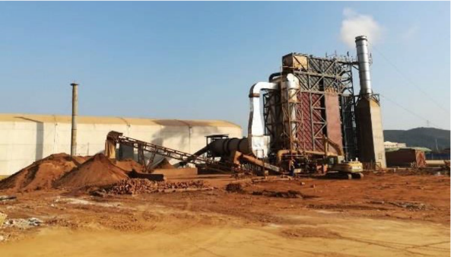
Environmentally sound management and disposal
of obsolete POPs pesticides and other POPs wastes (China)
Innovations:
Technological
Policy
Institutional
Business model
Factors :
Economic incentives
Combining several innovation types
Stakeholder engagement
Adaptive management
Results exceeded targets
Fly ash – 80 times
Pesticide elimination – 5 times
POPs pesticide waste – 5 times
Fly ash dioxins – 3 times
Reduced the health risks to a population ranging
from 4.3 million to over 15 million people.

Slide 11

LEARNING FROM CHALLENGES
Nonlinear, non-uniform impact trajectories
FACTORS
LESSONS
Complexity
Design characteristics
Diligence in Implementation
Known and
unknown risks
Adaptive management
1
Something can be learned even from disappointing projects
Effective adaptive management can generate big wins
Modest but thoughtful adaptive management can consistently deliver small wins
2
3

Slide 12




LEARNING FROM CHALLENGES
Moldova: Transforming the market for Urban Energy Efficiency by introducing Energy Service Companies (ESCO)
CHALLENGES
Low government ownership
Corruption scandals
Banking crisis and mistrust
Inadequate policy and
legal framework
Overly ambitious objectives
ADAPTIVE MANAGEMENT
POST COMPLETION
Terminated the project
Design of a new project with similar objectives but a different approach

Slide 13
Implications for Evaluation
Holistic View
Context Matters!
Systems Approach
Integration between Human and Natural Systems
Quantitative and Qualitative Approaches

Slide 14
Resources
Batra, G., Garcia, J., Temnenko, K. (2022). Transformational Change for Achieving Scale: Lessons for a Greener Recovery. In: Uitto, J.I., Batra, G. (eds) Transformational Change for People and the Planet. Sustainable Development Goals Series. Springer, Cham.
https://doi.org/10.1007/978-3-030-78853-7_3
GEF IEO. Evaluation of GEF Support for Transformational Change. https://www.gefieo.org/evaluations/evaluation-gef-support-transformational-change-2017
GEF IEO. Evaluation on Learning from Challenges in GEF projects. https://www.gefieo.org/evaluations/learning-challenges
Independent Evaluation Group (IEG) of the World Bank. Supporting Transformational Change for Poverty Reduction and Shared Prosperity
https://ieg.worldbankgroup.org/evaluations/supporting-transformational-change-poverty-reduction-and-shared-prosperity
Climate Investment Funds (CIF). Transformational Change Concepts https://www.cif.org/sites/cif_enc/files/knowledge-documents/tclp_workshop_updated_tc_concepts_may2021.pdf

