Slide 1
Approaches to Evaluating Transformational Change at the Green Climate Fund
Presented by Martin Prowse

Slide 2
Approach to Transformational Change in the GCF
• Governing Instrument: In the context of sustainable development, the Fund will promote the paradigm shift towards low-emission and climate-resilient development pathways
• Strategic Plan 2024 – 2027: The GCF will seek to support paradigm shift towards low-emission climate-resilient energy, transport, infrastructure, ecosystems, and food systems
• Integrated Results Management Framework: Foregrounds and elevates three impact areas and four components of the enabling environment:
  Scalability - potential for expanding the scale and impact of the proposed programme or project
  Replicability - potential for exporting key structural elements of the proposed programme or project elsewhere within the same sector as well as to other sectors, regions or countries
  Co-benefits - environmental, social, health, economic impacts, gender
  > Enabling environment - (i) regulatory framework and policies (ii) creation of an enabling environment (iii) knowledge and learning (iv) innovation
Strategic Plan 2024-2027: The GCF will incorporate evolving understanding of just and equitable transitions pathways in line with developments of such discussions within the UNFCCC and Paris Agreement

Slide 3
Evaluation Practice and Results on
Transformational Change at the GCF-IEU
Assessing the likelihood for transformational change at the GCF
Contributions to transformational change in Least Developed Countries
Realist review on just transition

Slide 4
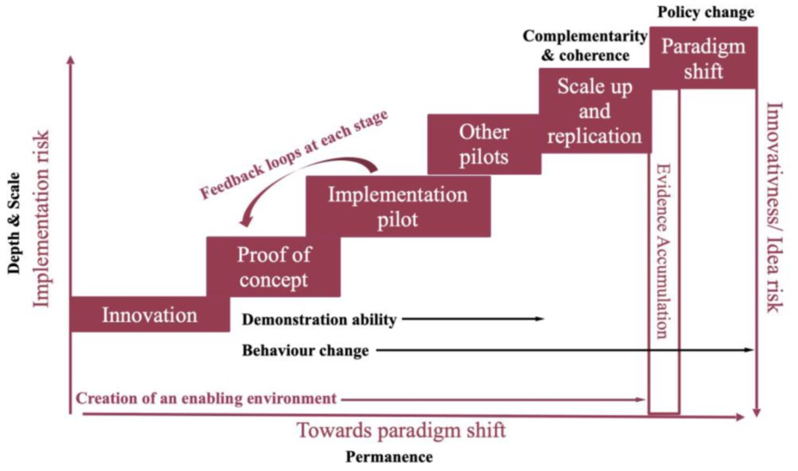
Assessing the likelihood for transformational change at the GCF
Assesses self-reported data from 125 GCF projects (March 2020)
Combines six steps of innovation with eight components of transformational change

Slide 5
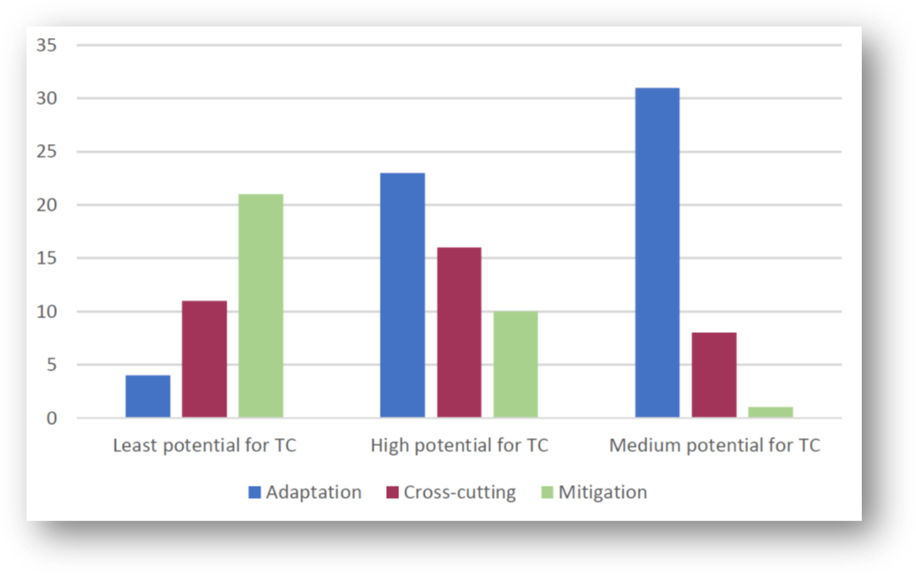
Assessing the likelihood for transformational change at the GCF
Assesses self-reported data from 125 GCF projects (March 2020)
Clusters with high and medium potential for TC had a high proportion of adaptation projects
The cluster which showed the least potential for TC contained most mitigation projects

Slide 6
Assessing the likelihood for transformational change at the GCF
Assesses self-reported data from 125 GCF projects (March 2020)
Highest paradigm shift potential - permanence, policy change, demonstration ability, and complementarity and coherence
Medium paradigm shift potential - permanence, scale, and behaviour change

Slide 7
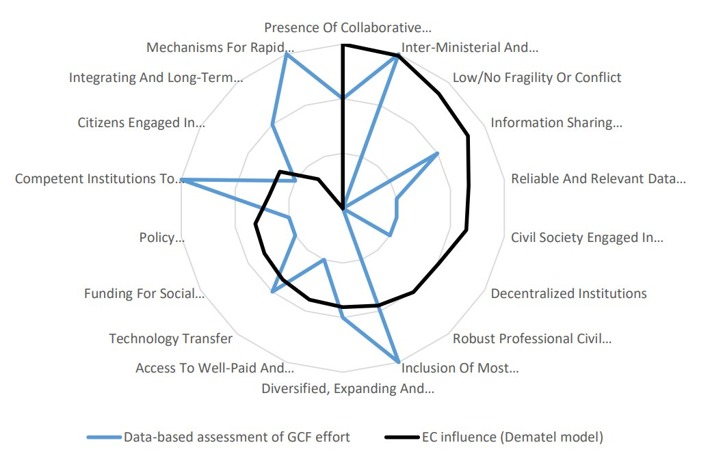
Contributions to transformational change in LDCs
Review of the technical literature identified conditions conducive to a low-carbon and climate-resilient developmental trajectories in LDCs - 18 conditions in six domains
  GCF scores highly for effort in:
  Inter-ministerial and government coordination
  Inclusion of vulnerable groups in decisions
  Competent institutions to support planning and implementation
  Mechanisms for rapid localized response to climate change
18 conditions are ranked (clockwise) in terms of influence – dark blue
GCF effort – light blue

Slide 8

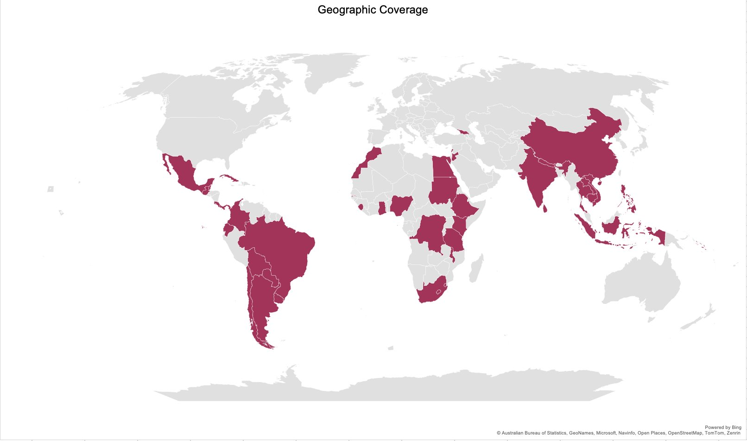
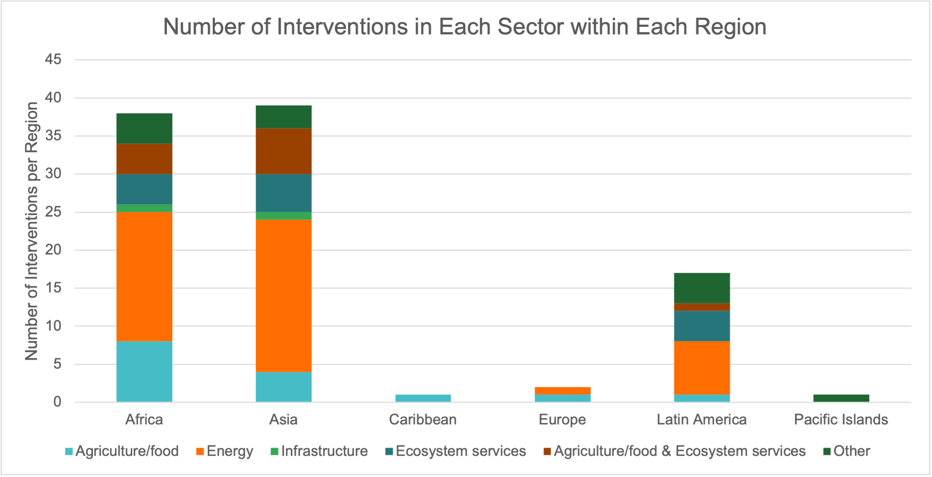
Realist review on just transition
Based on a rigorous review of existing literature, 99 interventions on just transition were identified in 76 studies
High regional diversity, but low representation for SIDS
Wide range of interventions
  e.g. climate-smart agriculture, land and marine conservation/protection, reforestation, large-scale RE infrastructure, small-scale RE, fossil fuel subsidy reform
Mitigation-only more frequent (61) than adaptation-only (12); some both (26)
Beneficiaries – households most frequent; private firms or public sector are targeted by less than half
Scale varies from individuals to country level in every sector except infrastructure (community-country)

Slide 9
Realist review on just transition
  The evidence base on the infrastructure sector is extremely thin
  Common enablers for just transition interventions across all or most sectors included in this review are robust funding mechanisms, strong alignment with needs and priorities, political will and ownership, alongside social dialogue and stakeholder engagement.
  Hard enablers such as funding, investments in infrastructure and technology as well as strategic clustering of projects were more evident in the energy sector, together with soft enablers such as political will, trust building and collaborations and partnerships
  In the agriculture and ecosystem sectors, we found that soft enablers such as alignment, coordination and contextual awareness emerged as important features of just transition interventions, alongside funding and technical know-how
  Common barriers to successful just transition across all sectors included bureaucratic and legal barriers, exclusion and unequal distribution of benefits, as well as inadequate technical skills.

Slide 10
Lessons learnt
Transformational change is essential to the global effort to mitigate and adapt to climate change. Just transition is increasingly part of this landscape.
  There is significant potential for international learning to improve the purposeful design and quality of policies, financial support, and collaboration between stakeholders, especially between non-Annex I countries
  Learning should capture the best practices for policies and processes while recognizing there is no one-size-fits-all approach, given that it depends on national contexts, circumstances and development priorities
  Increasingly, countries are placing greater value on just transition principles in their climate goals (38% of NDCs and 56% of Long-Term Strategies, according to UNFCCC)
  Decision makers need to minimize the social risks, maximize social opportunities – including impacts on employment, livelihoods and inclusive participation and social dialogue

Slide 11





Thank You
ieu@gcfund.org / mprowse@gcfund.org
@GCF_Eval
linkedin.com/company/gcf-eval
ieu.greenclimate.fund

