Slide 1

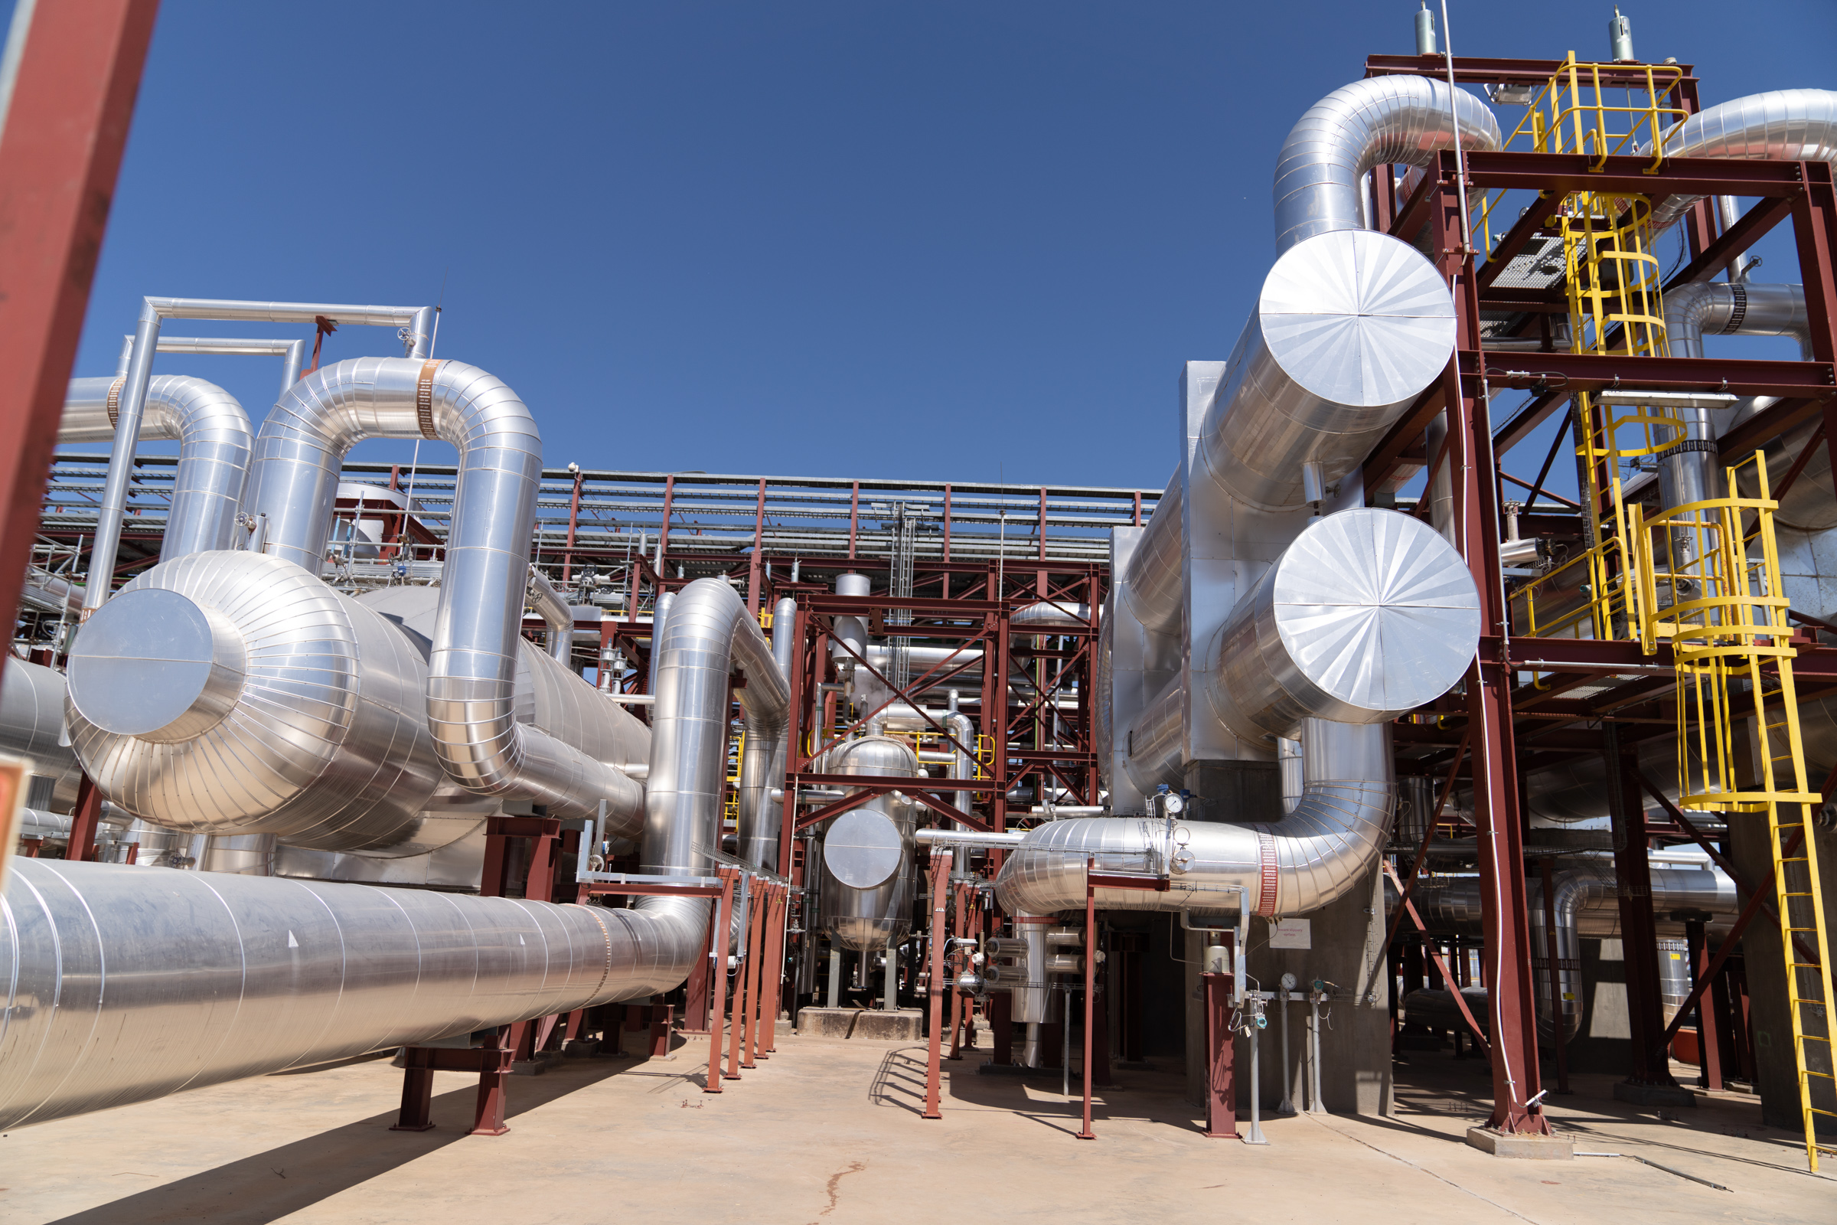
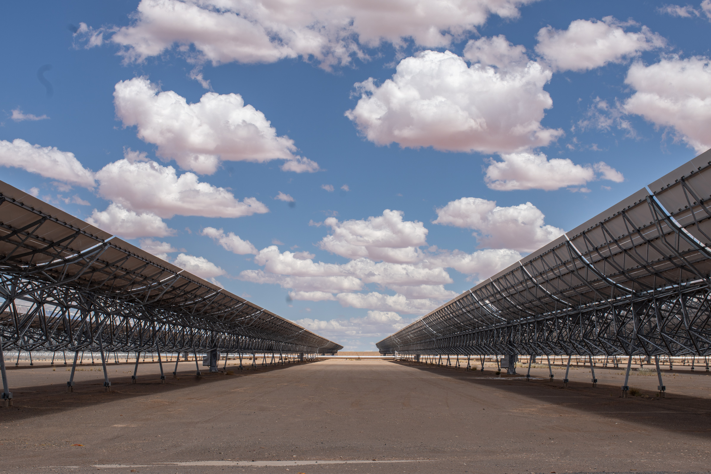
Evaluating Transformative Change in Climate Mitigation and Adaptation Projects
Insights from the AfDB/IDEV Evaluative Knowledge on Advancing Climate Resilience and Renewable Energy in Africa
Joseph MOUANDA,
Chief Evaluation Officer, IDEV/AfDB
Online, 5 June 2024

Slide 2

Content
Introduction
Policy Guidelines on Transformational Change
AfDB/IDEV Evaluation Practices
Transformational Change in IDEV’s Evaluations
Insights from the Evaluation of Renewable Energy
Main Takeaways and Future Directions

Slide 3
Introduction
Definition
Transformational change refers to profound, systemic shifts that lead to large-scale, sustainable impacts, fundamentally altering systems and structures.
Achieving transformational change is essential for addressing climate change, enhancing agricultural productivity, and ensuring environmental sustainability in Africa.
Dimensions of Transformational Change
Relevance: The strategic focus, design, and nimbleness of initiatives to enable transformation.
Systemic change: Fundamental shifts in system structures and functions.
Scale: Contextually large-scale transformational processes and impacts.
Sustainability: The robustness and resilience of changes.

Slide 4
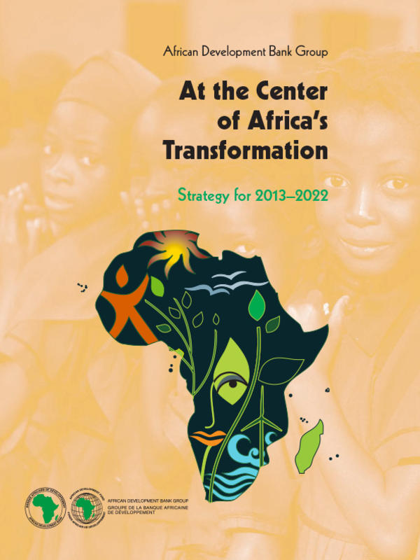
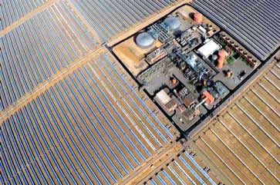




Policy Guidelines on Transformational Change
AfDB's Ten-Year Strategy 2013-2022 and TYS2024-2033
The AfDB's Ten-Year Strategy 2013-2022 aims to support Africa's economic transformation, focusing on inclusive growth and the transition to green growth.
The AfDB's Ten-Year Strategy 2024-2033 outlines the vision of an Africa that is prosperous, inclusive, resilient and integrated. This vision is supported by twin strategic objectives: accelerating inclusive green growth and driving prosperous and resilient economies.
Priorities – High 5s
The High 5s are five strategic priorities identified by the AfDB to accelerate Africa’s economic transformation.
They align with both Ten-Year Strategies, the African Union’s Agenda 2063 – The Africa We Want, and SDGs.
Light-up and power Africa
Feed Africa
Improve the quality of life for people of Africa
Integrate Africa
Industrialize Africa

Slide 5


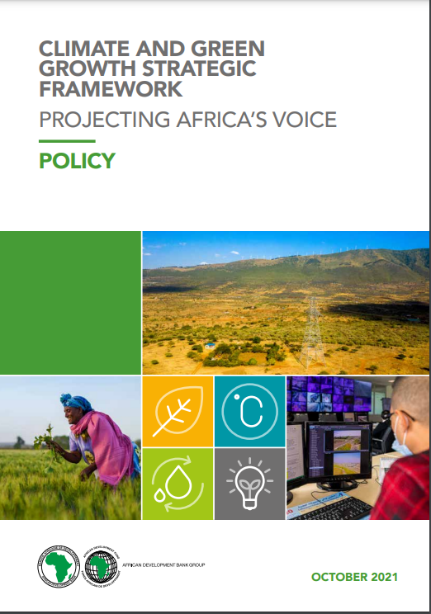
Policy Guidelines on Transformational Change
New Deal on Energy for Africa (NDEA)
The NDEA is a transformative partnership to achieve universal access to energy in Africa by 2025. It aligns with the High 5 priority "Light Up and Power Africa.
Climate and Green Growth Strategic Framework
The Strategic Framework articulates how the Bank will work with African countries to address climate change and promote green growth on the continent. It comprises three closely interlinked and complementary instruments — a Policy (open-ended), a Strategy (2021–2030) and an Action Plan (2021–2025) — which significantly scale up the Bank’s climate ambitions.

Slide 6
Evaluation Practices
Theory of Change
Utilize a theory of change approach to map out the expected pathways from intervention activities to desired outcomes and impacts.
Approach and methodology
Meta-Evaluation
Mixed-method approaches
Pipeline approach
Theory-based approach
Summative and formative approaches
Multiple lines of evidence
Benchmarking
Cluster Evaluation
Countries case study
Literature Review
Portfolio Review
Project level evaluation
Strategy and Policy Review

Slide 7
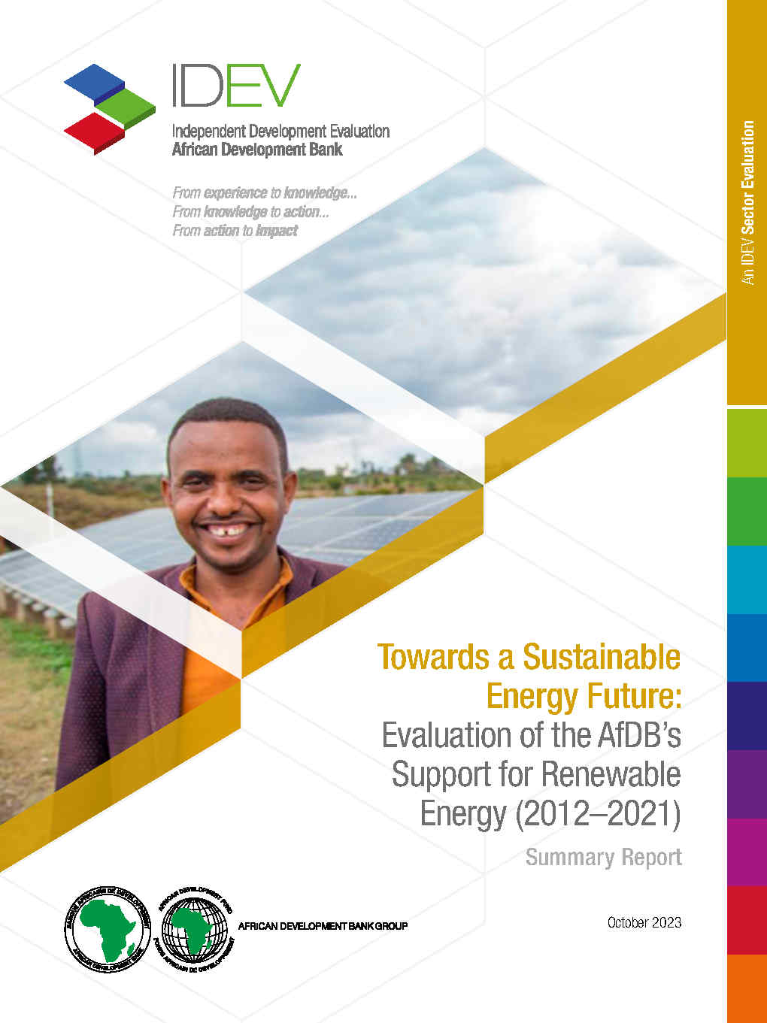
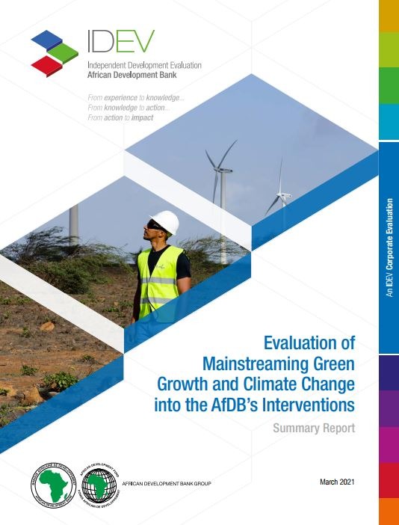
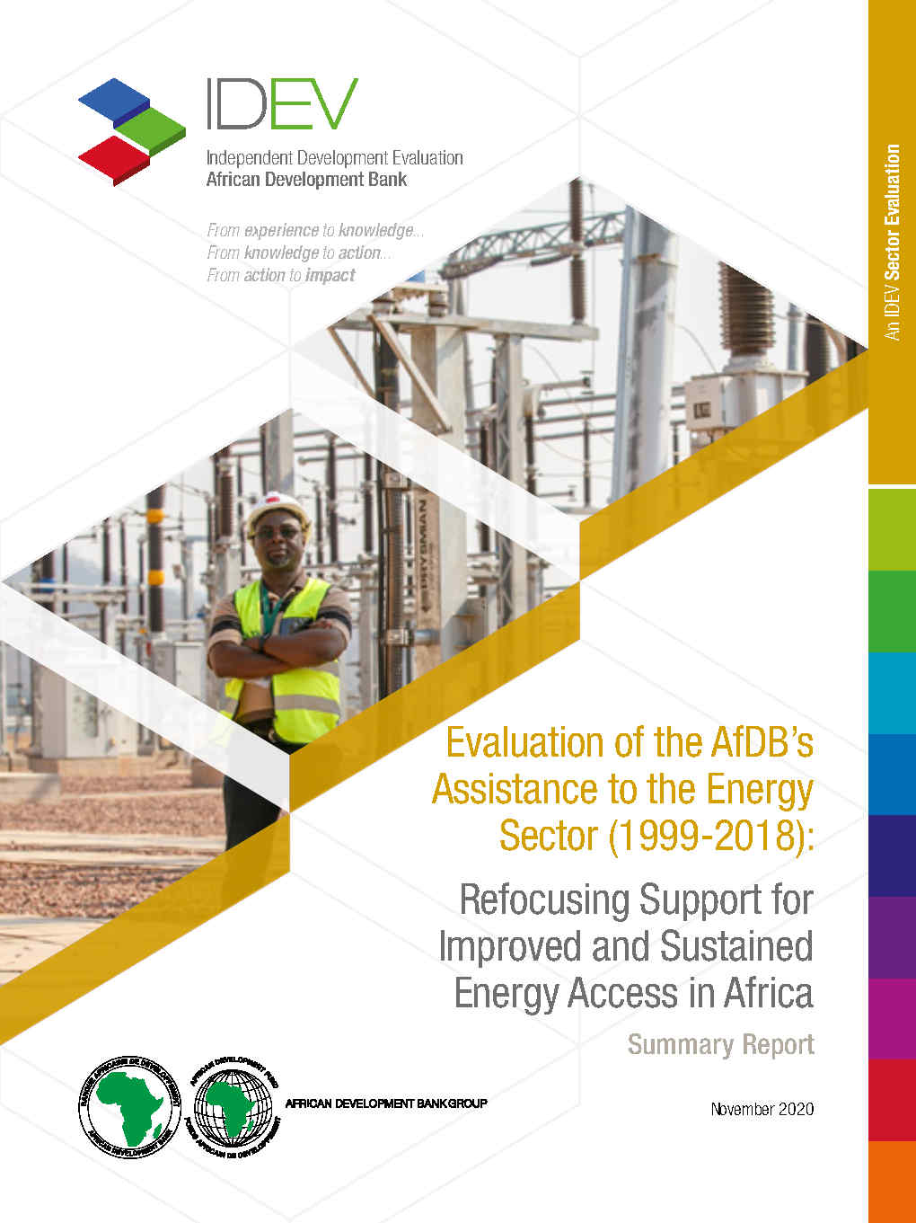
Transformational Change in IDEV’s Evaluation
What AfDB/IDEV did?

Slide 8

Transformational Change in IDEV’s Evaluation
Key Elements of Transformational change in Evaluation Reports
In the context of IDEV’s evaluation reports, transformational change goes beyond incremental improvements to achieve significant and sustainable impacts. It involves a holistic approach that considers various dimensions and levels of change, aiming for long-term benefits and resilience.
For example, the Evaluation of the AfDB’s Support for Renewable Energy aims to show how investments in renewable energy have transformed energy access, reduced carbon emissions, and promoted economic development.
This involves deploying innovative financing mechanisms, building regulatory frameworks, and fostering private sector participation.

Slide 9
Transformational Change in IDEV’s Evaluation
Challenges and Considerations
Complexity: Achieving transformational change is complex and requires a thorough understanding of the context, stakeholders, and systems involved. Evaluations must consider these complexities to provide accurate and useful insights.
Measuring Change: Evaluating transformational change involves measuring not just immediate outputs and outcomes but also long-term impacts and systemic shifts. This requires robust methodologies and indicators that can capture the depth and breadth of change.

Slide 10
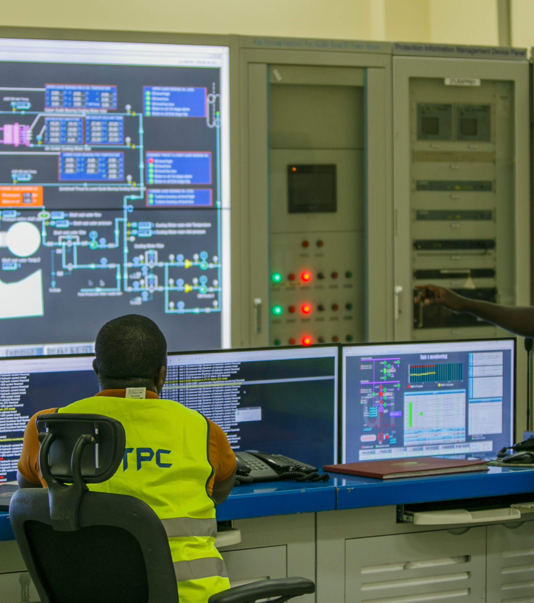
Transformational Change in IDEV’s Evaluation
Challenges and Considerations
Complexity: Achieving transformational change is complex and requires a thorough understanding of the context, stakeholders, and systems involved. Evaluations must consider these complexities to provide accurate and useful insights.
Measuring Change: Evaluating transformational change involves measuring not just immediate outputs and outcomes but also long-term impacts and systemic shifts. This requires robust methodologies and indicators that can capture the depth and breadth of change.

Slide 11

Insights from the Evaluation of Renewable Energy
Findings on Renewable Energy Deployment
Building the Gap Between High-Level AND Ground Implementation
Challenges: AfDB played a key role in developing various energy sector strategic documents, showcasing its dedication to RE. However, stakeholders pointed to a lack of action plans to complement the AfDB’s strategic documents on RE: this hindered the effective deployment of RE.
Solutions: Complementing strategies with action plans strengthens stakeholders' participation in RE.
Creating an Enabling Environment for Private Sector Participation
Actions: 1) Providing a conducive enabling environment for increased private investment supports RE deployment, and 2) Strengthening policy dialogue facilitates shaping RE strategic documents at regional and country level.
Notes:
The evaluation found that the AfDB's pivotal role in the development of several energy sector strategic documents (policies, strategies, and initiatives) demonstrated the Bank’s strong commitment to RE. However, stakeholders pointed to a lack of action plans to complement the AfDB’s strategic documents on RE: this hindered the deployment of RE.
To invest in RE in emerging markets, private sector investors require predictability and clarity on the procurement front.
A good example is the South African Renewable Energy IPP Procurement Program, which is a competitive tender process designed to facilitate private investments in grid connected RE generation.
Actions plan empowers stakeholder by giving them specific task, responsibilities, and tangible roadmap to follow, thereby encouraging greater engagement and participation in RE initiatives.

Slide 12
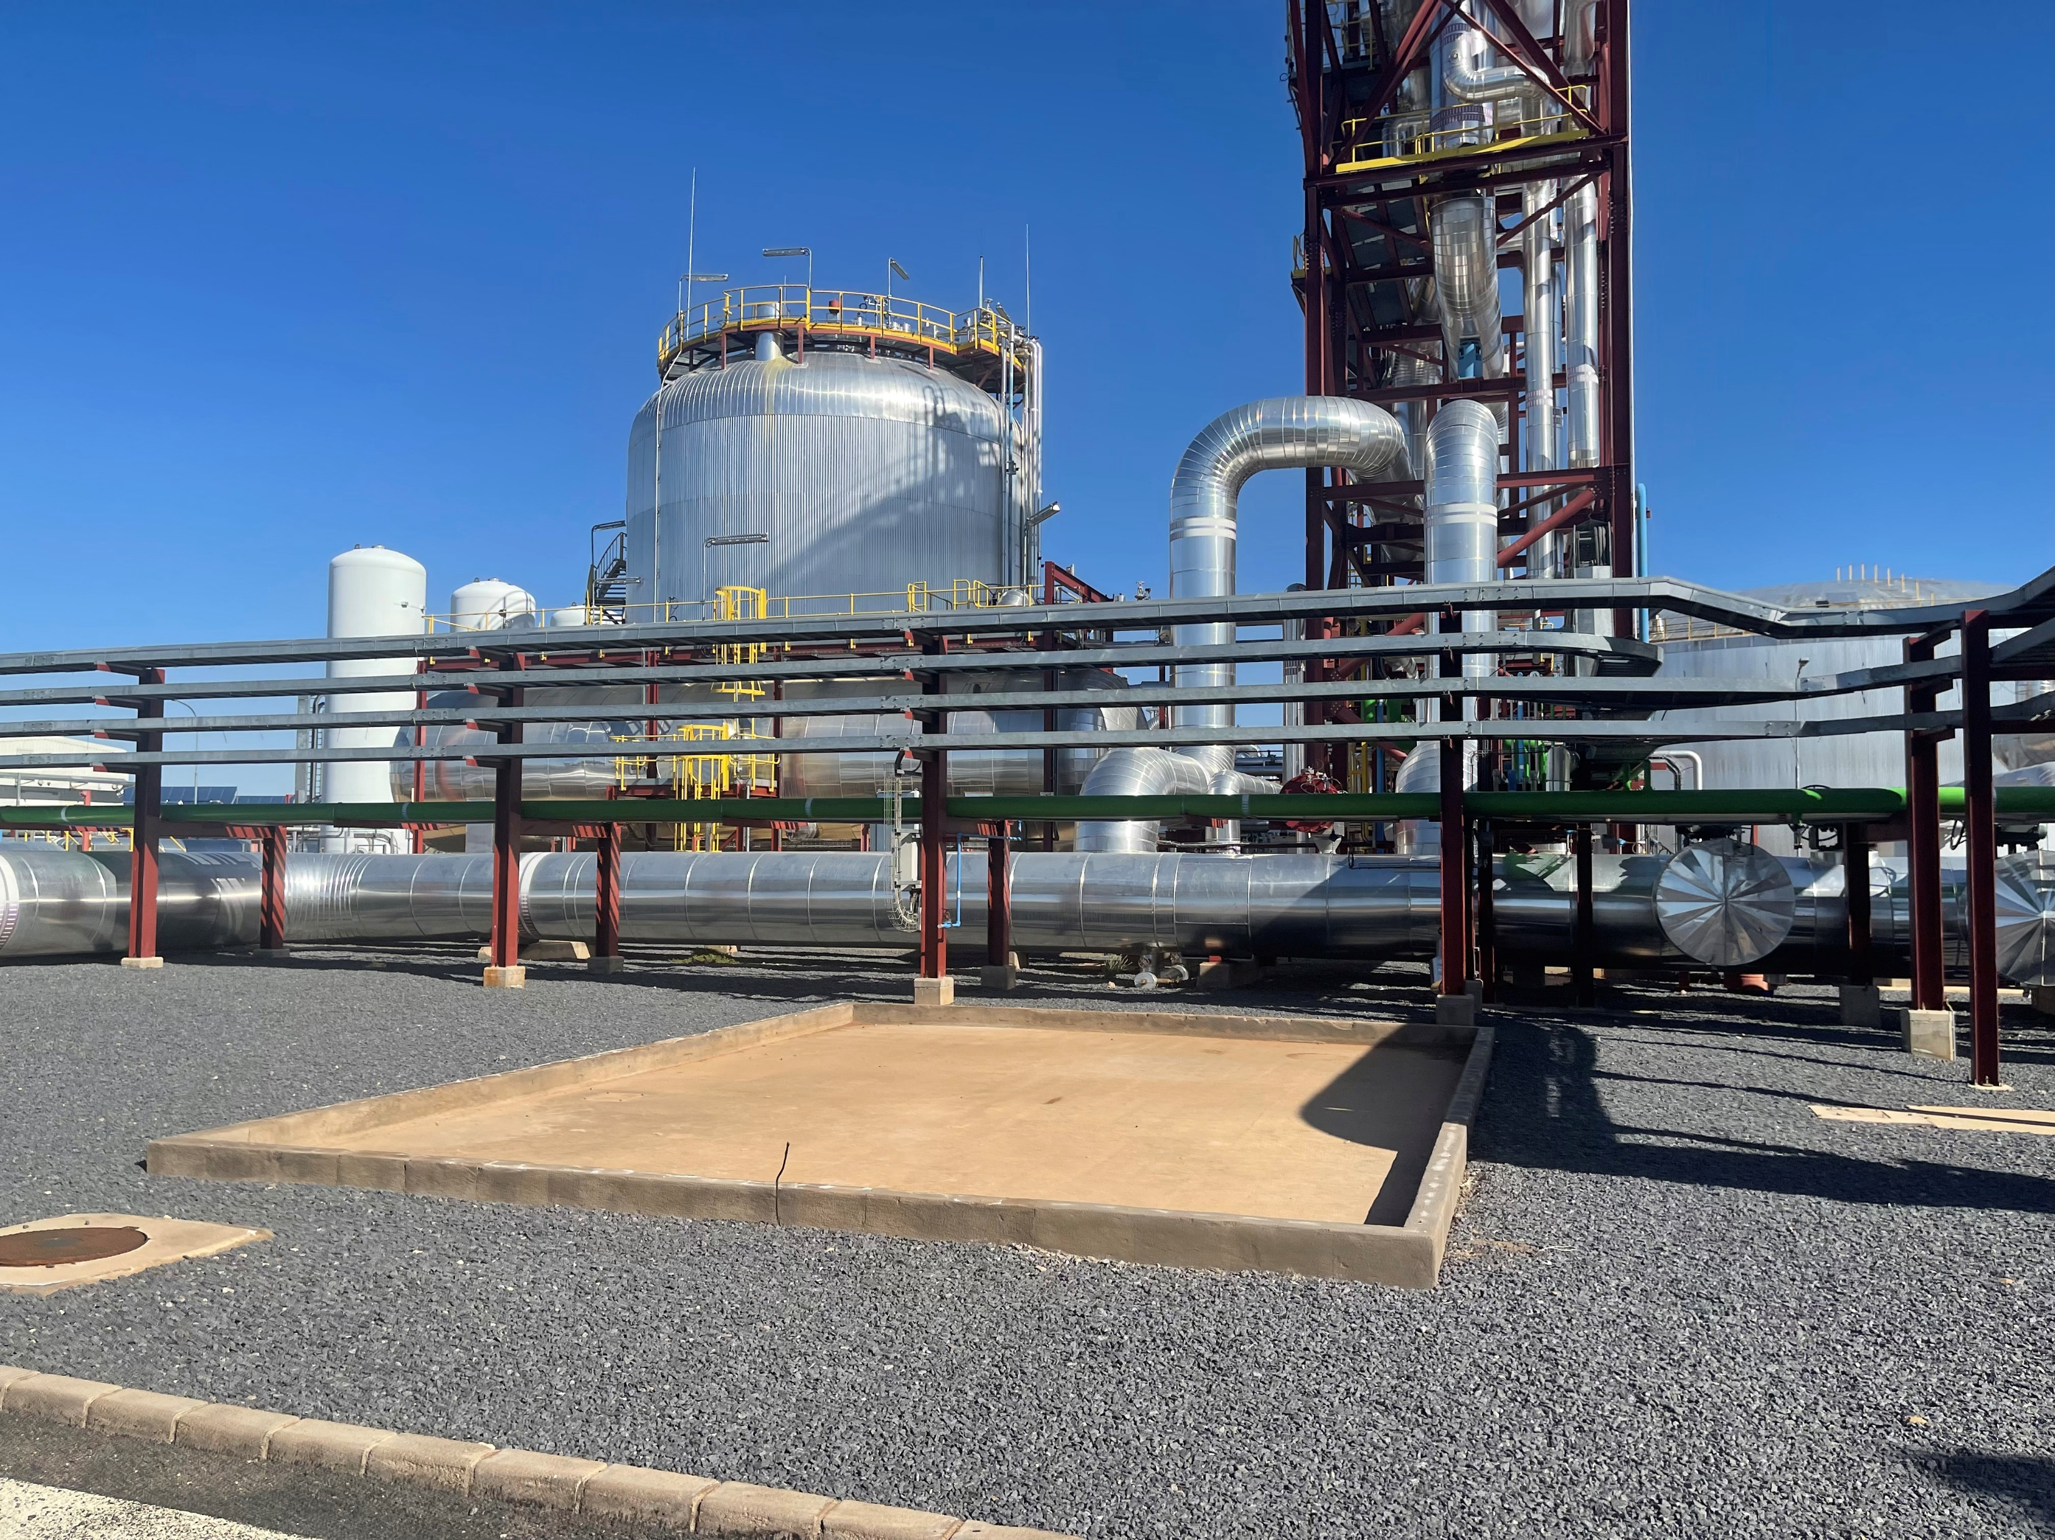
Insights from the Evaluation of Renewable Energy
Innovative Financing Solutions
Using blending concessional finance
Impact: Increased RE-based generation capacity and mobilization of concessional resources.
Challenges: Insufficient financing and integration issues.
Solutions: Financing grid infrastructure (T&D lines, storage) and adaptation for smoother integration of RE projects..
Deploying Innovative Risk Instruments
Findings: Adaptation to private sector roles and financial instruments.
Challenges: Sub-optimal risk-sharing.
Solutions: Prioritize project origination and risk sharing to scale up finance for RE infrastructure.

Slide 13

Insights from the Evaluation of Renewable Energy
Scaling Up Partnerships and Collaboration
Key Initiatives
Examples: Africa Energy Marketplace, Desert to Power Initiative, AfDB-IRENA partnership.
Lessons: Building effective partnerships creates synergies, mobilizes additional financing, and fosters impact.
Notes:
The Desert to Power (DtP) initiative aims to harness that solar energy to generate 10 GW of additional capacity to provide clean electricity for 250 million people via public, private, grid and off-grid projects by 2030.

Slide 14
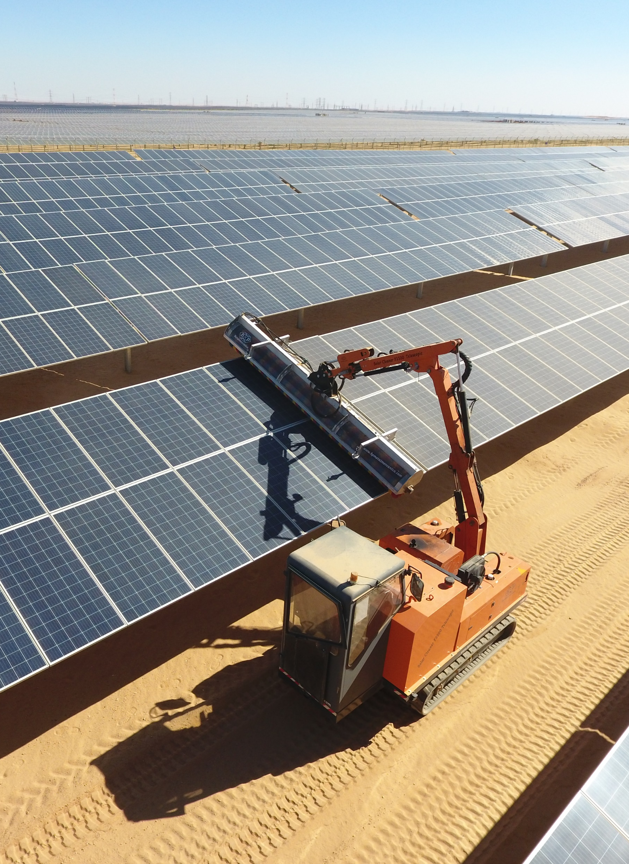
Findings on Ensuring Long-Term Sustainability
Ensuring Long-Term Sustainability
Technical Soundness and Financial Sustainability
Technical soundness: state-of-the-art technologies adapted to the country context and appropriately deployed in the field, despite some shortcomings in the maintenance mechanisms.
Challenges: Financial stress of power utilities and weak institutional environments.
Solutions: Address financial sustainability of power utilities to make large-scale deployment of renewable energies possible and strengthen institutional capacity to enhance RE sector governance.

Slide 15
Main Takeaways and Future Directions
Key Strategies for Transformational Change in Renewable Energy
Scaling Up Renewable Energy Projects: Prioritize large-scale projects and off-grid solutions.
Innovative Financing Solutions: Explore green bonds and climate finance instruments.
Strengthening Institutional Capacity: Enhance technical and regulatory capacity in African countries..
Enhancing Climate Resilience: Integrate climate resilience into RE projects..
Promoting Policy Advocacy and Dialogue: Promote supportive policies and foster regional cooperation..

Slide 16
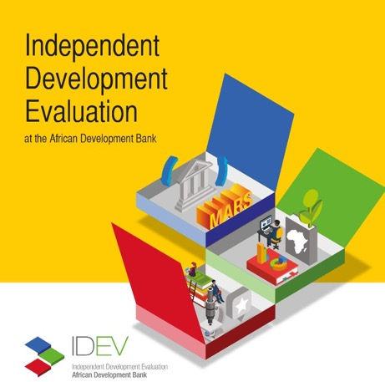

Address
IDEV
AfDB, CCIA Building
Abidjan, Cote d’Ivoire
Contact Info
Thank you
Emails:
j.mouanda@afdb,org
Website
http://idev.afdb.org/
Twitter
@evaluationafdb

