Slide 1


PARTNERSHIP COUNCIL
Global Evaluation Initiative
MARCH 2024

Slide 2

AGENDA
3.00 Welcome and introductions
Welcome remarks by Lily Chu and Isabelle Mercier
Welcome remarks by Dugan Fraser
Partners’ introduction
3.15 GEI results update
Overview of GEI’s approach to results reporting
Cumulative since GEI inception
Reporting period Jul 1 – Dec 31, 2023
Country examples
Thematic areas
3.45 Financial reporting
3.55 Break
4.00 GEI key updates
The future of IPDET
New CLEAR LAC Center
MENA and KSA
4.10 Fundraising strategy and update
Update on fundraising strategy approach
Preparing the visits to donors
4.30 Discussion and Q&A
5.00 Closing remarks

Slide 3


MEETING OBJECTIVES
To review and discuss Results achieved during this reporting period and cumulatively
To discuss and endorse Fundraising approach and MDTF extension

Slide 4
Welcome
and Introductions

Slide 5
GEI RESULTS

Slide 6
GEI Results Reporting
CLEAR evaluation highlighted need for better results reporting
GEI program has been working to improve results reporting
GEI reporting platform reaching functionality
Transition from old to new results platform – results may be revised upward

Slide 7
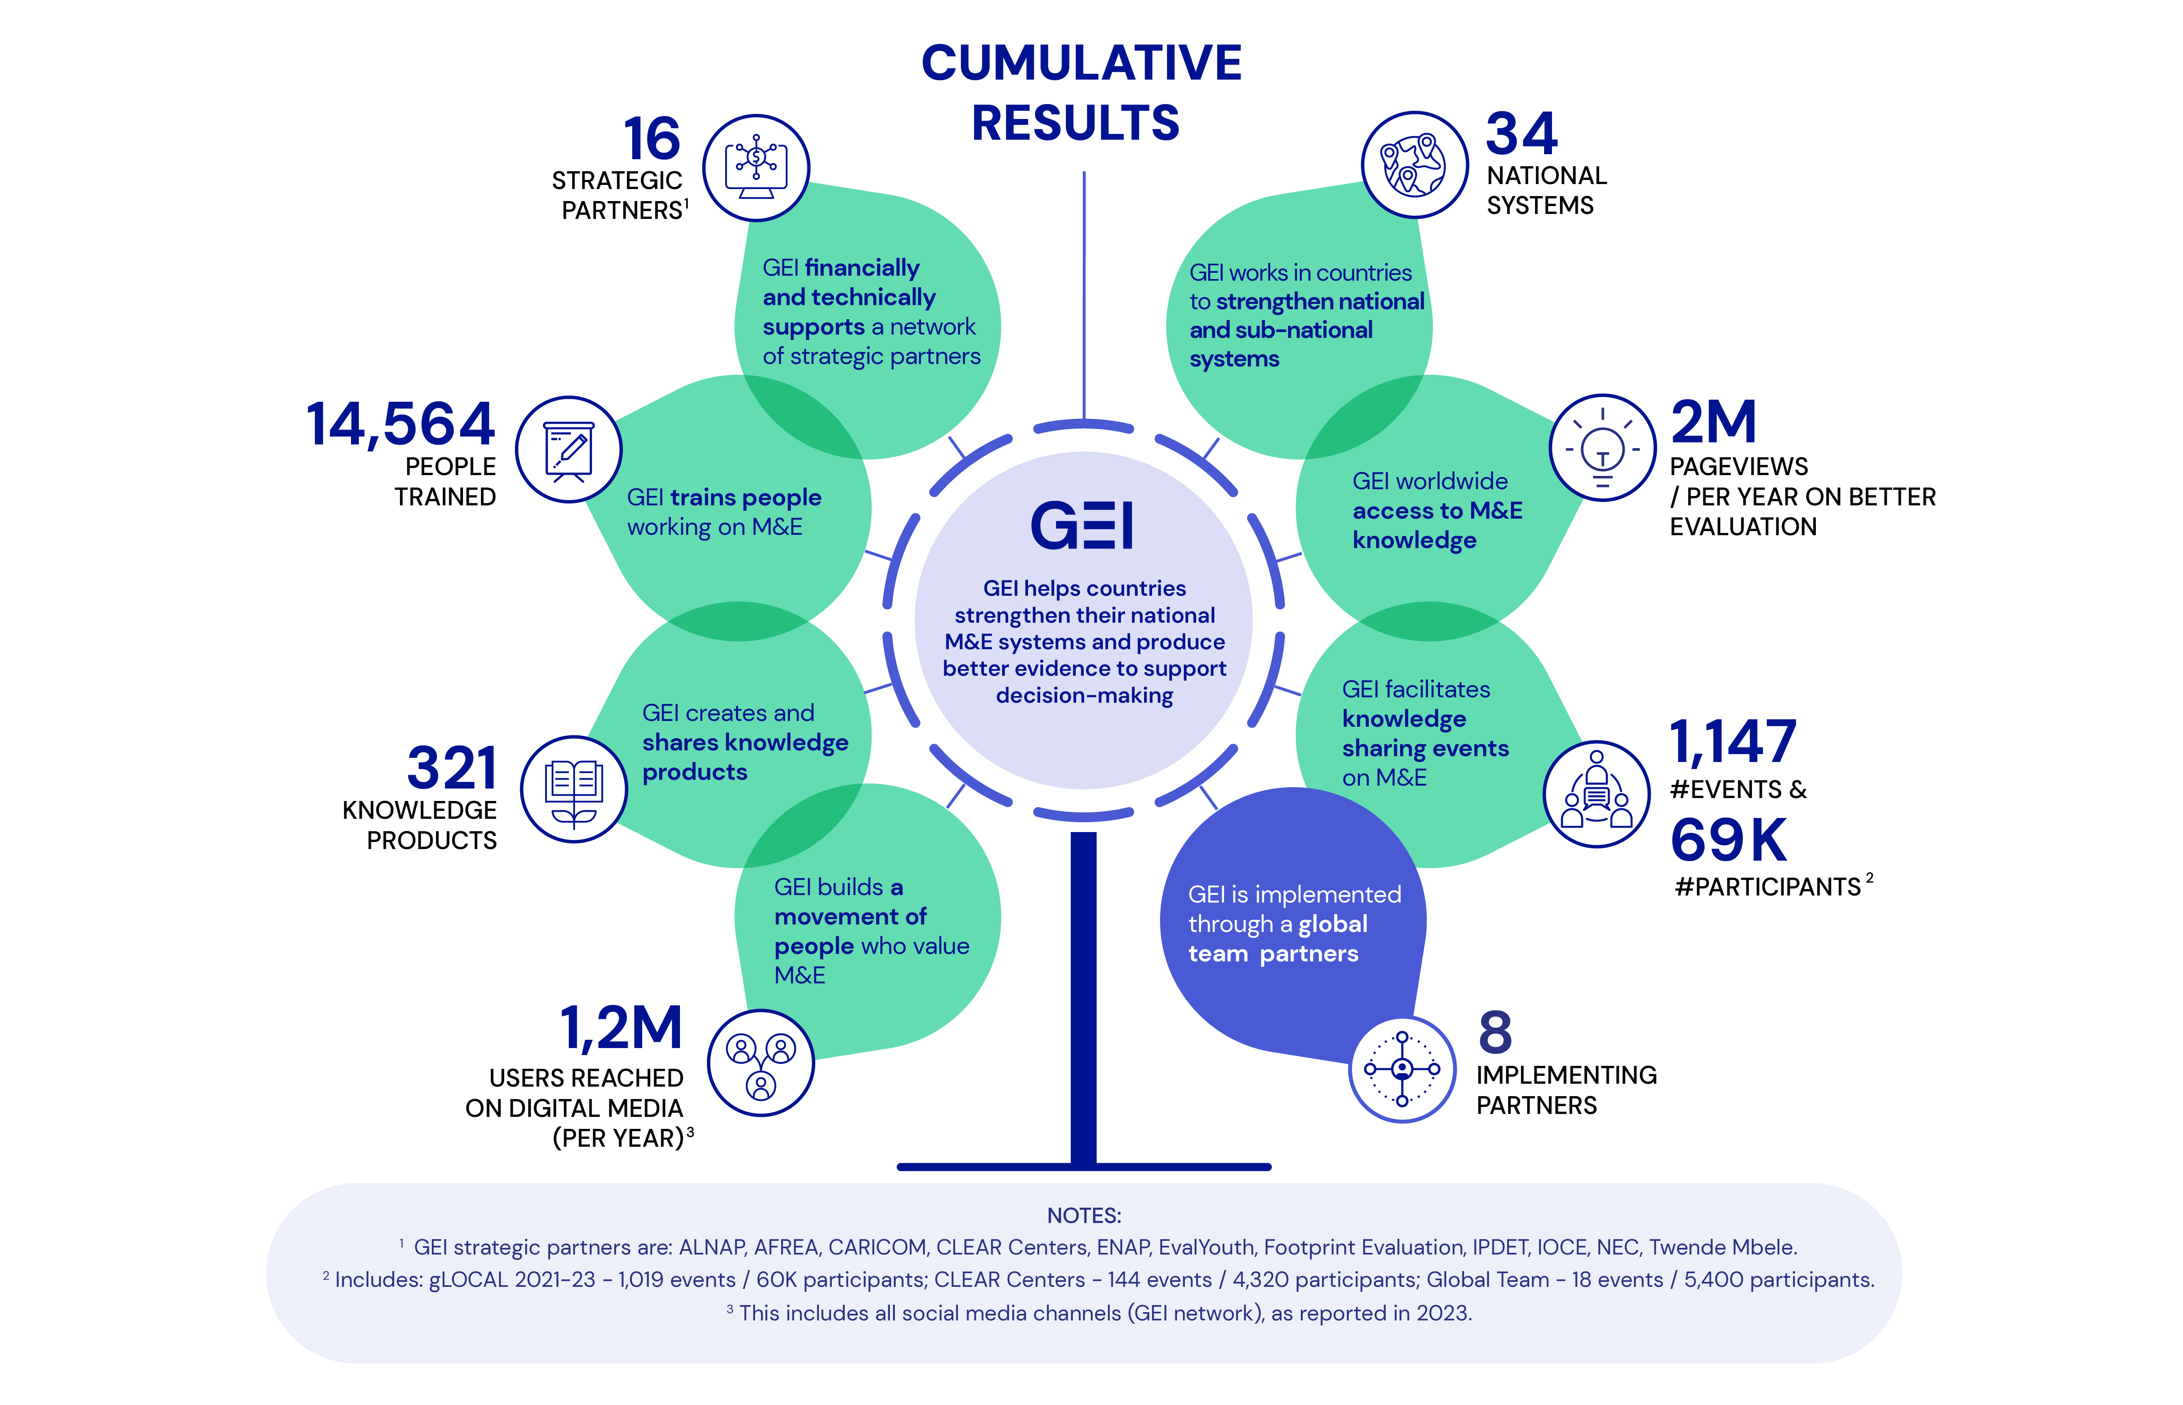

Slide 8
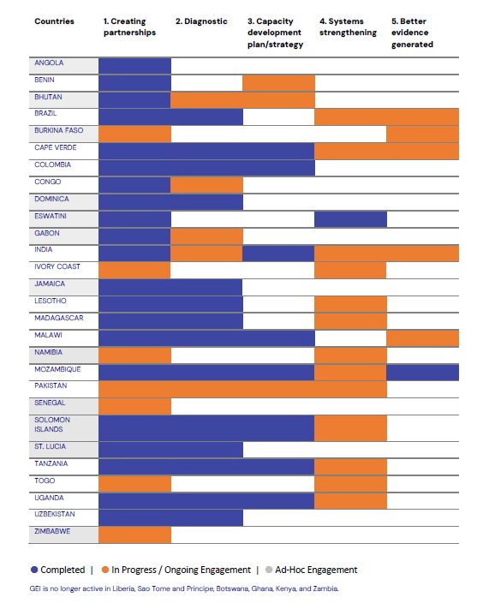
GEI RESULTS | REPORTING PERIOD JUL-DEC 2023
GEI is no longer active in: Liberia, Sao Tome and Principe, Botswana, Ghana, Kenya, and Zambia.

Slide 9
NUMBER OF PARTICIPANTS
GEI RESULTS | REPORTING PERIOD JUL-DEC 2023
Training and professional development
TRAINING (number of activities) | Jul-Dec 2023
Standalone Training Event < 1 day | 17
Standalone Training Event > 1 day | 24
Total | 48
% FEMALE PARTICIPANTS
NUMBER OF PEOPLE TRAINED | Jul-Dec 2023
Sum of Total Number of Participants | 2,942
% Female Participants | 49%

Slide 10
KNOWLEDGE AND COMMUNICATION
Knowledge Curation and Production (BetterEvaluation)
Knowledge Sharing
Communications
Launched Beta version of Strengthening National M&E Systems framework and resource library.
28 new resources published on other topics
52 new knowledge products (includes Blogs, Publications, Newsletters, Annual Reports, Videos)
Hosted 8 online knowledge events (OECD, NEC+12, among others).
Launched Observatory for Monitoring and Evaluation of Public Policies in French-speaking Africa (CLEAR-FA)
Planned calendar of knowledge sharing events for 2024 with CLEAR Centers and other partners.
Provided support to implementing partners for branding and social media management.
Developed and disseminated GEI's annual report for FY22-23.
Distributed three GEI newsletters to almost 10K subscribers.

Slide 11
THEMATIC AREAS
YOUTH
Second round of GEI's Hands-On Learning Program launched
Competition for Young and Emerging Evaluators (YEEs) on the topic of culturally-responsive evaluation
CLIMATE
Released guide on "Sustainability-inclusive evaluation: Why we need it and how to do it"
Engagement with the Climate Investment Fund (CIF)
Produced four online training videos for CIF observers on M&E in the climate action
Conducted workshops on rapid evaluation in climate action
GENDER
Dedicated consultant recruited
Reference group established
Conducted needs assessment with GEI partners utilizing a self-administered online survey
Developing a joint effort with UN Women to implement a Global Mapping of Gender in M&E systems
FRAGILITY
GEI and UNDP-IEO hosted a panel discussion on the role of evaluation systems during crises

Slide 12

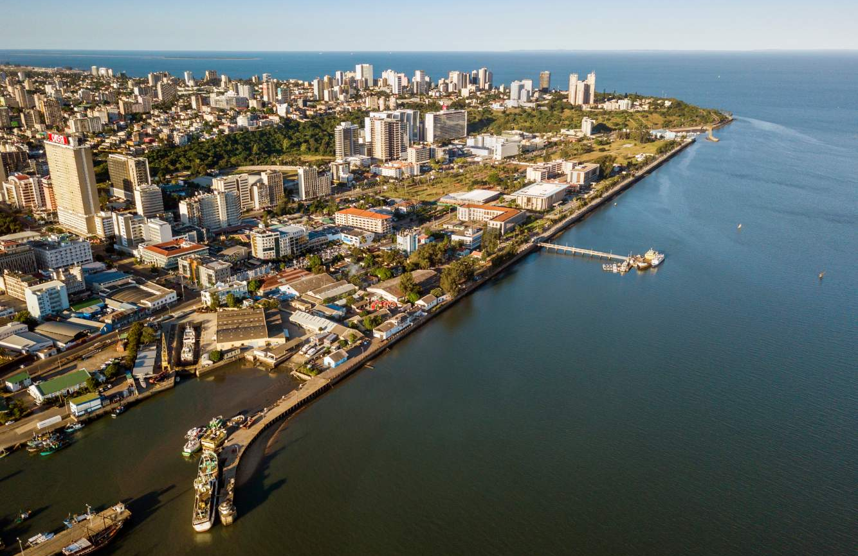
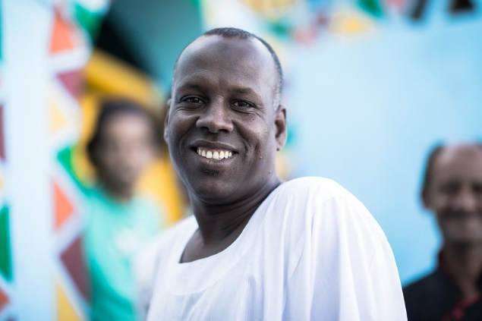
COUNTRY EXAMPLES
BHUTAN
MOZAMBIQUE
COTE D’IVOIRE
CLEAR SA support to develop Bhutan’s M&E framework under their national development strategy
Strong relationship with UNDP
CLEAR LAB finalized development of M&E manual for the Ministry of Finance
Partnership with the UNICEF
Support to water sector evaluation
CLEAR FA supported government in operationalizing its National Evaluation Law
Provided technical assistance in drafting three decrees
Regional roundtable of West African Economic and Monetary Union’s member states in strengthening their national evaluation systems and capacity

Slide 13

DISCUSSION & QUESTIONS
Q1 – Are you satisfied with the results produced?
Q2 – Are there areas that should receive more attention in the future?

Slide 14
GEI FINANCIALS

Slide 15
GEI Financial Reporting
GEI operates on resources provided by donor partners to the TF
Separate resources provided by World Bank IEG
Financial reporting as per World Bank policies and Admin Agreements cover only Trust Fund resources

Slide 16
FY24 GEI FINANCIALS RECAP
In FY24 GEI received
USD 2,216,225 from bilateral donors
USD 1,820,000 from multilateral donors
USD 3,100,000 from the World Bank IEG
Total available income in FY24 is 8,352,781 (includes carry over from FY23)
Total expenditures (RETF and BETF) in FY24 are USD 5,451,040
USD 4,251,040 was provided to implementing partners as grants in FY24
Estimated cost of GEI Evaluation will be USD 150,000 and it will be included in FY25 budget

Slide 17
DISCUSSION & QUESTIONS

Slide 18
GEI KEY UPDATES

Slide 19

Expanding IPDET to better meet the growing demand in TPD globally
Vision: IPDET to become GEI's principal partner in training and professional development
Taking IPDET to regions: deliver IPDET core course jointly with CLEARs in 3 regions
Deliver advanced-level workshops in Bern, (CH)
Design curricula and ensure quality for all IPDET-branded courses across the world
Coordinate GEI’s On-demand Training Facility
Competency framework, accreditation.
Harness IPDET alumni strength.

Slide 20
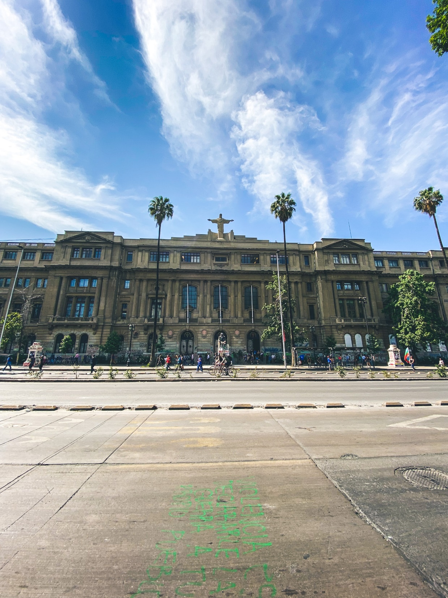
CLEAR LAC Regional Center
CLEAR LAC Center appointed in November 2023
First grant under preparation
Disbursement expected April 2024
Work program will focus on Dominican Republic, Guatemala, Paraguay, Peru and Mexico

Slide 21
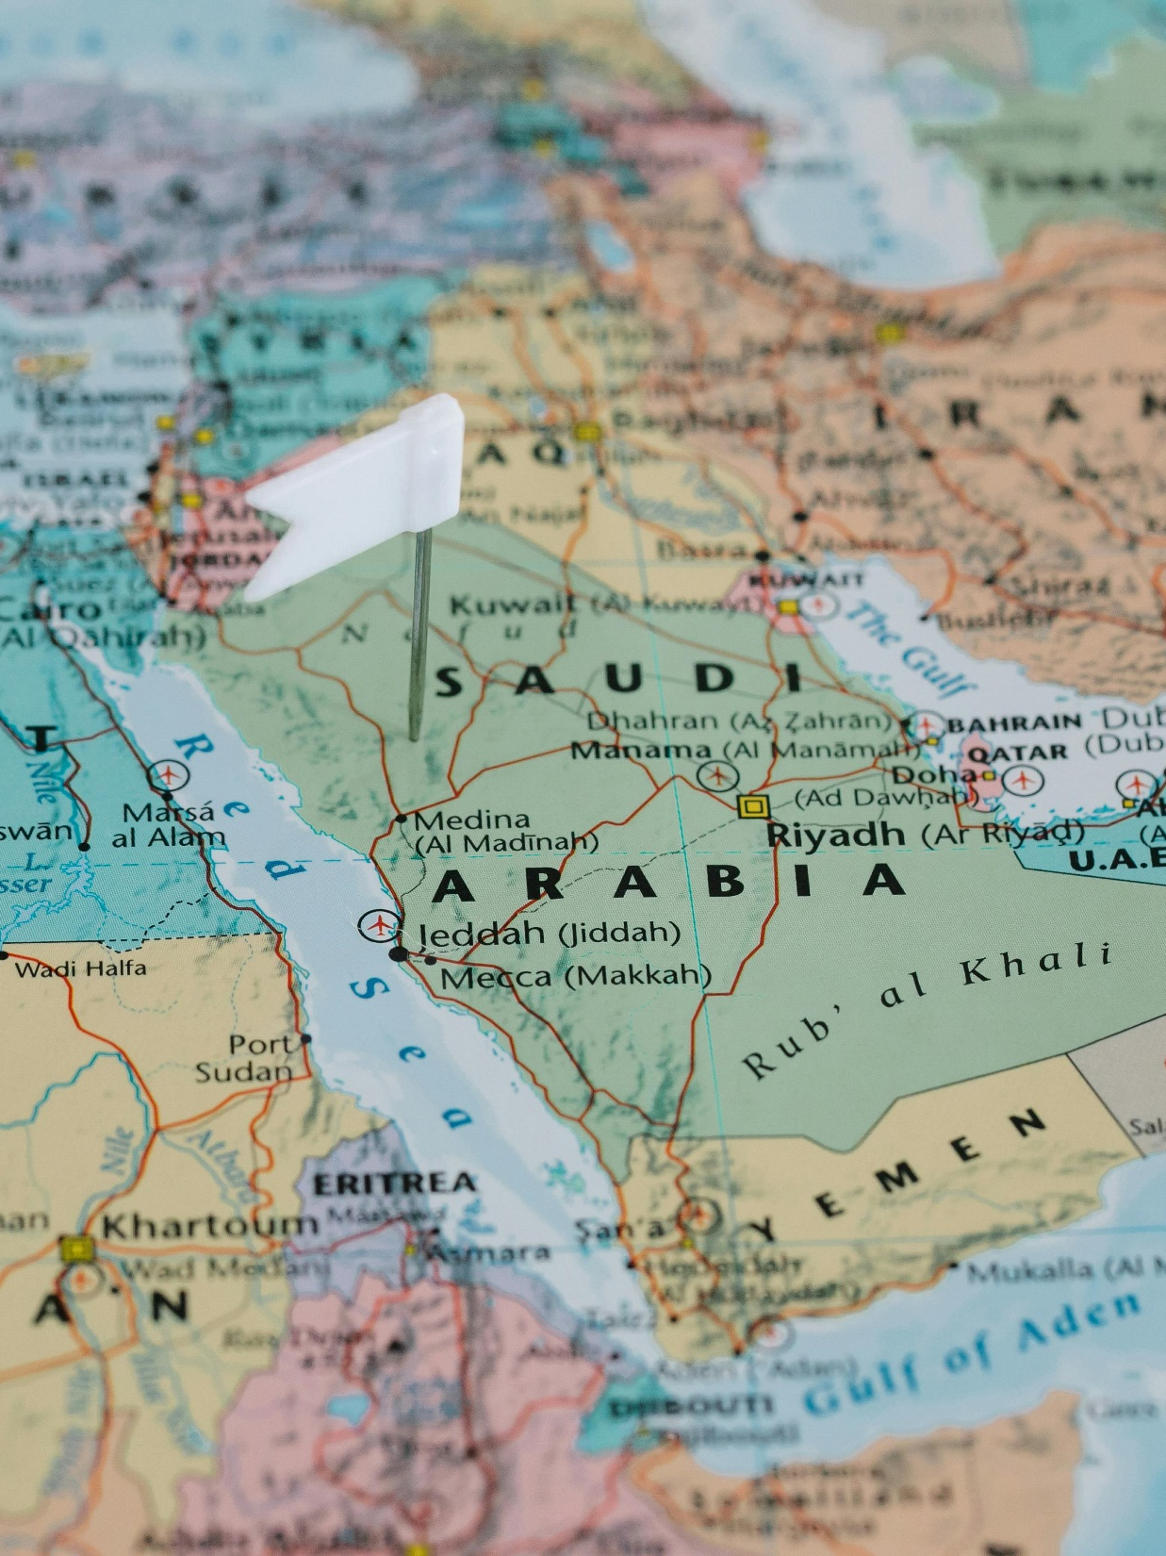
CLEAR MENA Regional Center
Ongoing relationship with Kingdom of Saudi Arabia
Technical assistance program by World Bank Governance Practice and GEI
Feasibility study for new CLEAR MENA Center under implementation (results expected June 2024)
KSA Delegation to visit CLEAR AA in April 2024
Dialogue between KSA and CLEAR Centers to inform design of CLEAR MENA Center

Slide 22
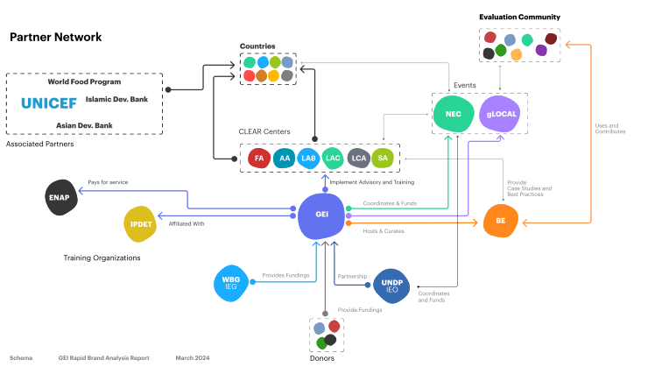
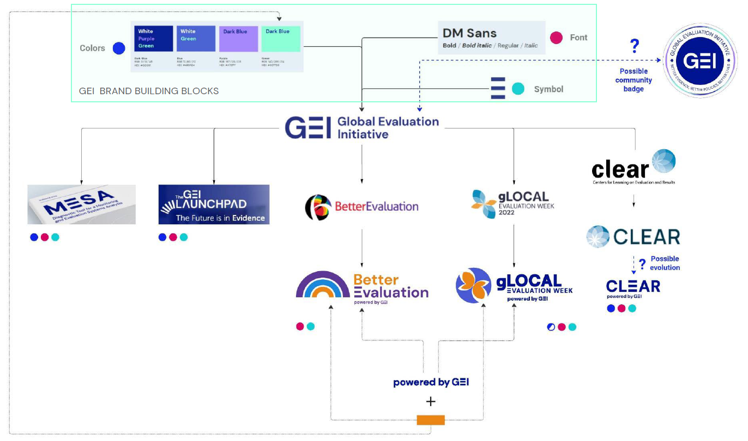
GEI Brand Analysis
WHY
Difficulty in understanding what the GEI does and the value that GEI provides.
Lack of clarity in the core positioning of the GEI relative to other evaluation organizations.
Confusion about how all the elements (GEI, World Bank, UNDP, CLEAR Centers, gLOCAL, NEC, BetterEvalution, IPDET, and ENAP) relate to each other.
WHAT
GEI Network Brand Assessment
Strategy Recommendations for the GEI
Implementation Roadmap

Slide 23
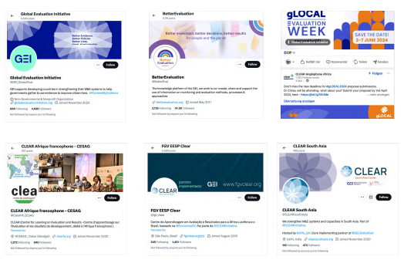
GEI Brand Analysis Recommendations
Re-brand the GEI and its sub-brands (BetterEvaluation, gLOCAL, IPDET, Clear)
Redesign BetterEvaluation and GEI websites
Introduce a brand management platform
Create a digital and social media strategy

Slide 24
DISCUSSION & QUESTIONS

Slide 25
GEI FUNDRAISING

Slide 26
STRATEGY WITH EXISTING PARTNERS
Spending CY24 to improve our value proposition and align it with donors’ priorities
Appointed a consultant in November 2023 to develop a fundraising and resource mobilization strategy.
Prepared plans to align GEI priorities with those of existing donors at ODA level (beyond evaluation offices).
Preparing strategic visits to BMZ (Germany), SDC (Switzerland), NEDA (Netherlands), DANIDA (Denmark), and FINNIDA (Finland) in May and June.
Expanding strategy to include collaborative fundraising with Implementing Partners (IPs) at the country level.

Slide 27
STRATEGY WITH PROSPECTIVE NEW PARTNERS
Prospective Donor Research
Screened prospective donors for alignment with GEI's strategic goals.
Plan to approach 30 new donors including government development arms, multilateral development agencies, and foundations.
Initiating conversations with the Charitable Foundations for potential funding in East Asia and the Pacific and Latin America.
Creation of Customizable fundraising tools and marketing materials.

Slide 28
EXTENDING THE MDTF
Current MDTF ends December 2025
Grants can be committed until June 2025
About 1 year left in GEI implementation
Urgency to extend the MDTF to ensure continuity of operations for CLEAR Centers
To extend the MDTF, all contributing partners must provide their approval.
Timeline to sign extension amendments and receive new funds is long and we need to act fast!

Slide 29
DISCUSSION & QUESTIONS

Slide 30



Thank you!

