Slide 1



Towards an Ecology of Evidence: Reimagining Evaluation’s role in Building a House of Care
Notes:
30 seconds
Ecology of evidence

Slide 2
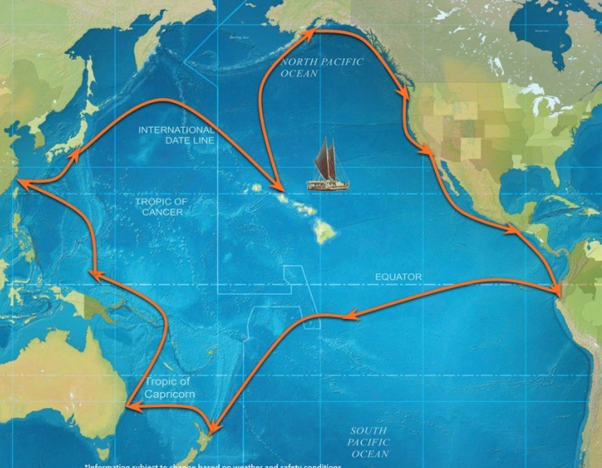
Example: Homelessness
The potential of an ecology of evidence: Dreaming big
Conference theme and Plenary challenges
SCOPE
Thinking about inequities and intersectionalities
Ideas for steps forward

Slide 3

THE CONFERENCE THEME:
The Future of M&E: Culture, Contexts, and Collaboration

Slide 4
The Specific Ask
GENERATION OF EVIDENCE
USEFUL AND ACCESSIBLE EVIDENCE
CULTURAL RESPONSIVENESS
Notes:
Boxes with transitions

Slide 5
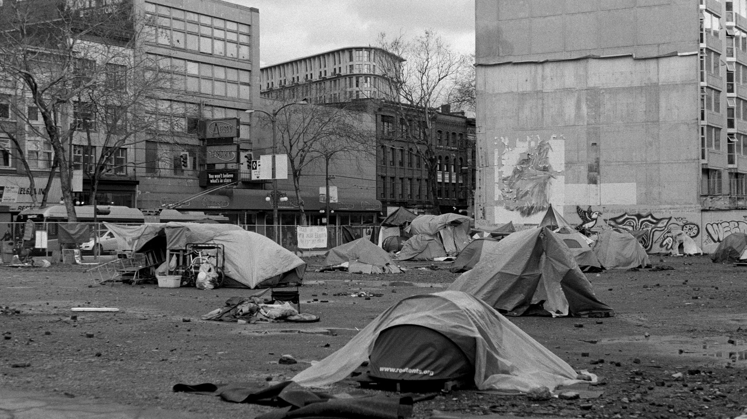
Getting real: Homelessness in Toronto
What kinds of evidence can help take system-level action to reduce homelessness?
  Lessons are very pertinent to global health and international development
Notes:
Two slides

Slide 6
PRESENT REALITY
Fragmented system
Poor response to the intersectionalities that drive homelessness
Mired in bureaucracy
High barrier
WHERE WE ARE HEADED
Building a system of care
System with Warmth and Care, love
What works for whom?
The need for a ’low barrier’ philosophy
Notes:
30

Slide 7

Towards evidence that can lead to a system-level response
Building a system-level house of care
How can the system:
Reduce trauma and despair
Provide shelter, warmth and care in a cold world
Notes:
Evidence exists for what interventions work but how do you build evidence for a system-level response?
Address issues of health –both physical and mental
Provide both short and long-term solutions

Slide 8
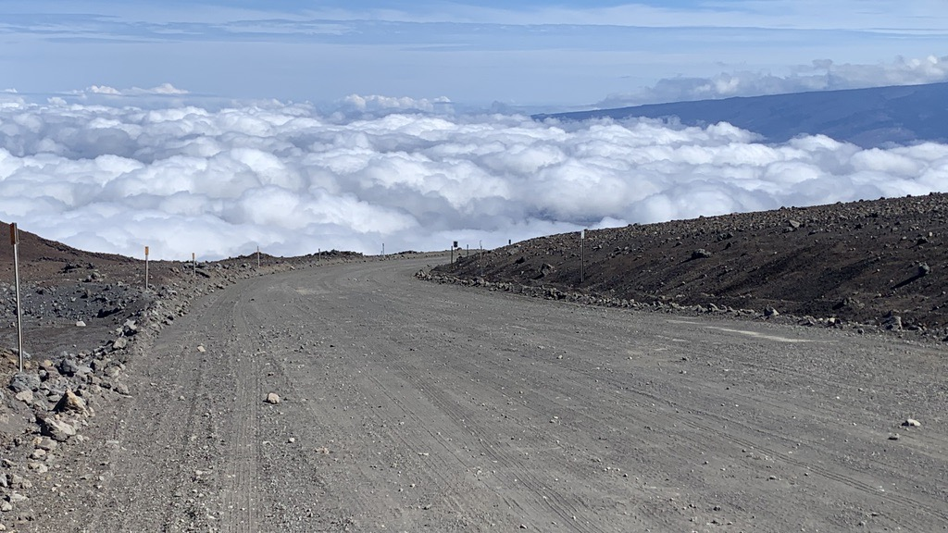
Nine questions
Respecting traditional knowledge
Realities of the limits of our knowledge
Innovations in evaluation/learning
Notes:
(15 seconds--make the picture an interesting background; make each of the questions in the 9 following slides stand out)

Slide 9
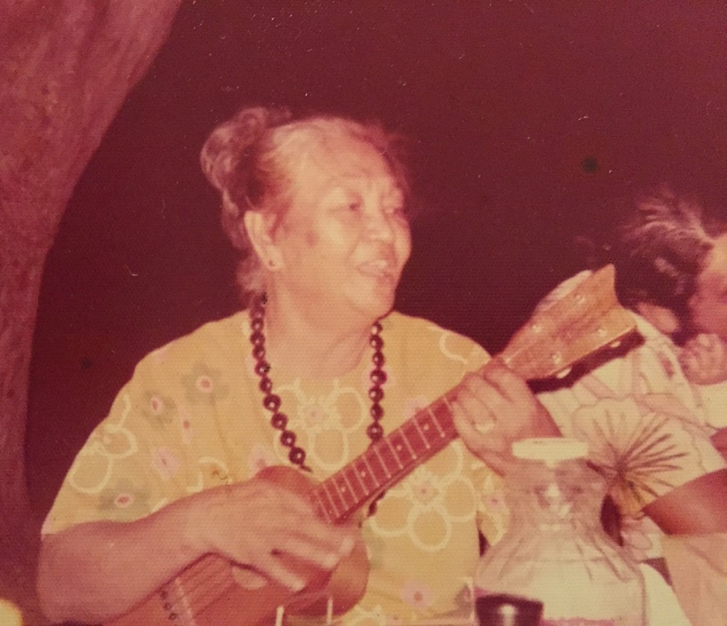
Question 1. Forward to the past: Learning from indigenous knowledge
What can we learn from existing knowledge systems of valuing?
‘aina and a sense of place;
valuing relationships: understanding identity, cultural context and knowledge;
causation and complexity;
aesthetics and valuing
Notes:
(Ian, April’s grandma; 20 seconds)

Slide 10

Question 2. The problem of incompleteness in our knowledge systems
How can evaluations help build the roadmaps as we make the journey?
We tend to exaggerate our initial understandings of contexts and support structures needed to make interventions work.
Notes:
30 seconds)
How do we learn more about contexts, the importance of collaboration and the relevance of culture as we evaluate?

Slide 11

Question 3. Evaluation as navigation
How can evaluations work as a navigational approach?
HISTORY MATTERS IN DEEP WAYS
  “You cannot look up at the stars and tell where you are. You only know where you are in this kind of navigation by memorizing where you sailed from. That means constant observation.”
Achieving Health Equity as a Navigational Goal

Slide 12

Question 4. Taking context(s) seriously
How do we know if an evaluation is taking contexts seriously?
Making understanding of context a critical aspect of defining rigor:
Multiple dimensions of contexts
Context matters is more than a slogan
Notes:
20 SECONDS

Slide 13
Question 5. Power issues in evidence generation: avoiding the colonists gaze
How can evidence generation be respectful of issues of power, history, trauma?
  Experiences of indigenous communities with research and evaluation
  “The colonial gaze….turned people into observed objects, and authorized the official discourses of European viewers, whose representations determined and fixed the status and stature of colonized subjects.”
Notes:
Two slides

Slide 14

From gold standards to ecologies of evidence
  What multiple sets of data/analysis do we need to lead to improve health, improve care, sustain systems and reduce inequities? Navigate decision making?
  How do we build a better ‘house of care’?
Question 6. Towards an Ecology of Evidence
Notes:
(20 seconds)

Slide 15


Question 7. Systems, Contributions and Shared Accountabilities
  How do we build shared accountabilities to incentivize collaborations for problems like homelessness and maternal health?
  How do we build an understanding of interactions between multiple interventions?
  Is coherence a good enough concept?
Notes:
25 seconds

Slide 16

Question 8. Learning as memory and attention
  How do we move beyond project-level learning to learning across organizations and across (and within) countries?
  How do we design learning systems that have memory? How do we promote attention to learning beyond the project-funding period?
  “There is no new learning without some form of memory and some form of attention.”
  - Tracy Tokuhama-Espinosa (2018)
Notes:
25 seconds

Slide 17
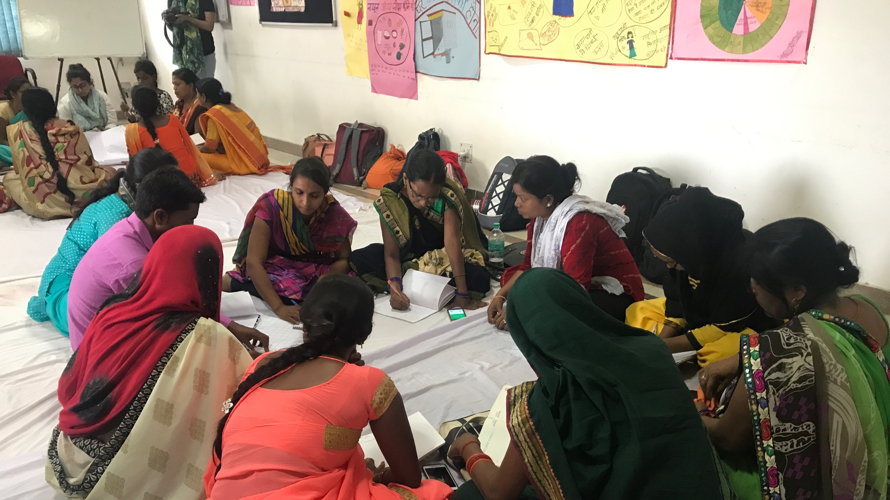
How can learnings from ‘pattern recognition techniques (machine learning, AI, etc) be combined with community dialogue to promote understanding of contexts?
Meaning making = Pattern recognition + respectful community dialogue
Question 9. Forward to the future
Pattern Matching and Community/system-level Dialogues
Notes:
(20 seconds)
The need for respecting contexts

Slide 18

Community/System Dialogues
Ecology of evidence
BUILDING A HOUSE OF CARE
Innovations in evaluation/
learning
Context/History/ Intersectionalities

Slide 19
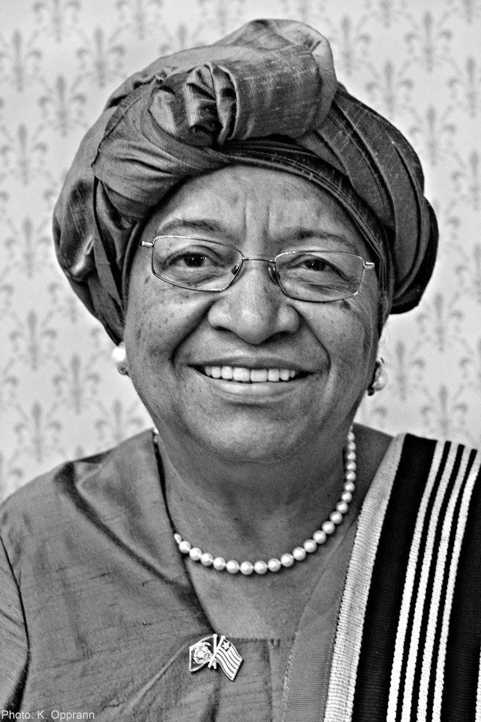
"If your dreams do not scare you, they’re not big enough...The size of your dreams must always exceed your current capacity to achieve them."
Ellen Johnson Sirleaf, Nobel Peace Prize Winner
Notes:
15

