Slide 1



Data Science and Context
Can the two be reconciled in future evaluation practice?
Estelle Raimondo, PhD
Methods Advisor
Photo: © Curt Carnemark / World Bank

Slide 2

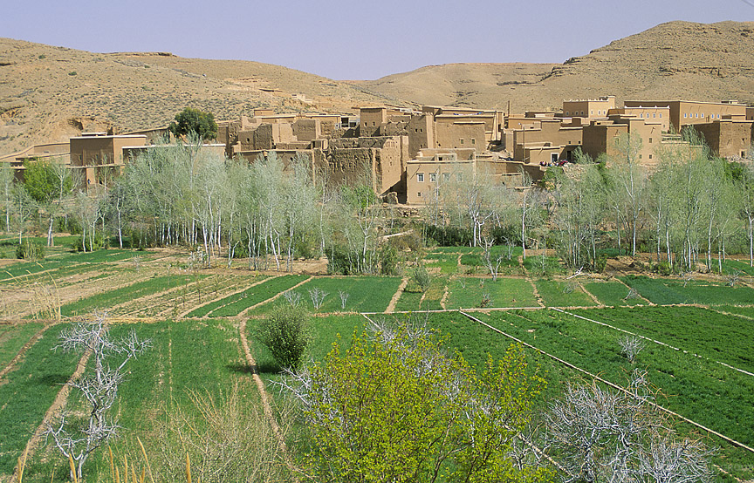

Slide 3
CONTEXT
Social, cultural, political and ecological conditions within which programs or policies occur

Slide 4
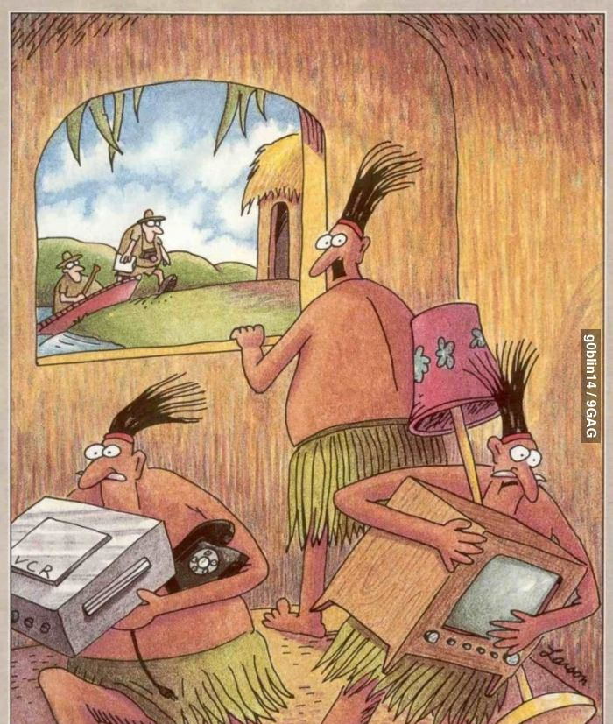
EVALUATORS!

Slide 5
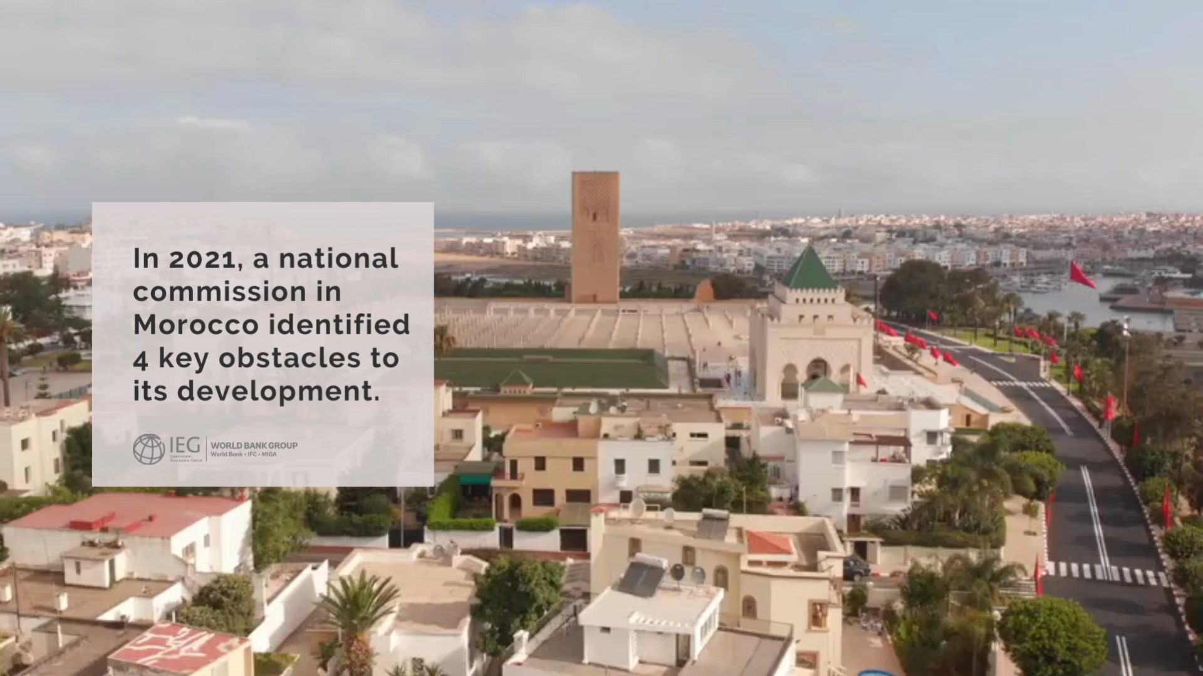

Slide 6

Photo: © Curt Carnemark / World Bank

Slide 7
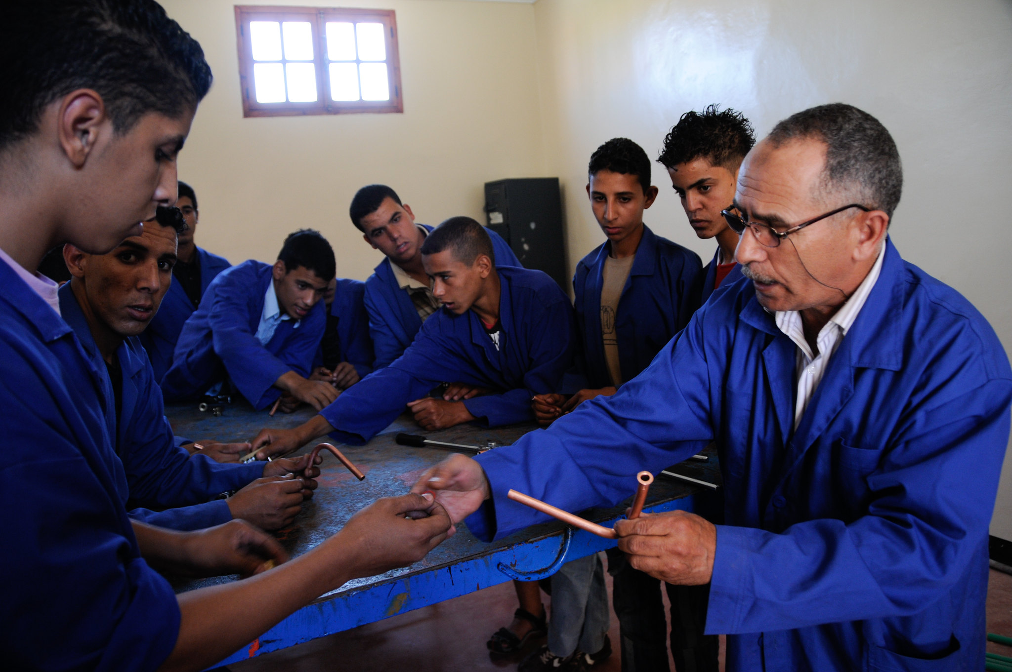
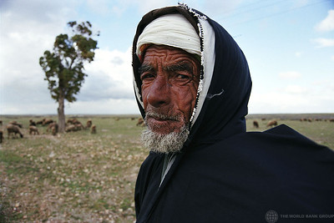

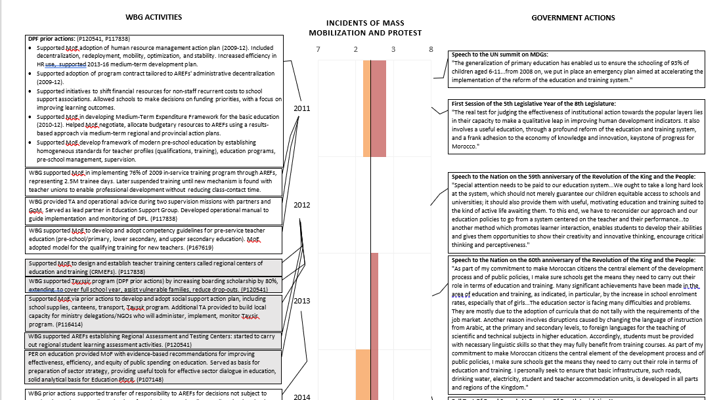

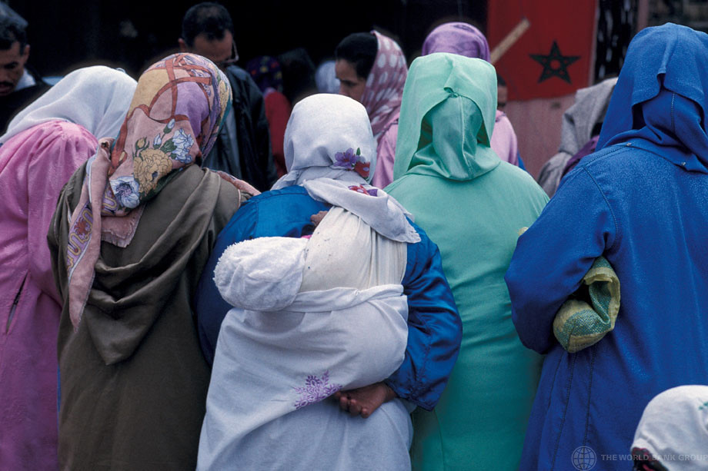

Slide 8
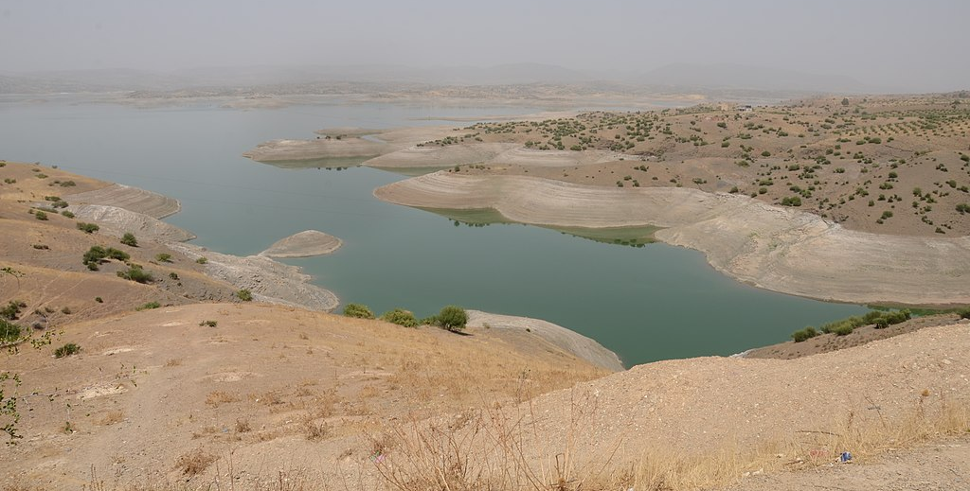

Slide 9
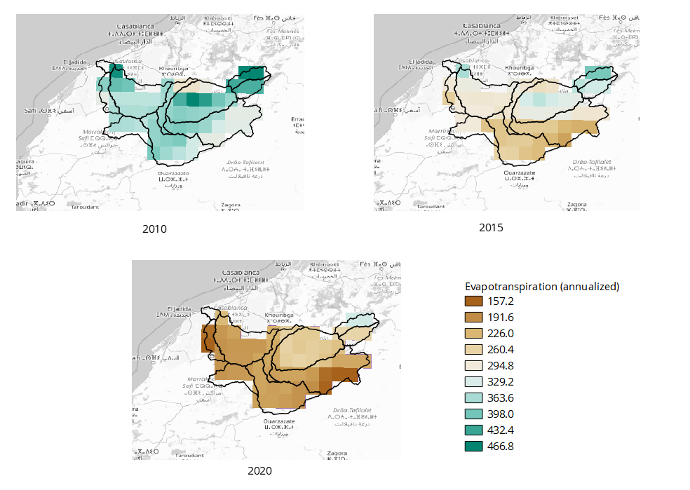

Slide 10
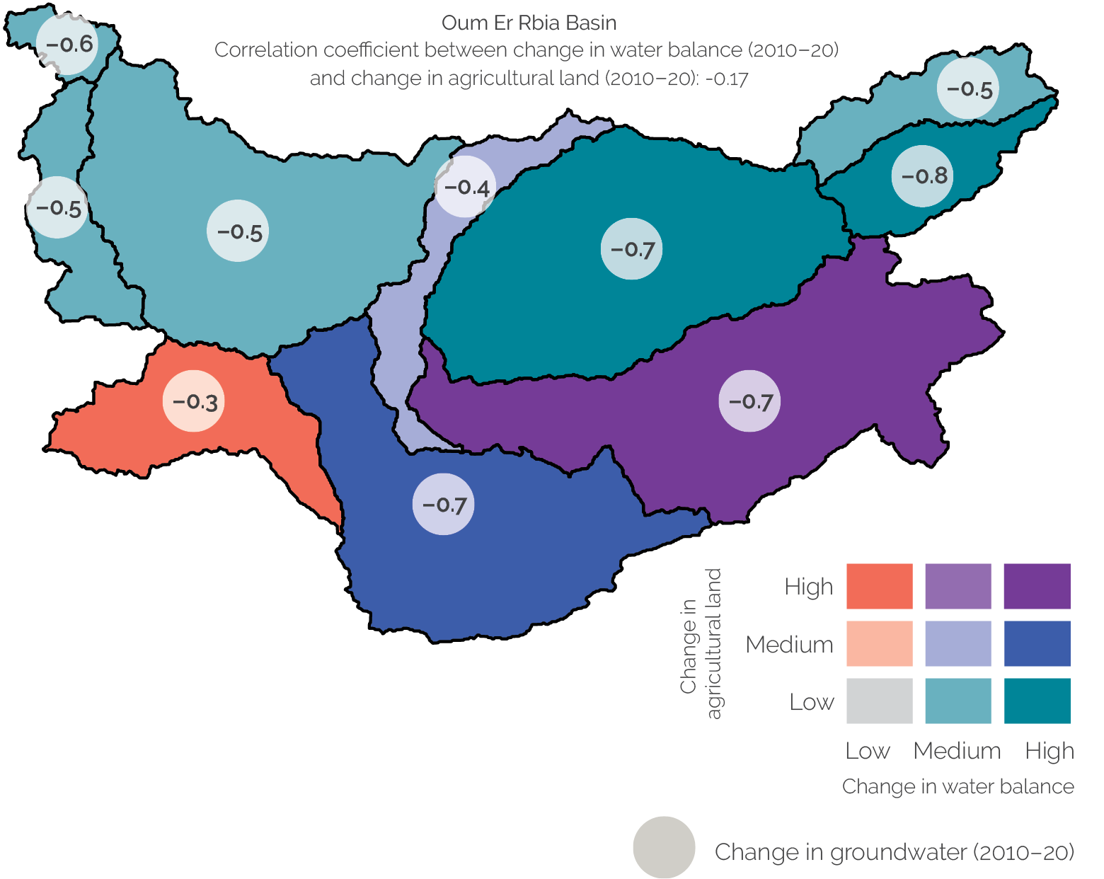

Slide 11
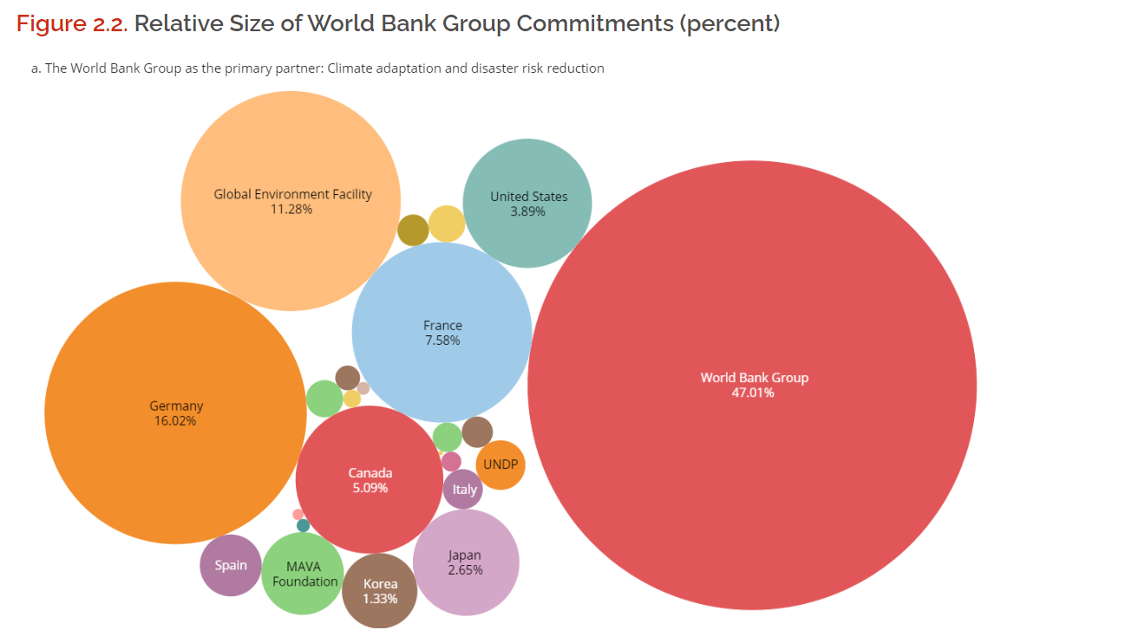

Slide 12
Evaluation questions and framework
Synergy of various expertise
Humility and transparency

Slide 13
Thank you!
eraimondo@worldbank.org

