Slide 1

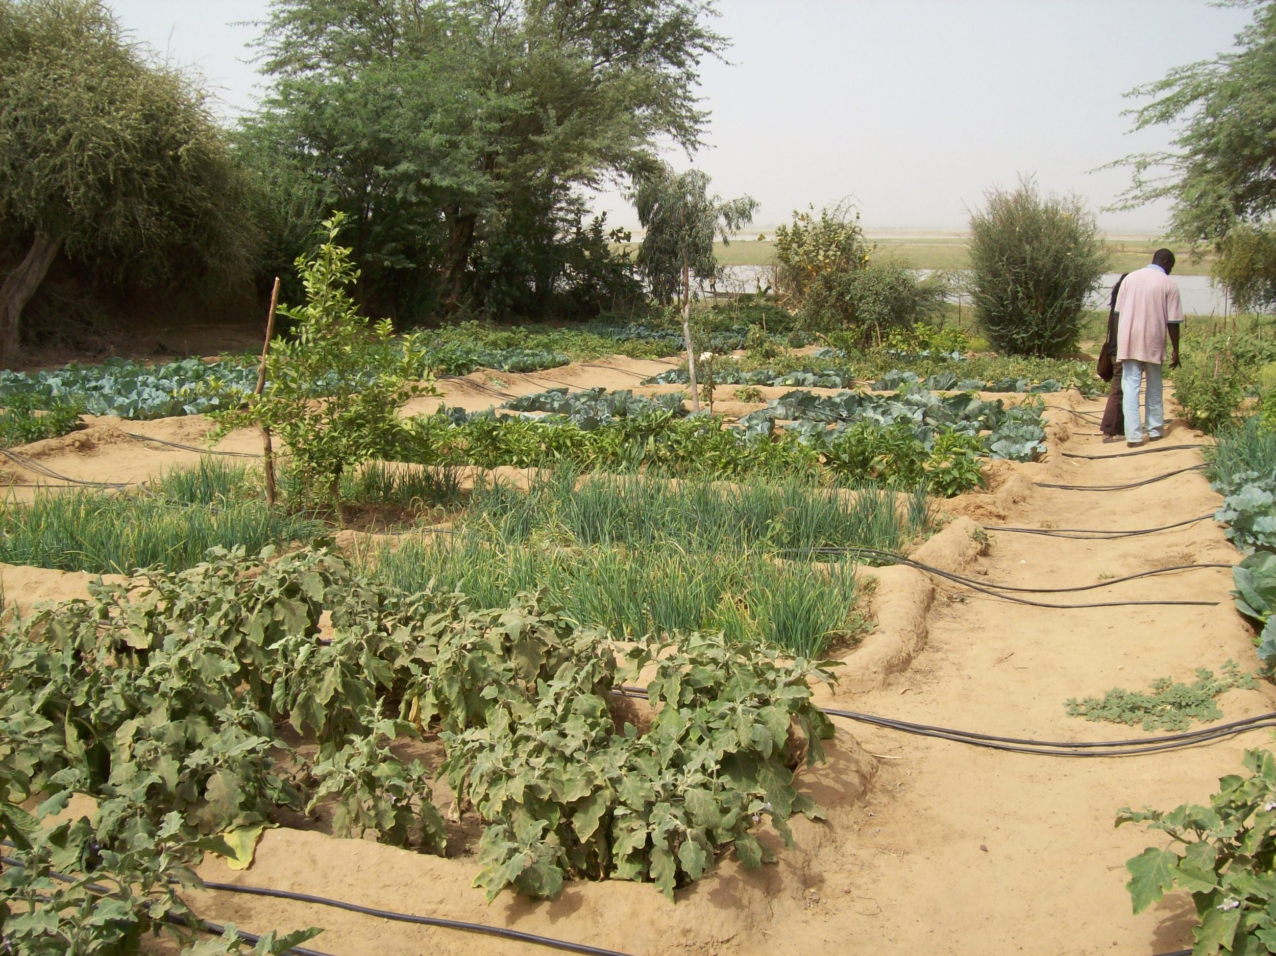

Include your logos here

Slide 2
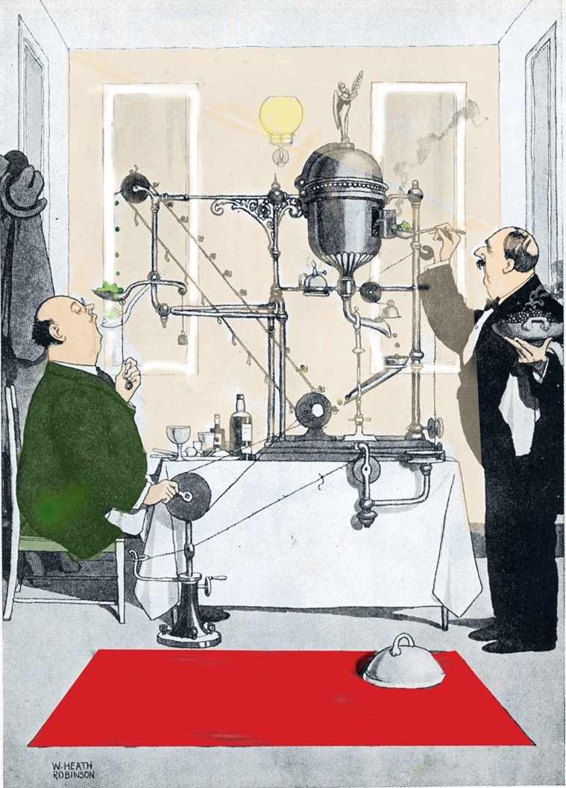
Include your logos here

Slide 3

Include your logos here

Slide 4

Include your logos here

Slide 5
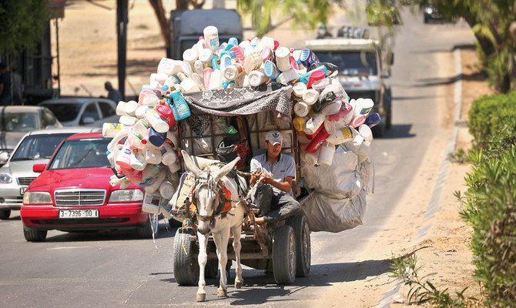
Include your logos here

Slide 6

Include your logos here

Slide 7
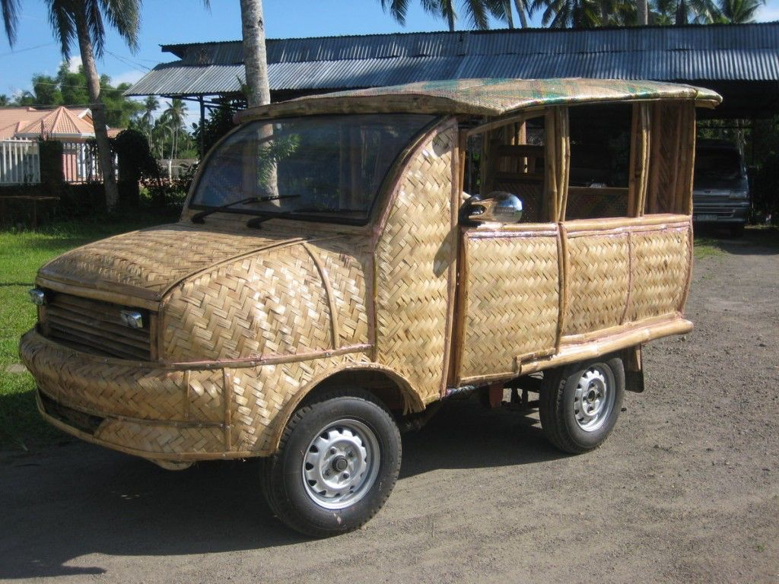
Include your logos here

Slide 8
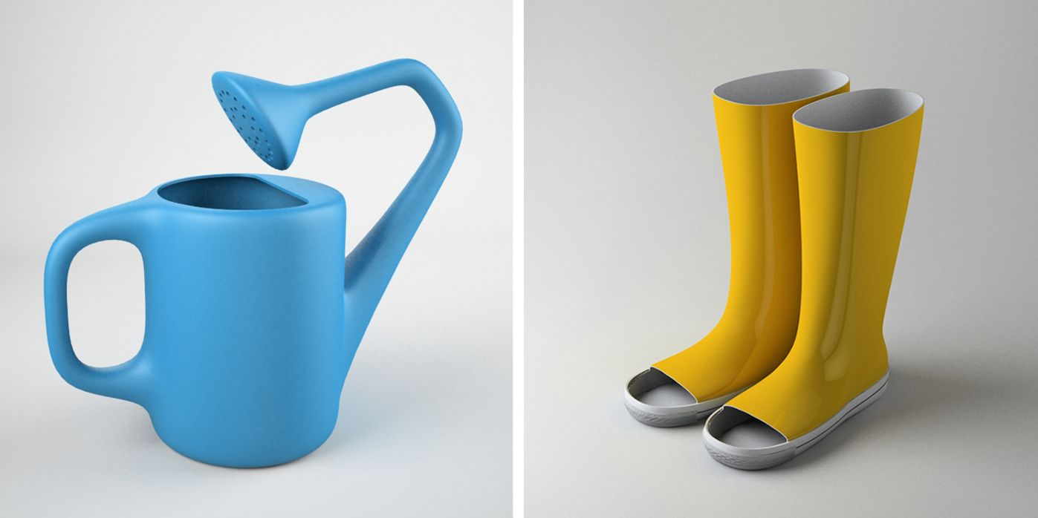
Include your logos here

Slide 9

Include your logos here

Slide 10

Include your logos here

Slide 11
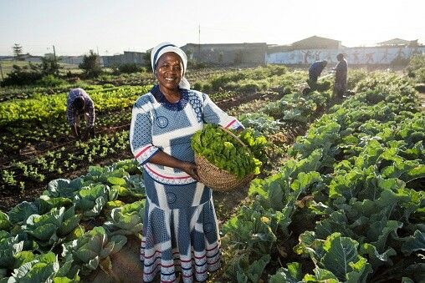
Include your logos here

