Slide 1
The Future of M&E: Culture, Context, and Collaboration
Glocal Opening Session
May 29, 2023 03:00 PM
Candice Morkel
Director, CLEAR-AA

Slide 2
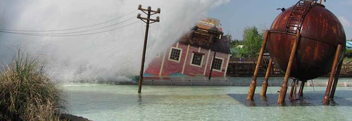
Challenges for strengthening the institutionalization of M&E in public policy
This Photo by Unknown Author is licensed under CC BY-SA

Slide 3
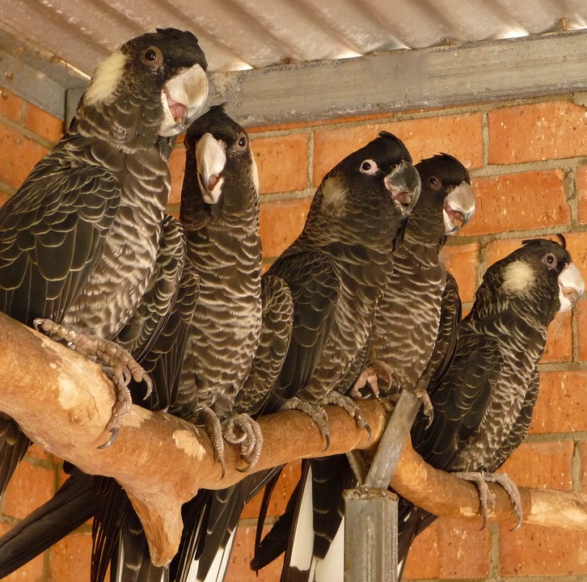
Instrumentalism (benign or contemptuous compliance?)

Slide 4
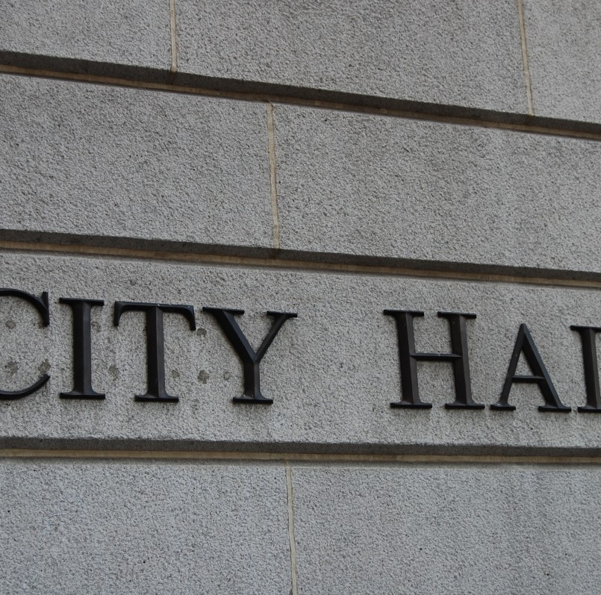
Over-dependence on champions

Slide 5

Weaknesses in coordination and integrated governance

Slide 6
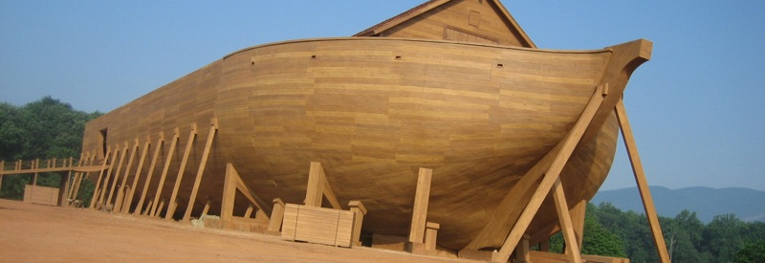
Opportunities to develop resilient M&E systems that can withstand institutional uncertainties & volatilities
This Photo by Unknown Author is licensed under CC BY-SA-NC

Slide 7


Transformative thinking

Slide 8
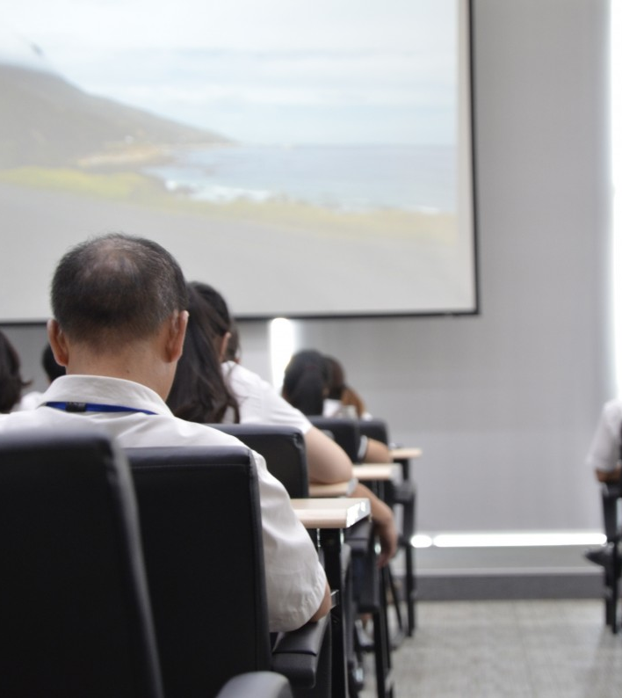
Capacity Development

Slide 9

Partnerships And Co-creation
This Photo by Unknown Author is licensed under CC BY-ND

Slide 10

This Photo by Unknown Author is licensed under CC BY-SA-NC

