Slide 1


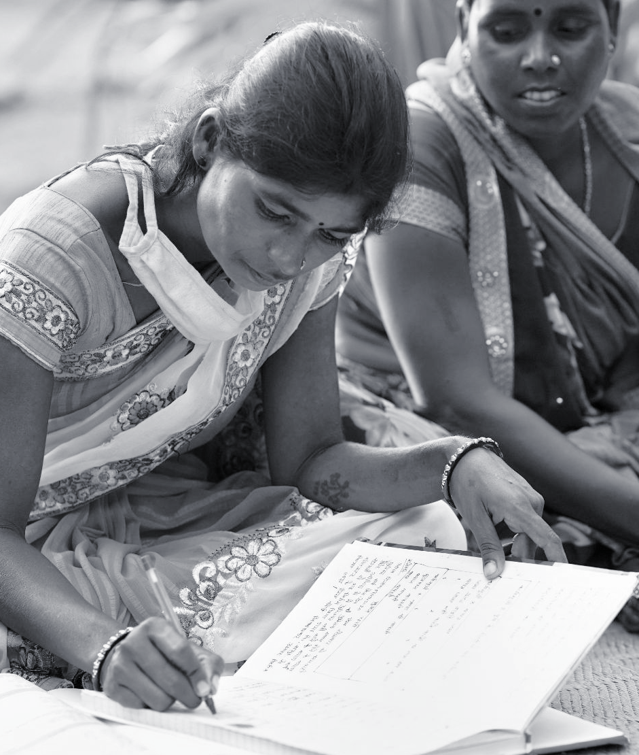

M&E From the Ground Up: Lessons From Monitoring the Swashakt Program
May 2022, gLOCAL Evaluation Week
Morchan Karthick
Data Scientist, LEAD at Krea University
3ie’s Swashakt program is a USD 7.3 million initiative supported by the Bill & Melinda Gates Foundation.
Image Credit: UN Women Asia and the Pacific/flickr

Slide 2
Why is SWASHAKT a Complex Program?

Slide 3
Unpacking Complexity
9
Implementing
Agencies
CDHI-Sakhi, Anandi, ILRT, NEEDS, IMAGO, Chitrika, Urmul, WASSAN, ACCESS
10
Geographical Locations
Andhra Pradesh, Bihar, Gujarat, Jharkhand, Madhya Pradesh, Odisha, Rajasthan, Telangana, Uttar Pradesh, West Bengal
4
Types of
Collectives
FPC, Association, SHGs, Informal Clusters
5
Types of Beneficiaries
Farmers, Kirana Store Owners, Bamboo Artisans, Craft Artisans,Textile Weavers
7
Types of Interventions
Capacity Development, Gender Training,
Financial Linkages, Product Innovation, Technology Upgrade, Infrastructure, Market Linkages

Slide 4
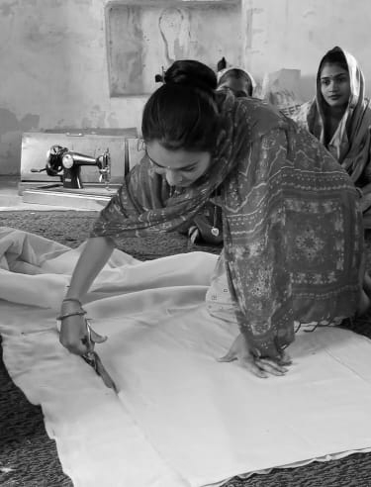
Complexity-Aware Monitoring
Multiple partners, components and objectives
Both program level and individual grantee level indicators need to be monitored
Measuring gender-sensitive indicators both at individual and enterprise level
Recognising and acknowledging monitoring blind spots of different projects
Recognising pace of change for different projects
Capacity of individual grantees to implement monitoring systems

Slide 5
Our
Approach

Slide 6
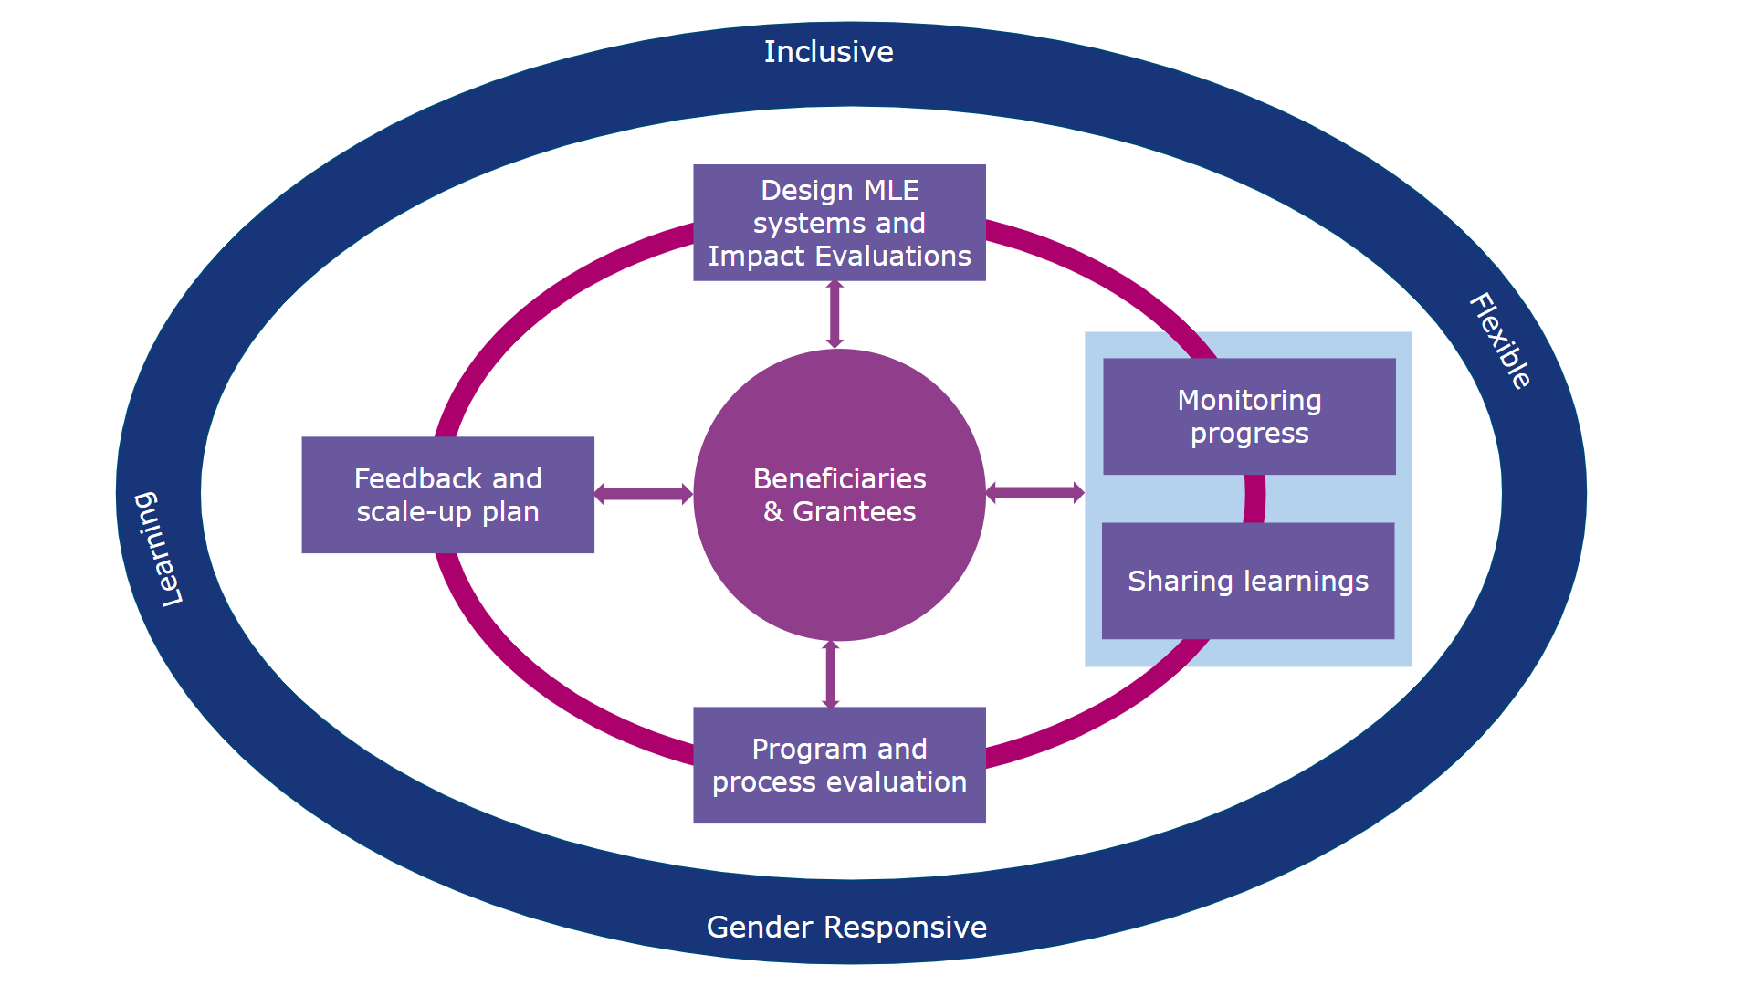
Participatory MLE Approach
Our MLE approach is focused on adaptive learning along with accountability.

Slide 7
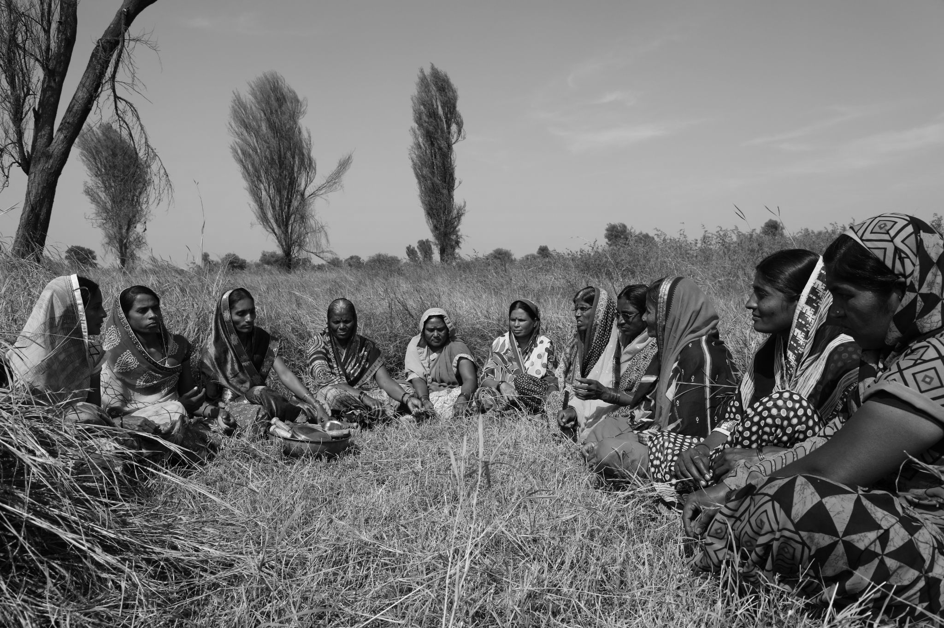
Developing SWASHAKT level ToC
Our objective was to collect data that gives the overall progress of the project but requires minimum efforts from the grantees.
We adopted a consultative process to come up with SWASHAKT level ToC and monitoring indicators.
Assessed identified indicators on two parameters before preparing the final indicators list – level of importance and feasibility.
The one-year projects reported the monitoring data on monthly basis and three-year projects on a quarterly basis.
Check-in calls conducted with each grantee after they share the monitoring data to assess progress, validate data and course correct where required.

Slide 8
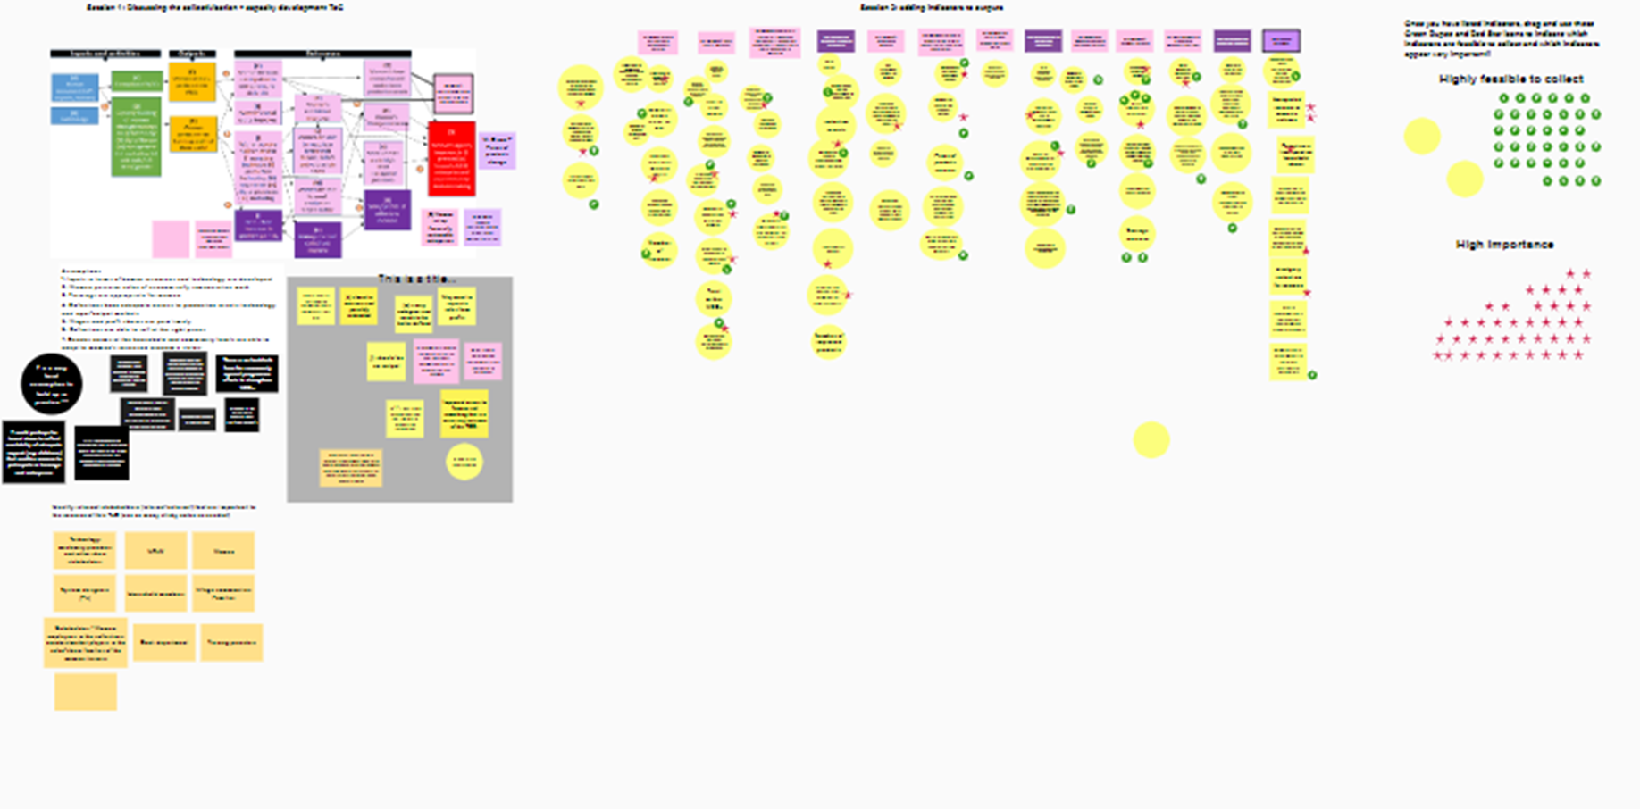
Developing the Swashakt Theory of Change (ToC)

Slide 9
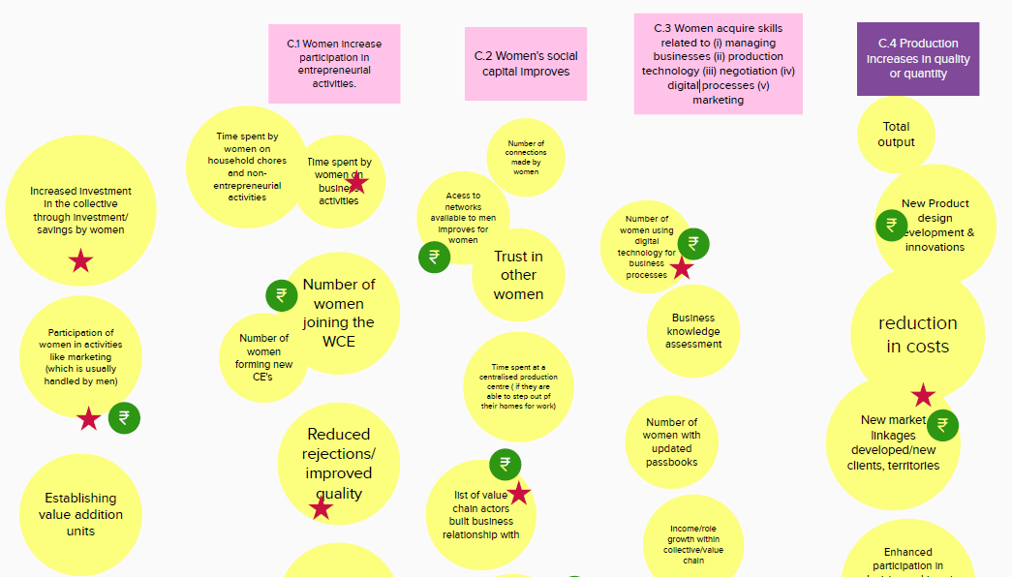
Developing the Swashakt-level ToC

Slide 10
Monitoring & Evaluation Approach
Program vs Project Level Monitoring
Co-developing Monitoring Framework
Capacity Building of Grantees
Keeping in Touch
Program Evaluation
Understand the trade off between collecting program level and project level data
Develop program level ToC and common indicators
Conduct several iterations with the grantees through workshops and meetings
Build sense of ownership among grantees
Have several iterations with the grantees in the initial months
Support monitoring officer in capturing complex indicators
Monthly check-in calls with all grantees
Scope to change indicators, targets or frequency of reporting based on grantee context and experience
Seek buy in for stakeholder and monitoring data used in pilot evaluation.
Ensure evaluations were designed jointly with implementing grantees.

Slide 11
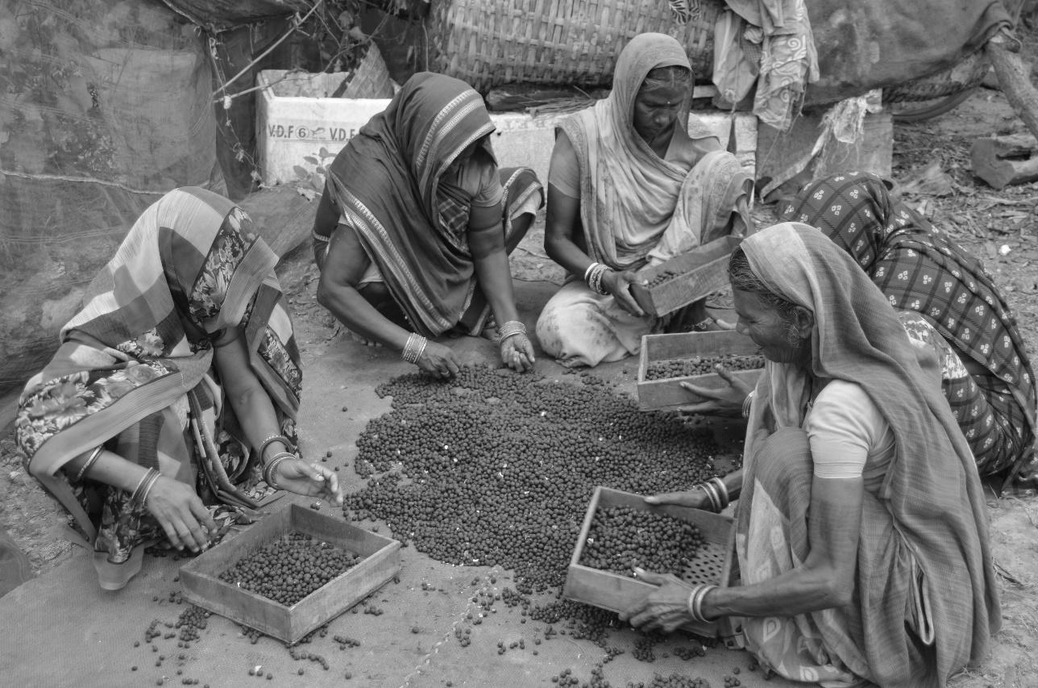
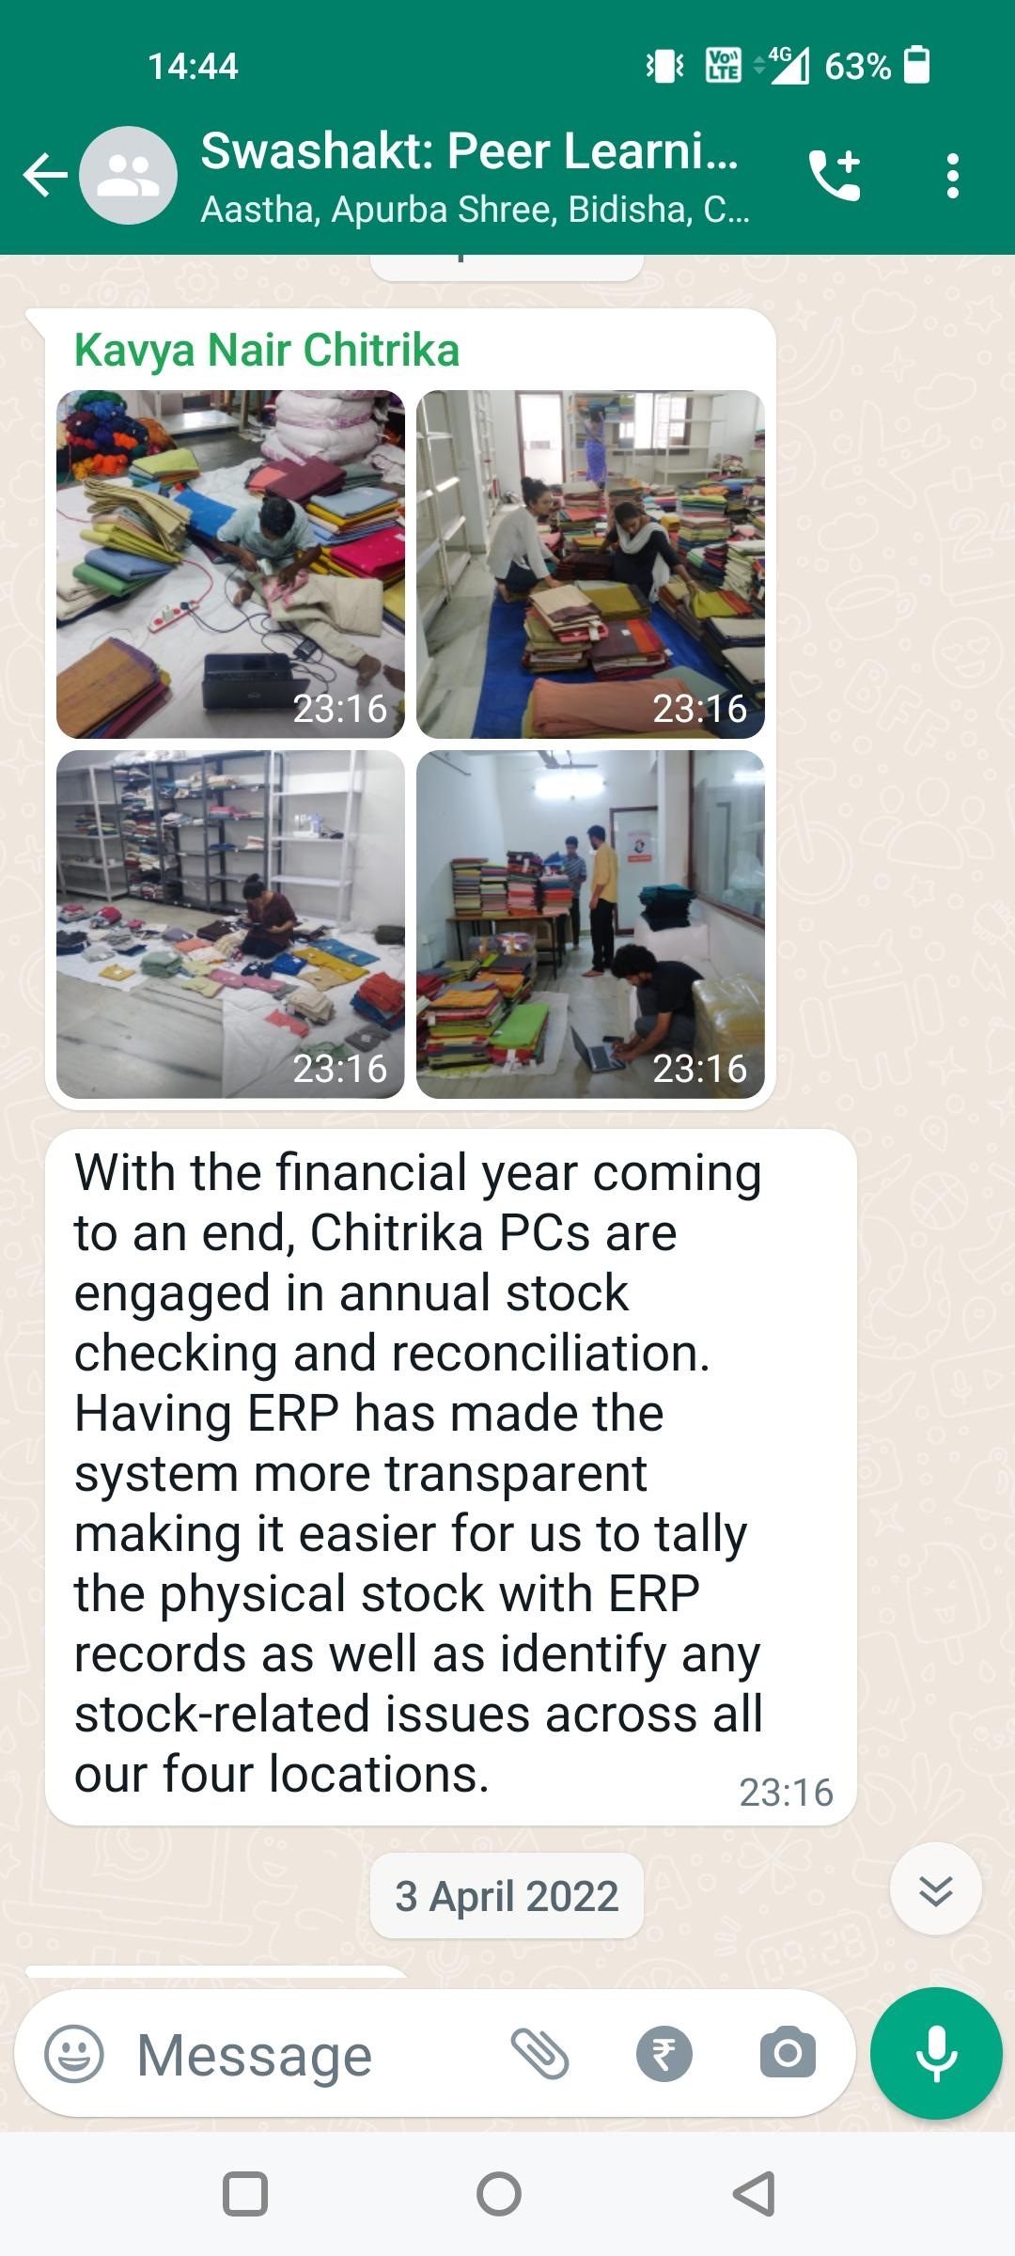
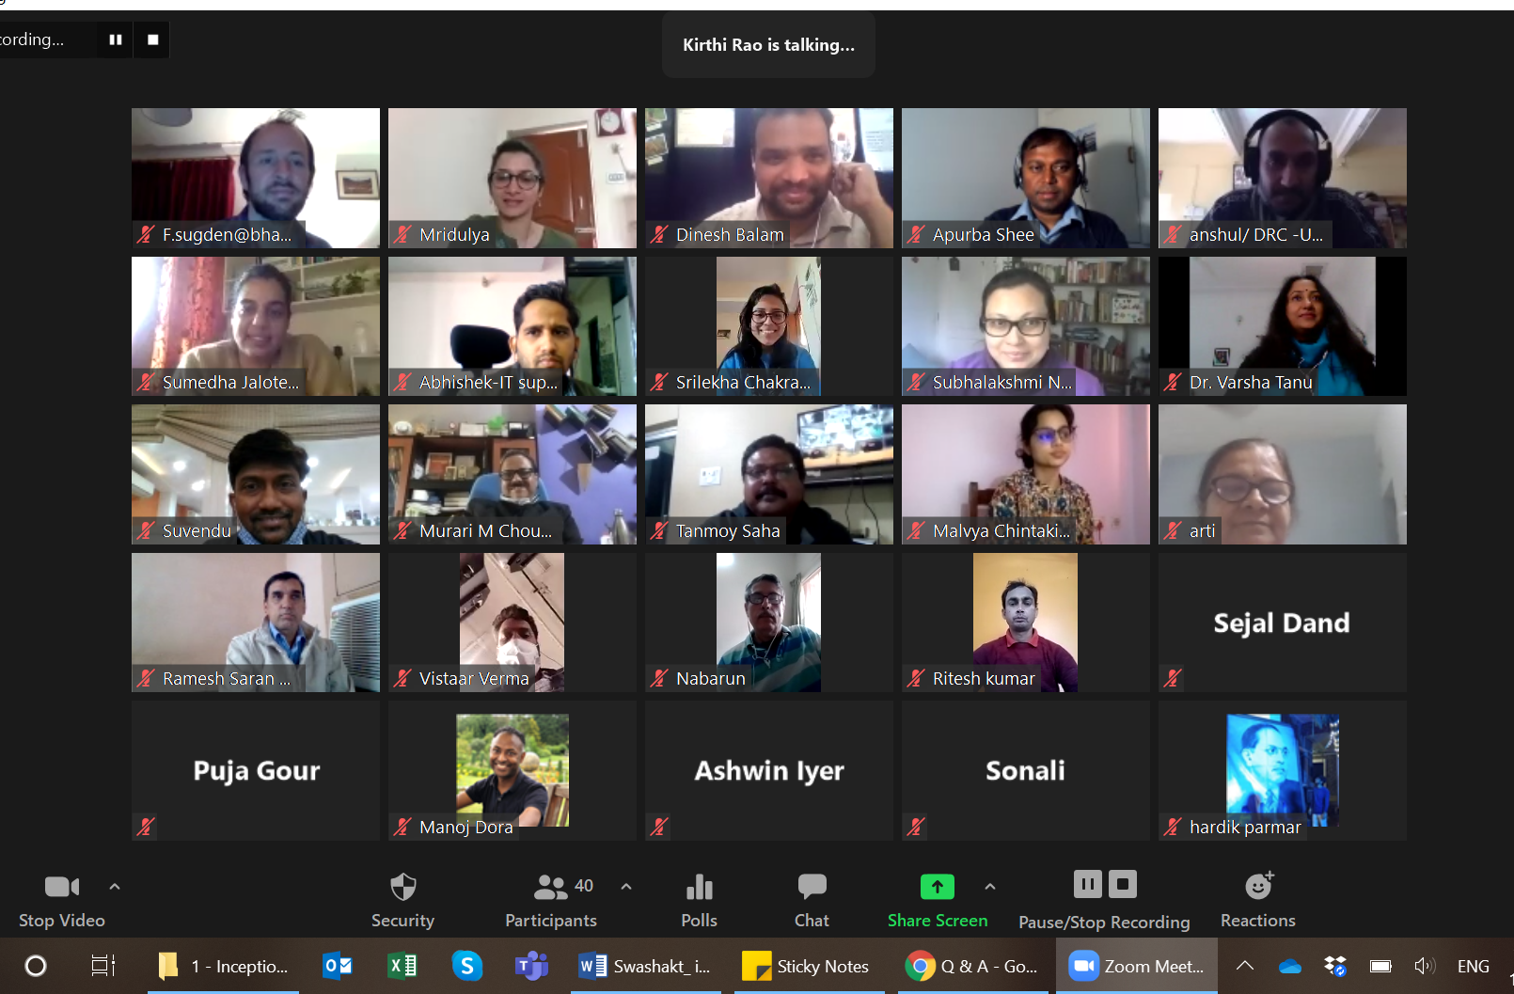
Learning Approach
Milestone Based Progress and Learning Review to Support Course Correction and Adaptation
  Informed project participant selection criteria, helped facilitate outreach to government stakeholders by connecting to other relevant project partners.
Peer Learning Meets and Whatsapp Platform to Facilitate Cross-Project Exchanges Across Implementation and Evaluation Teams
  Anchored around reflecting and sharing achievements, challenges, learning, e.g. understanding unit economics of collective enterprises
  Seeking support and guidance around specific aspects e.g. COVID preparedness strategies and undertaking data collection in this context
  Opportunity to connect bilaterally where needed
Platforms to Capture, Distil and Share Learning and Tacit Knowledge to Inform Future Programs, e.g., Medium Site
  Documenting process knowledge - why makhana production is a good fit for a collective-based model
  How women occupy and navigate spaces conventionally dominated by men e.g. wholesale markets
Documenting production processes: Makhana collective production cycle
Notes:
Example of bilateral connections - ACCESS in Rajasthan able to help Urmul in Rajasthan to connect with SRLM. Chitrika able to share about their learning from setting up ERP systems that are essential for all enterprises.
Could add that the pilot reviews and evaluations are part of the program’s agenda to generate learning about barriers and facilitators to setting up and enhancing viability, scale and returns of WECs?

Slide 12
Implementation Lessons

Slide 13



Lessons from Implementation
Participatory Processes
Must Be Inclusive
Building Capacity Without Overburdening
Importance of Feedback
Loops
Involving all stakeholders including ground level workers in program level visioning increased their ownership and motivation
With grantees leading the development of monitoring indicators we made sure the data is relevant for their own program review
Understanding what is the minimum data points required for program review and course correction
Making sure there are no tedious data collection requirements helps in getting timely and accurate data
Regular check-ins helped us finalise the cadence and data collection mechanism for different indicator types including the complex ones
We came up with a methodology to collect income data from a representative sample of beneficiaries to ensure data quality and reduce burden on grantees
Notes:
Timing of outcome indicator - instead of waiting for evaluation results
Income resilience questions added and removed

Slide 14
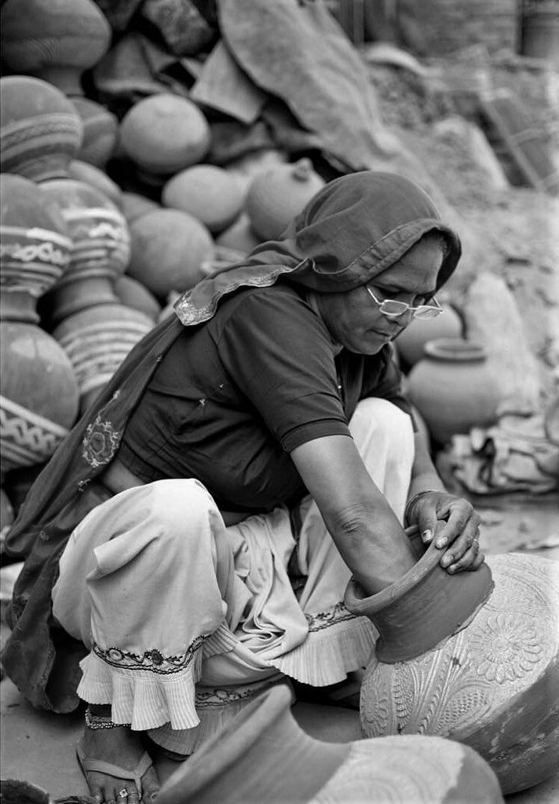


Lessons from Implementation
Data Triangulation Mechanisms Help
Regular Monitoring Helps
Grantees’ Cross-Learning
Setting up data triangulation mechanisms especially for complex indicators helps in improving data quality
Example - Collecting income data both at women level and enterprise level helped in comparing and triangulation
The same intervention is being implemented through different mechanisms by each of the grantee, e.g., ERPs
Regular discussions help in capturing best practices of one grantee and explore its feasibility with other grantees - Eg: Wages paid by the enterprises

Slide 15



Lessons from Implementation
Frequent Interactions Help
in Course Correction
Monitoring Systems Help
Build Evidence Portfolio
Staying Connected Through
Peer Learning Platform
With implementation uncertainties caused due to COVID-19 pandemic, review of monitoring data helped us course correct where required
Implementing agencies reprioritized activities, revised targets through discussions without having any implication on resources
The monitoring systems help grantees improve their data systems and generate a evidence portfolio to showcase their impact
Implementation partners are a key audience for learning from the formative and impact evaluation that draw from the monitoring systems.
Peer learning events help grantees feel connected to the overall program and to one another
Grantees are sharing challenges, learning and achievements through WhatsApp group and peer learning meets

Slide 16
Thank You
Learn More About Our Work:
Twitter: @3ieNews
Twitter: @LeadatKrea
The views expressed in this presentation are those of the authors and do not necessarily reflect positions or policies of the Bill & Melinda Gates Foundation.

