Slide 1
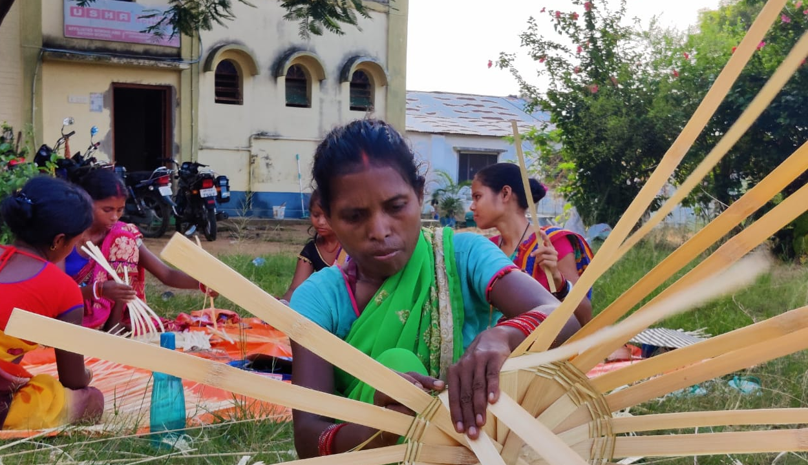

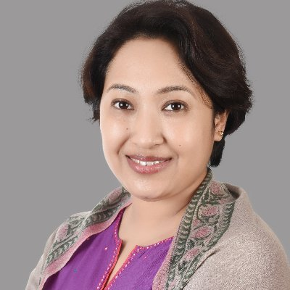
M&E from the ground up: lessons from monitoring the Swashakt program
Bidisha Barooah
3ie

Slide 2
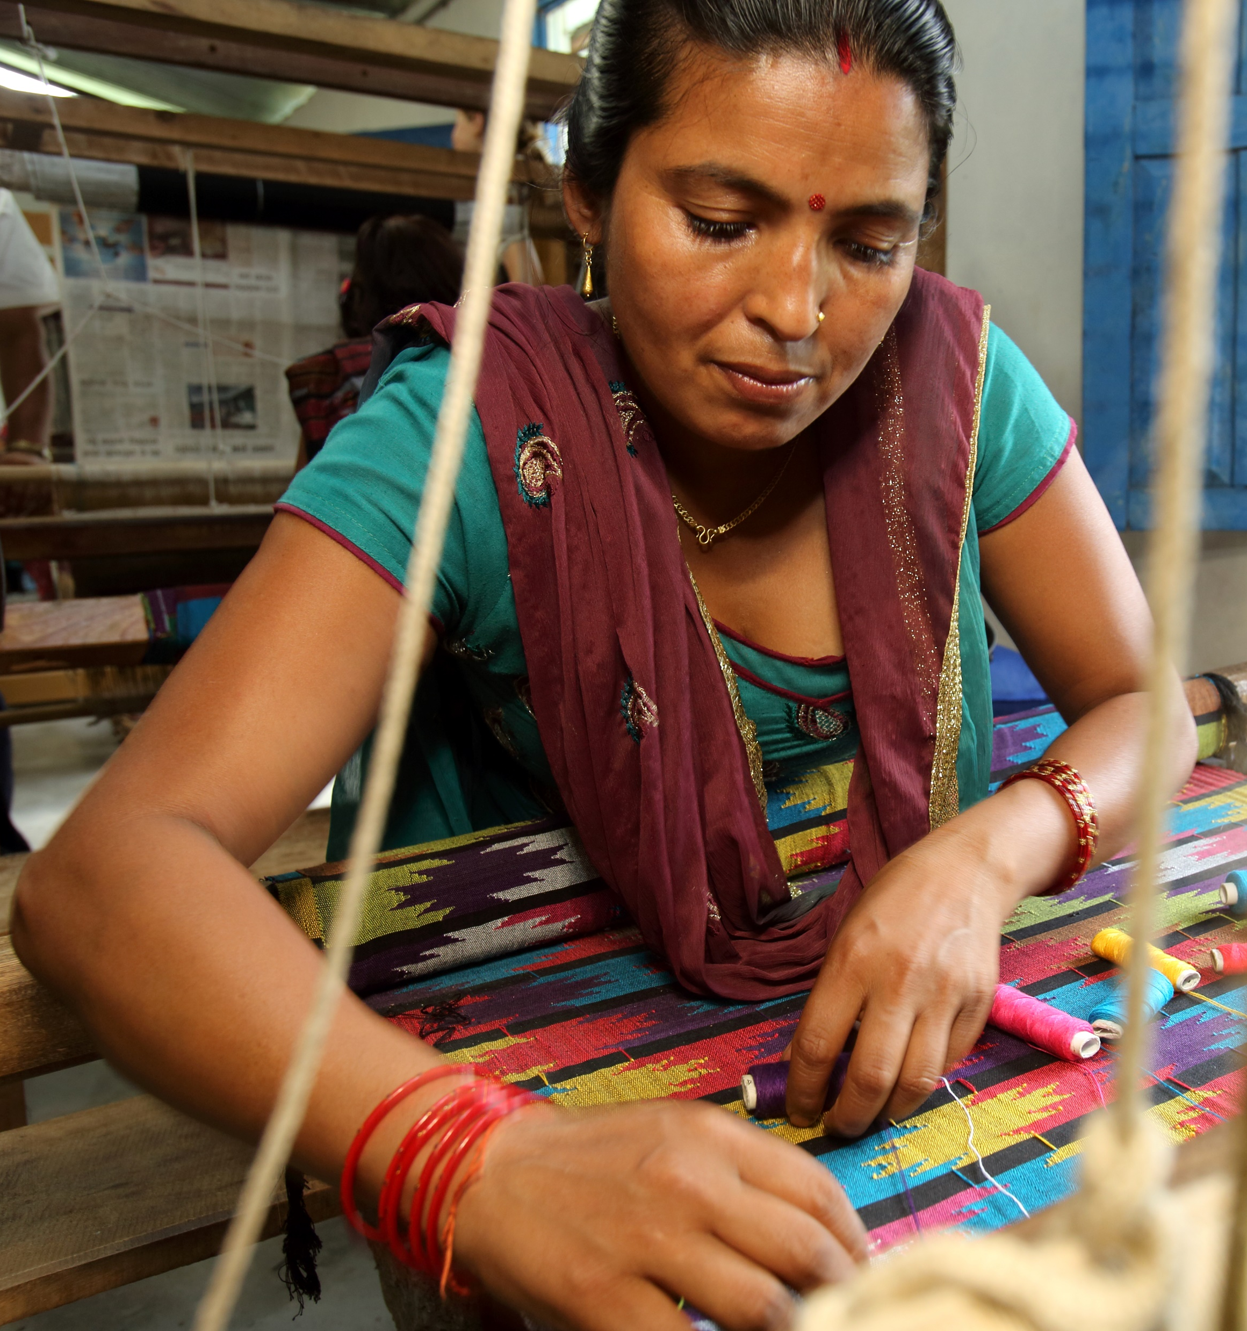
Why invest in women’s collectives for women’s economic empowerment?
Endowments, entitlements and investments that women receive are not the same as men
  Women constitute 14% of landowners in India (Agarwal et al 2020)
Women’s economic empowerment: control over their economic lives
Supporting women-run and led businesses can give resource-poor women ownership and agency over economic assets
  Evidence of long-run effects of asset transfer+ financial inclusion programs in India (Banerjee, Duflo, Sharma 2021)
Collective enterprises can alleviate the structural and systematic disadvantages that women’s enterprises face
  Collective action to access resources and markets
  Collective bargaining
  Reduction in costs
  Economies of scale
  Share risks
  Problems of free-riding, inefficient investments, co-ordination
Empowerment collectives
Group support
Economic assets
Income generating activities
Markets
Networks

Slide 3
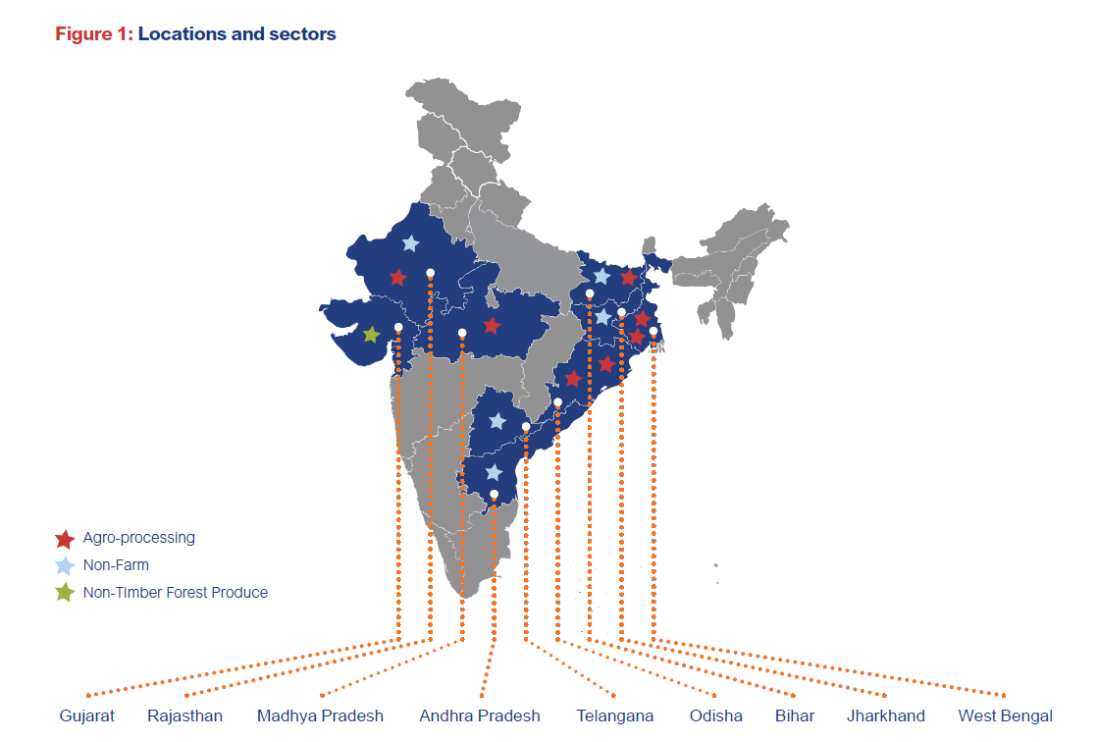
Swashakt: projects span 9 states and several sectors
Success stories of collectives in India such as SEWA, Kudumbashree, SERP
SHGs are a platform for rural women: Over 80 million women mobilized in SHGs
  Increase in access to financial assets
  Improvements in income and income sources
  Better linkages with social programs
  Women’s economic inclusion
  All impacts are higher with further collectivization of SHGs or federations (Kochar et al 2020)
3ie with support from Bill & Melinda Gates Foundation launched the Swashakt program in 2020.
The 9 Swashakt projects set up and replicate models of women’s collective enterprises across 9 states in India.
Name of project​ | Product​ | Type of WEC​
Collectively run agro-processing enterprises in the Eastern Gangetic Plains​ | Makhana, Vermicompost​ | FPC
Strengthening Women Farmer Producer Organisation in Tribal Communities of Gujarat, India​ | Mahua residue, Mango, Turmeric​ | PC
Rural Retail Shops: Empowering women through collective-based approaches in Bihar​ | Services​ | Association​
Women's Entrepreneur Collective- NEEDS​ | Bamboo craft​ | PC
Scaling up RUDI, a SEWA Women Collective Enterprise from Gujarat​ | Local agricultural produce​ | Aggregation​
Creating agency of women in weaving value-chain in India, impacting 1,700 women weavers by 2023 through collectivization​ | Cotton woven handloom​ | FPC
Crafts Incubation Hub, Rajasthan​ | Handicraft​ | Aggregation​
Economic and Empowerment Impacts of Millet Processing and Value Addition Enterprises by Women SHGs in Tribal Areas of Odisha ​ | Millets​ | SHGs​
Gramyashakti: Developing rural women’s spice processing enterprises in three Indian states​ | Spices | FPC​

Slide 4
Women’s economic empowerment and collectives
  Technical and technology trainings
  Skill building exercises
  Gender integration trainings
  Leadership trainings
  Enterpreneurial trainings
  Soft skills
Power within: capabilities, knowledge, self esteem
Power to: take economic decisions (agency) within households and enterprises
Swashakt Solutions
WEE
Power with: organize with others to enhance economic activities and entitlements
Power over: access to and control over financial, material and knowledge based assets
  Collectivisation
  Partnerships
  Governance
  Networks
  Common production units
  Group credit
  Market access
  Digitization
Source: Pereznieto and Taylor (2014), Dang et al (Forthcoming)

Slide 5
Thank you

