Slide 1
Evaluating in Crisis -COVID 19 and rapidly changing context and implications for evaluation practice
Justus Kamwesigye
UNICEF ESARO

Slide 2
Getting started
Nothing remains the same. Change will always take place
What if change is so dramatic, abrupt and disruptive?

Slide 3
What actually changes
Technological Environment/Advances

Slide 4
What actually changes
The Political Environment

Slide 5
What actually changes
The Political Environment - Stability, policies,

Slide 6
What actually changes
The Legal Environment - laws and regulations

Slide 7
What actually changes
The Economic Environment - Income and Economic Development

Slide 8
What actually changes
Risks - Epidemics, Conflict and Natural Disasters

Slide 9
Implications for M&E
Distortion of baseline and planning scenarios
The validity of theories of change
Target population, expected results and performance measures – trends are affected
Data sources – access to respondents, disrupted administrative information systems, statistical systems.
Donor priorities and funding availability

Slide 10
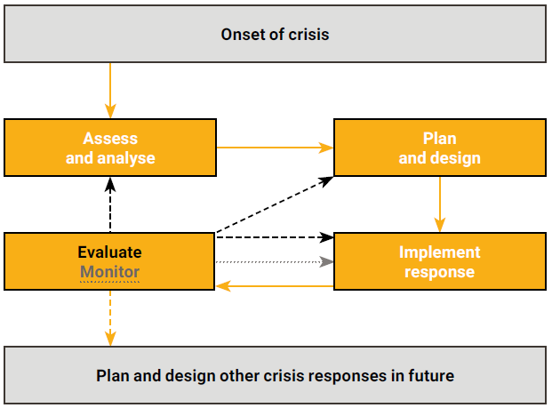
M&E in Emergency Response cycle
Source: ALNAP 2016

Slide 11
COVID 19
Movement restrictions
Changing priorities
Need for real time data
Resource constraints
Fake news and monitoring misinformation
Do no harm principle

Slide 12
What do we need to do differently
The biggest change we need to make in our practice is in how things are done, not what is done.

Slide 13
What do we need to do differently
Embrace change – crisis brings change, for better or for worse
Maintain updated context and situation analysis information – Cause, timescale and frequency, areas and populations affected, capacity gap analysis.

Slide 14
What do we need to do differently
Build adaptive learning systems - Adapt plans, program designs and strategies, update theories of change.
Consider evaluability assessments to look at Clarity, Relevance, Plausibility, Validity or reliability, Testability, Contextualized, Consistent, Complexity, and Agreement

Slide 15
What do we need to do differently
Focus on use – e.g. developmental evaluations

Slide 16
What do we need to do differently
Systems thinking – COVID has shown interconnectedness of almost everything.

Slide 17
What do we need to do differently
Rethink and priorities on the quality criteria of evidence. You cannot have it all.
Accuracy + representativeness + relevance+ generalizability + attribution + clarity of contexts and methods.

Slide 18
What do we need to do differently
Explore new approaches – e.g Chronology mapping, Nested Actor-Based Theories of Change.

