Slide 1
Shifting from traditional M&E to a fully digitized data ecosystem in response to the COVID-19 crisis, VVOB Rwanda
By Jacques Ntezimana, VVOB

Slide 2
Contents
  About VVOB programme and why Data Ecosystem
  Which data is included in the Data Ecosystem
  Process followed to automate the system
  Data Ecosystem Architecture- Things done differently in M&E aspects to build resilience
  What changes the system has brought?
  Challenges & lessons learned
  Conclusion – what to keep in mind as M&E practitioners
  Domo on dashboard

Slide 3
About VVOB programme and Data Ecosystem
  VVOB education for Development in Rwanda (VVOB) is implementing Leading, Teaching and Learning Together(LTLT) programme (2018-2021) funded by DGD and the MasterCard Foundation.
  VVOB works in strategic partnership with the Ministry of Education and in operational partnership with Rwanda Basic Education Board, and the University of Rwanda – College of Education
  A primary goal of this programme is to improve the quality of basic education in Rwanda by strengthening the competences of key education actors through improved CPD services and support systems for these actors
  As part of building resilience, VVOB has shifted the delivery of its CPD training from face-to-face modality to blended or online modality.
  During Covid -19 crisis the CPD content was re-designed for online delivery

Slide 4


About VVOB programme and Data Ecosystem
  M&E component was also innovated to respond on fast-changing environment and continue collecting data during lockdowns
  Throughout, VVOB has fully digitized/automated its M&E system through Data Ecosystem to allow M&E data flows from data collection to reporting
  System also allows more adaptive implementation of the trainings and more effective follow up and adjustments.

Slide 5
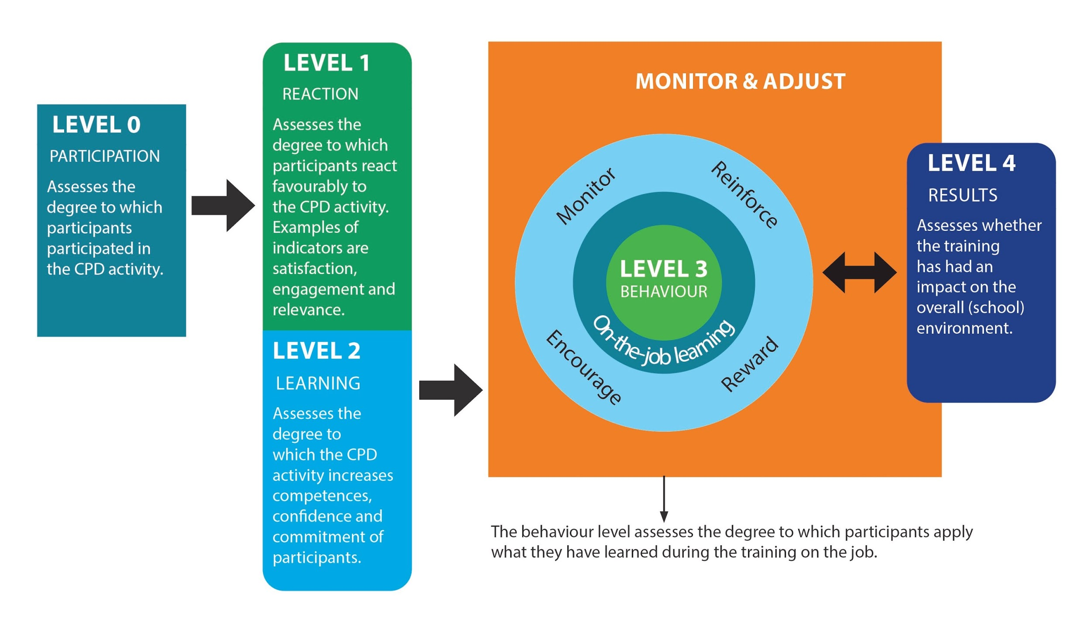
Which data is included in the ecosystem?
Monitoring-Level 0: Attendance forms & completion data
Evaluation- Level 1: Satisfaction surveys
Evaluation- Level 2: KAP surveys (pre& post surveys)
Evaluation- Level 3: CPD assessment tool
Impact- Level 4: School-leadership assessment tool
Mixed methods like Most Significant Changes Stories, FGDs are also used to capture impact but are not a part of ecosystem.
K.Model helps us telling stories of the effects of our training as we move along, without waiting for mid and end term evaluations !!
Our data collection tools follow the framework of Kirkpatrick model

Slide 6
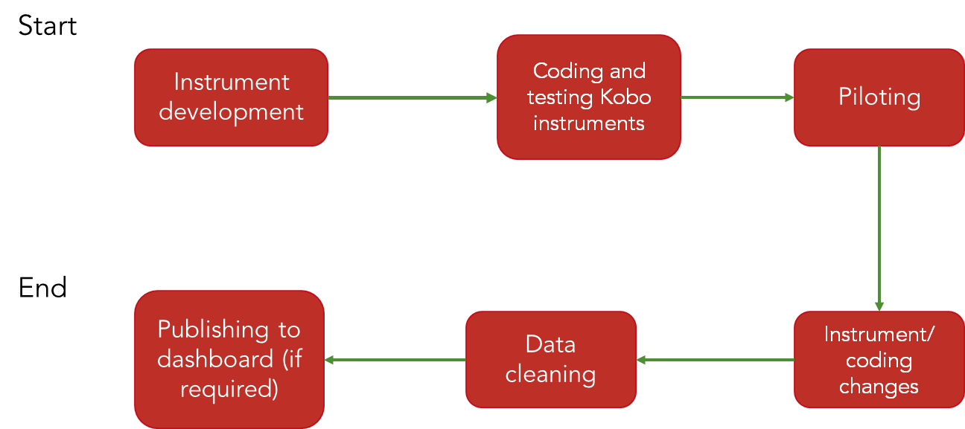
Process

Slide 7
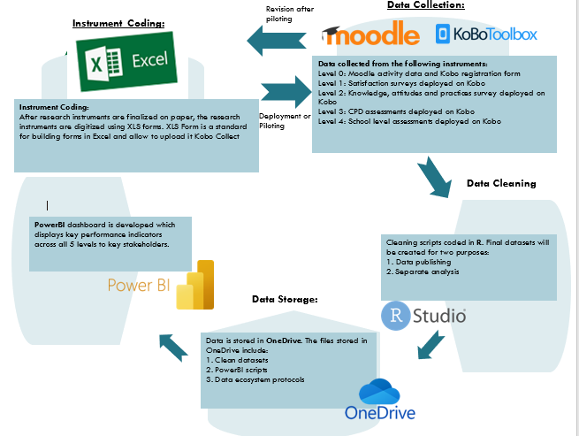
What VVOB has done differently in M&E aspects to build resilience
VVOB re-designed its M&E system to be more systematic and automated
VVOB embraced the fast-changing environment by responding on development needs of building resilience
The digitalization of M&E data flows go from data-collection, over data cleaning, analysis and reporting (through dashboard)

Slide 8
What changes the system has brought?
  Fully remote data collection – no paper-based surveys, collection of data to continues during lockdowns
  Visualizations of real time data to assess the effects of our training
  Shorter feedback loops from data collection to reporting
  More efficient and straightforward process=less errors
  Data is more accessible to different stakeholders
  Interaction with the data
  Largely automated analysis and reporting which makes it easier for operational partners to adopt our M&E system

Slide 9
Challenges & lessons learned
Compatibility between applications: not all applications can ‘communicate’ with each other
Solutions:
  Be ready for alternative application or software
  Initiate learning partner to offer technical support
Low response rates to online surveys: different strategies needed to increase rates
Solutions:
  Monitoring submissions rate
  Reminders via WhatsApp, phone calls etc.
  Engagement of training advisors in collection of data

Slide 10
Challenges & lessons learned (cont.'s)
Lack of buy-in from users
Solutions:
  Pilot-testing of all tools to ensure it matches needs
  Involvement of users in development of the system
  Showcasing the benefits and added value
  Capacity building for users

Slide 11
Conclusions
Always crisis change comes with the good and the worse things:
  Good things –case of data ecosystem
    Learn new skills
    Make working environment easier and more adaptable
    Quick cope on the crisis change
  Worse things
    Leave out those who persist on traditional working environment
M&E practitioners must keep themselves up to date with new trends in MEL- New evaluation methods, technological innovation etc

Slide 12
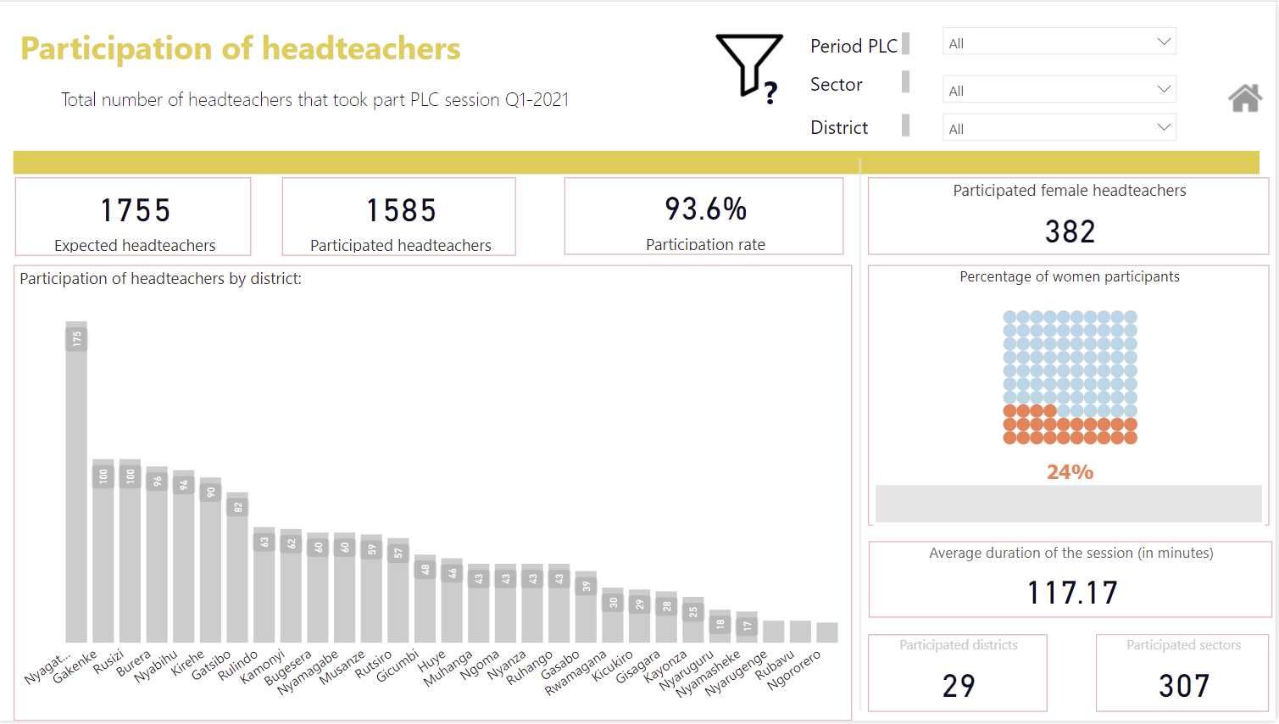
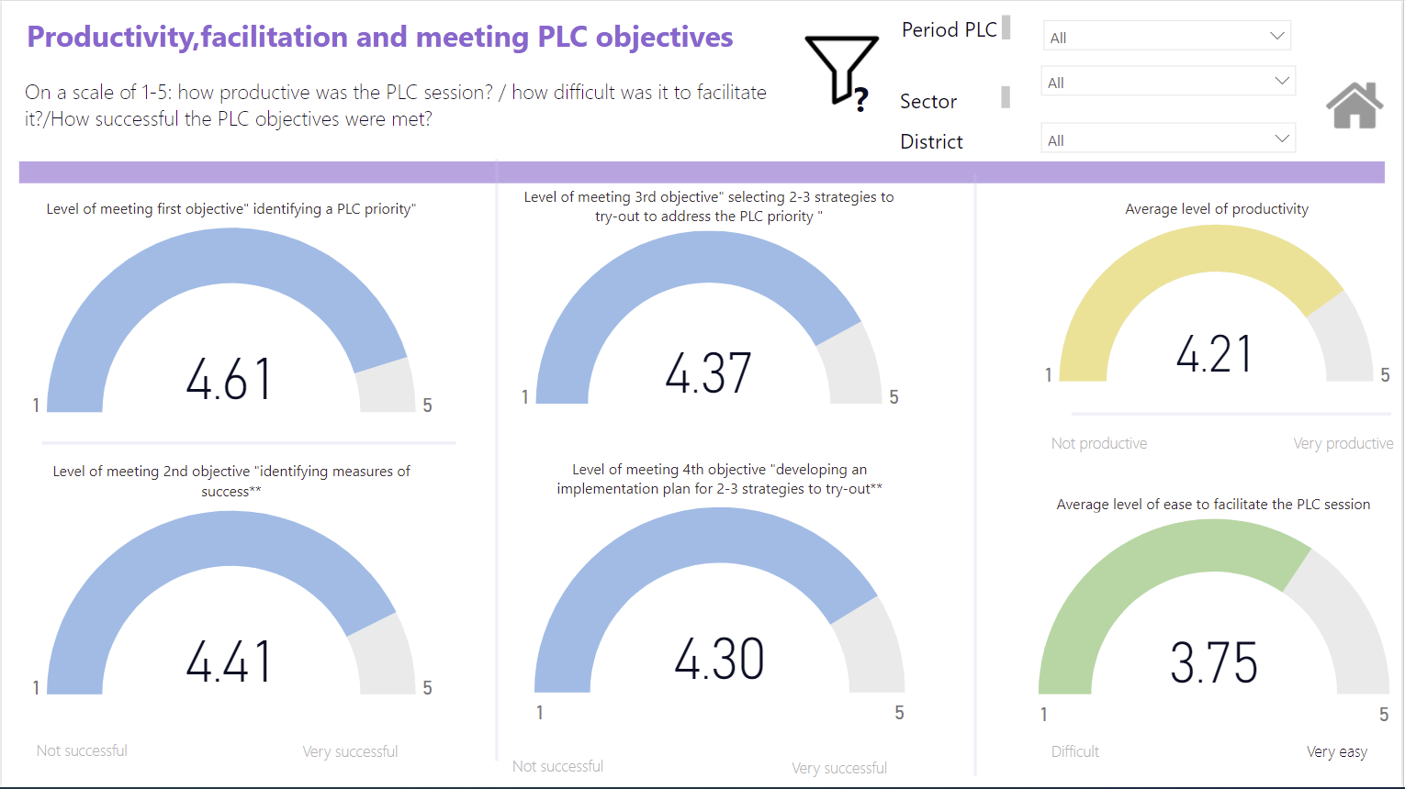
Demo on Dashboard-Final product of data ecosystem

Slide 13





Special thank you to our partners.

