Slide 1
M&E Approaches Across the Region
A COMPARISON FROM A TRAVELING EVALUATOR
SANDRA ORTEGA
Notes:
Thank you for this opportunity to present some of my lessons learned from my travels in evaluation. My background is in empowerment evaluation which we’ll get to shortly as an innovative approach to monitoring and evaluation especially in pilot and developing programs and projects.

Slide 2


Sustainable Development Goals
Notes:
As I began preparing for this conversation, I reviewed the sustainable development goals and settled on the three shown in the slide as closely matching the work that i’m involved in. The first is good health and well being, the second is gender equity and the third is reducing inequalities. I believe that all three of these United Nations SDGs are so closely related and interrelated to the projects I’m involved in.

Slide 3
U.S. Work
Notes:
The majority of my work in the United States for the past 20 years has been in violence prevention and health and well-being of families. Most recently--say the past 12 years my work has focused on gender based violence prevention and at the core of this work is a reduction of inequalities. I am currently working on 2 projects that are funded by the Centers for Disease Control and Prevention to prevent perpetration of violence against women---both domestic violence and sexual violence. Both of these projects use a social justice lens and look at the inequities that create the conditions for violence to occur. Our focus is on changing the community conditions and policies that go hand in hand and substituting those policies and community conditions with ones that will build resilient communities and therefore increase health and well being of the community members.
Of course, evaluating in prevention is difficult as the outcomes can be a long time coming. Therefore, the monitoring piece of the M&E continuum is vital to ensure we are documenting processes and resources that are being implemented to get us to the outcomes. It is an iterative process that can take many years of dedication and monitoring. We have seen some outcomes over the years and shifts in social norms and organizational practices that are supporting gender equity and focusing in on the social determinants of health.

Slide 4
Empowerment Evaluation
Notes:
So how does Empowerment Evaluation fit into the work? As an empowerment evaluator I serve as a critical friend to the project implementers. I offer evaluation expertise and support the project staff’s development of evaluation skills while I’m learning about the project content and context. As most of us know so much of a program’s success is context driven and without knowing the context within which the project is being implemented I could totally misframe the evaluation. So, EE has as its foundation co-learning and capacity building to achieve outcomes. The principles of EE include (1) improvement, (2) community ownership, (3) inclusion, (4) democratic participation, (5) social justice, (6) community knowledge (knowledge closely related to practice), (7) evidence-based strategies (e.g., interventions, practices), (8) capacity building, (9) organizational learning, and (10) accountability. Most importantly the model emphasizes community ownership and democratic participation so the processes and outcomes are truly sustainable once the evaluator and the money associated with the evaluation ends.
In 2015 Lennise Baptiste approached me to work with her and her T&T team on a project sponsored by the Inter-American Development Bank & the Gov’t of Trinidad and Tobago. This project fit perfectly with my interest in working with communities to learn together about how to achieve outcomes that support good health, well being and violence prevention.

Slide 5
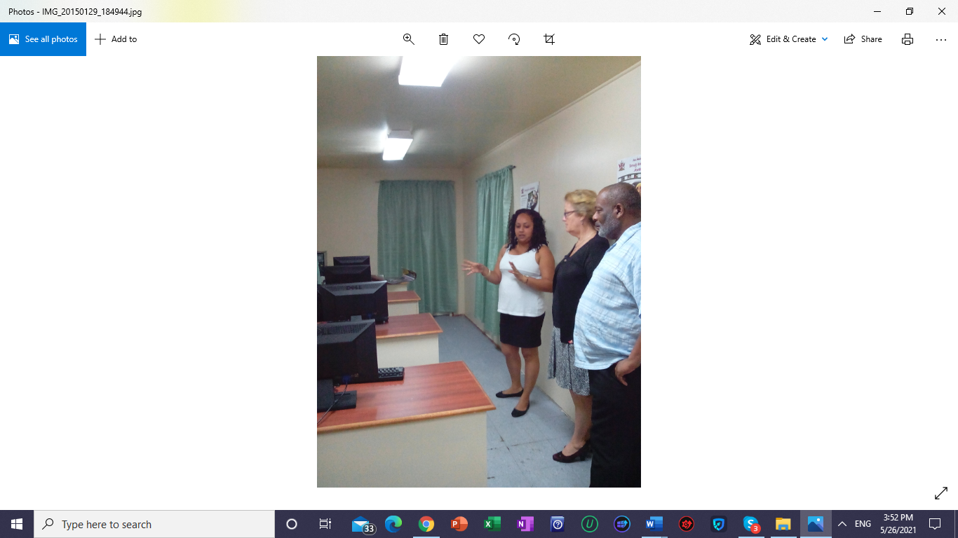

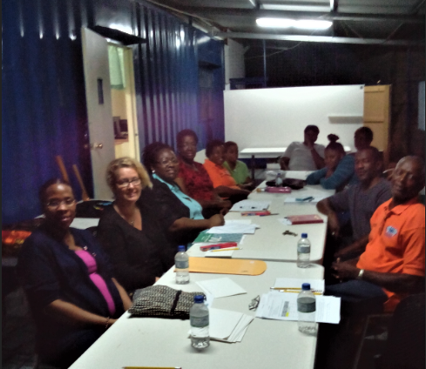
TT Citizen Security
Notes:
From left to right - 1- community action group Pinto Rd, Arima, Trinidad, 2- Community Action Group - Sangre Grande Trinidad, 3 - Community Action Officer for Sangre Grande group

Slide 6
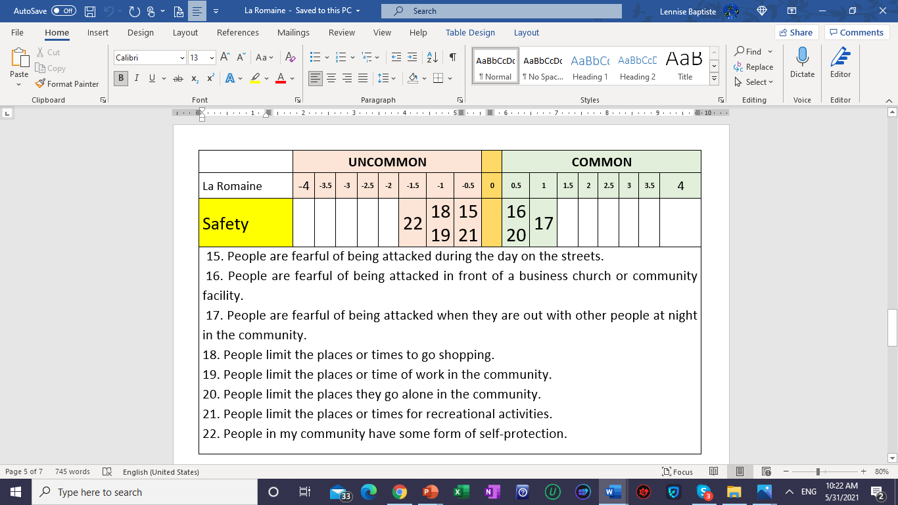
Community Data Collection
  Concerns – safety of evaluation team, safety of respondents, anonymity, individual opinion
  Method – Q methodology – what is common, sorting according to frequency analyze

Slide 7
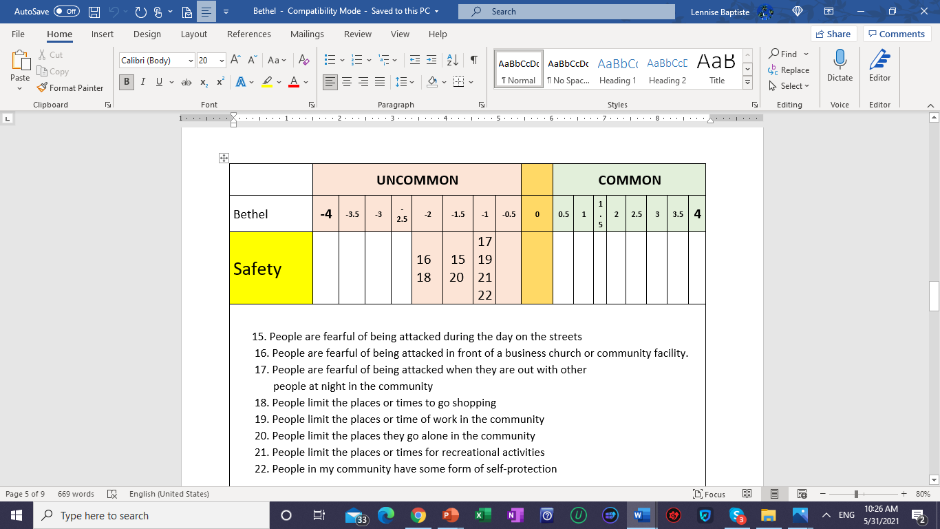
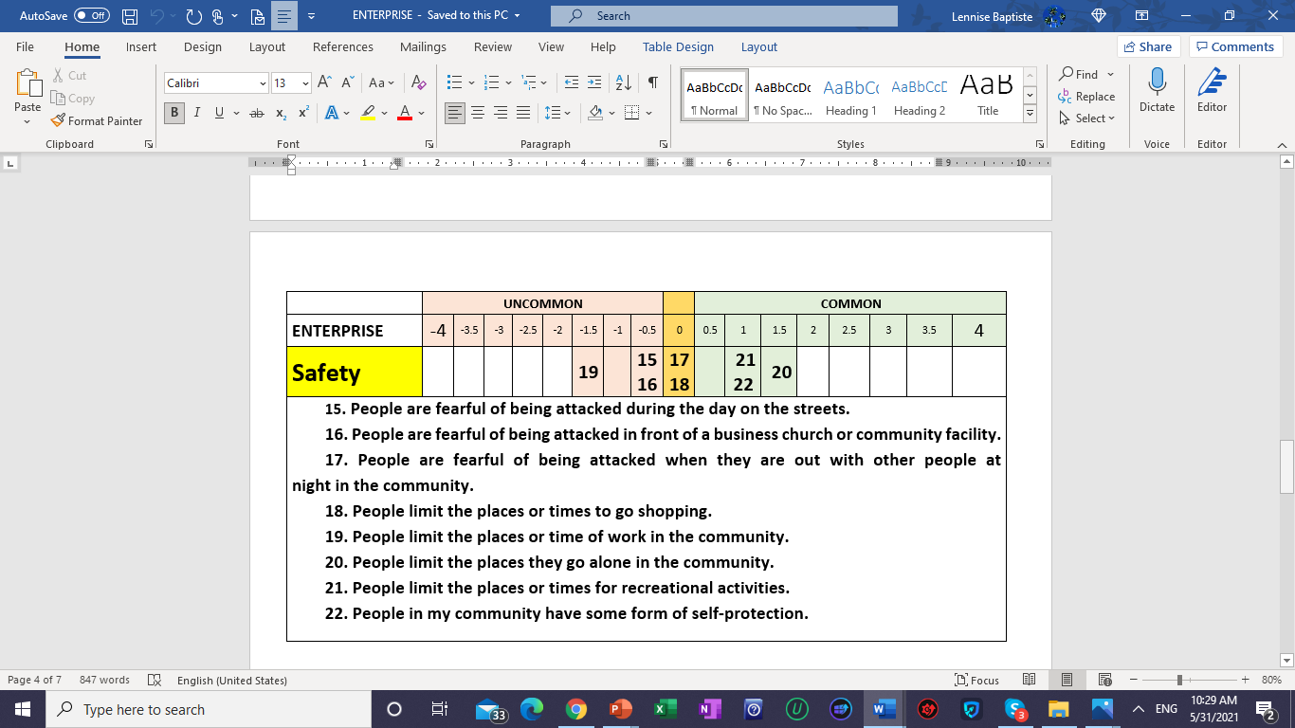

Community Data Collection
  Concerns – safety of evaluation team, safety of respondents, anonymity, individual opinion
  Method – Q methodology – what is common, sorting according to frequency analyze

